Slide 1

SynID
Making smarter campuses

Slide 2
About Us
We are a team of young enthusiasts with a dream to spread technology to all spheres of life in order to bring convenience and security to one and all. Three of us with this common goal have come together under the name and style of ‘SYNTAX’. The term syntax means the structure of programming which is the core of every technological system.

Slide 3
Problem
Unable to properly monitor students using RFid - like systems. Existing systems are prone to glitches which can transmit incorrect information.
Lights, fans, air conditioners remain running even when there are no students or teachers in the classroom for long periods of time which leads to electricity wastage.
Using many systems rather than one, interconnected system causing inefficiency and wastage of resources.

Slide 4
Solution
Efficiency in energy (Electricity) usage
A mobile phone - like device that essentially connects to the entirety of the campus
Student monitoring becomes easier than ever
Automation of several available facilities

Slide 5

Product
Varying levels of system access
Student Monitoring
Facility efficiency
Internet access depending on card
The levels of access are A, T, and S, standing for Administrator, Teacher and Student. This hierarchy (Admin then Teach then Student) is essentially a simple method of restricting access for certain people to certain areas.
The phone transmits signals to nearby cameras, which can scan the area to see if the student actually is present in the area, and has not merely left the phone in it.
Certain facilites - the lights, whiteboards and pollution detectors, for example, will work depending on how many phones are in an area, transmitting signals to them.
internet access will be dependent on what level of access one’s card has. This allows for restrictions on certain websites, and the amount of internet one can use.

Slide 6
Market Size
90%
25
All
Percent
Thousand
Total number of campuses worldwide
Serviceable available market
Total we can provide to
Total available market
As all can afford
Market share

Slide 7
Business Model
Total campuses we can provide to
Share of market = 90%
Average Fee
Every system purchase costs 200 thousand dollars, and 60 thousand per repair / update.
REVENUE
562500000 total installation income + 1350000000 for yearly repairs / updates

Slide 8
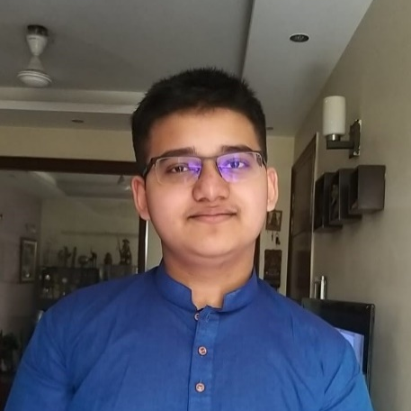
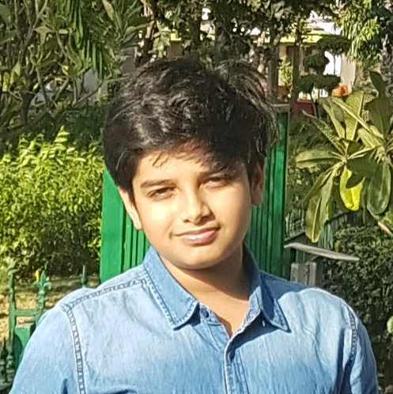
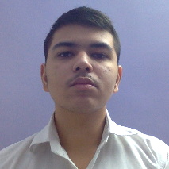
Team
Smart . Young. Novel. Talented. Acomplished. X-traordinary = SYNTAX
Ujaan Rakshit
Mahatwa Kumar
Aradhaya
Main programmer
3D – Designer and Pitch Deck editor
Programmer
Coded the main code in Python as well as creating the idea behind the SynID
Designed the 3D model of the product using fusion 360, and added finishing touches to the pitch deck.
Coded some of the code for the program as well as creating the base for the pitch deck

Slide 9
Summary
The problems highlighted are faced by institutions around the globe, yet in spite of strict instructions, such problems are prevalent.
The ever evolving technology combined with four sight and conceptualization can provide the solution which will go a long way in protecting scarce resources
Our product is helping make the campuses secure
we understand that free society activists may treat this product as a surveillance device. But please remember that it is not so. It will only help to make the campus more secure and child friendly. No personal information is collected through the device and any data collected can be accessed only by the consent of the head of the institution.

Slide 10
Thank you!
SynID – By SYNTAX

