Slide 1

NKWATIA PRESBYTARIAN SENIOR HIGH SCHOOL
INTRODUCTION TO LOOPS
Kwakye-Nti Samuel

Slide 2
LOOPS

Slide 3
Aims and Objectives
Understand what the while group of loops are and Why they are needed
Be able to design and code while loops in QBasic

Slide 4
Do While.. Loop Construct
The DO WHILE...LOOP construct can be used when you don't know how may times the loop should be executed before entering the loop ,
The WHILE statement checks to see if the condition is True, if it is then the loop continues to execute
The statements between the DO WHILE and LOOP are executed repeatedly until the condition is FALSE

Slide 5
While loop
General structure:
DO WHILE Condition
statements to be repetitively executed....
LOOP ‘
The while loop only terminates when the condition is False
If the condition is initially False, the loop may not execute at all !

Slide 6
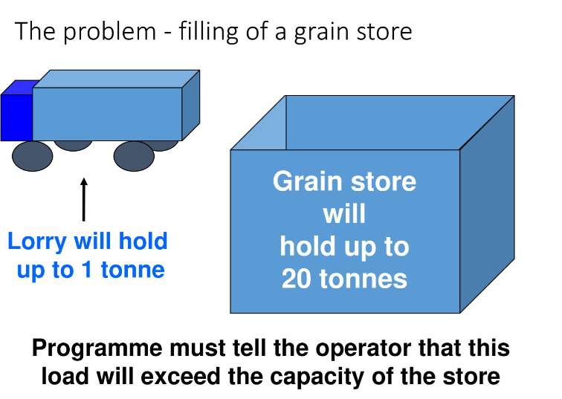

Slide 7
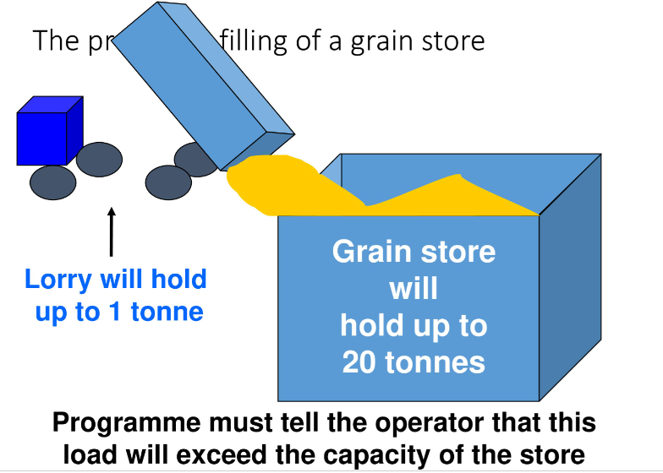

Slide 8
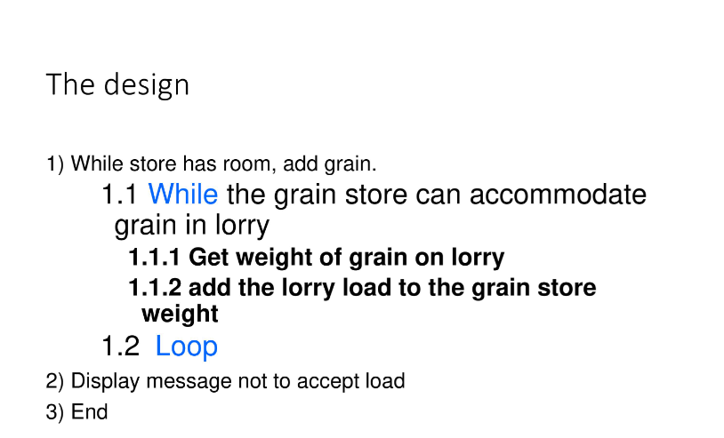

Slide 9
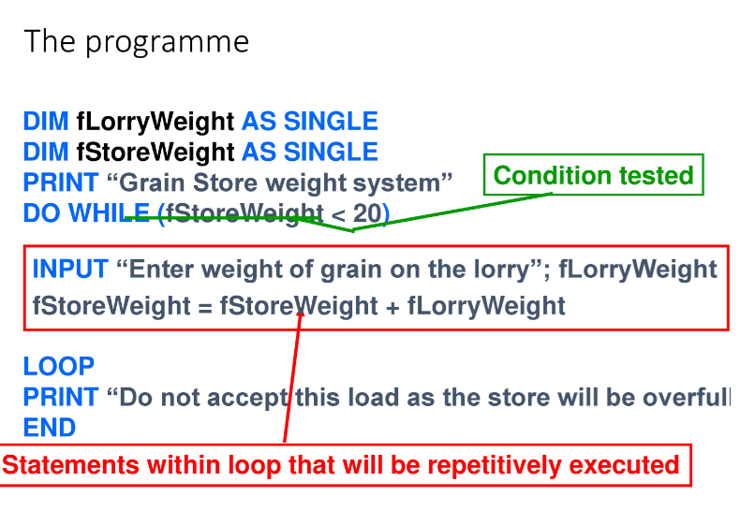

Slide 10
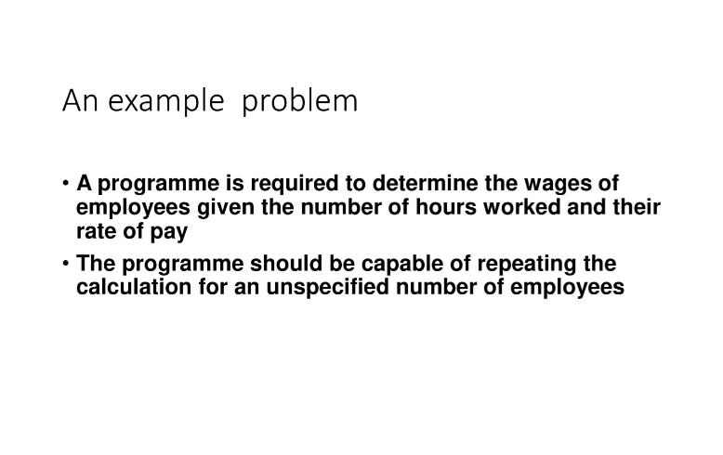

Slide 11
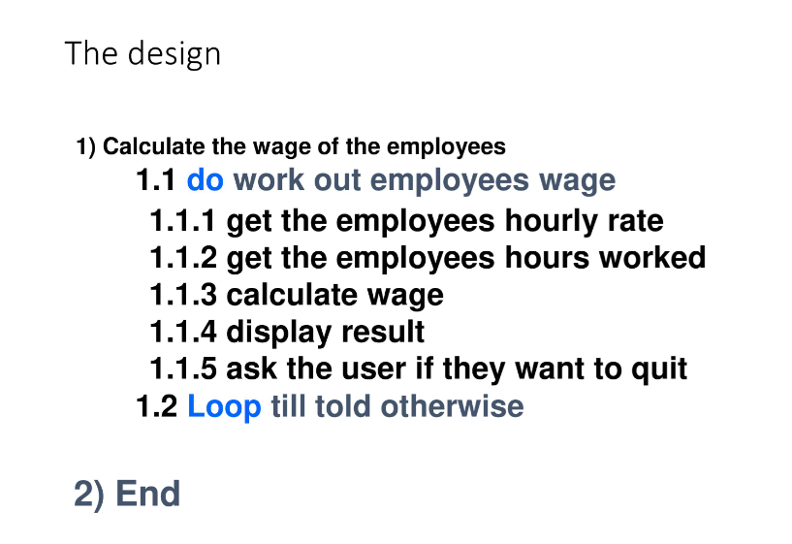

Slide 12
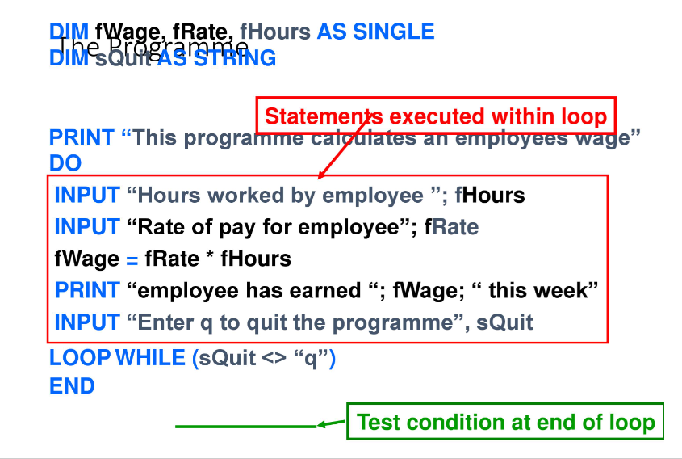

Slide 13
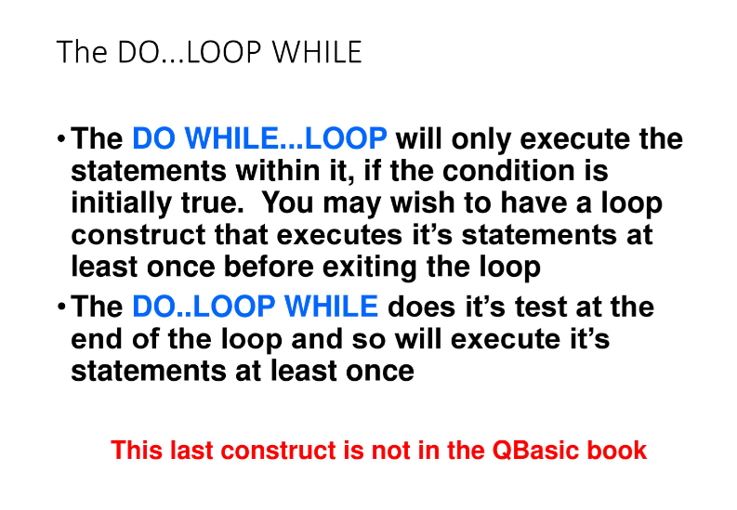

Slide 14
THANK YOU
QUESTION?

Slide 15
