Slide 1
Programmatic Advertising

Slide 2
Programmatic Advertising
广告展现形式 ( Native, Display, Video ) 在广告主、SDK 及客户端的理解
Ad Network 与 Ad Exchange (ADX) 有什麽不同?
什麽是程序化购买 (Programmatic buy)? 跟实时竞价 (Real-Time Bidding) 相同吗?
程序化的生态系，有哪些 players? 各自KPI是什麽? 跟广平对标状况?
什麽是国际上讲的 DSP ?
直客广告主/Agency 如何跟流量方透过程序化做生意?
程序化怎么计价?
程序化生态内的主流广告流量形式? Native/Display/Video ?
ADX 如何取得流量? In-app? Webpage?
ADX 如何取得 demand? SDK demand / JS tag demand 各是什麽?
什麽样的对接方式可以取得什麽 demand?
对于 demand 方，什麽是 JS tag? VAST tag? VPAID tag? 需求方/广告主用 tag 投放的好处是什麽?
什麽是 mediation? Waterfall 管理?
什麽是 header bidding? Header bidding 的好处?
程序化运营是怎么优化收入的?
为什麽要做程序化?
程序化offer跟直销offer有什麽不同?
为什麽广告主想用程序化来投放广告? 跟拿素材给我们投放有什麽不同?
从数据收集角度来看
从广告投放及优化来看
从广告平台技术面来看
程序化的对接方式有哪些? 为什麽要走国际规格? 让需求方适配我们的规格不行吗?
程序化的广告素材怎么审查? 不审查不是很危险嘛? 有什麽控管机制?

Slide 3
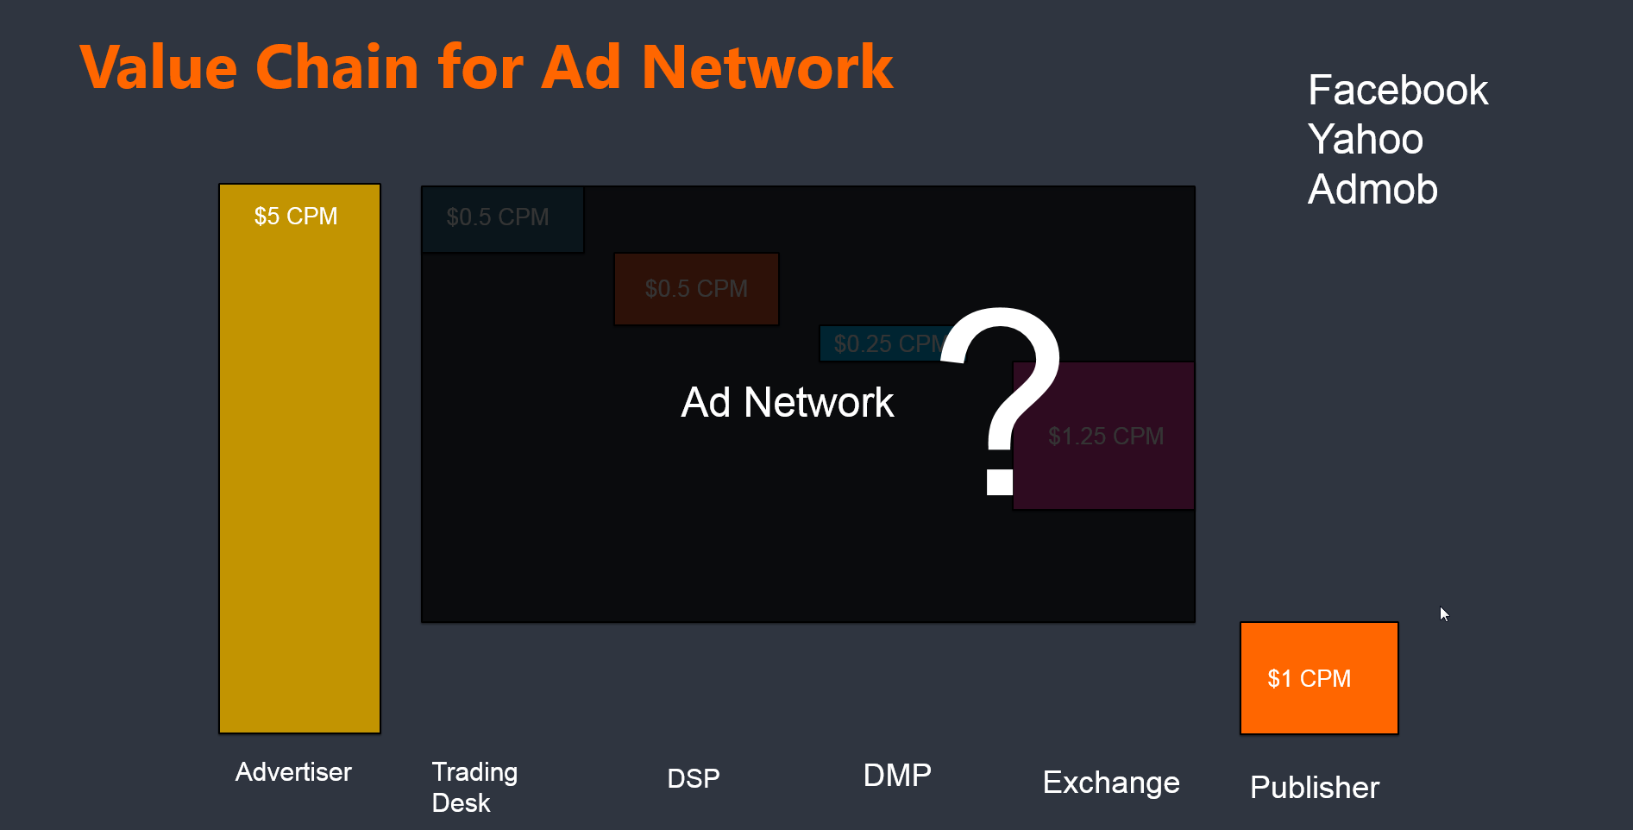
Value Chain for Ad Network
Ad Network 与 Ad Exchange 有什麽不同?

Slide 4
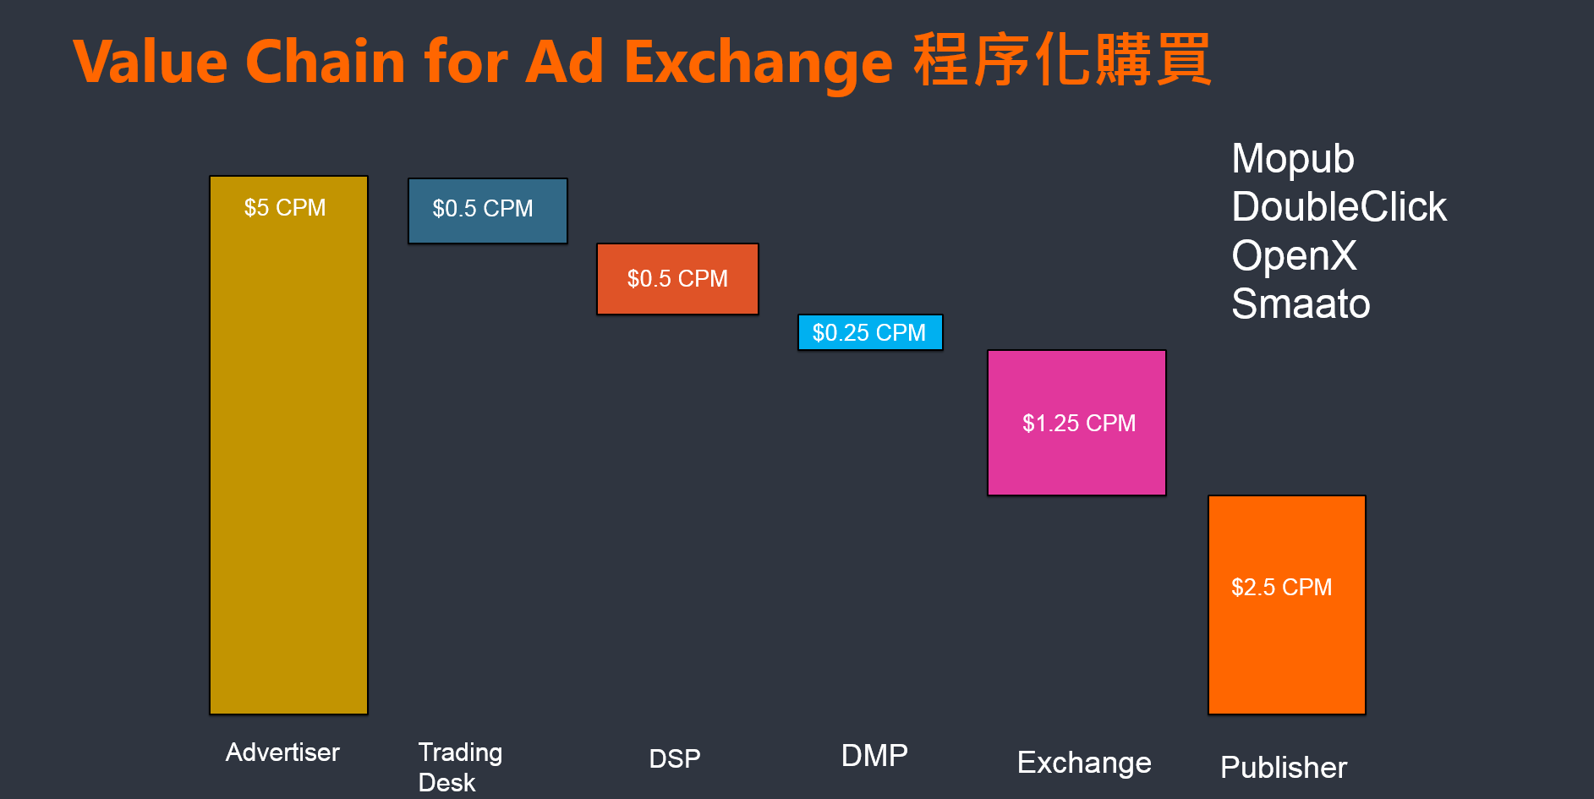
Value Chain for Ad Network
Ad Network 与 Ad Exchange 有什麽不同?

Slide 5
KPI of each player
App / Site / Publisher
SSP
Ad Network (Exchange)
DSP
Trading Desk
Advertiser
Higher CTR
Higher CPM
Higher fillrate
Higher show rate
Optimize --
Lower CPC or CPI
Higher CTR
Higher CVR
CPM pricing (video ads, brand)
CPC pricing (brand, performance)
CPA pricing (performance)
SSP/Ad Network
Provide “Good inventory” (high CTR) to buyer
Maxmize Revenue: CPM*[(Autions*Fill rate* Show rate)/1000)]
DSP
Optimize ads performance to minimize CPC or CPI
Maximize Clicks or Conversions

Slide 6
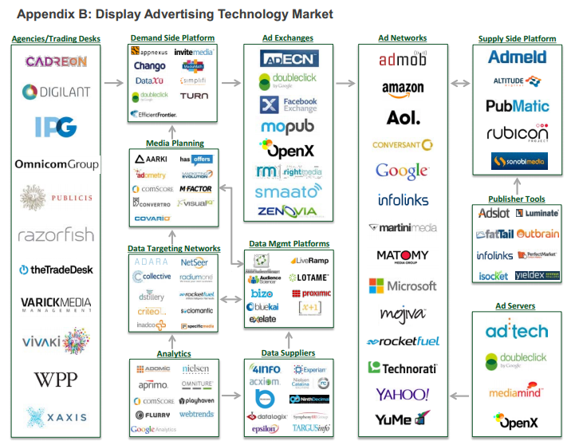

Slide 7
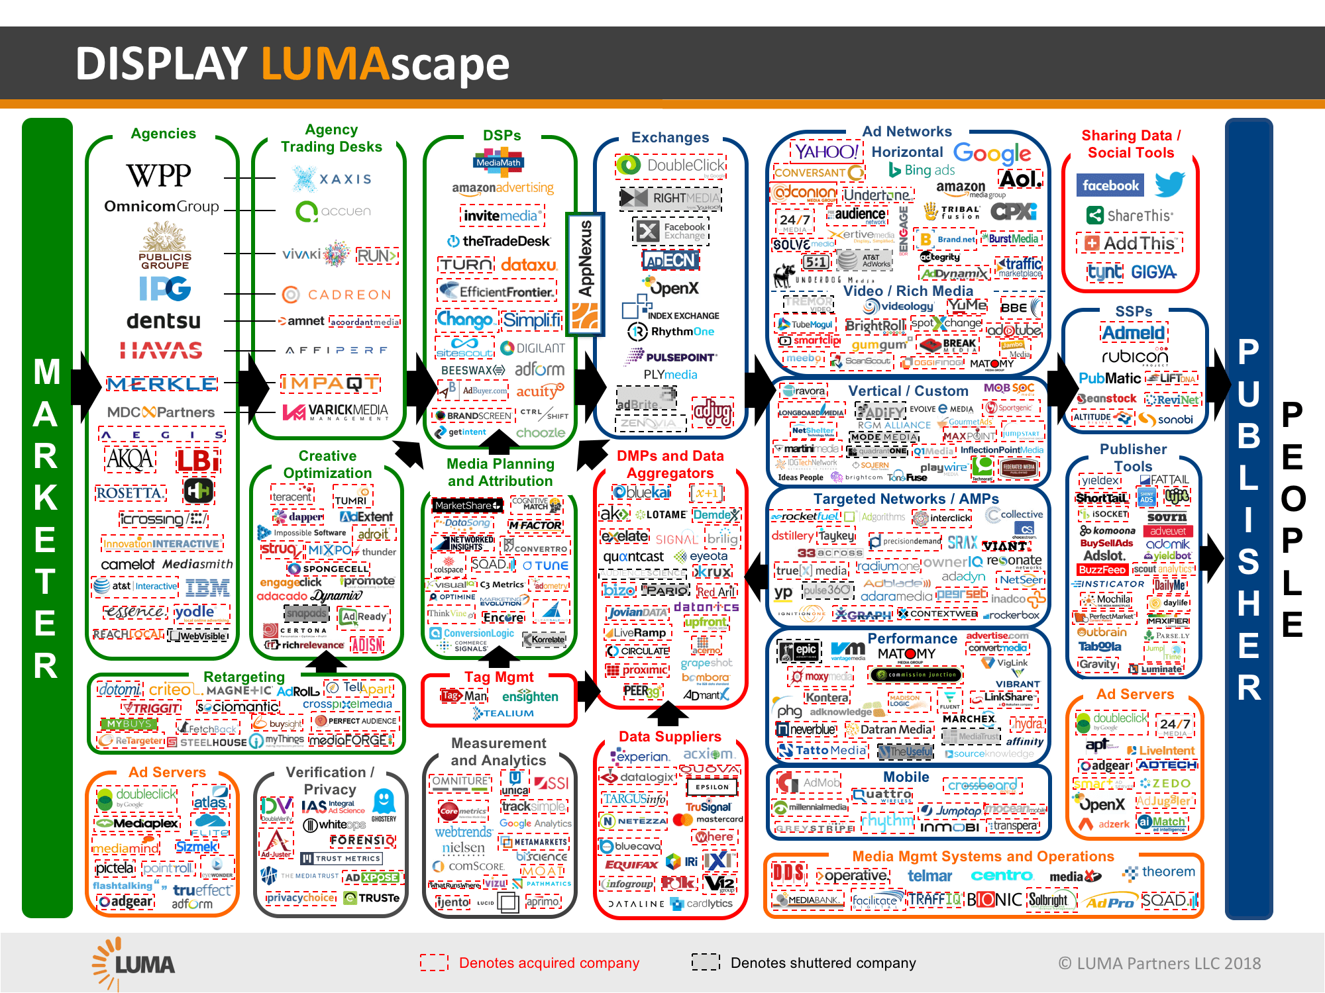

Slide 8
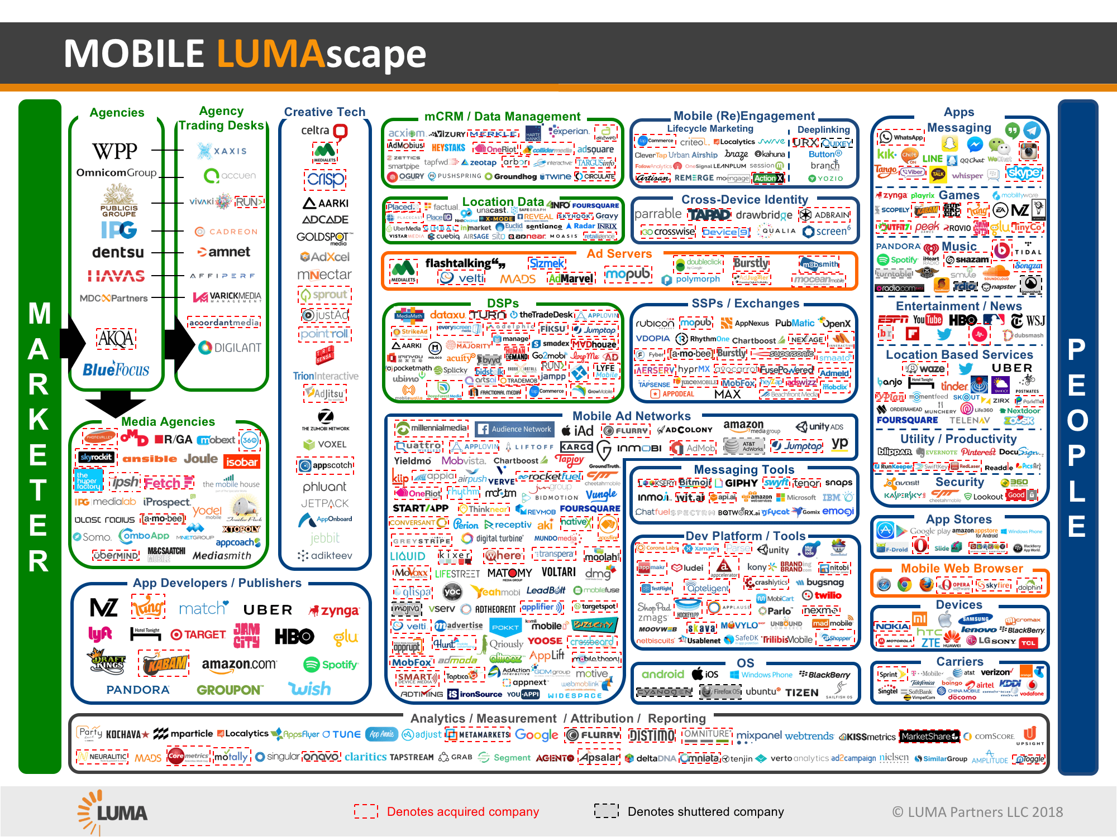

Slide 9
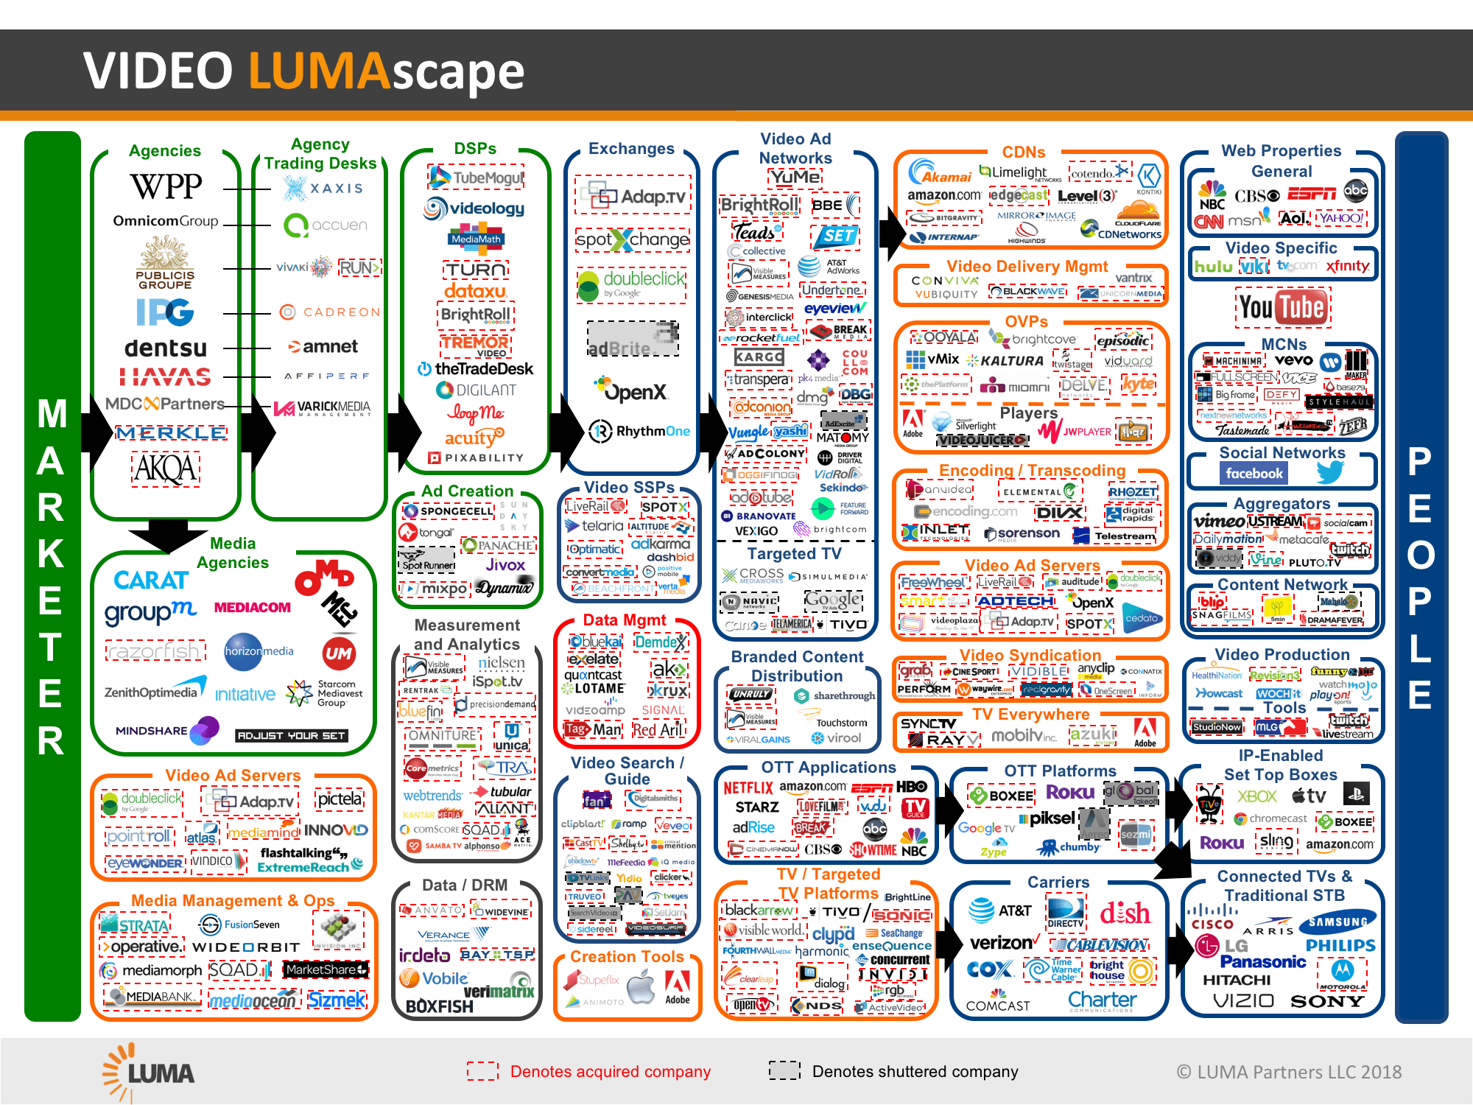

Slide 10
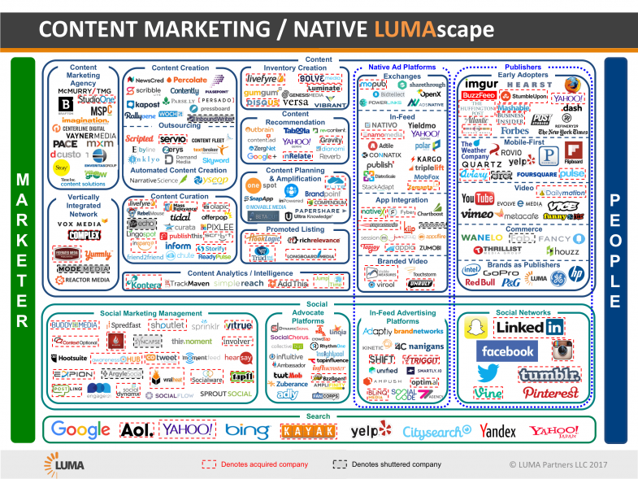

Slide 11
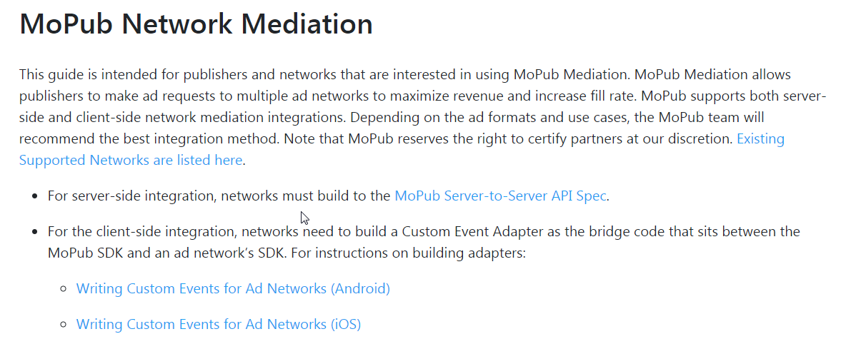
Network Mediation
Server side mediation – JS tag for display, VAST tag for video, none for native
Client side (SDK) mediation –
SDK integrated on client side, and using master SDK’s adapter to connect slave SDK
allow for native, display, video
https://developers.mopub.com/docs/mediation/mopub-network-mediation/

Slide 12
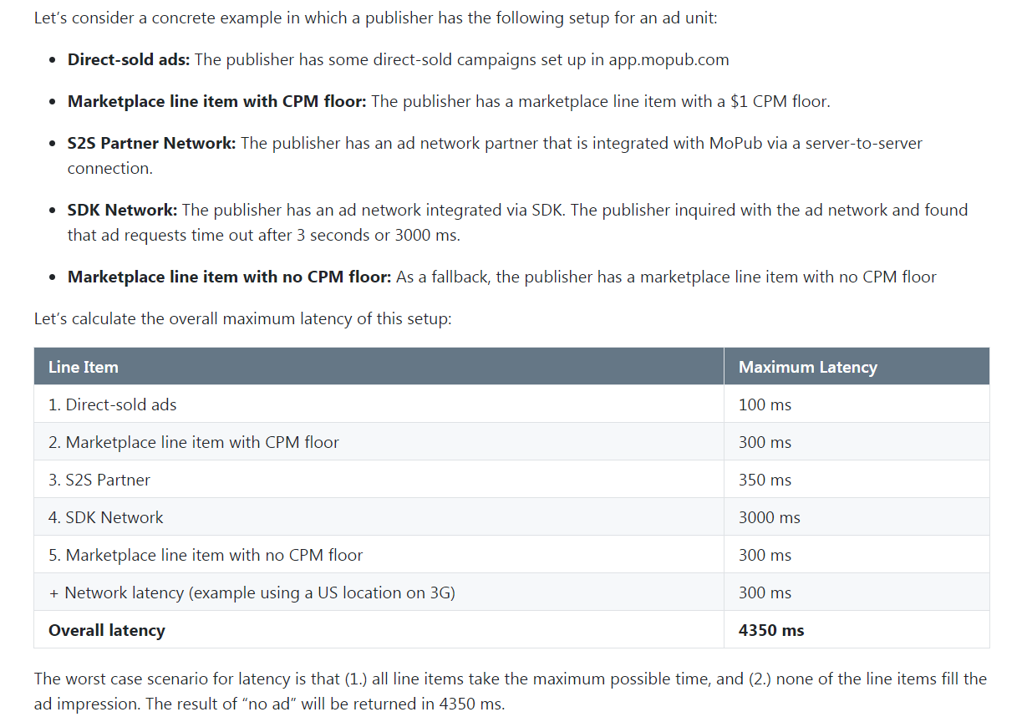
Mediation / Waterfall
https://developers.mopub.com/docs/mediation/waterfall-latency-and-best-practices/

Slide 13
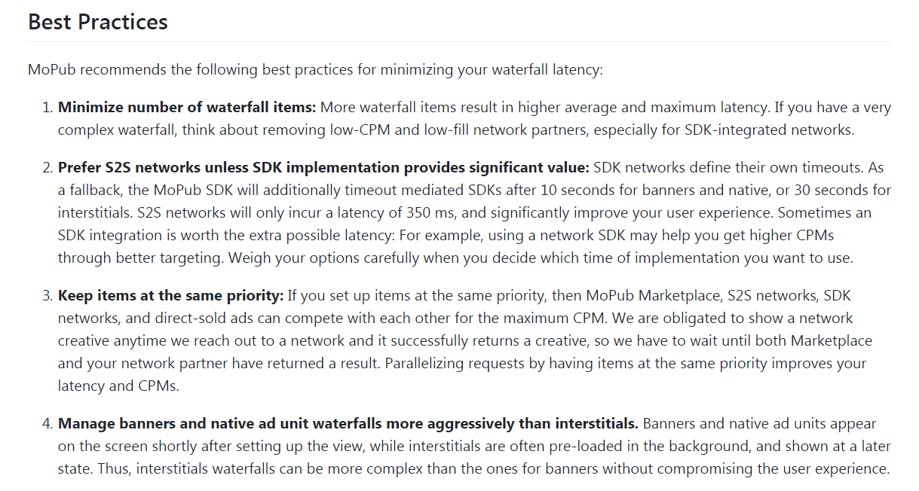
Mediation / Waterfall
https://developers.mopub.com/docs/mediation/waterfall-latency-and-best-practices/

Slide 14
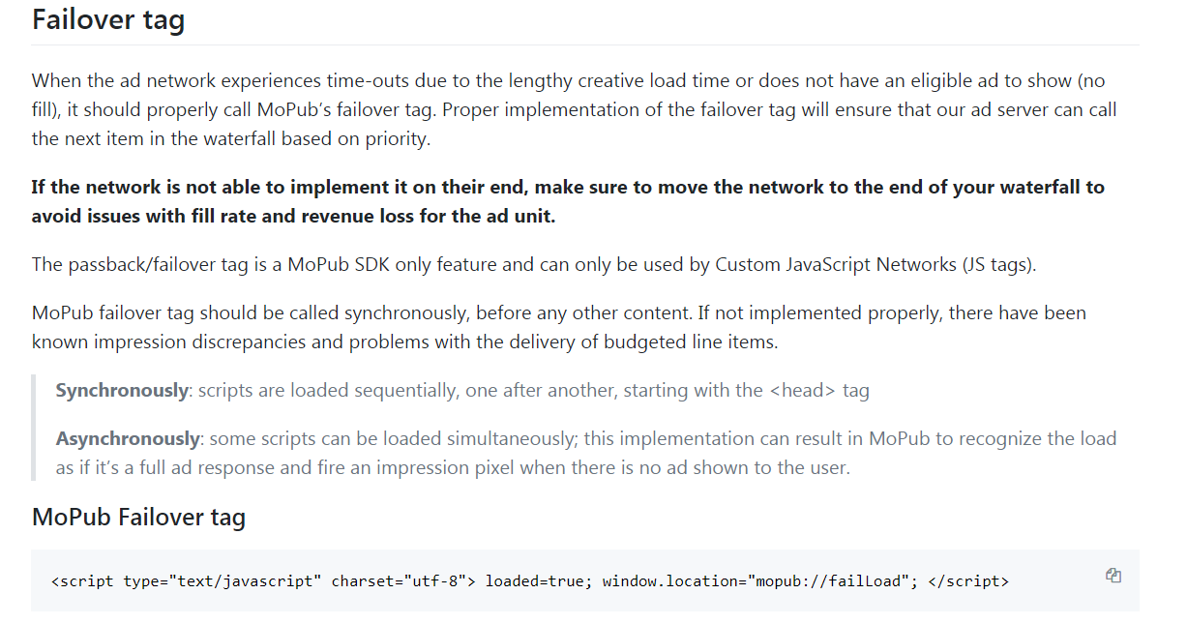
https://developers.mopub.com/docs/mediation/custom-networks/

Slide 15
DCM tag https://support.google.com/dcm/partner/answer/2826636
Ad size
ADX ad size https://support.google.com/adxbuyer/answer/3011898?hl=en&ref_topic=21122
Adsense mobile ads https://support.google.com/adsense/answer/185668?hl=en&ref_topic=1307421
DFP https://support.google.com/dfp_premium/answer/1100453?hl=en

Slide 16
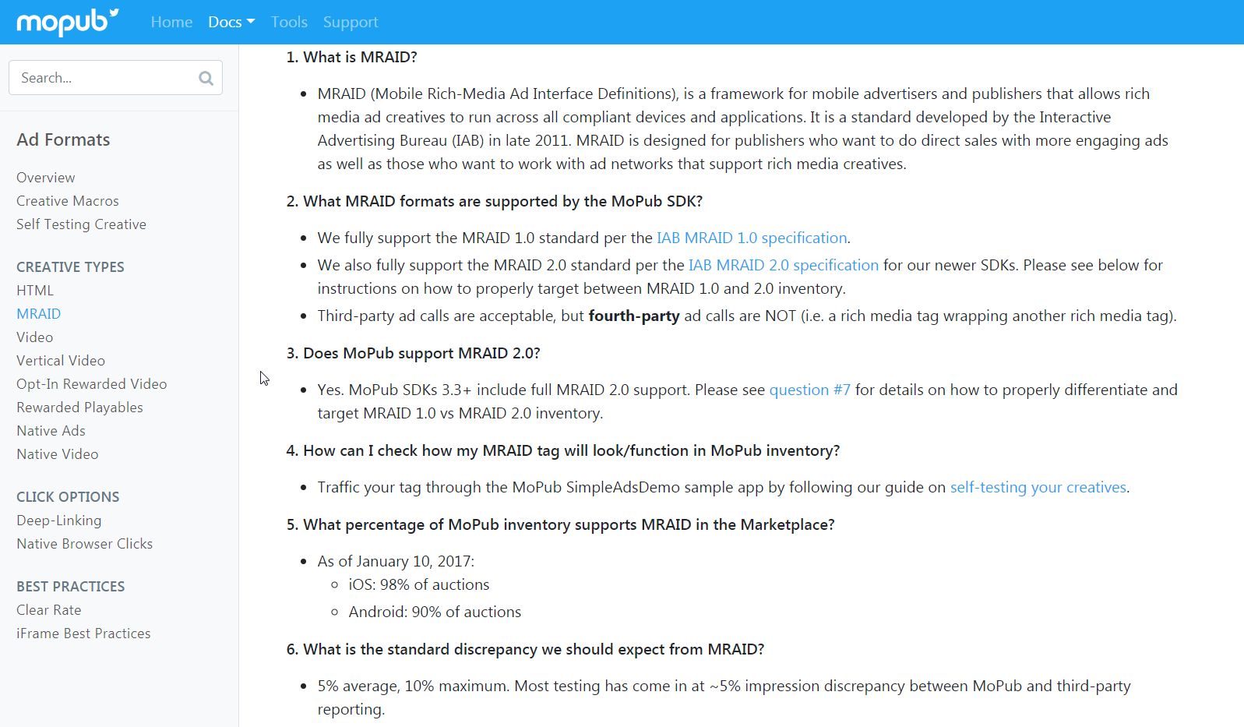
https://developers.mopub.com/docs/ad-formats/mraid/

Slide 17
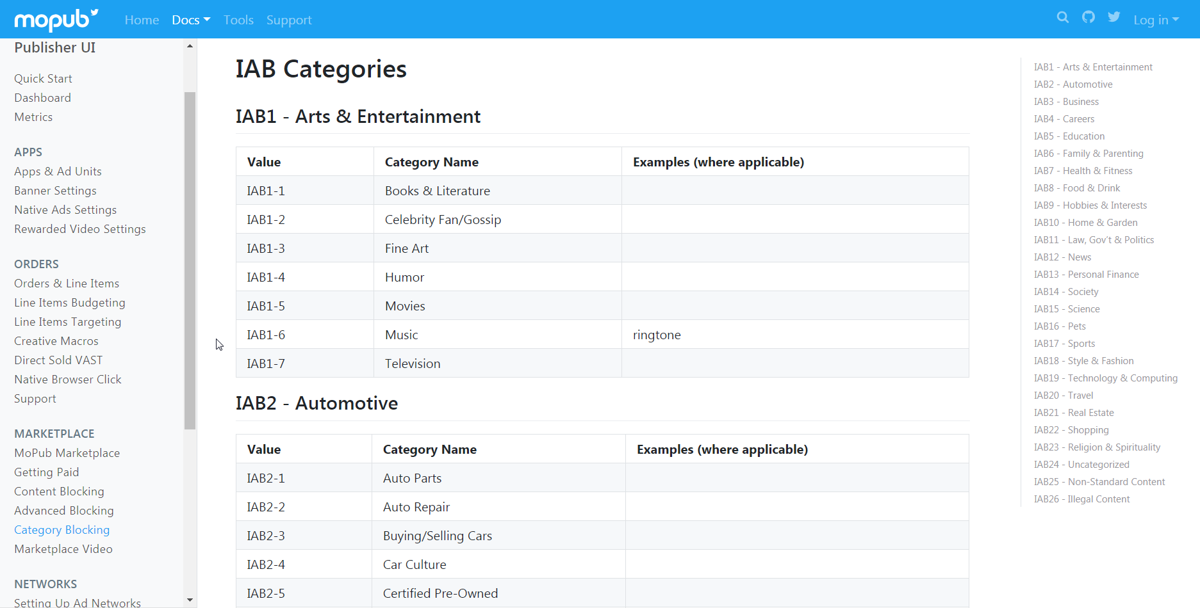
https://developers.mopub.com/docs/ui/marketplace/iab-category-blocking/

Slide 18
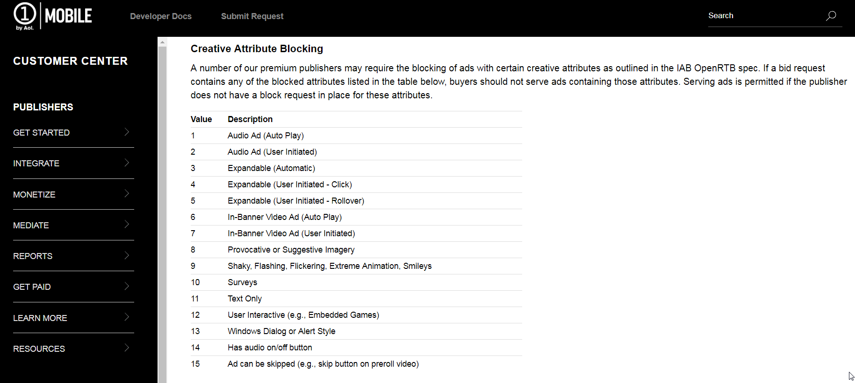
https://learn.onemobile.aol.com/hc/en-us/articles/115006598187-Restricted-Ad-Content-and-Control

Slide 19
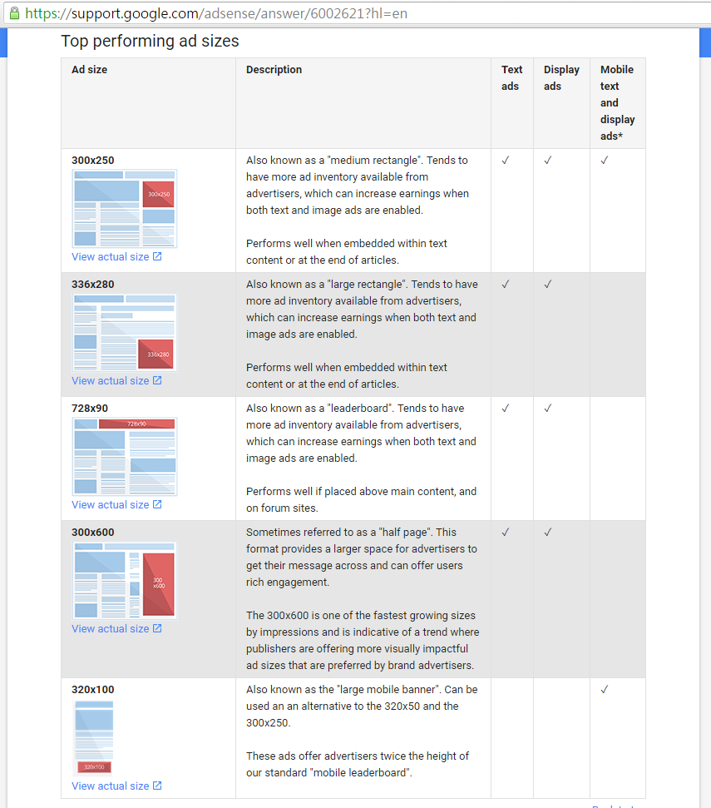
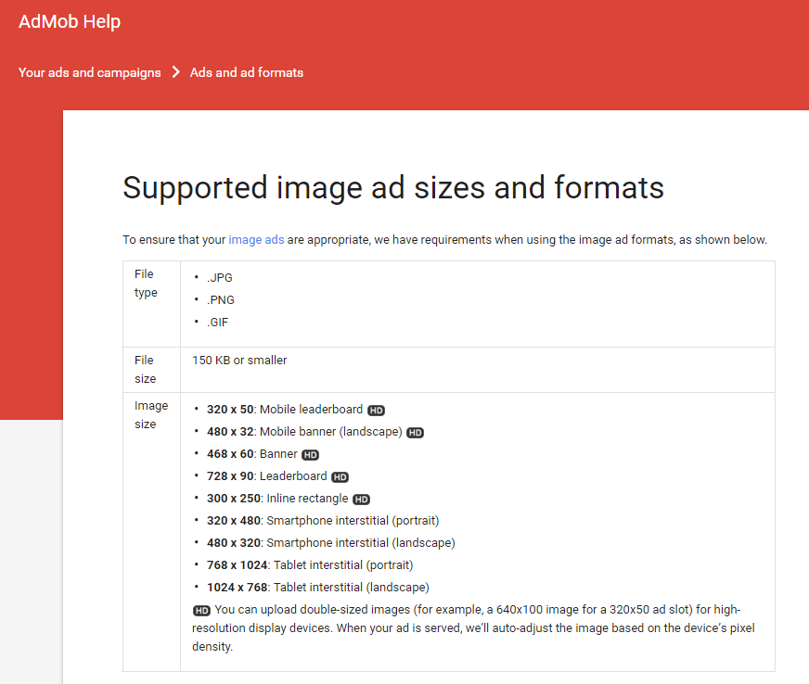
廣告通用尺寸

Slide 20
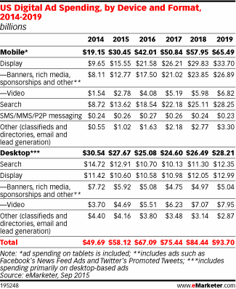
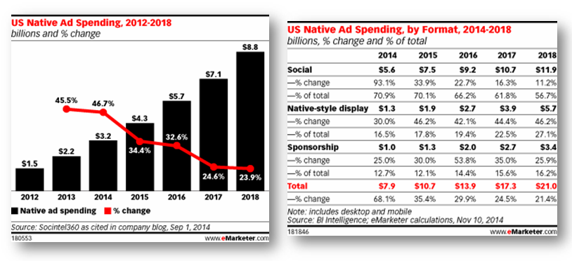
在 Facebook 以外的世界， Native 非常稀少
Mobile $30.45 Billions
Display $15.55
Native $5.5
Social $3.8
Native Style $1.0
Sponsorship $0.7
Banner/Interstitial $11.35
Video $2.78

Slide 21
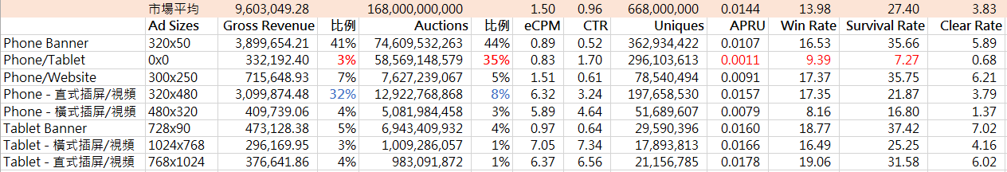
Mopub 市場概況 – 以廣告尺寸細分
320x50 Banner
流量及收入皆占比 40% 以上，是 Mobile App 最大宗的流量及需求尺寸
Native
流量占比 35%, 但只占 3% 收入。eCPM 及 Win Rate 低於市場平均水準，eCPM 甚至低於 320x50 Banner
插屏圖片/視頻
流量占比 8%, 占比 32% 收入。eCPM 是 320x50 Banner 的 7 倍，300x250 的 4 倍

Slide 22
為什麼廣告主預算移動到 native 速度緩慢?
Native 在 app 上體驗好，但不見得可以充分發揮廣告創意。 尤其是品牌廣告，需要廣告創意發揮，有故事有包裝
媒體/廣告主購買專為 native 製作廣告素材的意願不高 (總盤子小)
結合 gender/ age / location / user interest 製造差異化，可提高單價
傳統 webview 廣告的好處? 互動, 創意發揮，图片广告，网页广告，互动广告

