Slide 1
Adjusted D-Line Plus/Minus
Mike Dalrymple

Slide 2
Overview of Investigation
Publicly available NFL data (nflscrapR and nflfastR) only include the names of players who possessed the ball during a play
SIS charting data includes the names of every player lined up as a defensive linemen for every play
Allows for the ability to fit an adjusted plus/minus model for defensive linemen
Adjusted plus/minus models are used in sports such as hockey (Macdonald), where there is publically available data that indicates which players are involved on every play

Slide 3
Model Overview
Modeling EPA of individual plays using a linear mixed effect model
Fixed effects include indicator variables that indicate if a player is on the field for individual plays
Intercept of model varies by the team on offense (the random effect)
Linear mixed effect models have been used by the nflscrapR team to estimate offensive NFLwar and by Baseball Prospectus to estimate player impact on called strike probability
Coefficient of player indicator variable is the points above average that player is expected to add to EPA for each play they are on their field
Can then multiply the player’s points above average coefficient by the number of plays they are on the field in order to find the total points above average the player added
This framework is very similar to what was used by the nflscrapR team to estimate offensive NFLwar

Slide 4
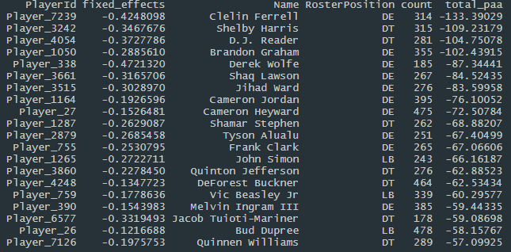
Model Results (Top 20 Defensive Linemen)
Since EPA is from the point of view of the offense, lower values are better for defensive players
These players don’t really line up with my prior belief of the best of defensive linemen

Slide 5
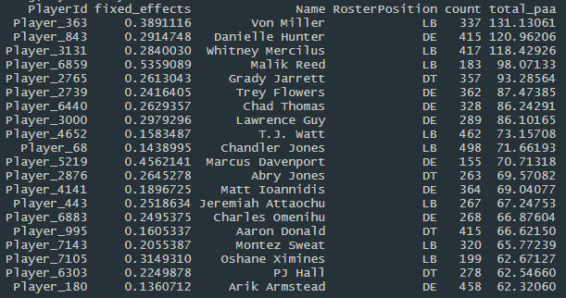
Model Results (20 Worst Defensive Linemen)
Multiple players that I was expecting to be ranked as some of the best defensive linemen, are instead included in this list

Slide 6
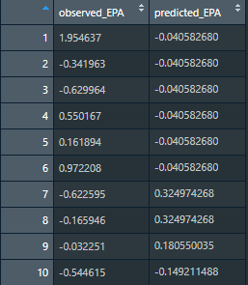
Model Predictions
The model doesn’t appear to predict the observed EPA particularly well
This is in part due to the nature of the model
If plays involve the same linemen and offensive team, then the model will predict the same EPA for each play

Slide 7
What’s wrong with the model?
Theories
A mistake might exist in the code used to calculate the model
Very possible due to the time constraint of the challenge
I’m hoping to review my work after the challenge to see if the model is working properly
Not enough data to train an adjusted plus/minus model
Trying to fit 693 individual player parameters on a dataset of 16793 plays
Possible that half a season isn’t enough data to discern which players have most impact on EPA
Defensive packages are two interdependent for a plus/minus model to work
Other sports might have a greater variety in the grouping of players involved in a play
Without this variety in defensive groups, the model might be unable to find which players are really impacting EPA
Other variables should be included in the model, in order to better predict EPA

Slide 8

Attempting to find points added by position
Even though we have seen the model is subpar, I’m still going to attempt to answer the question of interest
Found the sum of the total points added to EPA by position, and then divided by the number of players with that position in order to find the average PAA for each position
Appears that DE and DT add more value than LB

Slide 9
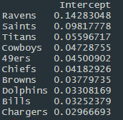
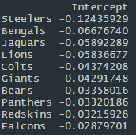
Brightspot: Strongest and Weakest Offenses
Strongest
Weakest
Model does a better job identifying team wide offensive strength

Slide 10
Conclusion
Attempted to create an adjusted plus/minus model for defensive linemen
It didn’t work!
This framework is still worth investigating further, especially if researcher has access to additional charting data

Slide 11
Sources
Yurko, Ventura, Horowitz (2018): nflWAR: A Reproducible Method for Offensive Player Evaluation in Football
https://arxiv.org/pdf/1802.00998.pdf
Macdonald (2001): A Regression-Based Adjusted Plus-Minus Statistic for NHL Players
http://www.hockeyanalytics.com/Research_files/Regression_Based_Plus_Minus.pdf
Judge, Pavlidis, Brooks (2015): Moving Beyond WOWY: A Mixed Approach To Measuring Catcher Framing
https://www.baseballprospectus.com/news/article/25514/moving-beyond-wowy-a-mixed-approach-to-measuring-catcher-framing/
Hajduk (2019): Introduction to Linear Mixed Models
https://ourcodingclub.github.io/tutorials/mixed-models/

