Slide 1
SportsInfoSolutions Analytics Challenge 2020
Matthew Karan

Slide 2
Evaluation Metrics
To determine the most valuable defensive line position, the following metrics were developed to measure the impact of each defensive alignment through key gameplay events:
DIA – Defensive Impact Average
DIRWA – Defensive Impact Rush Weighted Average
DIPWA – Defensive Impact Pass Weighted Average
PDIWA – Positional Defensive Impact Weighted Average
PDIRA – Positional Defensive Impact Rush Average
PDIPA – Positional Defensive Impact Pass Average
PDIAD – Positional Defensive Impact Average Differential

Slide 3
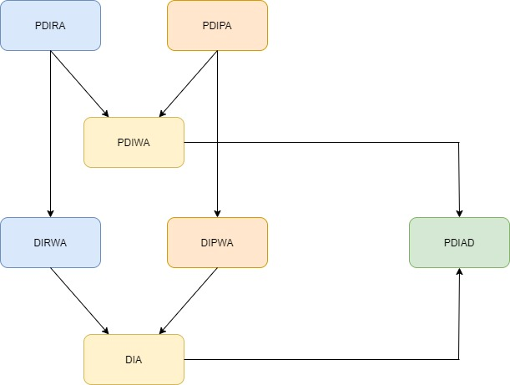
Evaluation Metrics
Metric Breakdown:
DIA – Defensive Impact Average
Average of DIRA & DIPA
DIRWA – Defensive Impact Rush Weighted Average
Weighted Average of PDIRA
DIPWA – Defensive Impact Pass Weighted Average
Weighted Average of PDIPA
PDIWA – Positional Defensive Impact Weighted Average
Average of PDIRA & PDIPA
PDIRA – Positional Defensive Impact Rush Average
Average score of impact on rushing plays
PDIPA – Positional Defensive Impact Pass Average
Average score of impact on passing plays
PDIAD – Positional Defensive Impact Average Differential
Difference between PDIWA & DIA

Slide 4
Evaluation Metrics - PDIRA
PDIRA (Positional Defensive Impact Rush Average) is a measurement of the average impact of a specific position on the defensive line against rushing plays.
Calculated by:
Each rushing play is evaluated for key gameplay events. These events add or subtract points.
PDIRA is the average of this score for all rushing plays per position

Slide 5
Evaluation Metrics - PDIPA
PDIPA (Positional Defensive Impact Pass Average) is a measurement of the average impact of a specific position on the defensive line against passing plays.
Calculated by:
Each passing play is evaluated for key gameplay events. These events add or subtract points.
PDIPA is the average of this score for all passing plays per position

Slide 6
Evaluation Metrics - PDIWA
PDIWA (Positional Defensive Impact Weighted Average) is a measurement of the average impact of a specific position on the defensive line cumulative of rushing and passing plays.
Calculated by:
Weighted average of PDIRA & PDIPA
df['pdia_w_avg'] = (df['pdira_sum'] + df['pdipa_sum']) / (df['pdira_count'] + df['pdipa_count'])

Slide 7
Evaluation Metrics - DIRWA
DIRWA (Defensive Impact Rush Weighted Average) is the weighted average score for the entire defensive line against rushing plays.
Calculated by:
Weighted average of PDIRA
pdira_sum = df['pdira_sum'].sum() pdira_count = df['pdira_count'].sum() dira_w_avg = pdira_sum / pdira_count

Slide 8
Evaluation Metrics - DIPWA
DIPWA (Defensive Impact Pass Weighted Average) is the weighted average score for the entire defensive line against passing plays.
Calculated by:
Weighted average of PDIPA
pdipa_sum = df[‘pdipa_sum'].sum() pdipa_count = df[‘pdipa_count'].sum() dipa_w_avg = pdipa_sum / pdipa_count

Slide 9
Evaluation Metrics - DIA
DIA (Defensive Impact Average) is a measurement of the average impact of the entire defensive line. This metric is used as a baseline for which to compare against all the possible defensive line positions.
Calculated by:
Average of DIRWA & DIPWA

Slide 10
Evaluation Metrics - PDIAD
PDIAD (Positional Defensive Impact Average Differential) is the difference between each position’s impact and the overall defensive line impact. This metric is used to compare relative performance (above or below average) of each position on the defensive line.
Calculated by:
Difference between PDIWA and DIA

Slide 11
Gameplay Events Breakdown
To calculate the scores for PDIRA and PDIPA, certain gameplay events were evaluated as having impact.
Rushing
Solo Tackle, Assisted Tackle, Tackle for Loss, Forced Fumble, Recovered Fumble, Safety
Passing
Solo Tackle, Assisted Tackle, Tackle for Loss, Solo Sack, Assisted Sack, Pressure, Forced Fumble, Recovered Fumble, Pass Breakup, Interception, Safety

Slide 12
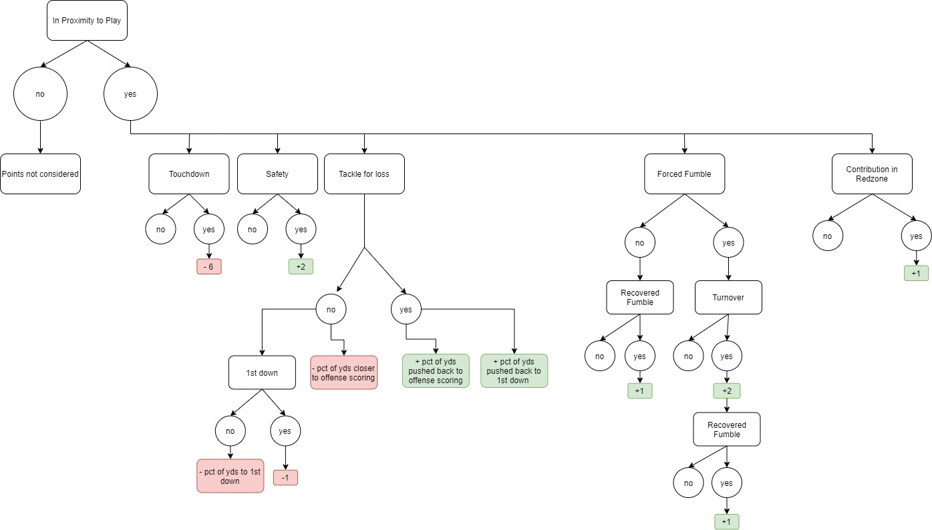
Gameplay Events Breakdown - Rushing
Breakdown for rushing plays to generate scores for PDIRA

Slide 13
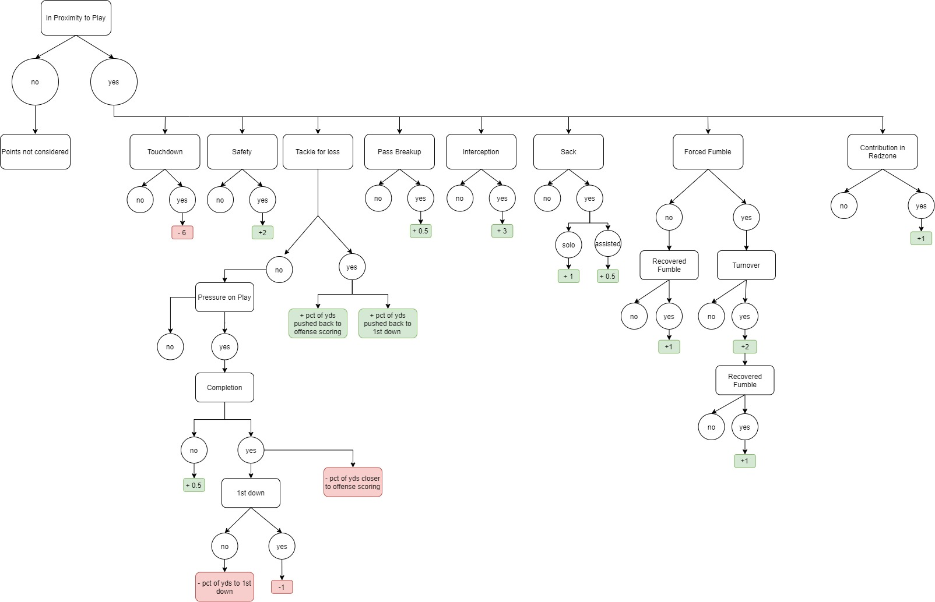
Gameplay Events Breakdown - Passing
Breakdown for passing plays to generate scores for PDIPA

Slide 14
Gameplay Events Breakdown
While most of the gameplay events are self explanatory, there are a few clarifications for some more involved scoring decisions.
Proximity to play
Tackle for loss
Redzone contribution

Slide 15
Gameplay Events Breakdown - Proximity
Proximity to play is used to determine if a player could be in the region to affect the play.
For rushing:
Did the player make a tackle: solo or assisted
Was the player near the gap that the RB used
Did the player have any other impact contributions
Forced fumble, fumble recovery

Slide 16
Gameplay Events Breakdown - Proximity
Proximity to play is used to determine if a player could be in the region to affect the play.
For passing:
Did the player make a tackle: solo or assisted, sack: solo or assisted
Was the player rushing, did they get pressure on the QB
Did the player have any other impact contributions
Forced fumble, fumble recovery, pass breakup, interception

Slide 17
Gameplay Events Breakdown – Tackle for Loss
Tackle for loss is used to determine if the offense made progress down the field.
If progress was made, the defense position is penalized in two regards:
1) Percentage of progress made compared to remaining yards for the offense to score
2) Percentage of progress made compared to remaining yards for the offense to achieve a first down
If progress was not made, the defense position is awarded points in two regards:
1) Percentage of yards the offense was pushed back compared to their original yards remaining to score
2) Percentage of yards the offense was pushed back compared to their original yards remaining to achieve a first down

Slide 18
Gameplay Events Breakdown – Redzone Contribution
Redzone contribution is used to award the defensive position additional points for performing an impactful gameplay event within 20 yards of either endzone.
This is to indicate extra importance on the gameplay event where that defensive position either contributed to preventing offensive progress towards scoring on the defense side of the field, or contributed towards increasing the chance of a defensive score on the offense side of the field ie. safety.

Slide 19
Conclusion
After calculating the scores, based on the PDIAD (Positional Defensive Impact Average Differential), the most valuable overall defensive line position is:
9 Tech, right side of field
PDIAD value of 0.0865

Slide 20
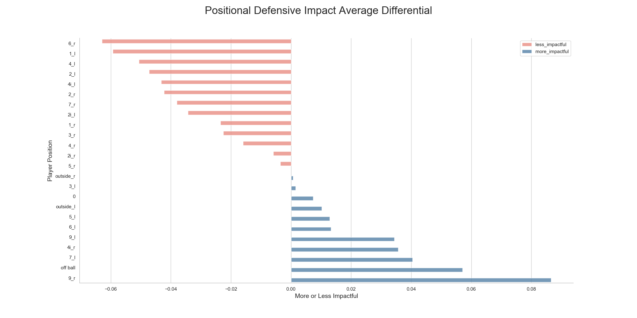
Conclusion

Slide 21
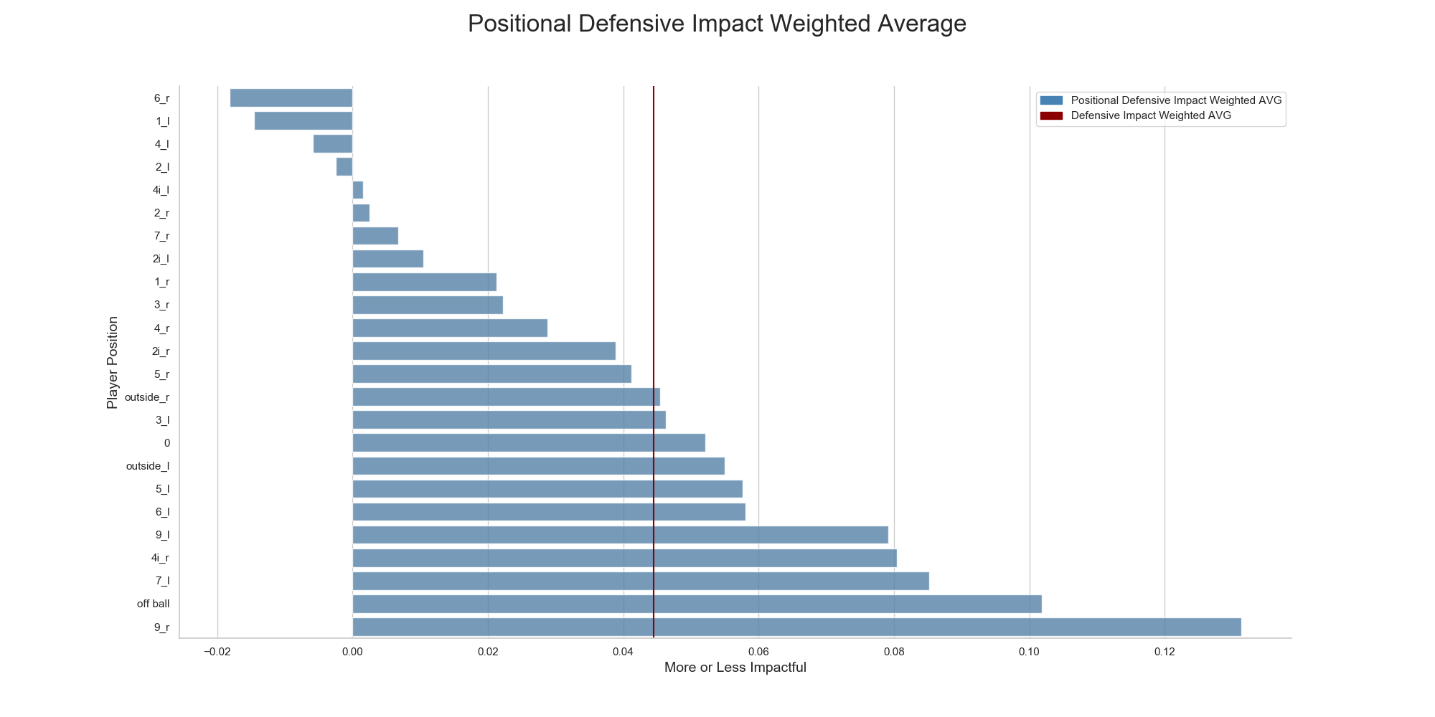
Conclusion
When compared against the PDIAD of all the other possible defensive alignments, players in 9 Tech on the right side of the field had the greatest overall impact.
Left: PDIWA, Right: PDIAD

Slide 22
Different Context – Pass vs Rush
While PDIAD gives us the overall most impactful defensive alignment, it does not consider rush vs pass plays.
We find that the most valuable defensive position changes when isolating only rushing plays or only passing plays.

Slide 23
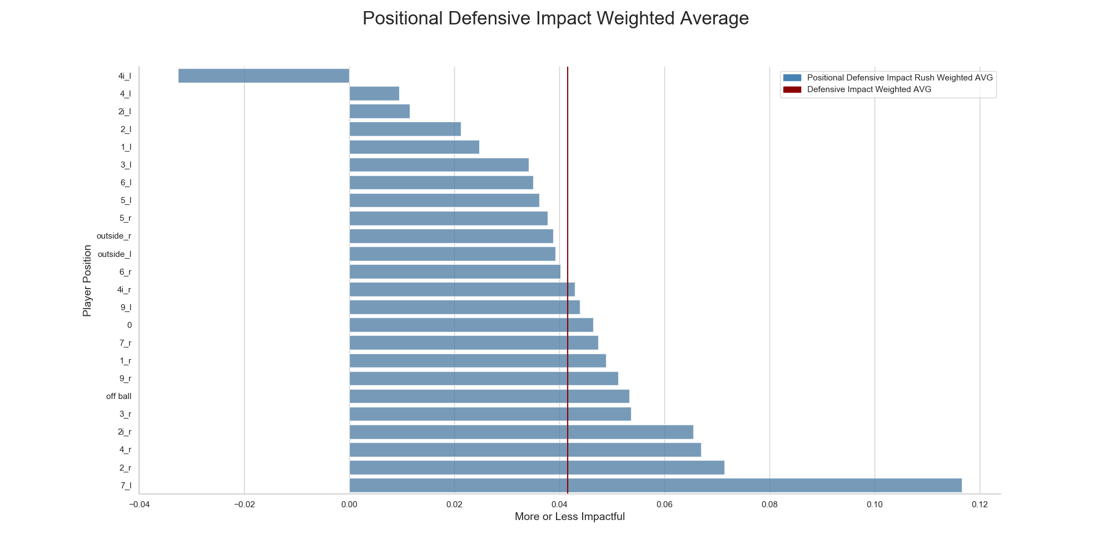
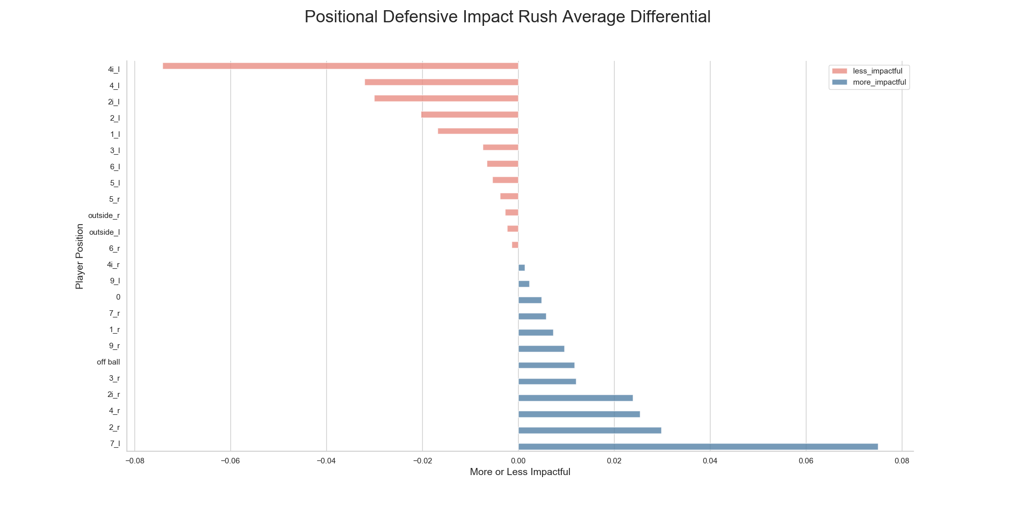
Different Context – Pass vs Rush
If we consider only PDIRA (Positional Defensive Impact Rush Average) the most valuable position becomes 7 Tech, left side.
Left: PDIRA, Right: PDIARD

Slide 24
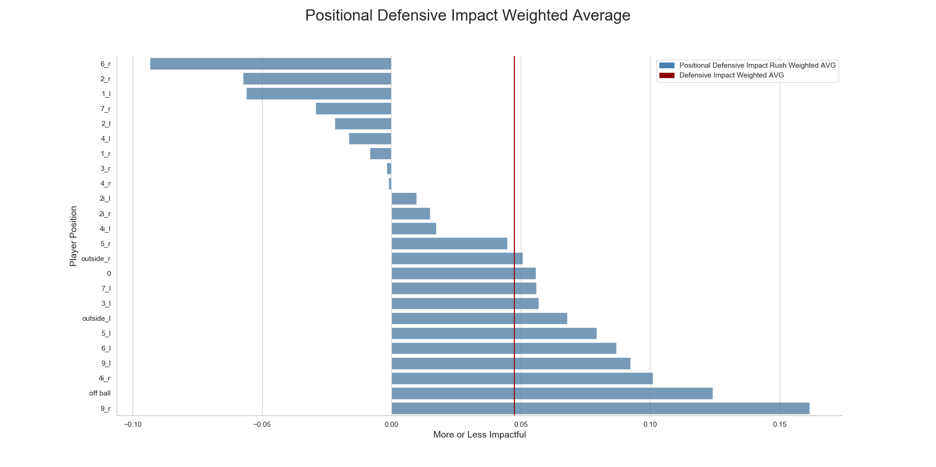
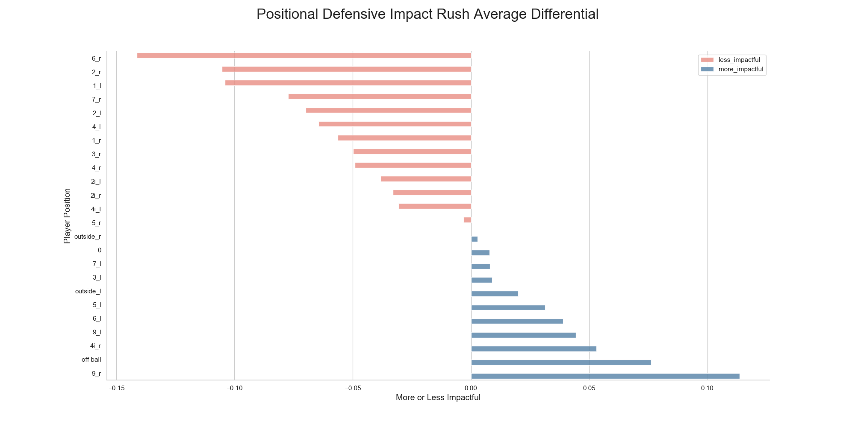
Different Context – Pass vs Rush
If we consider only PDIPA (Positional Defensive Impact Pass Average) the most valuable position is still the same, as well as the 2nd most valuable position. However, the 3rd most valuable position changes to 4 Tech, left side from 7 Tech, left side
Left: PDIRA, Right: PDIARD

Slide 25
Assumptions
In performing the scoring calculations, some assumptions were made.
For proximity to play, there is no definitive way to determine from the data provided whether a specific position was actually involved in the play, or close enough to the play to be considered involved. As such, points could be awarded or not awarded on plays where this assumption was made incorrectly.
This analysis does not consider game score, time remaining, or progress into the NFL season. This is specifically an isolated look at the overall impact per defensive position on an average play. However there is the possibility that there are elements that contribute to better or worse performance.

Slide 26
Assumptions
Defensive positions were set as their Tech positions for the plays. This does mean that the same player can, and likely will, have multiple defensive positions. However this analysis is not of individual players, but the average impact of each alignment across all plays recorded in that alignment. There is possibility that specific players could have an affect on the overall impact of a defensive alignment.

Slide 27
Limitations & Future Analysis
In regards to the PDIAD metrics used in this analysis, the following additional data would supplement the scoring process:
Rushing:
If designed gap was not used, what would it have been?
X,Y Coordinates of each player
Passing:
Time to throw
Angle of pass release to determine which defensive positions are nearby
Did the QB leave the pocket? Was it schematic?

