Slide 1
Sports Info Solutions D-Line Analytics Challenge
By Emmett Kiernan
Northeastern University Economics M.S. Recent Graduate
2019 Kaggle NFL Big Data Bowl 97th Percentile Finisher
Former Subpar D-III Defensive Lineman

Slide 2
Initial Data Adjustments
Filter out Spikes and QB Kneels
Remove players not listed as DL or LB, as well as those who rushed on fewer than 50% of passing snaps
Add a column for standardized player value. Uses OverTheCap pick value from Lee Sharpe’s GitHub for drafted players still on rookie contract and SpotTrac’s 2019 average salary for all others. A value of 1.0 equates to one standard deviation greater than the mean salary/draft value for all players in the sample across all positions.

Slide 3
Position Definitions:
The SIS data really helps clarify vague roster positions which don’t always translate between schemes. I divided players into three position groups using K-Means Clustering on player alignment data: Edge (LBs and pass rushing DEs), Tackle (mostly 3-4 DEs and pass rushing DTs), Nose (mostly 3-4 NTs and run stuffing DTs). See the table below for some examples of what kinds of players fall under each cluster. This allows an easy comparison between schemes, as outside linebackers in 3-4 defenses hold similar responsibilities to defensive ends in 4-3 schemes.
Edge Snap Leaders: | Tackle Snap Leaders: | Nose Snap Leaders:
Jason Pierre-Paul, TB (493) | Cam Heyward, PIT (474) | Kenny Clark, GB (410)
Chandler Jones, AZ (492) | DeForest Buckner, SF (461) | Javon Hargrave, PIT (410)
Bud Dupree, PIT (476) | Ndamukong Suh, TB (455) | Vita Vea, TB (406)
Khalil Mack, CHI (467) | Christian Wilkins, MIA (412) | Larry Ogunjobi, CLE (377)
Nick Bosa, SF (466) | Aaron Donald, LA (411) | Davon Godchaux, MIA (370)

Slide 4
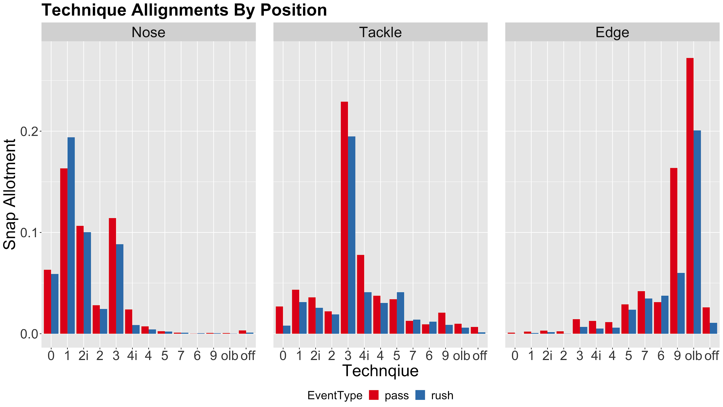

Slide 5
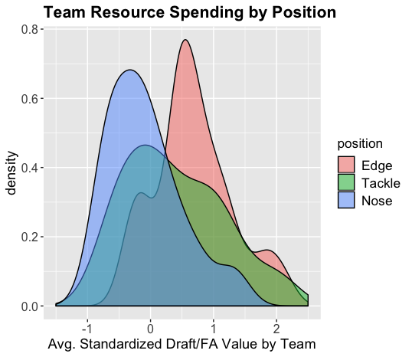
Resource Distribution
On average, teams dedicate the most salary/draft resources on Edge players
Tackle has the widest dispersion amongst teams
This gives us a solid prior for positional value
Note: Average position resources spent per team is measured on a per player-snap basis, so more Edges being on the field or on a roster does not impact the results.

Slide 6
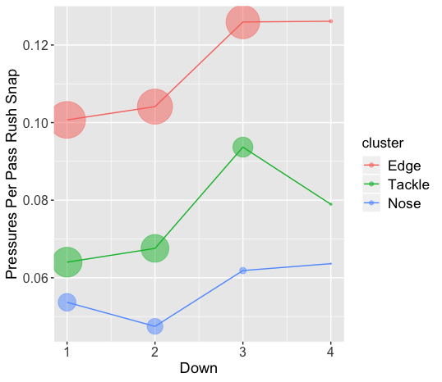
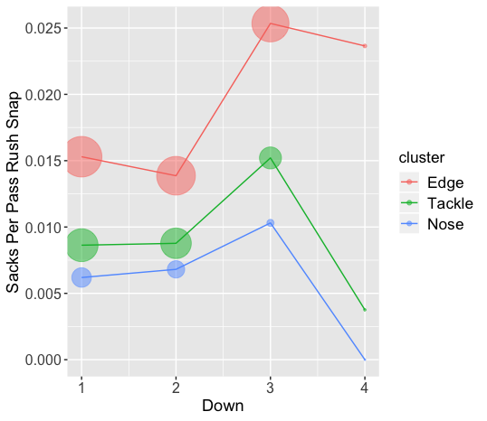
Pressure and Sack Rates By Position

Slide 7
Not All Pressures Are Created Equal?
I fit two models to assess the impact of a pressure on the play outcome. The first measures EPA/play. Turnovers and big plays by the offense have a disproportionate impact on average EPA. While one option would be to control for these plays since the noise may outweigh the benefits, it is also possible that which position the pressure comes from affects the likelihood of these high impact plays. For that reason, I fit two models, one with the dependent variable as EPA and the other as Success (binary variable for whether EPA was positive or not). Both models suggested that Edge pressures have the most impact on the result of the pass play. Next, I will use a mixed effects model to estimate each player’s ability to generate pressure.

Slide 8
Pass Rush Model: Intro
Fit a logit mixed effects model to evaluate player pass rush ability
Only passing plays where the player is rushing are included
Formula: Pressure = as.factor(Down) + Distance + Technique + (1 | Player)
The partial pooling component of mixed effects allows more accurate comparisons between players with different sample sizes
I am using pressures and not sacks, as a higher frequency event is more applicable to an 8 week sample. Timo Riske (Pro Football Focus) has also shown that turning pressures into sacks is not a repeatable skill.

Slide 9
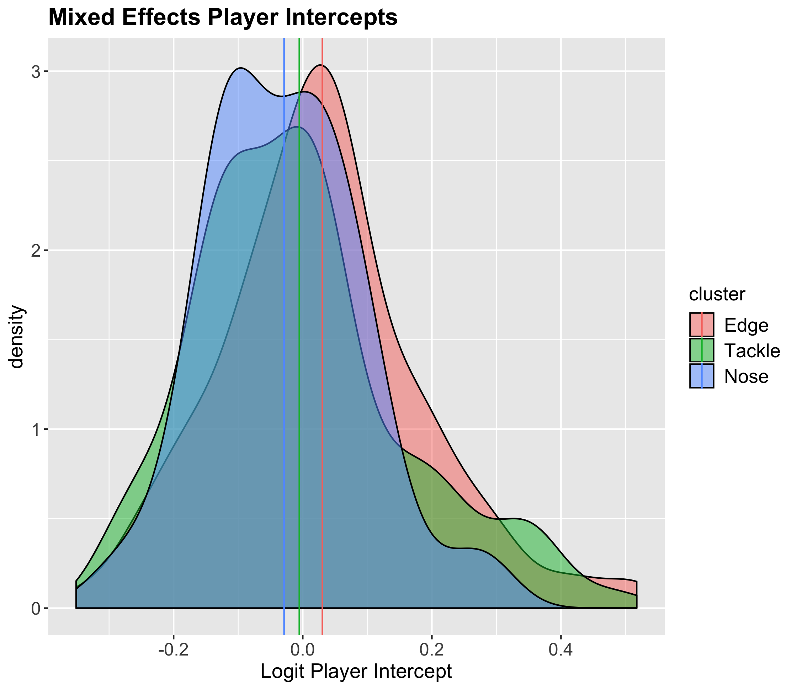
Pass Rush Model: Position Distribution
The player intercepts show individual ability to create pressures, while controlling for both situation and alignment
We can see here that Nose has the tightest distribution, while Tackle and Edge are similarly dispersed

Slide 10
Pass Rush Model: Top Performers
Best Edge Intercepts: | Best Tackle Intercepts: | Best Nose Intercepts:
1. Shaq Barrett, TB | 1. Aaron Donald, LA | 1. Kenny Clark, GB
2. Za’Darius Smith, GB | 2. Cam Heyward, PIT | 2. Javon Hargrave, PIT
3. T.J. Watt, PIT | 3. Chris Jones, KC | 3. Armon Watts, MIN
4. Trey Flowers, DET | 4. Joey Bosa, LAC | 4. Vita Vea, TB
5. Shaq Lawson, BUF | 5. D.J. Reader, HOU | 5. Mike Pennel, KC

Slide 11
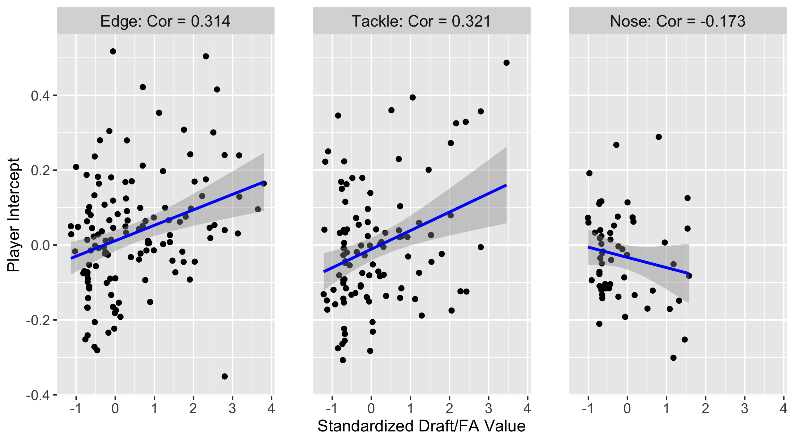
Pass Rush Model: Return On Investment

Slide 12
Pass Rush Model: Conclusions
While controlling for alignment and situation, the distribution between all three positions is similar. Edge and Tackle also produce similar return on investment when it comes to pressures. However, Edge pressures occur on a higher percentage of snaps, have a greater impact on the play result, and teams give more pass rushing snaps to the position. The data clearly shows that Edge is the most most valuable D-Line position for defending the pass.
All of the above reasons also hold true as to why Tackle is more valuable to pass rush than Nose, other than pressure’s effect on play outcome. Additionally, the difference in return on investment between the two positions widens the gap even further.

Slide 13
Pass Rush Model: Assumptions and Limitations
The biggest limitations are not knowing the talent of the offensive lineman blocking each player, which players are being double teamed, or the impact coverage had on creating the pressure.
While I do believe focusing on pressures more than sacks is the correct decision in any sample due to the latter being a rare event, with more weeks of data I would certainly have paid more attention to them. It is reassuring to see that even with just eight weeks of data, the two metrics follow the same patterns while comparing rates by down and position.
The partial pooling element in accessing the player intercepts is extremely valuable for dealing with players of different sample sizes. One future improvement would be using priors to regress players to different means. For example, Myles Garrett likely deserves to be punished less for his small sample size than a player without the same draft capital and past production.

Slide 14
Run Defense Models
Using statistics to divide up individual defensive player impact on run plays is a bit more difficult than with pass rushing, but having alignment data makes things slightly easier. I will test out three different metrics to try and assess the importance and talent distribution of the three defensive line positions:
Negative EPA Tackles
Gap Changes Forced
Adjusted Success Rate on Defender’s Side of Ball
All of these models use mixed effects, so just like with the pass rush results, partial pooling allows for fair comparisons of players with different amounts of snaps.

Slide 15
Negative EPA Tackles: Intro
If a defensive lineman makes a tackle on a run play with negative EPA, they clearly helped their team. While it is true that the player who makes the tackle is often not solely responsible for stopping the rush, making or assisting the tackle is likely an indicator that the defensive player had at least some role in the outcome.

Slide 16
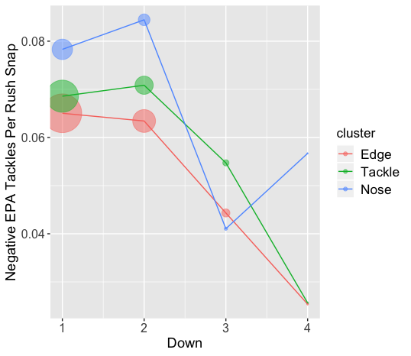
Negative EPA Tackles: By Position
Noses make negative EPA tackles at the highest rate on all downs but third.
The sample sizes are much larger on the early downs, as indicated by the size of the points.

Slide 17
Negative EPA Tackles: Model
Mixed Effects Linear Model
Filter for only run plays
Formula: Negative EPA Tackles = as.factor(Down) + ToGo + RunGap + Technique + (1 | Player)
This also could have been treated as an ordered logistic model, due to tackles only taking values of 0, .5, or 1

Slide 18
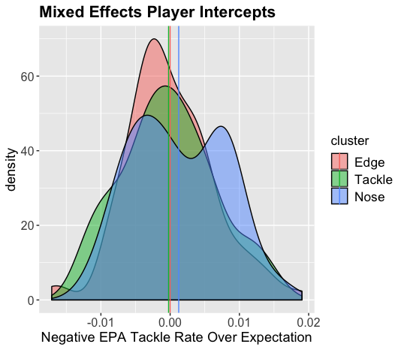
Negative EPA Tackles: Distribution
While controlling for situation and technique, Noses have a much wider distribution. They also have more players with positive values, showing that they produce more Negative EPA Tackles than the other positions, even with control variables in place. We will see on the next slide, however, Tackles produce more return on investment with this metric.

Slide 19
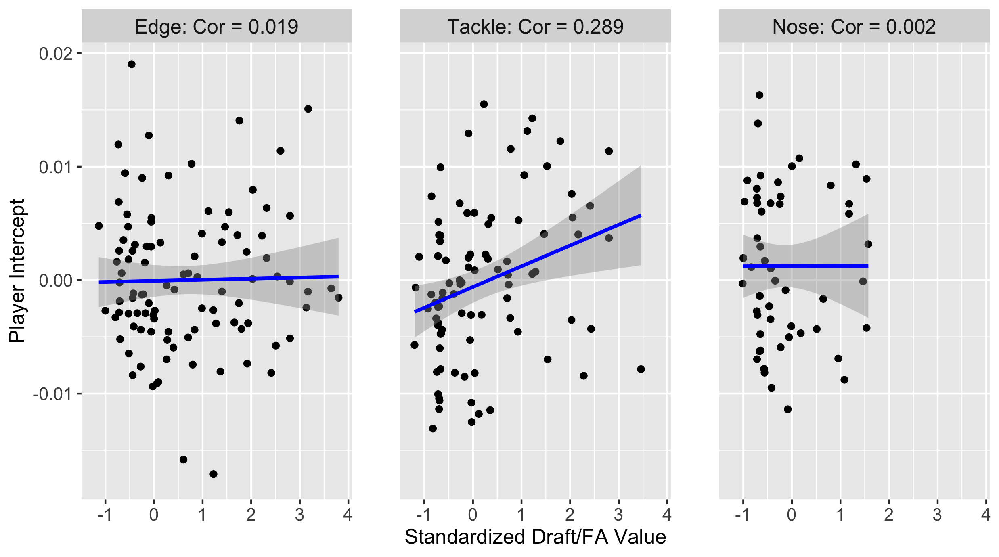
Negative EPA Tackles: Return On Investment

Slide 20
Negative EPA Tackles: Top Performers
Best Edge Intercepts: | Best Tackle Intercepts: | Best Nose Intercepts:
1. Vince Biegel, GB | 1. William Gholston, TB | 1. Mike Pennel, KC
2. DeMarcus Lawrence, DAL | 2. Jonathan Allen, WAS | 2. Mike Purcell, DEN
3. Carlos Dunlap, CIN | 3. Jeffery Simmons, LAC | 3. Dalvin Tomlinson, NYG
4. Markus Golden, NYG | 4. Lawrence Guy, NE | 4. Damon Harrison, DET
5. Matt Judon, BAL | 5. Ed Oliver, BUF | 5. Larry Ogunjobi, CLE

Slide 21
Rushing Success Rate: Model
Mixed Effects Logit Model
Fitler for rushing plays toward the direction where the defensive player lined up, unless they are in a 0 Technique
Formula: Success = as.factor(Down) + ToGo + RunGap + (1|Offensive Team) + (1|Name)
Offensive team is being controlled for here

Slide 22
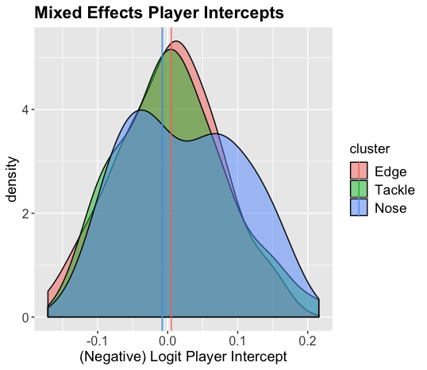
Rushing Success Rate: Model
More evidence toward Nose having both the widest distribution for run stuffing ability. While the means are similar for all three positions, Noses also appear to have the highest impact players for creating unsuccessful rushing plays.
Note: Since negative intercept is being used, being on the right side of the x-axis is still a positive, despite a value of success = 1 being a bad thing.

Slide 23
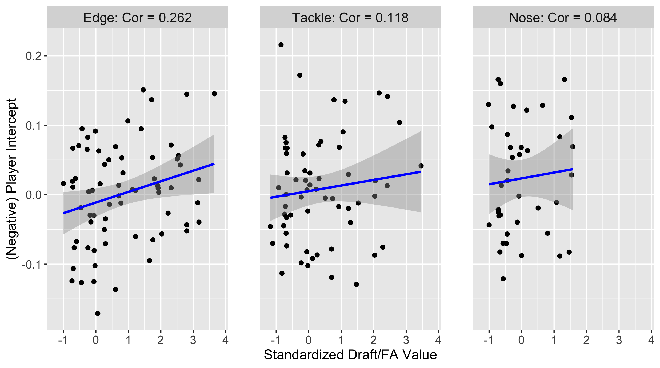
Rushing Success Model: Return on Investment

Slide 24
Rushing Success Rate: Top Performers
Best Edge Intercepts: | Best Tackle Intercepts: | Best Nose Intercepts:
1. Justin Houston, KC | 1. D.J. Reader, HOU | 1. Grover Stewart, IND
2. Khalil Mack, CHI | 2. Tyson Alualu, PIT | 2. Damon Harrison, DET
3. Dante Fowler, LA | 3. Leonard Williams, NYG | 3. Nick Williams, CHI
4. Brandon Graham, PHI | 4. Fletcher Cox, PHI | 4. D.J. Jones, SF
5. Bud Dupree, PIT | 5. Henry Anderson, NYJ | 5. Malcom Brown, NO

Slide 25
Gap Changes Forced: Intro
Plays where the runner is forced to use a non-designated have a lower average EPA of .06. This is one of the few situations where the defensive line controls the outcome with little noise from other players. I am crediting a defensive player with a role in forcing a gap change if the run was toward their side. The reason for doing this rather than just for plays toward the gap they lined up at, is that oftentimes an unexpected player in the backfield forces a change before the runner can even get to the gap. It also increases the sample size for each player and accounts for twists and stunts where the D-line are responsible for different gaps than where they lined up before the snap. Additionally, assigning exact gap responsibilities is trickier for Edge defenders and run plays toward the C and D gaps, even if there are no twists taking place.

Slide 26
Gap Changes Forced: Model
Mixed Effects Logit Model
Fitler for rushing plays toward the direction where the defensive player lined up, unless they are in a 0 Technique
Formula: Used Designated Gap = RunGap + (1 | Player)
There is not much need for control variables here, as I feel they would all add noise to the model

Slide 27
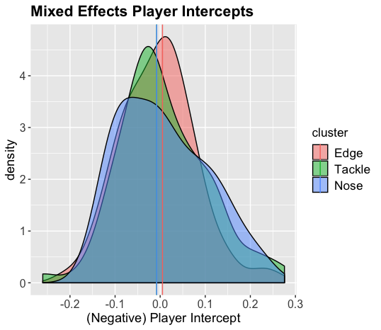
Gap Changes Forced: Distribution
More evidence toward Nose having the widest distribution for run stuffing ability, as well as having the players with the highest impact over expectation.

Slide 28
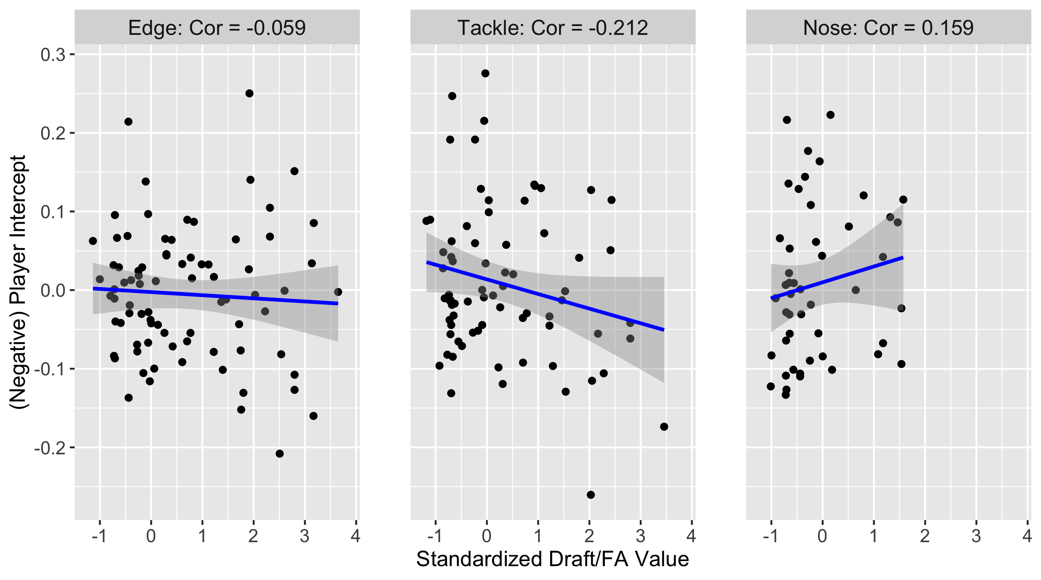
Gap Changes Forced: Return on Investment

Slide 29
Gap Changes Forced: Top Performers
Best Edge Intercepts: | Best Tackle Intercepts: | Best Nose Intercepts:
1. Danielle Hunter, MIN | 1. Shamar Stephen, MIN | 1. Dalvin Tomlinson, NYG
2. Maxx Crosby, OAK | 2. Dean Lowry, GB | 2. Mike Purcell, DEN
3. Von Miller, DEN | 3. B.J. Hill, NYG | 3. Javon Hargrave, PIT
4. Everson Griffen, MIN | 4. Shelby Harris, DEN | 4. Corey Peters, AZ
5. Markus Golden, NYG | 5. John Atkins, DET | 5. Christian Covington, DAL

Slide 30
Rushing Conclusions
Of the three rushing metrics, I consider Negative EPA Tackles to be the most important, as it requires the fewest assumptions about other players. Next would be Rushing Side Success Rate, which has the most impact on game results, but is harder to divide up credit. Last is Gap Changes Forced, which was fun to explore, but has a sample size issue, as well as limitations with dividing up credit.
Noses create negative EPA tackles at the highest rate and have the fattest tails for all three intercepts. Return on investment appears to be quite random and likely mostly attributed to noise.

Slide 31
Final Conclusions
What is the most important defensive position? Edge defender is the most valuable defensive position. It is a passing league and Edge is clearly the most important position when it comes to pressuring the passer. I consider Tackle the second most important overall, as the position’s return on draft/FA investment for generating quarterback pressure is so much greater than the ROI for Noses in the run game.
What is the nature of the distribution of talent between the defensive line positions? When controlling for both game situation and technique, Nose has the widest distribution. This would not be recognized with traditional defensive statistics. Edge and Tackle have quite similar distributions for all four metrics evaluated.
In which in-game or roster construction scenarios would the answer to Question 1 change? Tackles cost less than Edges, both in the draft and in free agency, so if a team did not have the resources to get a premier Edge, finding a quality Tackle could be the next best option. In a situation where a team needed to prioritize stopping the run over the pass, Edge could become the most important. However, most analytics people would almost always want to encourage an opponent to run the ball more.

