Slide 1
Quantifying Defensive Lineman Value
By Brandon Boyd and Colin Clapham Contact: bboyd619@comcast.net colinclapham18@gmail.com

Slide 2
Outline
Assumptions
What is the most valuable defensive line position?
Defining positionality
Measuring average EPA effect for each position
What is the nature of the distribution of talent between defensive line positions?
Discovering which players perform best at which position
Measuring distribution of EPA effect at each position
Measuring distribution of athleticism at each position
Which in-game or roster construction scenarios would the answer to question 1 change?
Revisiting EPA effect in high-leverage scenarios
Revisiting EPA effect in early down vs. late down scenarios
Weighing average EPA effect against AAV/rookie contract status
Limitations and Future Analysis

Slide 3
1. Assumptions
Hex methodology for positions (described on slide 5)
All players with roster position of S, CB, or LB removed from data
Treated pass and run plays as equal
Our model was created to control for run vs. pass plays
Used upper quantile of data based on snap count for positional hexes

Slide 4
2. Which is the most valuable defensive line position?
To address this question, we:
Defined positions using a unique and descriptive “hex” system as described in slide 5
Measured each player’s average EPA output from all their snaps at the different hexes they played at
Created a linear model to determine which hex led to most negative EPA when controlled for all other variable

Slide 5
2.1 – Defining Positionality
LEFT
RIGHT
9
6
7
5
4
4i
3
2
2i
1
0
1
2i
2
3
4i
4
5
7
6
9
TE
T
G
C
G
T
TE
Rather than just focusing on DE vs. DT, we created positional “hexes” that include:
Roster position (DE, DT)
Side of field (L, C, or R)
Technique used on play
E.g. Chris Jones played DTL2i on 10 snaps in the data set, Shaq Lawson played DER7 on 18 snaps

Slide 6
2.2 – Measuring average EPA
Position Hex | Count | Avg EPA
DEROutside | 1801 | -0.10
DTL2i | 1514 | -0.07
DTC0 | 2170 | -0.06
DEL7 | 1079 | -0.05
DTR2i | 1986 | -0.05
DER7 | 1301 | -0.04
DEL3 | 1520 | -0.04
DELOutside | 1871 | -0.04
DER6 | 1036 | -0.04
DEL9 | 2705 | -0.03
DTR3 | 4474 | -0.03
DEL5 | 1244 | -0.02
DTR1 | 3216 | -0.02
DTL1 | 2833 | -0.02
DTL3 | 5449 | -0.01
DER5 | 1295 | -0.01
DER9 | 3047 | -0.01
DEL6 | 1239 | 0.00
DER3 | 1606 | 0.04
We averaged the EPA of plays involving each of the 18 upper quantile (based on snap counts) hexes
Right-side defensive ends with outside technique registered the highest average EPA among all hex combinations

Slide 7
2.3 – Average EPA, controlled for in-game events (cEPA)
Hex | cEPA
DEL5 | -0.068
DER6 | -0.058
DTC0 | -0.056
DTL2i | -0.049
DTR2i | -0.047
DEROutside | -0.039
DER3 | -0.036
DEL7 | -0.034
DEL6 | -0.029
DTR3 | -0.029
DTL1 | -0.028
DTL3 | -0.027
DER7 | -0.025
DTR1 | -0.021
DELOutside | -0.017
DER9 | -0.008
DER5 | -0.005
DEL9 | 0.003
We created a linear model to measure each hex’s individual effect on EPA, independent of other variables (R² = 0.79)
The output of this model is a coefficient we’re calling cEPA for controlled EPA
Variables in model include:
Yards to First Down
Side of Field
Start Yard
Pass/Rush play
Touchdown
Safety
Turnover
Offensive Yardage
Assisted Tackle
Solo Sack
Assisted Sack
Pass Breakup
Hex Combo

Slide 8
2.3 – Average EPA, controlled for in-game events (cEPA)
Hex | cEPA
DEL5 | -0.068
DER6 | -0.058
DTC0 | -0.056
DTL2i | -0.049
DTR2i | -0.047
DEROutside | -0.039
DER3 | -0.036
DEL7 | -0.034
DEL6 | -0.029
DTR3 | -0.029
DTL1 | -0.028
DTL3 | -0.027
DER7 | -0.025
DTR1 | -0.021
DELOutside | -0.017
DER9 | -0.008
DER5 | -0.005
DEL9 | 0.003
cEPA used to evaluate value of the position as a whole, average EPA used to evaluate individual players
Using cEPA, DEL5 produces the greatest negative effect on EPA, controlled for other in-game variables
Based on this model, DEL5 is the most valuable defensive line position
Players who played DEL5, ranked by snap count:
Carlos Dunlap
Lawrence Guy
Chad Thomas
Joey Bosa
Maxx Crosby

Slide 9
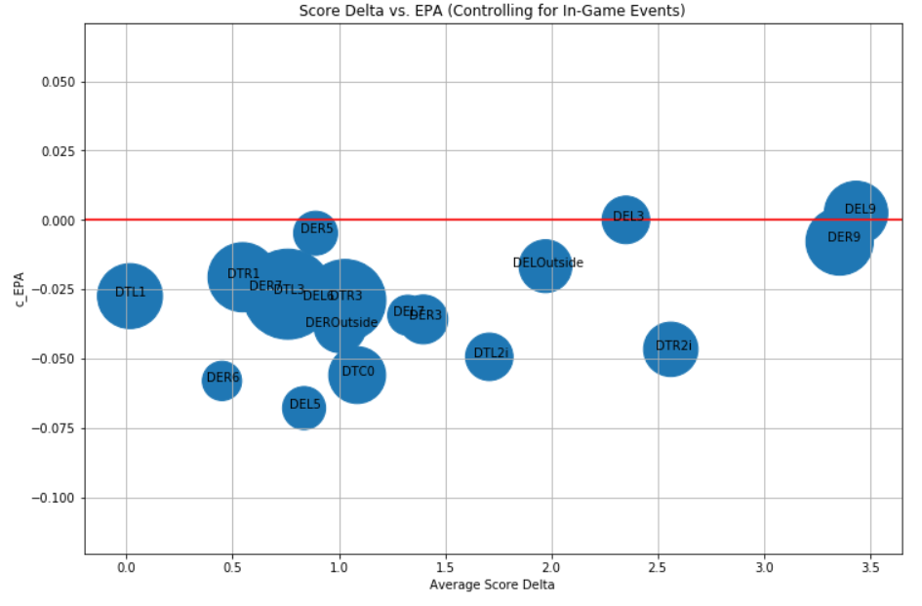
2.3 – Average EPA, controlled for in-game events (cEPA)
Chart shows each hex’s cEPA against the score delta in their game
DEL5’s low cEPA occurs in >1 point games

Slide 10
3. What is the nature of the distribution of talent between defensive line positions?
To address this question, we:
Determined frequency that each player played at given hexes
Created histograms for each hex based on players in hex’s frequency of negative EPA plays
Quantified distribution using measures of kurtosis to evaluate distribution of talent across hexes

Slide 11
3.1 – Determining frequency of player snaps at each hex position
We broke down the plays that each defensive lineman played at different hexes
Chart at right shows Aaron Donald’s snaps at different positional hexes in the dataset
Positional Hex | Snap count
DTR3 | 158
DTL3 | 142
DTL4 | 18
DTR5 | 17
DTR4i | 15
DTL5 | 14
DTL4i | 10
DTR4 | 8
DTR9 | 5
DTL9 | 5
DTL7 | 3
DTCOff Ball | 3
DTR1 | 3
DTR7 | 2
DTL2 | 2
DTR2 | 2
DTL1 | 2
DTC0 | 1
DTR2i | 1
DTLOutside | 1
DTL6 | 1
DTL2i | 1
DTROutside | 1

Slide 12
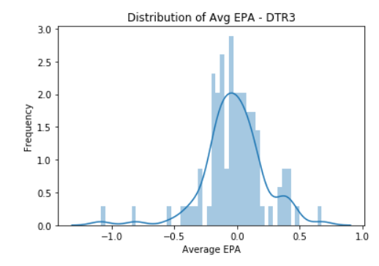
3.2 – Histograms for each hex’s negative EPA player frequency
Created histograms for each positional hex to examine distribution of talent across the position
X – Average EPA of all plays of player who played snaps at given positional hex
Y – Frequency of plays at average EPA level from given positional hex

Slide 13
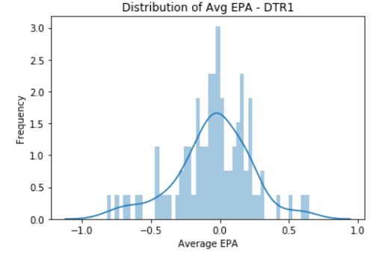
3.2 – Histograms for each hex’s negative EPA player frequency
Created histograms for each positional hex to examine distribution of talent across the position
X – Average EPA of all plays of player who played snaps at given positional hex
Y – Frequency of plays at average EPA level from given positional hex

Slide 14
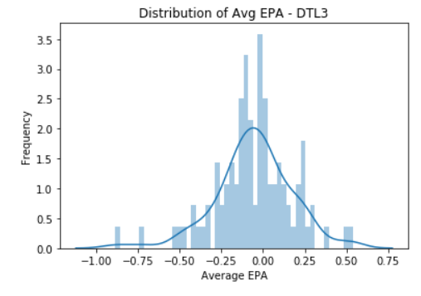
3.2 – Histograms for each hex’s negative EPA player frequency
Created histograms for each positional hex to examine distribution of talent across the position
X – Average EPA of all plays of player who played snaps at given positional hex
Y – Frequency of plays at average EPA level from given positional hex

Slide 15
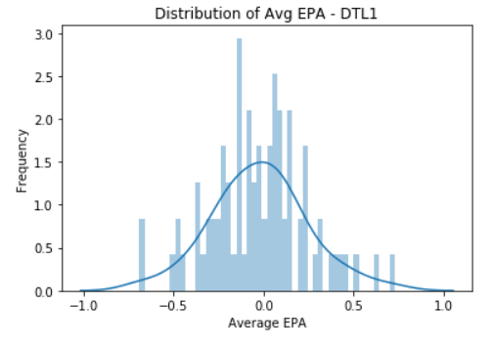
3.2 – Histograms for each hex’s negative EPA player frequency
Created histograms for each positional hex to examine distribution of talent across the position
X – Average EPA of all plays of player who played snaps at given positional hex
Y – Frequency of plays at average EPA level from given positional hex

Slide 16
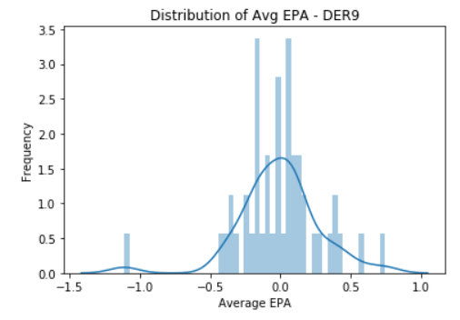
3.2 – Histograms for each hex’s negative EPA player frequency
Created histograms for each positional hex to examine distribution of talent across the position
X – Average EPA of all plays of player who played snaps at given positional hex
Y – Frequency of plays at average EPA level from given positional hex

Slide 17
3.3 – Quantifying distribution of talent with measures of kurtosis
Used measures of kurtosis to quantify the nature of the distribution
The greater the measure of kurtosis, the narrower the distribution of talent for that positional hex
Measures of kurtosis were only applied to top five positional hexes by snap count due to variability in snap counts across hexes
Hex | cEPA | Kurtosis
DTR3 | -0.029 | 3.96
DTL1 | -0.028 | 0.48
DTL3 | -0.027 | 1.67
DTR1 | -0.021 | 0.85
DER9 | -0.008 | 3.91

Slide 18
4. Which in-game or roster construction scenarios would the answer to question 1 change?
To address this question, we
Revisited cEPA to see how it changes in high-leverage, early, and late-down scenarios
Examining high-leverage scenarios using average EPA
Examined early vs. late-down scenarios using average EPA
Examined cEPA against hex AAV and rookie contract status

Slide 19
4.1 - Revisited cEPA to see how it changes in high-leverage and early/late down scenarios
Hex | cEPA | cEPA for scenarios
DEL5 | -0.068 | -0.066
DER6 | -0.058 | -0.055
DTC0 | -0.056 | -0.055
DTL2i | -0.049 | -0.049
DTR2i | -0.047 | -0.046
DEROutside | -0.039 | -0.037
DER3 | -0.036 | -0.035
DEL7 | -0.034 | -0.033
DEL6 | -0.029 | -0.027
DTR3 | -0.029 | -0.027
DTL1 | -0.028 | -0.026
DTL3 | -0.027 | -0.025
DER7 | -0.025 | -0.023
DTR1 | -0.021 | -0.018
DELOutside | -0.017 | -0.015
DER9 | -0.008 | -0.008
DER5 | -0.005 | -0.003
DEL9 | 0.003 | 0.003
Defined high-leverage plays as occurring in the fourth quarter or overtime where score delta ≤8 (using Pro Football Focus’ definition of “clutch”)
Re-ran cEPA, controlling for high-leverage and early vs. late-downs
Ranking of positional hex cEPA stayed the same other than DEL6 and DTR3 swapped rank

Slide 20
4.2 – Examining high-leverage scenarios using average EPA
Positional Hex | Snap Count | Avg EPA
DEROutside | 1406 | -0.10
DEL3 | 1144 | -0.06
DTL2i | 1183 | -0.06
DER7 | 1075 | -0.05
DER6 | 862 | -0.04
DTR2i | 1498 | -0.04
DTC0 | 1745 | -0.04
DEL5 | 976 | -0.04
DEL7 | 862 | -0.03
DEL9 | 1996 | -0.03
DTR3 | 3536 | -0.02
DTR1 | 2590 | -0.02
DTL1 | 2308 | -0.01
DTL3 | 4402 | -0.01
DELOutside | 1423 | -0.01
DEL6 | 1012 | 0.003
DER5 | 1014 | 0.005
DER9 | 2255 | 0.02
DER3 | 1268 | 0.06
Looked at plays using previous definition of clutch
Using just average EPA of plays involving each hex, DEROutside produced the most negative EPA
Players who played DEROutside, ranked by snap count:
Melvin Ingram III
Yannick Ngakoue
Tarrell Basham
Derek Barnett
Jason Pierre-Paul

Slide 21
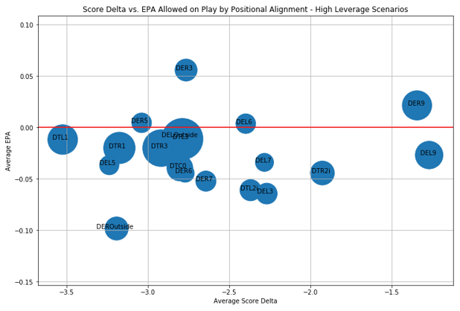
4.2 – Examining high-leverage scenarios using average EPA

Slide 22
4.3 – Examining early vs. late-down scenarios using average EPA
Positional Hex | Snap Count | Avg EPA
DEROutside | 1416 | -0.07
DER7 | 1126 | -0.07
DTL2i | 1327 | -0.06
DEL7 | 931 | -0.05
DEL3 | 1179 | -0.05
DTR1 | 2784 | -0.03
DELOutside | 1450 | -0.02
DEL9 | 1904 | -0.02
DTC0 | 1564 | -0.02
DTR3 | 3797 | -0.02
DTL3 | 4700 | -0.01
DER5 | 1053 | -0.01
DER6 | 916 | -0.01
DTL1 | 2423 | -0.007
DEL5 | 1021 | -0.006
DTR2i | 1790 | -0.0005
DEL6 | 1118 | 0.01
DER9 | 2137 | 0.02
DER3 | 1211 | 0.03
Looked at plays on just first and second down
DEROutside produced the most negative EPA
Players who played DER7, ranked by snap count:
Everson Griffen
Al-Quadin Muhammad
Clelin Ferrell
Mario Addison
Jerry Hughes

Slide 23
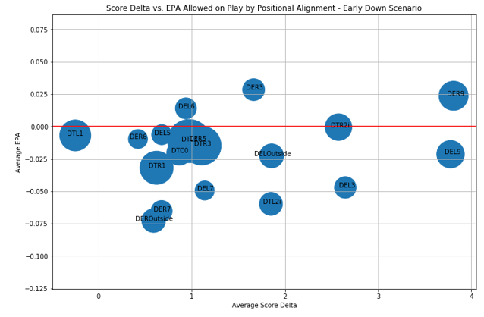
4.3 – Examining early vs. late-down scenarios using average EPA

Slide 24
4.3 – Examining early vs. late-down scenarios using average EPA
Position Hex | Snap Count | Avg EPA
DER4i | 262 | -0.30
DTL4i | 240 | -0.24
DEROutside | 385 | -0.22
DTR4i | 264 | -0.21
DEL4i | 273 | -0.20
DTC0 | 606 | -0.16
DEL4 | 237 | -0.11
DTR3 | 677 | -0.10
DTL1 | 410 | -0.09
DEL5 | 223 | -0.08
DELOutside | 421 | -0.08
DER9 | 910 | -0.07
DEL9 | 801 | -0.05
DTL3 | 749 | -0.03
DEL3 | 341 | -0.03
DER5 | 242 | 0.01
DTR1 | 432 | 0.06
DER3 | 395 | 0.09
DECOff Ball | 245 | 0.13
Looked at plays on just third and fourth downs
Note: Much smaller sample size, more susceptible to outliers
DER4i produced the most negative plays in late-down scenarios
Players who played DER4i, ranked by snap count:
Cameron Heyward
Jonathan Allen
Denico Autry
Carlos Watkins
Trey Flowers

Slide 25
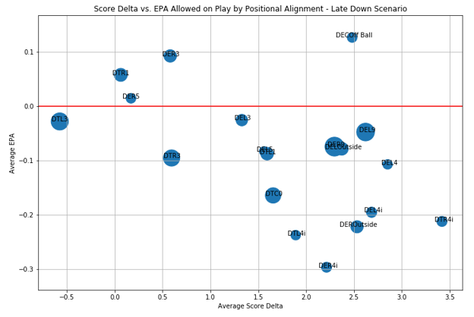
4.3 – Examining early vs. late-down scenarios using average EPA

Slide 26
4.4 - Examined cEPA against hex AAV* and rookie contract status
We compared each hex’s cEPA against the weighted average annual value (AAV), in millions, of players who played snaps at that hex
AAV was weighted by snap counts per player
Also included % of players who played at each hex who are currently on rookie contracts
Positional Hex | Snap Count | Avg EPA | Weighted Average AAV ($M) | % on Rookie Contracts
DEROutside | 1801 | -0.10 | 8.05 | 39%
DTL2i | 1514 | -0.07 | 4.41 | 33%
DTC0 | 2170 | -0.06 | 4.98 | 36%
DEL7 | 1079 | -0.05 | 7.11 | 34%
DTR2i | 1986 | -0.05 | 3.53 | 40%
DER7 | 1301 | -0.04 | 6.69 | 33%
DEL3 | 1520 | -0.04 | 3.97 | 30%
DELOutside | 1871 | -0.04 | 7.68 | 35%
DER6 | 1036 | -0.04 | 7.52 | 35%
DEL9 | 2705 | -0.03 | 7.98 | 32%
DTR3 | 4474 | -0.03 | 6.20 | 36%
DEL5 | 1244 | -0.02 | 5.74 | 32%
DTR1 | 3216 | -0.02 | 3.65 | 39%
DTL1 | 2833 | -0.02 | 4.08 | 35%
DTL3 | 5449 | -0.01 | 6.54 | 32%
DER5 | 1295 | -0.006 | 5.86 | 46%
DER9 | 3047 | -0.006 | 7.94 | 39%
DEL6 | 1239 | -0.0007 | 7.89 | 33%
DER3 | 1606 | 0.04 | 5.54 | 27%
*All contract values are as of 7/9/2020

Slide 27
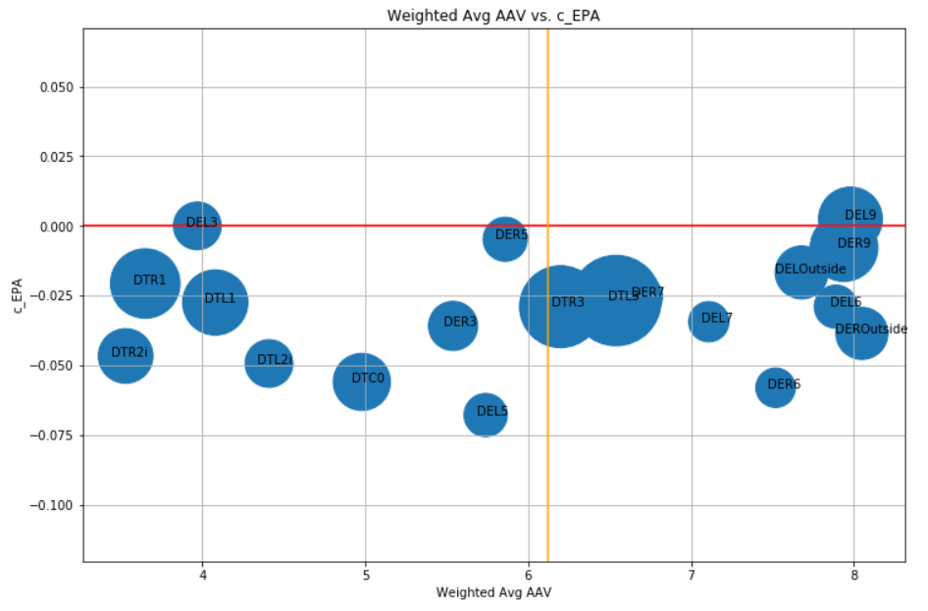
4.4 - Examined cEPA against hex AAV* and rookie contract status
*All contract values are as of 7/9/2020

Slide 28
4.4 - Examined cEPA against hex AAV* and rookie contract status
Positional Hex | Player Name | Snap Count | Avg EPA | Average AAV ($M) | Rookie Contract | Weighted Avg AAV ($M)
DTR3 | John Atkins | 88 | -0.02 | 0.54 | Yes | 6.20
DTL1 | Poona Ford | 82 | -0.20 | 0.57 | Yes | 4.08
DTR1 | Poona Ford | 107 | -0.03 | 0.57 | Yes | 3.65
DER7 | Al-Quadin Muhammad | 83 | -0.12 | 0.65 | No | 6.69
DTL1 | Sebastian Joseph-Day | 74 | -0.21 | 0.65 | Yes | 4.08
DTL2i | Grover Stewart | 103 | -0.13 | 0.70 | Yes | 4.41
DER9 | Trey Hendrickson | 83 | -0.20 | 0.79 | Yes | 7.94
DER9 | Maxx Crosby | 98 | -0.02 | 0.83 | Yes | 7.94
DEROutside | Tarell Basham | 118 | -0.17 | 0.84 | Yes | 8.05
DELOutside | Tarell Basham | 126 | -0.16 | 0.84 | Yes | 7.68
DTR3 | Justin Jones | 82 | -0.17 | 0.87 | Yes | 6.20
DEL3 | Chris Wormley | 80 | -0.18 | 0.89 | Yes | 3.97
DEL7 | Rasheem Green | 66 | -0.09 | 0.89 | Yes | 7.11
DEROutside | Chase Winovich | 83 | -0.04 | 0.96 | Yes | 8.05
DTR1 | Larry Ogunjobi | 130 | -0.19 | 0.98 | Yes | 3.65
DTR1 | Dalvin Tomlinson | 105 | -0.002 | 1.14 | Yes | 3.65
DTR3 | Dalvin Tomlinson | 74 | -0.03 | 1.14 | Yes | 6.20
DTR3 | PJ Hall | 95 | -0.05 | 1.18 | Yes | 6.20
This analysis applied to individual players identifies players who are performing well at specific hexes and are underpaid relative to weighted average AAV
*All contract values are as of 7/9/2020

Slide 29
4.4 - Examined cEPA against hex AAV* and rookie contract status
Same chart but with players on non-rookie contracts
Positional Hex | Player Name | Snap Count | Avg EPA | Average AAV ($M) | Rookie Contract | Weighted Avg AAV ($M)
DER7 | Al-Quadin Muhammad | 83 | -0.12 | 0.65 | No | 6.69
DTR2i | Timmy Jernigan | 68 | -0.003 | 2.00 | No | 3.53
DTR3 | Timmy Jernigan | 69 | -0.05 | 2.00 | No | 6.20
DER9 | Adrian Clayborn | 141 | -0.02 | 2.88 | No | 7.94
DEL9 | Benson Mayowa | 103 | -0.08 | 3.05 | No | 7.98
DTR3 | Shelby Harris | 113 | -0.06 | 3.25 | No | 6.20
DTR2i | Andrew Billings | 78 | -0.03 | 3.50 | No | 3.53
DTL2i | Andrew Billings | 84 | -0.008 | 3.50 | No | 4.41
DTL3 | Shamar Stephen | 124 | -0.08 | 4.15 | No | 6.54
DTL3 | Nick Williams | 74 | -0.21 | 5.00 | No | 6.54
DTR3 | Maliek Collins | 96 | -0.12 | 6.00 | No | 6.20
DTR3 | Rodney Gunter | 79 | -0.05 | 6.00 | No | 6.20
*All contract values are as of 7/9/2020

Slide 30
5. Limitations and future analysis
Limitations
Sample size
Could do much more with more data from 2019 and data over multiple years, would uncover players missing from set due to injury or suspension
Lack of offensive alignment information
Any probability model with a low frequency of positive outcomes (i.e. turnovers in our data set) will have difficulty achieving a high True Positive and a low False Negative rate

Slide 31
5. Limitations and future analysis
Future analysis
Greater sample size would allow us to create:
A probability model for turnover creation by hex
A more thorough sample of which positional hex players are most effective and ineffective at (e.g. Which positional hex does Grady Jarrett perform best at?)
How players’ value changes over the course of time (over a given season and over several seasons)
Knowing offensive formation/personnel on each play could help us understand how certain defensive line combinations perform against certain offenses

Slide 32
Questions?
Contact: Brandon Boyd at bboyd619@comcast.net Colin Clapham at colinclapham18@gmail.com

