Slide 1
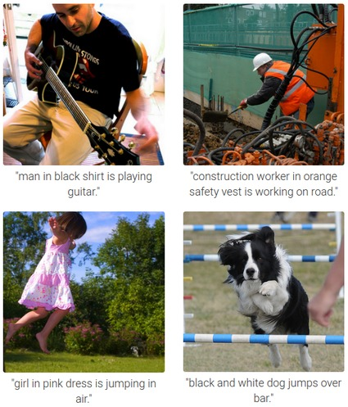
STAT 157 - Project #4:
Image Captioning
Project Midterm Presentation
Group Members:
Zabin Bashar, Jilin Cao, Mike Jin, Daniel Kim
March 5, 2019

Slide 2
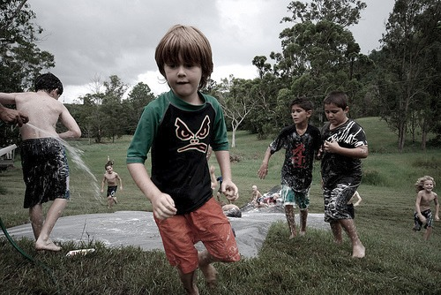
Flickr8k Dataset
The dataset contains 8000 of images from Flickr, an image and video hosting service, each of which has 5 captions by different people.
The image is given 5 different captions:
A boy runs as others play on a homemade slip and slide.
Children in swimming clothes in a field.
Little kids are playing outside with a water hose and are sliding down a water slide.
Several children are playing outside with a wet tarp on the ground.
Several children playing on a homemade water slide.
Notes:
As we can see, there are some differences among them:
Caption 1 focuses on a boy running.
“Children” vs “kids”.
Caption 2 is not a grammatically correct sentence.
Having different captions helps a model catch these subtleties and be able to generalize better.

Slide 3
Project Procedure
Problem Statement
The problem we want to solve is: Given an image, find the most probable sequence of words (sentence) describing the image.
Data Preprocessing
Convert each image to a 3-dimensional (height, width, color) vector.
Convert words into numbers, e.g. a = 1, and = 2, pen = 3, boy = 4, etc.
Image captioning model architecture
CNN to extract images into high-level features (objects, background, etc.)
Multi-layered Long Short Term Memory networks (RNN) to embed words.
Training phase
Loss function, optimization, batch training, etc.

