Slide 1
CRYPTOCURRENCY
Presented By : Saumyajit Das
Roll number : L20183074
Department : Information Technology(4th year)
Session : 2017-2021

Slide 2
OVERVIEW OF CRYPTOCURRENCY
Cryptocurrencies, virtual currencies, electronic coins, digital coins, digital tokens and blockchain tokens are different names for the same thing.
A crypto currency is a digital asset designed to work as a medium of exchange that uses strong cryptography to secure financial transactions, control the creation of additional units, and verify the transfer of assets.
The decentralized control of each cryptocurrency works through distributed ledger technology, typically a Blockchain, that serves as a public financial transaction database.
Bitcoin, first released as open-source software in 2009, is generally considered the first decentralized cryptocurrency by Satoshi Nakamoto after that 4000 altcoins created so far.
Having a cryptocurrency means having a private key (similar to a password) giving the holder the ability to transfer the cryptocurrency to someone else. Private keys are stored in digital wallets. There are multiple consensus mechanisms for validating transactions. The main ones are:
Proof-of-Work (PoW): validators validate transactions by running an algorithm to solve a cryptographic puzzle. This is known as. Mining creates new coins. Validators are rewarded with new coins and transactions fees (if any).
Proof-of-Stake (PoS): validators validate transactions by staking (“depositing”) cryptocurrencies. No new coins are (usually) created. Validators are rewarded with transaction fees only.

Slide 3
A Cryptocurrency is a system that meets six conditions:
The system does not require a central authority, its state is maintained through distributed consensus.
The system keeps an overview of cryptocurrency units and their ownership.
The system defines whether new cryptocurrency units can be created. If new cryptocurrency units can be created, the system defines the circumstances of their origin and how to determine the ownership of these new units.
Ownership of cryptocurrency units can be proved exclusively cryptographically.
The system allows transactions to be performed in which ownership of the cryptographic units is changed. A transaction statement can only be issued by an entity proving the current ownership of these units.
If two different instructions for changing the ownership of the same cryptographic units are simultaneously entered, the system performs at most one of them

Slide 4
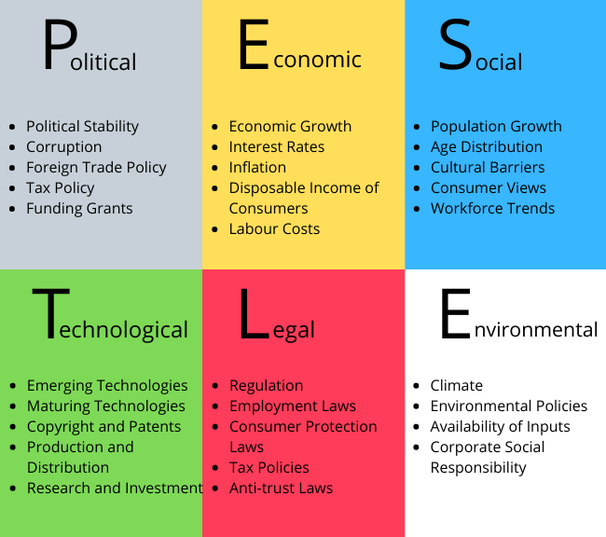
PESTLE ANALYSIS
If the project at hand is to determine a new product, business venture or opportunity, often a PESTLE analysis is the best way to achieve a great outcome. Various internal and external factors can affect functioning of a business or working of a project or value of a brand. These factors cannot controlled by the business but can influence decision making.

Slide 5
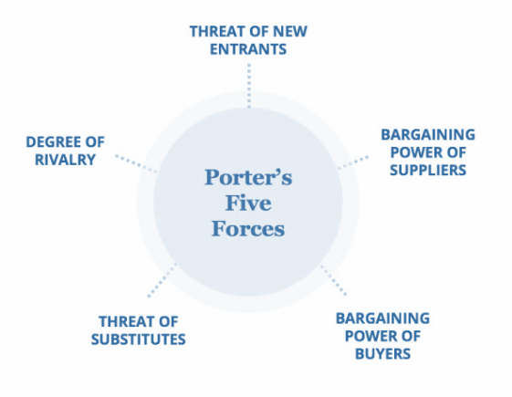
PORTERS 5 FORCES ANALYSIS
It is to analyze competition of business. It draws from industrial organization (IO) economics to derive five forces that determine the competitive intensity and, therefore, the attractiveness (or lack of it) of an industry in terms of its profitability. An "unattractive" industry is one in which the effect of these five forces reduces overall profitability. The most unattractive industry would be one approaching "pure competition", in which available profits for all firms are driven to normal profit levels.

Slide 6
MARKET POTENTIAL AND GROWTH STUDIES
Prominent drivers fueling crypto-currency market growth
• Growing Visibility
• Surging Investor Interest
• Regulatory Progress
• Strong Momentum
Cryptocurrency Data Mining
The Global Cryptocurrency Mining Market has been witnessing steady rise for the past decade owing to its rise in applications in its relevant industry
The global Cryptocurrency Mining market is segmented on the basis of region/countries, product types, and applications.
Growth studies of Cryptocurrency
The cryptocurrency markets will still likely see tremendous growth in trading volume in 2019, growing by an estimated 50
Trading fees on centralized exchanges to increase as well, rising from an estimated $2.1 billion in collected fees in 2018 to well over $3 billion in 2019

Slide 7
DEMAND AND FORECASTING FOR BITCOIN
Time series demand forecasting is done on 1500+ Bitcoin data traded from 2014-2018.
Data shown below is in Million (Mn).
Summary for the same is given as below:

Slide 8
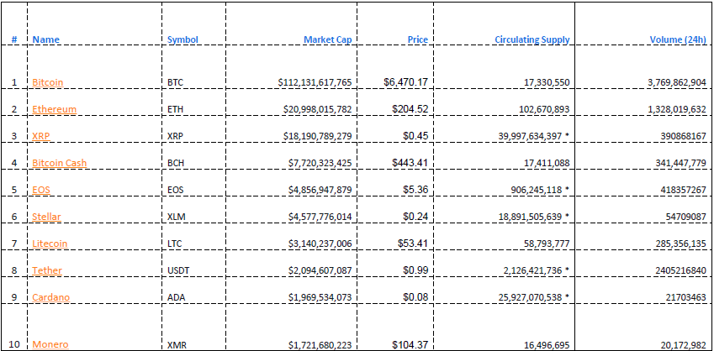
PERCEPTION MAPPING

Slide 9
PERCEPTION MAPPING (Cont.)
•Perception Mapping is done based on Top 10 Cryptocurrency in the market
•Data is based on yearly market share and volume traded by cryptocurrency in open market.

Slide 10
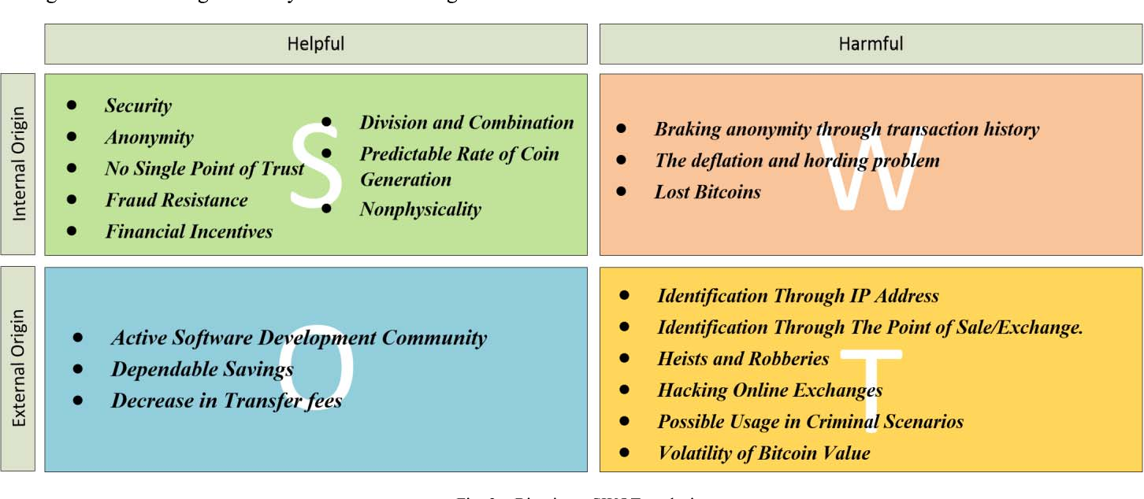
SWOT ANALYSIS OF CRYPTOCURRENCY

Slide 11
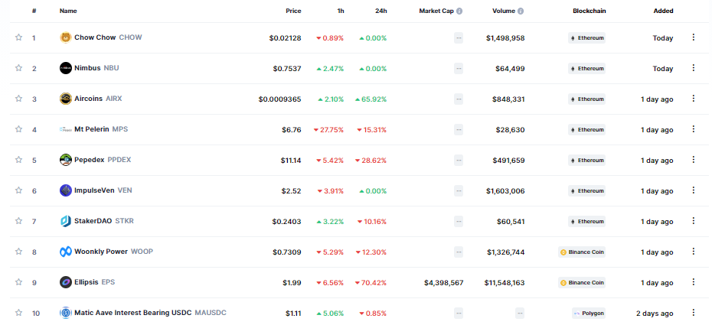
NEW CRYPTOCURRENCIES ADDED TO THE MARKET IN LAST 30 DAYS

Slide 12
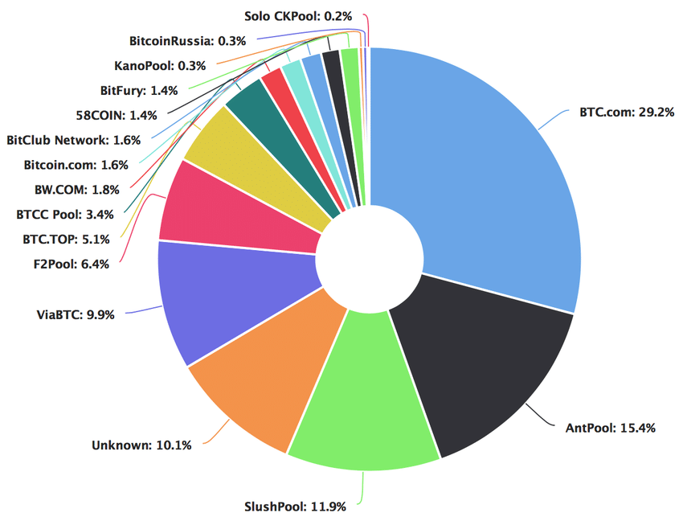
DISTRIBUTION & PROMOTION
Exclusive Distribution: This is about
having an exclusive channel for
distribution of product that also lead to
the branding and better control in
market. As this is a online product and
has no physical significance it will be
only sell and bought through online and
transaction will be based on hash
technology algorithm.

Slide 13

DISTRIBUTION & PROMOTION (Cont.)

Slide 14
EXPECTED CHALLANGES
Volatility
Ease of Use.
Widespread acceptance.
Potential of theft.
Reputation of Criminal activity.
Tax Issues.
Scalability.

Slide 15
THE FUTURE
Cryptocurrency development is advancing at a much more rapid scale than simply a Bitcoin.
Those are all very positive things for cryptocurrency and blockchain.
Scaling is a big hurdle for blockchain, but cryptocurrency has a whole lot of other problems to solve in order to succeed
Next big asset class for investors (being digital gold) as well as possibly a global payment
Cryptocurrency wants to essentially be a new layer of the internet on which decentralized apps are run. That is HUGE.
Recommend investing significantly heavier in Bitcoin as its momentum at this point almost seems unstoppable.

Slide 16
THANK YOU

