Slide 1
PHISHING Technology
Presented by – Omar Farahan Molla
Roll – L20181081
Department – CSE(4th year)
Paper – CSE 792(Int.)
Paper Name – Seminar
Session – 2018-2021

Slide 2
Content
Introduction
Phishing Techniques
Types of Phishing
Causes of Phishing
Anti Phishing
Effects of Phishing
Defend against Phishing Attacks
Conclusion

Slide 3
Introduction
Phishing is the act of attempting to acquire information such as username, password and credit card details as a trustworthy entity in an electronic communication.
Communications purporting to be from popular social web sites, Auction sites, online payment process or IT administrators are commonly used to lure the unsuspecting public. Phishing emails may contain links to websites that are infected with malware.

Slide 4
Phishing Techniques
LINK MANIPULATION
FILTER EVASION
WEBSITE FORGERY
PHONE PHISHING

Slide 5
Types of Phishing
Deceptive - Sending a deceptive email, in bulk, with a “call to action” that demands the recipient click on a link.
Malware-Based - Running malicious software on the user’s machine. Various forms of malware-based phishing are:
➢ Key Loggers & Screen Loggers
➢ Session Hijackers
➢ Web Trojans
➢ Data Theft

Slide 6
Types of Phishing
DNS-Based - Phishing that interferes with the integrity of the lookup process for a domain name. Forms of DNS-based phishing are:
➢ Hosts file poisoning
➢ Polluting user’s DNS cache
➢ Proxy server compromise
Man-in-the-Middle Phishing - Phisher positions himself between the user and the legitimate site.

Slide 7
Types of Phishing
Content-Injection – Inserting malicious content into legitimate site.
Three primary types of content-injection phishing:
➢ Hackers can compromise a server through a security vulnerability and replace or augment the legitimate content with malicious content.
➢ Malicious content can be inserted into a site through a cross-site scripting vulnerability.
➢ Malicious actions can be performed on a site through a SQL injection vulnerability.

Slide 8
Causes of Phishing
Misleading e-mails
No check of source address
Vulnerability in browsers
No strong authentication at websites of banks and financial institutions
Limited use of digital signatures
Non-availability of secure desktop tools
Lack of user awareness
Vulnerability in applications

Slide 9
Anti-Phishing
Social responses
Technical approaches
➢ Helping to identify legitimate websites.
➢ Browsers alerting users to fraudulent websites.
➢ Eliminating Phishing mail.
➢ Monitoring and takedown.
Legal approaches

Slide 10
Effects of Phishing
Internet fraud
Identity theft
Financial loss to the original institutions
Difficulties in Law Enforcement Investigations
Erosion of Public Trust in the Internet.

Slide 11
Defend against Phishing Attacks
Preventing a phishing attack before it begins
Detecting a phishing attack
Preventing the delivery of phishing messages
Preventing deception in phishing messages and sites
Counter measures
Interfering with the use of compromised information

Slide 12
Conclusion
No single technology will completely stop phishing. However, a combination of good organization and practice, proper application of current technologies, and improvements in security technology has the potential to drastically reduce the prevalence of phishing and the losses suffered from it.

Slide 13
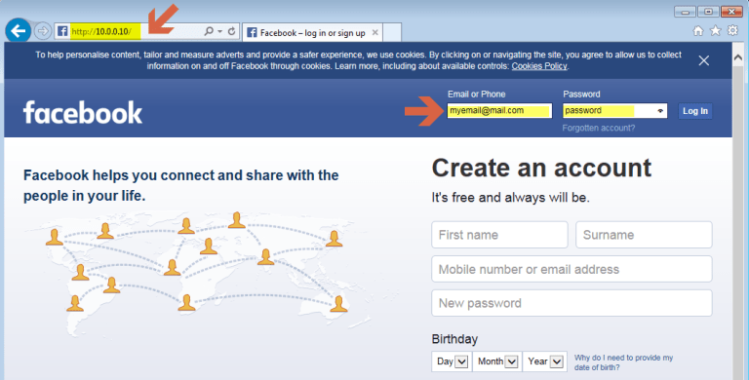
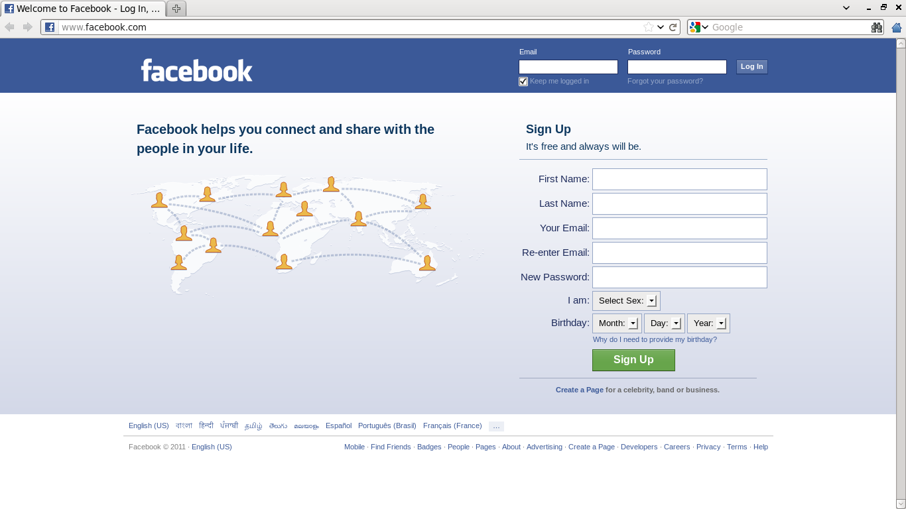
Example
Fake Facebook Page
Original Facebook Page

Slide 14
References
www.Google.com
www.Wikipedia.com
www.Studymafia.org
www.Geeksforgeeks.org

Slide 15
Thank You

