Slide 1
Hangout
一个logstash indexer的替代方案
刘佳@携程

Slide 2
1.为何开发hangout
2.与logsatsh性能对比
CON
TENTS
3.支持的input/filter/output
4.设计架构变迁
5. 参数调优
6.找到瓶颈
7. mesos+marathon+gitlba

Slide 3
Why
Hangout

Slide 4
慢

Slide 5
日志系统框架
Agent
(rsyslog
Logstash..)
kafka
Logstash
(filters)
ES

Slide 6
性能对比

Slide 7
Kafka
Grok
Date
ES

Slide 8
日志格式
03/May/2016:18:11:13 +0800] ws.com vms100001 10.0.0.100 POST /test.php?param=/apiversion=6 80 - 10.1.0.100 110.110.119.123 HTTP/1.1 "Mozilla/5.0 (Linux; Android 5.0.2; HTC M8t Build/LRX22G) AppleWebKit/537.36 (KHTML, like Gecko) Version/4.0 Chrome/37.0.0.0 Mobile Safari/537.36_eb64__Ctrip_CtripWireless_6.15.2" "-" "-" 200 1145 418 0.082 0.082 10.8.177.24:80 200 backend_441

Slide 9
Grok配置
^\[%{HTTPDATE:logtime}\] %{HOSTNAME:domain} %{IPORHOST:hostname} %{IP:serverAddr} %{WORD:requestMethod} %{DATA:requestUri} %{NUMBER:serverPort} (-|%{USER:remoteUser}) %{IP:remoteAddr} (-|(?<forwarded>[0-9.]+(, [0-9.]+)*)) %{NOTSPACE:serverProtocol} ("-"|%{QS:UA}) ("-"|%{QS:cookie}) ("-"|%{QS:referer}) %{NUMBER:statusCode} %{NUMBER:requestLength} %{NUMBER:bodyBytesSent} %{NUMBER:request_time} (-|%{NUMBER:upstream_responseTime})( : %{DATA})? (-|%{NOTSPACE:upstreamAddr})( : %{DATA})? (-|%{NUMBER:upstreamStatus})( : %{DATA})? %{DATA:proxy_host}$

Slide 10
Logstash VS Hangout
logstash
Filters: 32 threads(default)
时钟时间 22m
cpu时间 53:22.65
Hangout
Filters: 4 threads
时钟时间 8m
Cpu时间 12:30.06

Slide 11
Logstash VS Hangout
L VS H

Slide 12
Plugins

Slide 13
Input
Stdin / Kafka / NewKafka
Filter
Grok / Date / KV / Convert/ GeoIP2 / URLDecode / UA
Output
Stdout / Elasticseach / Kafka

Slide 14
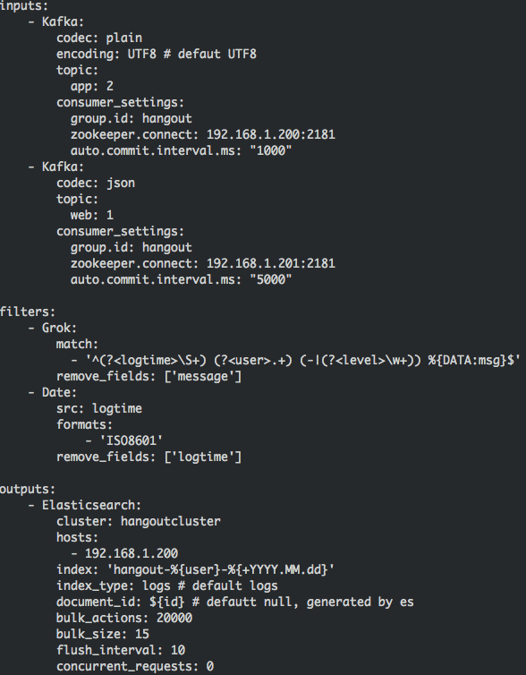
bin/hangout –f http://10.0.0.100/example.yml
https://github.com/childe/hangout/blob/master/example.yml

Slide 15
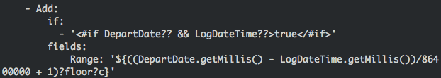
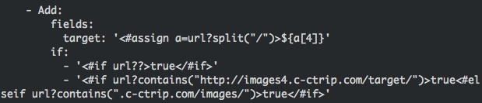

感谢freemarker!

Slide 16
架构变迁

Slide 17
标杆
kafka-elasticsearch-standalone-consumer
https://github.com/reachkrishnaraj/kafka-elasticsearch-standalone-consumer

Slide 18
V1
Kafka
partition1
partition2
Kafaf Input
consumer1
consumer2
Message Q 1
partition3
partition4
Grok Filters
thread1
thread2
thread3
thread4
Message Q 2
Date Filters
thread1
Message Q 3
......
Message Q N
ES Output

Slide 19
V2
Kafka
partition1
partition2
Kafaf Input
consumer1
consumer2
Message Q 1
partition3
partition4
All Filters
thread1(grok,date...)
thread2(grok,date...)
Message Q 2
ES Output

Slide 20
V3
Kafka
partition1
partition2
Kafa Input
Consumer 1
Consumer 2
partition3
partition4
ES Output
All Filters
Es Output
All Filters

Slide 21
对比测试

Slide 22
测试代码片断
for (int i = 0; i < this.messageCount; i++) { for (int j = 0; j < this.repeated; j++) { s = "172.17.0.2"; m = p.matcher(s); m.matches(); } }

Slide 23
NO-Q VS Q
# time java -cp test-java-queue-0.1.jar DirectWriter 1000000 4 20
real 0m2.511s
user 0m9.752s
sys 0m0.236s
# time java -cp test-java-queue-0.1.jar QueueWriter 1000000 4 20
real 0m2.948s
user 0m12.160s
sys 0m1.144s

Slide 24
Complex Filter
time java -cp test-java-queue-0.1.jar QueueWriter 1000000 4 1
real 0m1.309s user 0m2.920s sys 0m1.242s
time java -cp test-java-queue-0.1.jar QueueWriter 1000000 4 10
real 0m1.826s user 0m7.321s sys 0m1.006s
# time java -cp test-java-queue-0.1.jar QueueWriter 1000000 4 100
real 0m12.176s user 0m49.884s sys 0m1.633s

Slide 25
Extreme Compare
# time java -cp test-java-queue-0.1.jar DirectWriter 1000000 4 1
real 0m0.250s
user 0m0.821s
sys 0m0.074s
# time java -cp test-java-queue-0.1.jar QueueWriter 1000000 4 1
real 0m1.416s
user 0m3.057s
sys 0m1.332s

Slide 26
参数调优
Input thread
bulk_actions: 60000
bulk_size: 50
flush_interval: 120
concurrent_requests: 0
HO_HEAP_SIZE

Slide 27
找到瓶颈
2016-05-05 03:18:28,138 INFO XXX thread-1 executionId: 37759
2016-05-05 03:18:28,138 INFO XXX thread-1 numberOfActions: 60000
2016-05-05 03:18:38,326 INFO XXX thread-1 bulk done with executionId: 37759
2016-05-05 03:18:46,311 INFO XXX thread-1 executionId: 37760
2016-05-05 03:18:46,311 INFO XXX thread-1 numberOfActions: 60000
2016-05-05 03:18:52,409 INFO XXX thread-1 bulk done with executionId: 37760

Slide 28
mesos+marathon+gitlab
资源分配/隔离
增加/减少实例
环境和版本一致
配置放在远端服务器

Slide 29
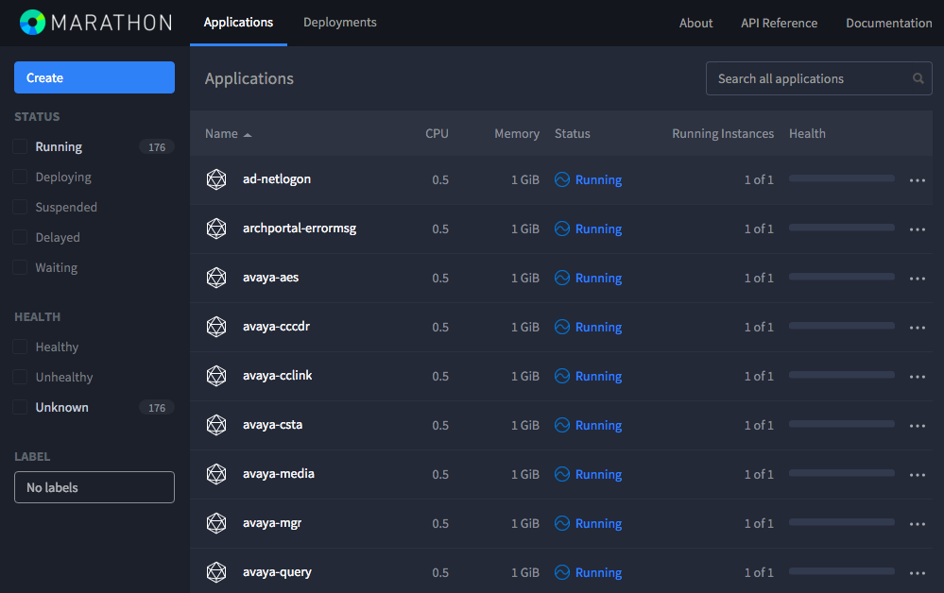

Slide 30
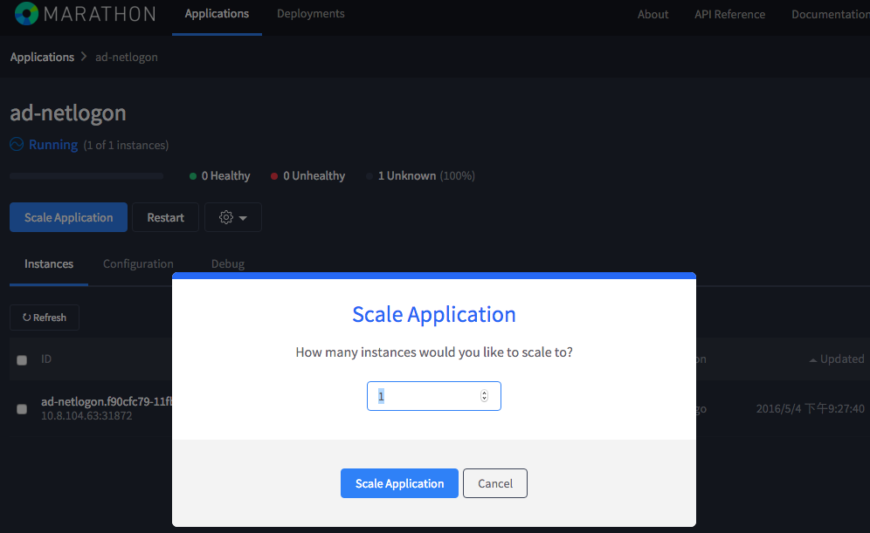

Slide 31
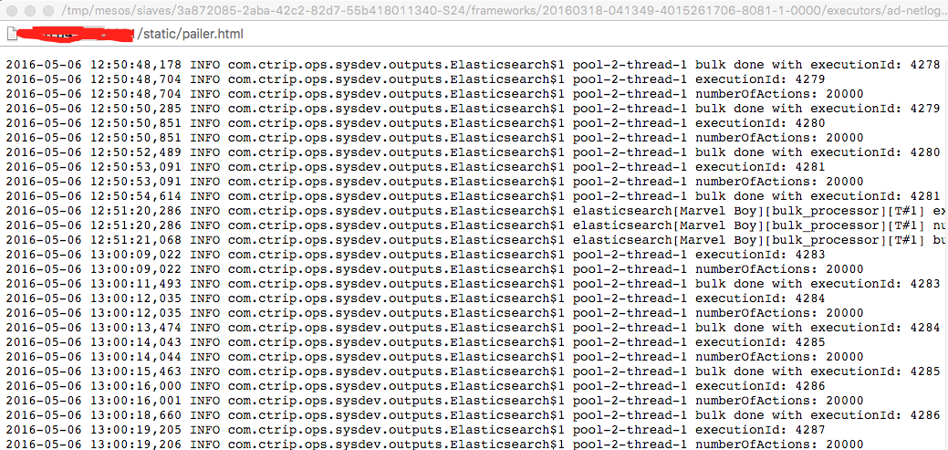

Slide 32
https://github.com/childe/hangout

Slide 33
Thanks!

