Slide 1


SentinelAI
Problem Statement Title - AI-Powered Behavioral Anomaly Detection for Cybersecurity
Developed By- Sujoy Sen
GitHub Repository: https://github.com/Kingjoy7/SentinelAI

Slide 2
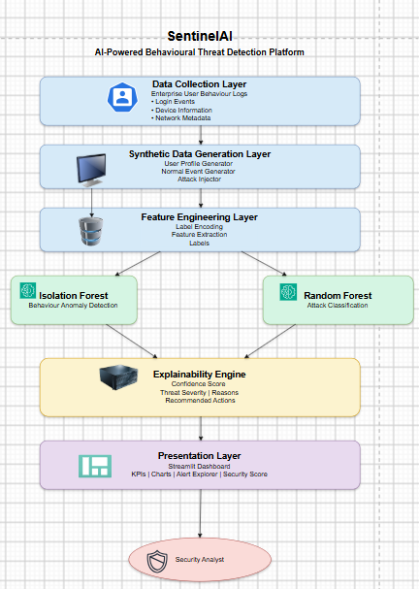
PROPOSED SOLUTION
Problem
🔴 Traditional systems generate high false-positive alerts
🔴 Massive enterprise logs
🔴 Manual monitoring is difficult
🔴 Rule-based systems miss unknown attacks
Our Solution
🟢 AI-powered behavioural analysis
🟢 Behaviour anomaly detection
🟢 Attack classification
🟢 Explainable AI
🟢 Interactive SOC Dashboard
Innovation
✔ Synthetic Enterprise Dataset
✔ Two-stage AI Detection Pipeline
✔ Explainable AI
✔ End-to-End Cybersecurity Workflow

Slide 3
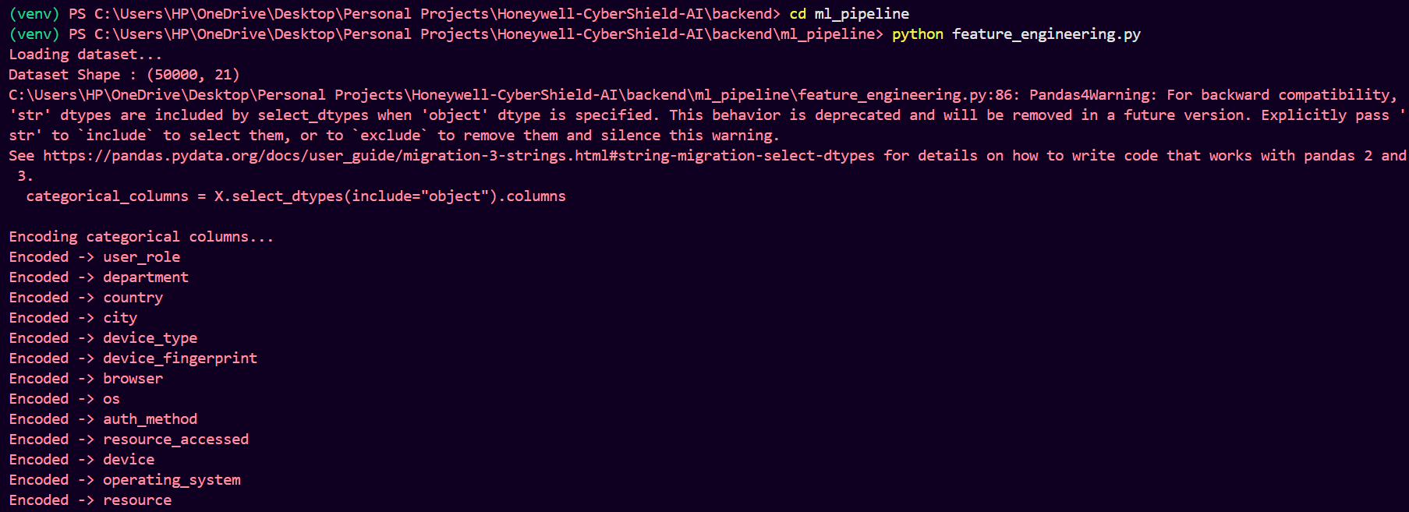
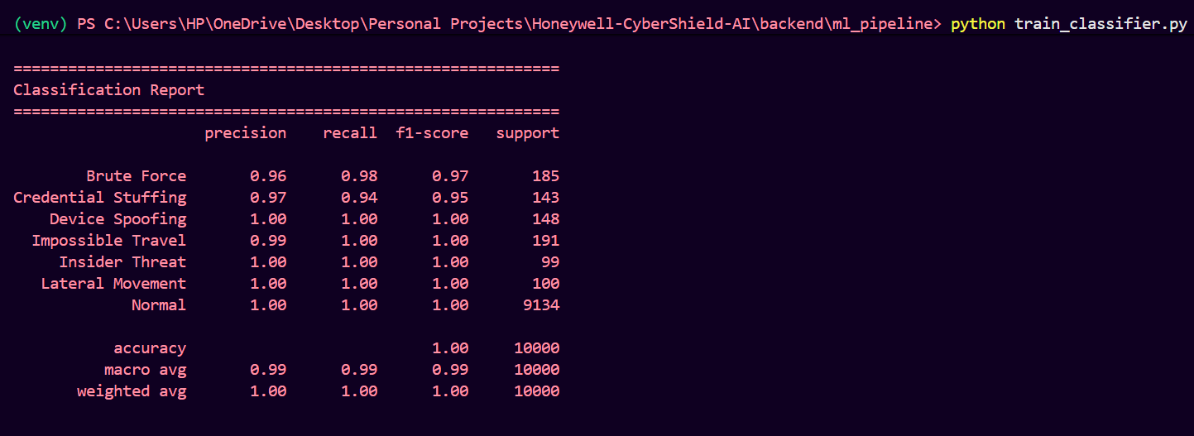
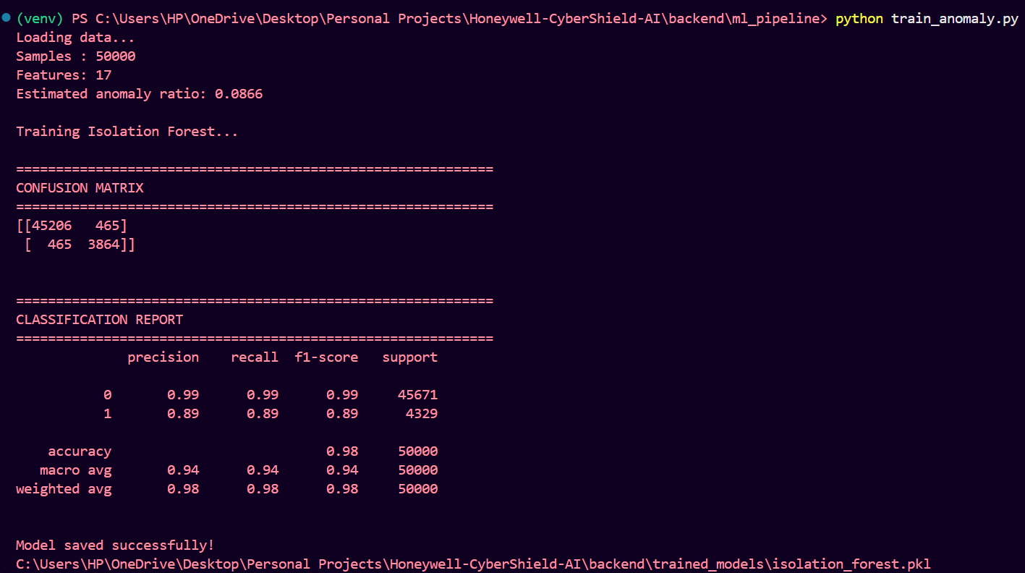
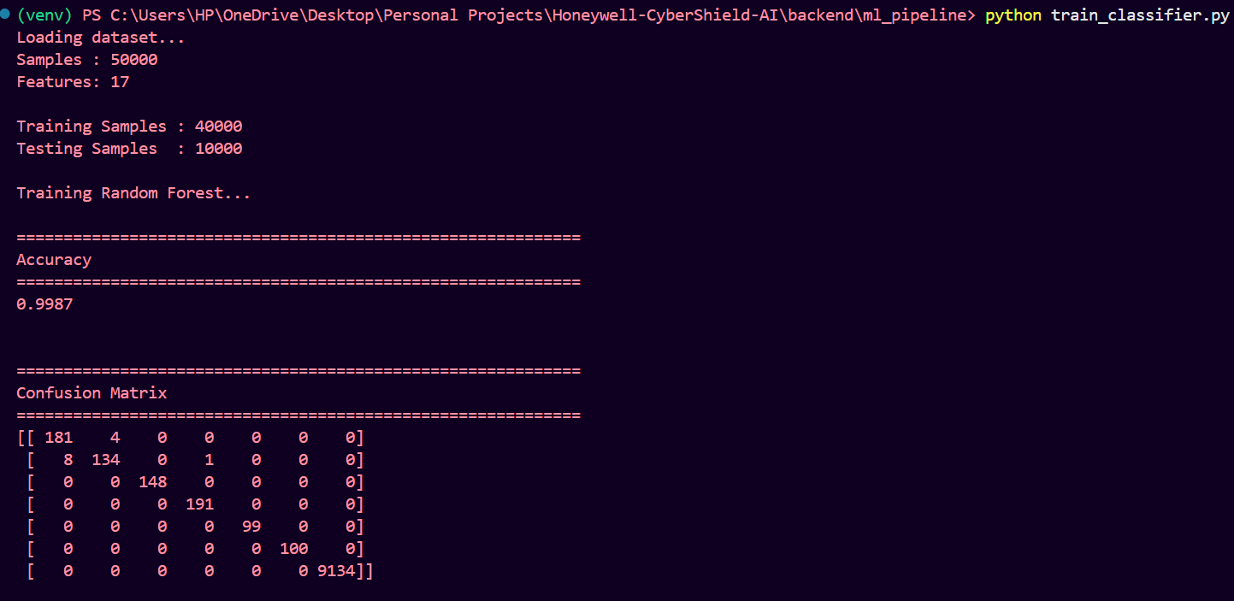
TECHNICAL APPROACH
User Profiles
│
▼
Behavior Simulation
│
▼
Synthetic Attack Injection
│
▼
Feature Engineering
│
▼
Isolation Forest
│
▼
Random Forest
│
▼
Explainability
│
▼
SOC Dashboard
Technologies
🐍 Python
📊 Pandas
🤖 Scikit-learn
📈 Plotly
🖥 Streamlit

Slide 4
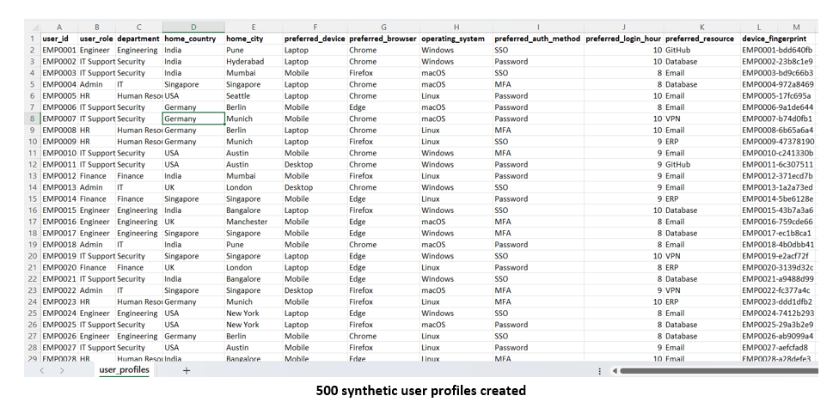
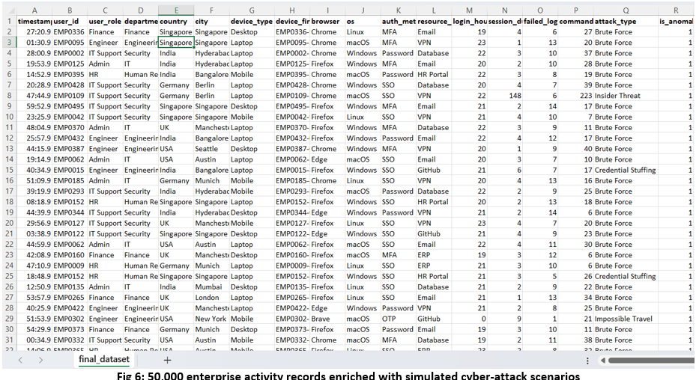
FEASIBILITY AND VIABILITY
Project Highlights
👤 500 Users
📊 50K Logs
⚔ 6 Attack Types
🤖 98% Detection
🎯 99.9% Classification
Challenges
• Lack of real enterprise data
• Behaviour diversity
• Explainability
Solution
• Synthetic Dataset
• AI Models
• Explainability Engine

Slide 5
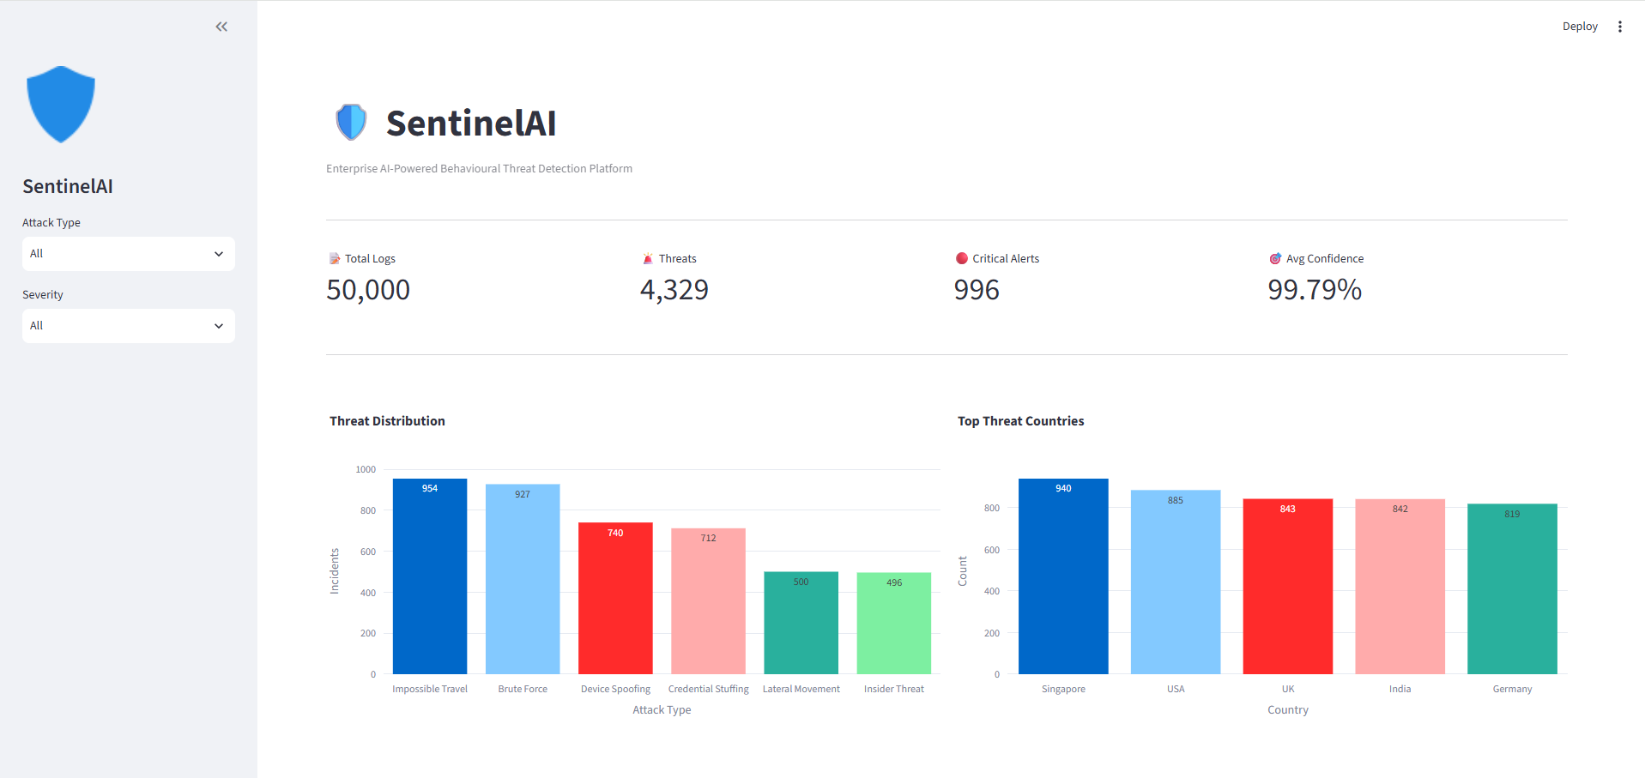
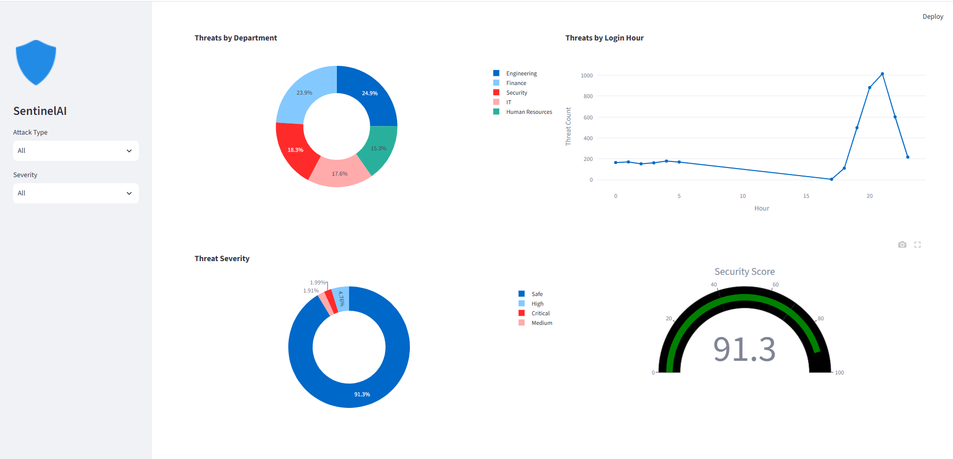
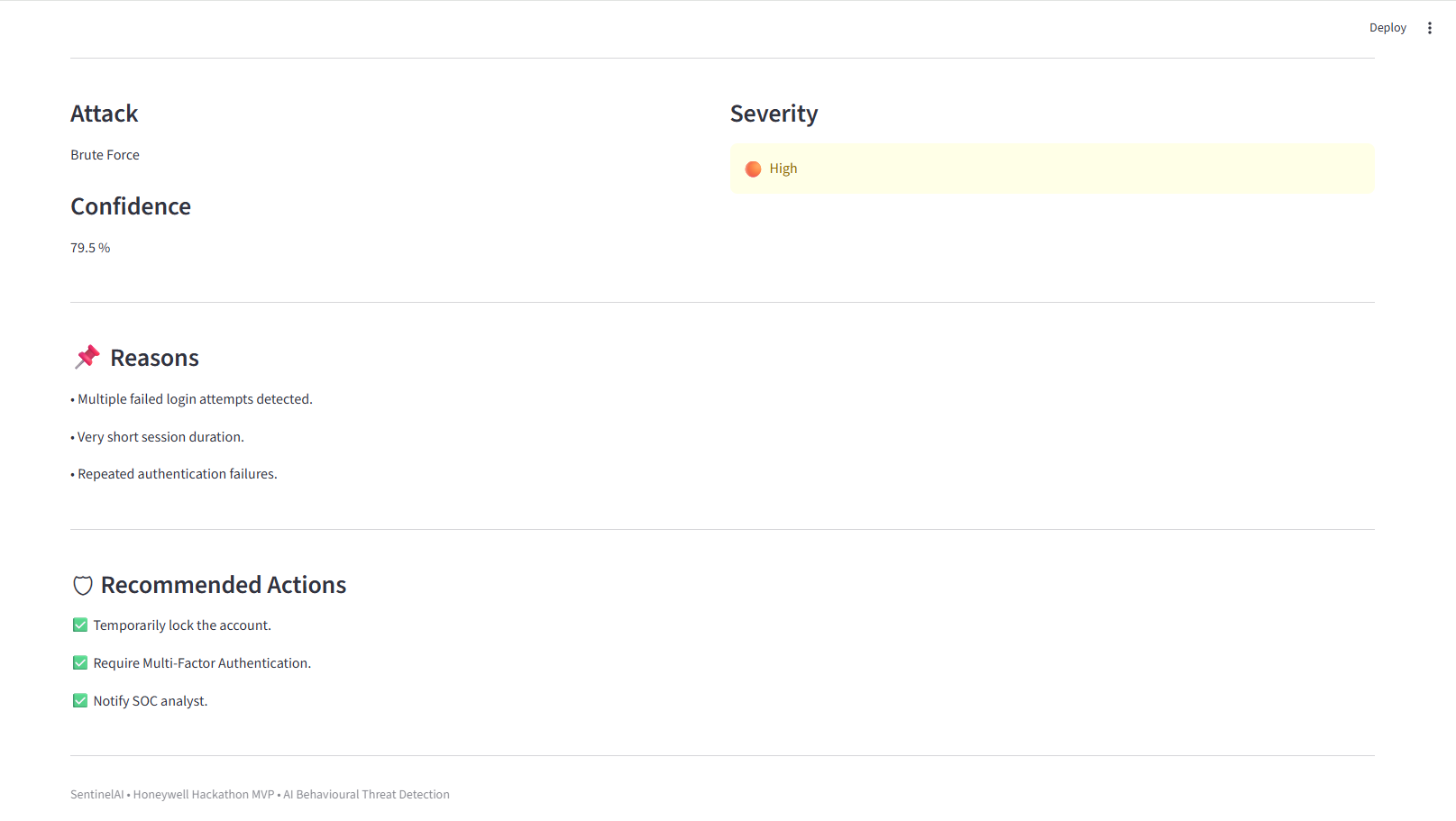
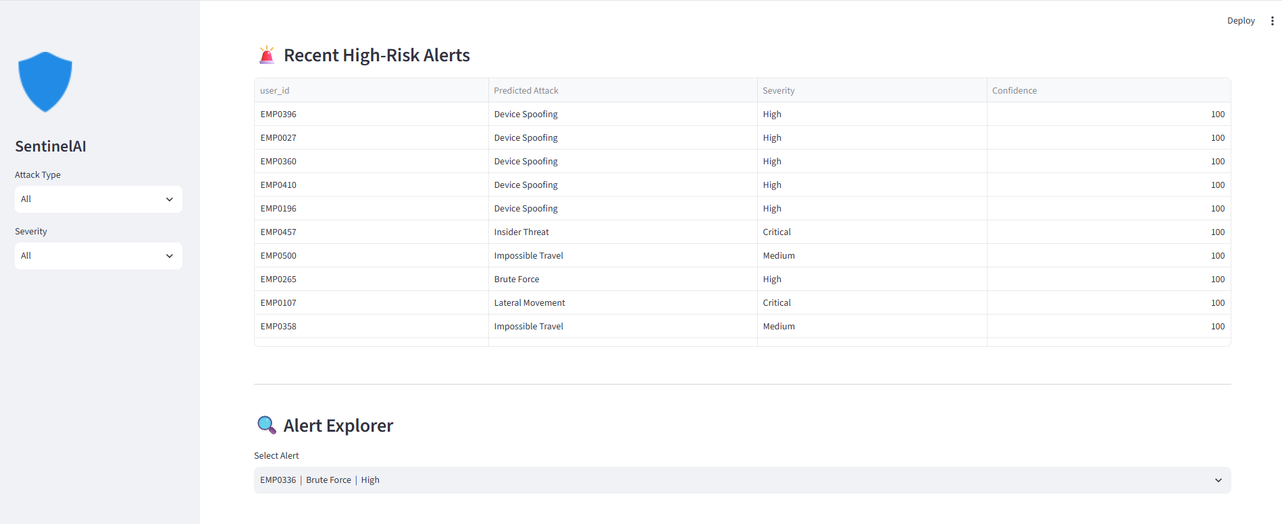
ARTIFACTS
Dashboard Overview
Threat Analytics
Alert Explorer
AI Explanations

Slide 6
RESEARCH AND REFERENCES
📚Research Sources
MITRE ATT&CK Framework
NIST Cybersecurity Framework
OWASP Security Guidelines
Scikit-learn Documentation
Streamlit Documentation
Plotly Documentation
🚀Future Scope
Real-time enterprise log ingestion.
Integration with SIEM platforms.
Deep learning-based behavioral analytics.
Cloud-native deployment.
Role based authentication and access control.

