Slide 1
Problem Statement & Team Details
Problem Statement:
Traditional street lighting systems operate continuously, leading to unnecessary energy consumption. The goal is to develop an automatic street light system that activates only when needed, reducing energy wastage and improving efficiency.
Team Members:
- Ishika Raj
- Ishaan Sinha
- Sujoy Sen

Slide 2
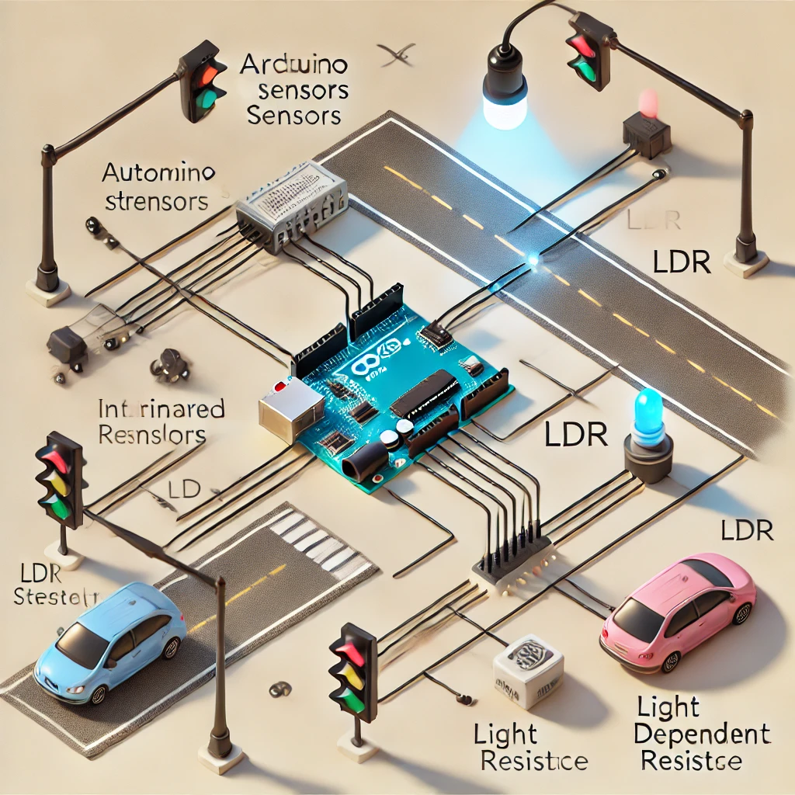
Abstract & System Diagram
In urban areas, street lights remain on even when not required, leading to energy wastage.
This project utilizes IR sensors, LDR sensors, and Arduino to create a smart street light
system that activates when a vehicle or pedestrian is detected.
The system ensures energy efficiency, cost reduction, and improved safety.

Slide 3
Sensors Used in Automatic Street Light System
1️⃣ Infrared (IR) Sensor
- Detects vehicles and pedestrians using infrared radiation.
- Works by emitting and receiving infrared signals.
- Used to trigger the street lights when motion is detected.
2️⃣ Light Dependent Resistor (LDR) Sensor
- Measures ambient light intensity.
- Turns street lights ON when it's dark and OFF during daylight.
- Helps in automatic brightness control to save energy.
3️⃣ Ultrasonic Sensor
- Detects moving objects by sending and receiving ultrasonic waves.
- Can be used as an alternative to IR sensors for vehicle detection.
- Works well in various weather conditions.

