Slide 1
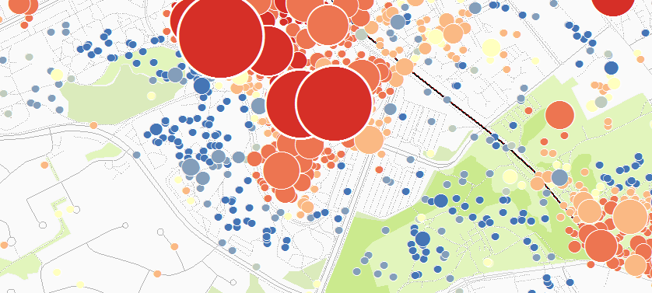
Workshop part 2: photo density
Hot Spot Analysis for visualizing spatial distribution of photos
Mapping and Symbolization

Slide 2
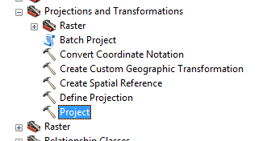
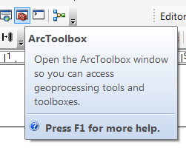
Project results
Open ArcGIS (BasemapLayout.mxd)
Open ArcToolbox (1)
Go to Data Management Tools/ Projections/ Project (2)
Project both output files to a suitable Projected Coordinate System

Slide 3
Project Photo Clusters
Open ArcGIS (BasemapLayout.mxd)
Open ArcToolbox (1)
Go to Data Management Tools/ Projections/ Project (2)
Project photo clusters (allPhotoClusters.shp) to a suitable Projected Coordinate System

Slide 4
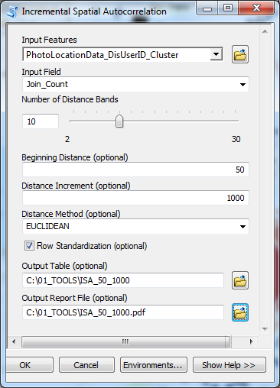
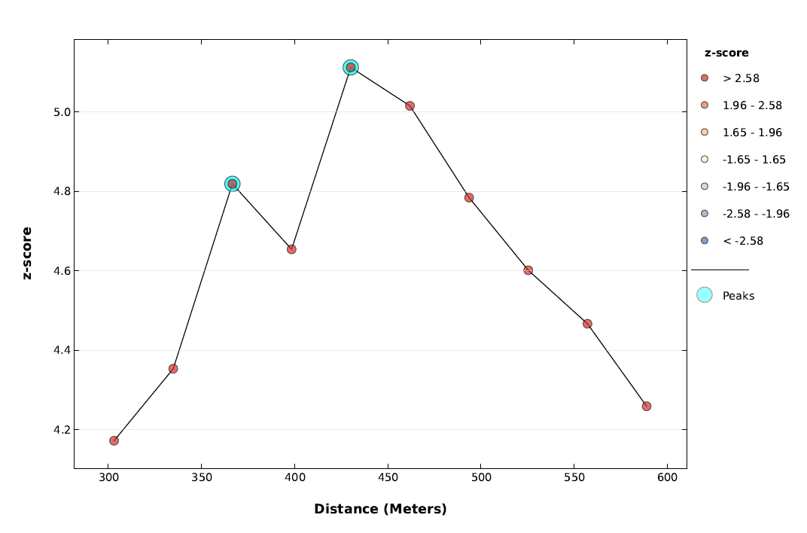
Spatial Autocorrelation
Optionally, to detect the Distance where Clustering is most pronounced: run Incremental Spatial Autocorrelation
(Spatial Statistic Tools > Analyzing Patterns)
The First Spike is usually indicating the distance where clustering is most pronounced (Example: at about 370 m)
Use this value for Hot Spot Analysis Distance Band Threshold

Slide 5
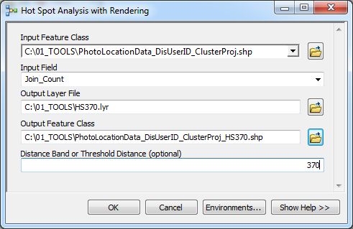
Getis-Ord Gi*
Run Hot Spot Analysis with Rendering for visualizing characteristic photo distribution patterns:
Hot Spot Analysis uses the Getis-Ord GI-Star Statistic > evaluates number of photos at each location by comparing the local mean to the global mean and then determining, whether the difference is statistically significant
open Tool Hot Spot Analysis with Rendering (Spatial Statistic Tools > Rendering)
Input Field = Join_Count (Number of users per cluster)
Enter Distance from previous Step (Example: 370 m) as Threshold Distance OR: choose Threshold Distance based on desired precision of information (Scale/Paper Size)

Slide 6
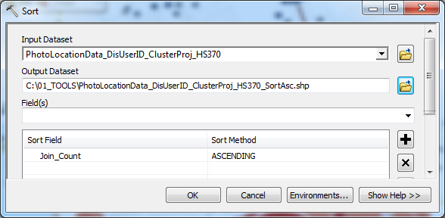
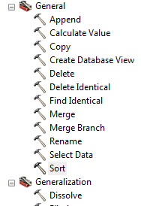
Sort Cluster File
To prevent small Cluster Points from overlapping large Cluster Points, sort Cluster-File:
Use Tool Sort (Data Management Tools > General > Sort)
Sort ASCENDING based on Field [Join_Count]

Slide 7
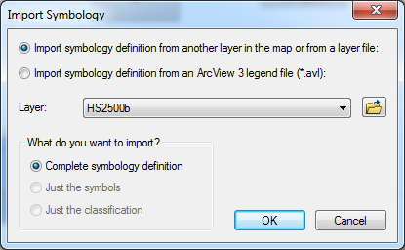


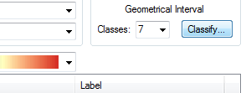
Symbolize Layer
Layer properties > Symbology > Import..
Import Layer Symbol Definition from existing Layer in BasemapLayout.mxd: “HS2500b”
Choose GIScore –Field in next Window & Click ok
Click Classify & Recalculate based on Geometric Interval or Natural Breaks Algorithm

Slide 8
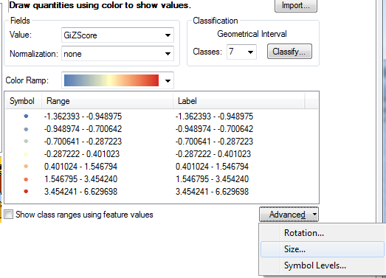
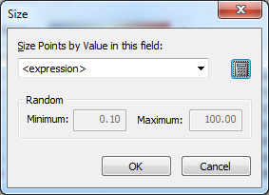
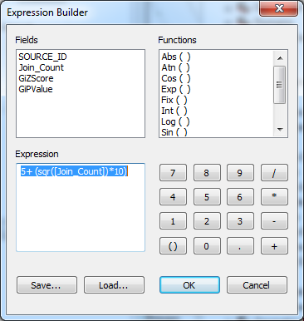
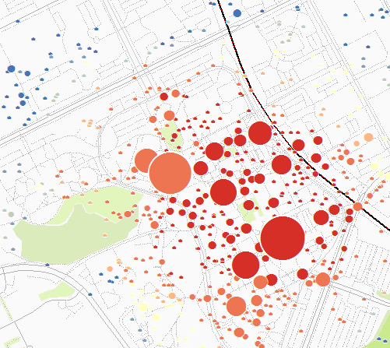
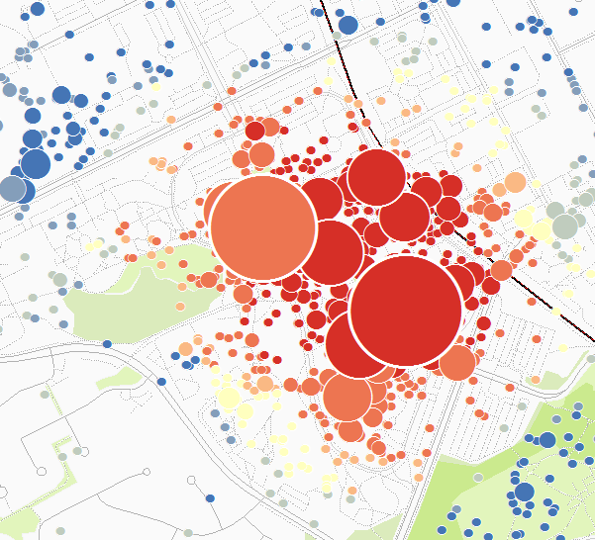
Point Size Formula
Layer properties > Symbology > Advanced > Size
Click on Calculator (Expression Builder): Formula: 5+ (sqr([Join_Count])*10)
5+ > Set Size of Smallest Points
Sqr() > Optional Point Size Curve flattening (reduce difference between largest and smallest points)
* 10 > Set Size of Largest Points

Slide 9
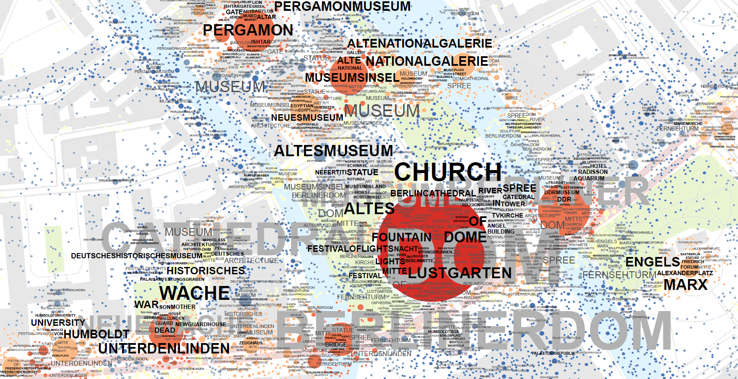
Final Map Display

