Slide 1
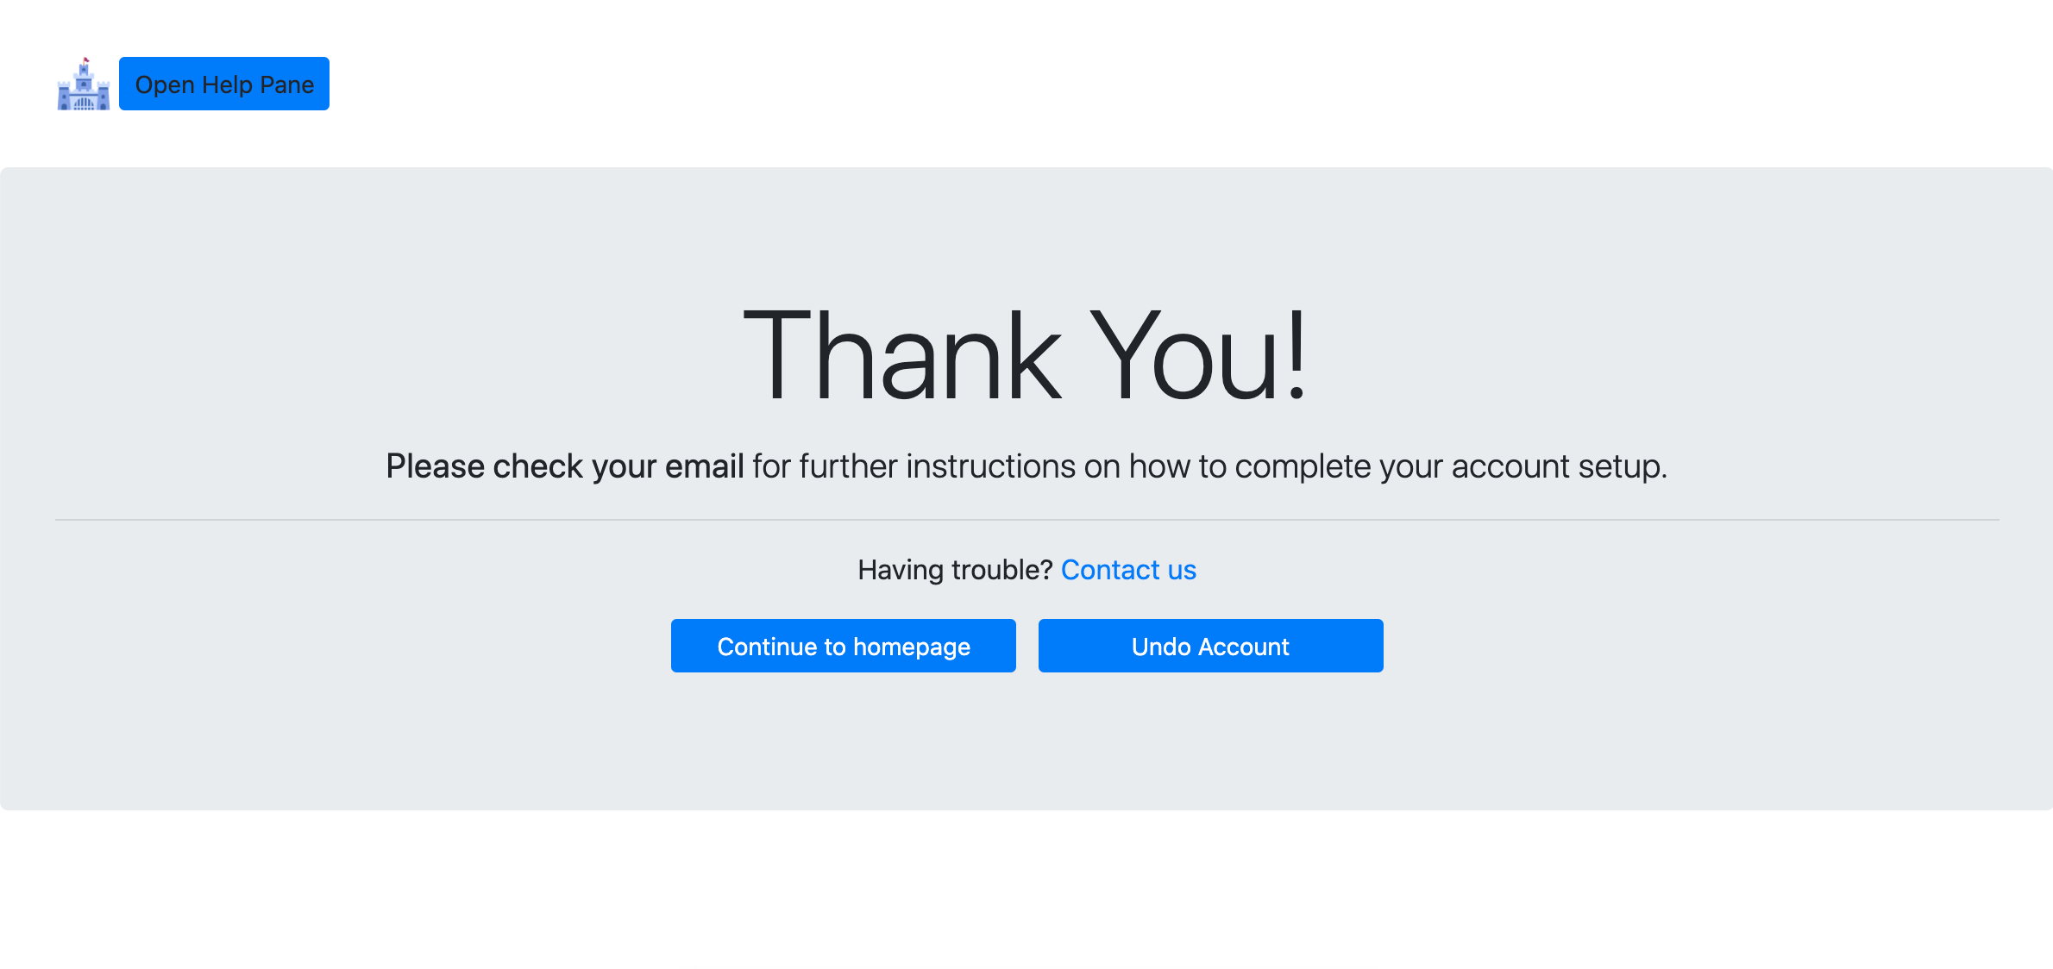
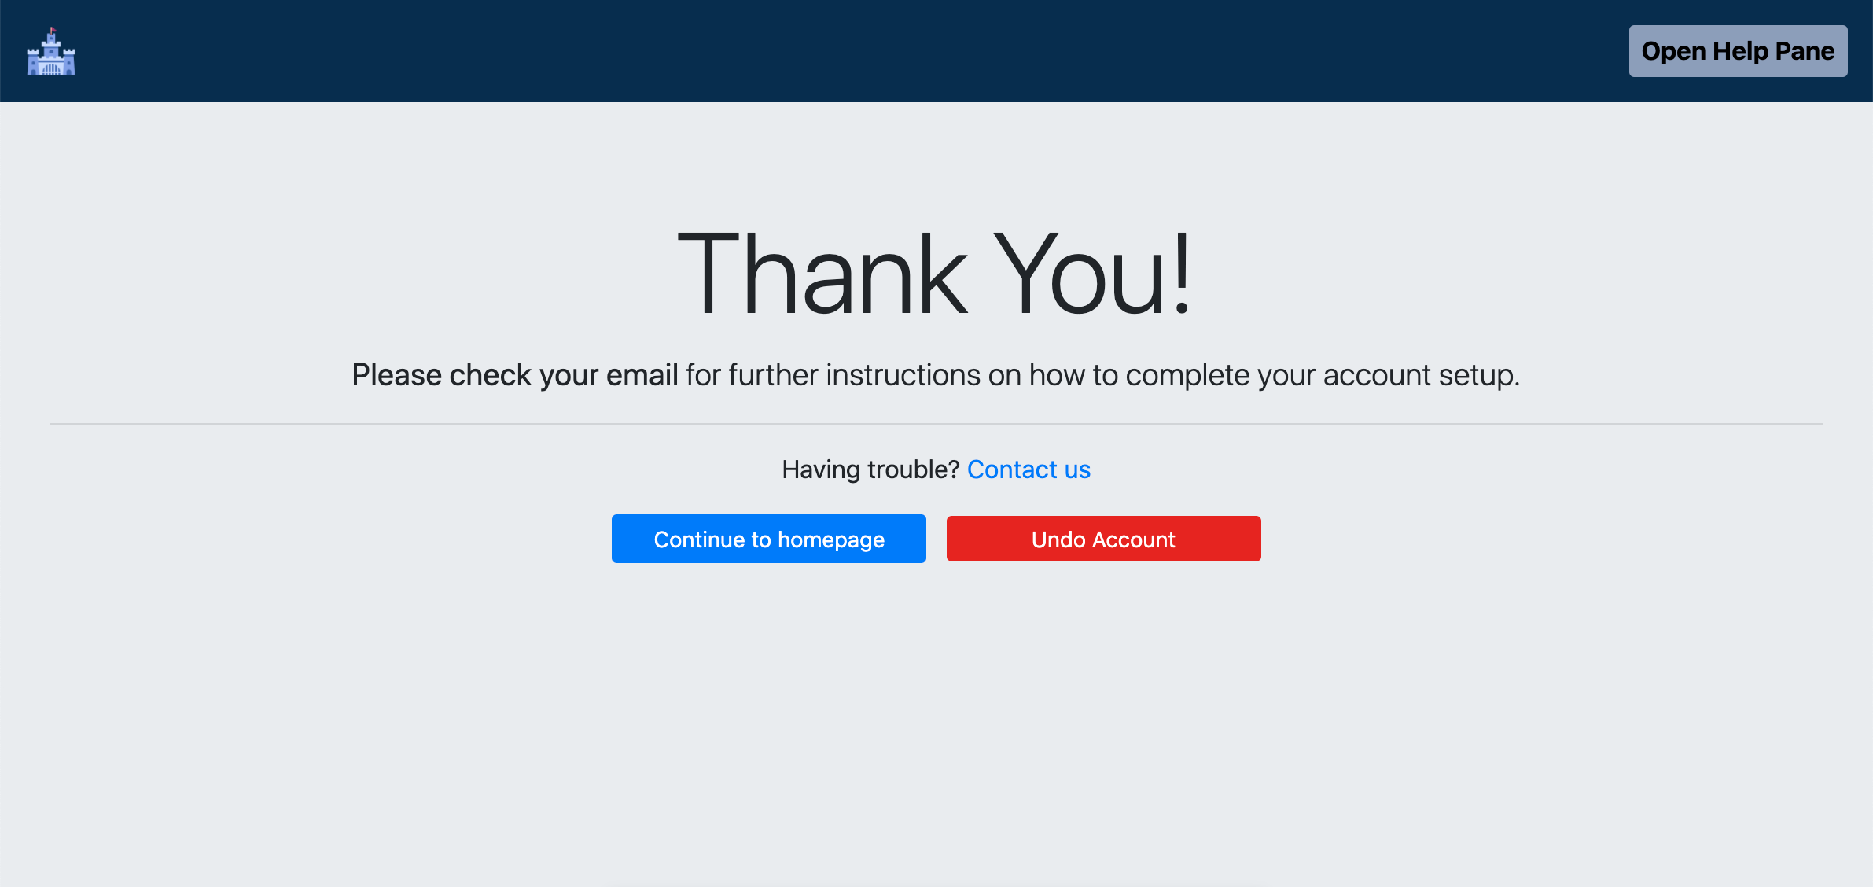
Desktop: Old version
New version

Slide 2
Desktop
Colour of this top bar: #0A2D50. Padding: 1rem
Put the “help pane” button on this side. Colour of button: #8D9EBC Text: black, bold, 1rem.
Color of “undo” button: #E2231A
Make the whole page background the same grey, instead of having the white.

Slide 3
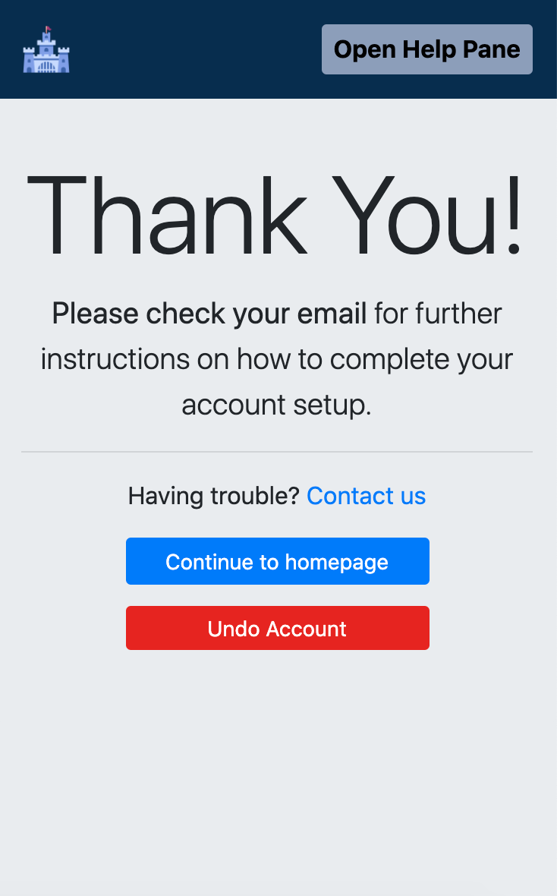
Mobile
Note for Product Managers (devs, do not implement): The contact form this link takes us to is really annoying for the user on mobile. Could we look into making it so that if they’re on mobile, this link makes them send us an email instead?
Space between these buttons: 0.75rem

