Slide 1

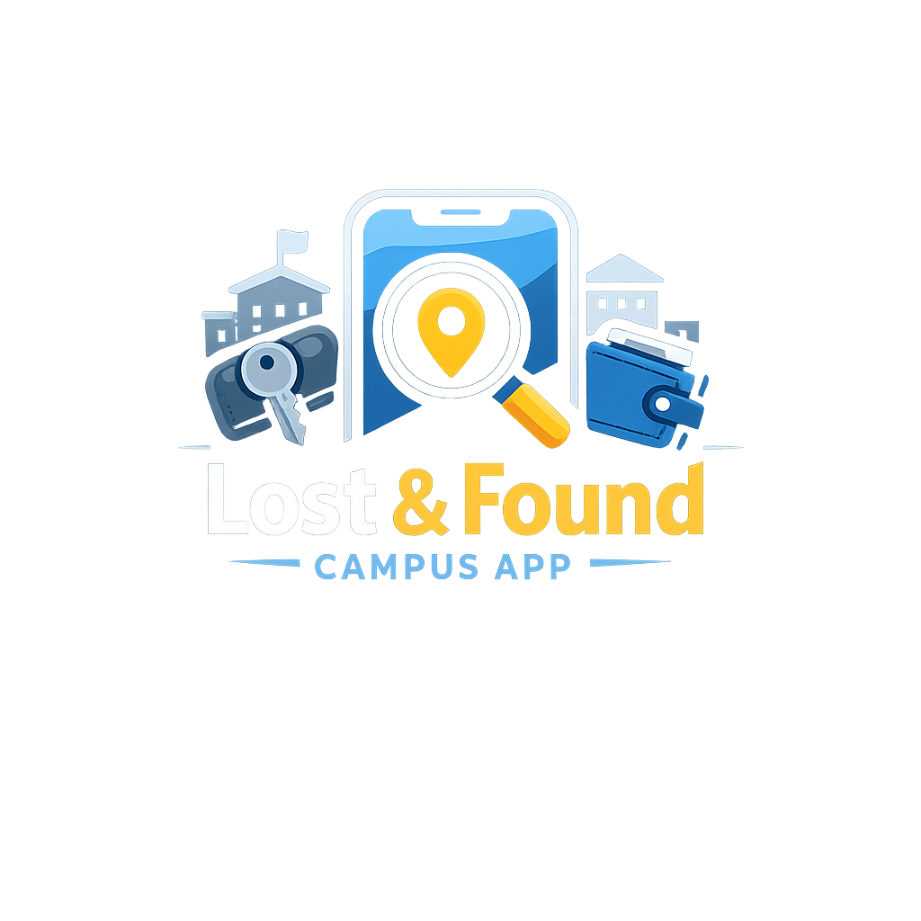
Lost & Found
Campus Cloud System
Khasanov Sayfillo | Cloud Design & Implementation

Slide 2
What is this app?
Lost & Found Campus App is a mobile application that helps students upload, search,
and recover lost items on campus.
📷
🔍
💬
Upload Items
Search Items
Contact Owner

Slide 3
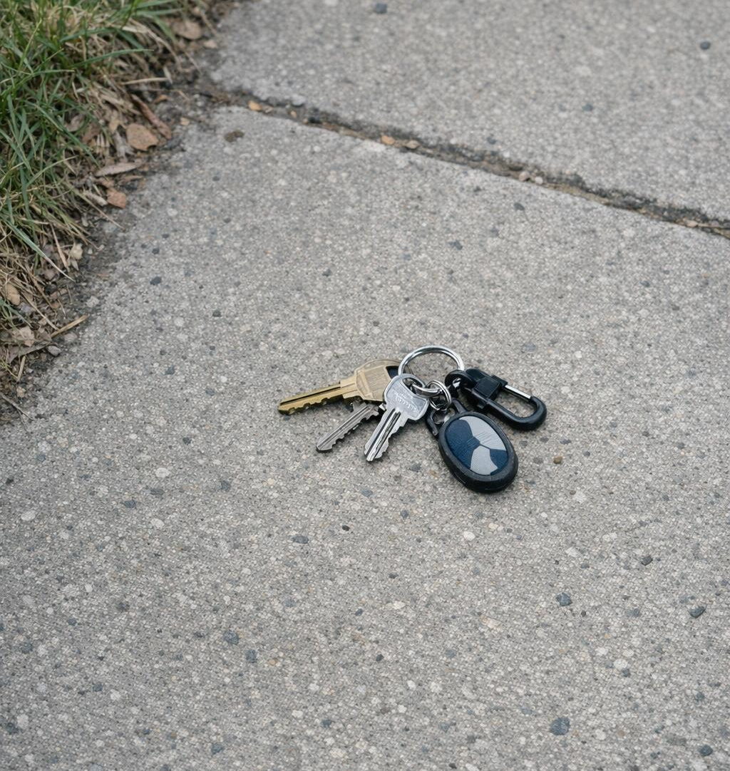


Problem
Students often lose personal belongings
Difficult to find item owners
Social media/group chats are inefficient
No centralized campus system

Slide 4
Solution
This app provides a simple mobile platform where students can report lost items and contact owners easily.
📷
🔍
Upload Lost Items
Browse Found Items
📂
💬
Browse Categories
Contact Owner

Slide 5
Main Features
📷
Upload Item
🔍
Search System
Users can upload lost/found items with images.
Users can search items quickly.
📂
Categories
💬
Contact Owner
Items are organized by category.
Users can communicate with the uploader.

Slide 6
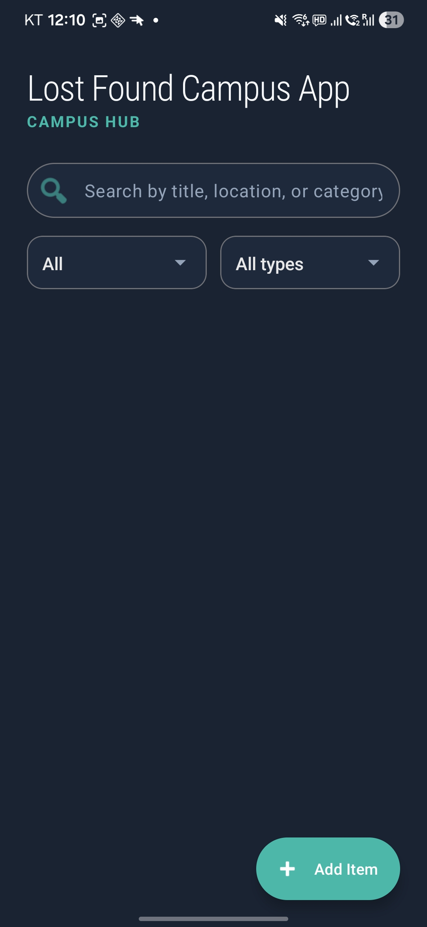
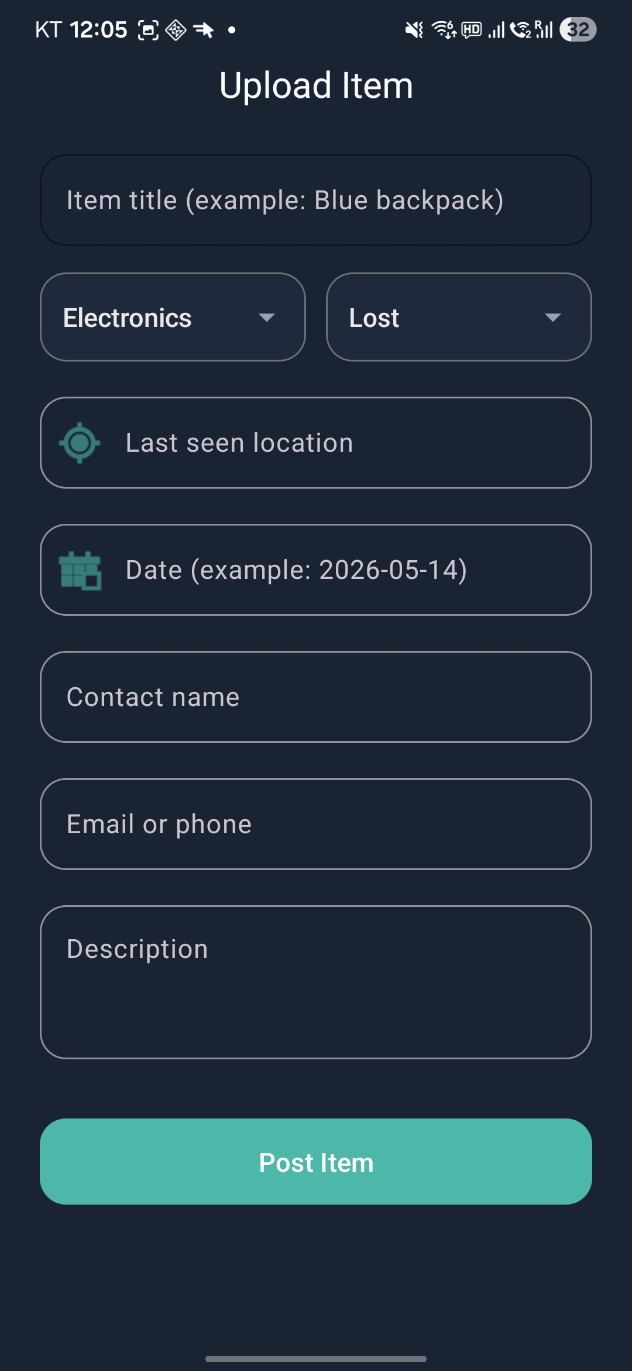
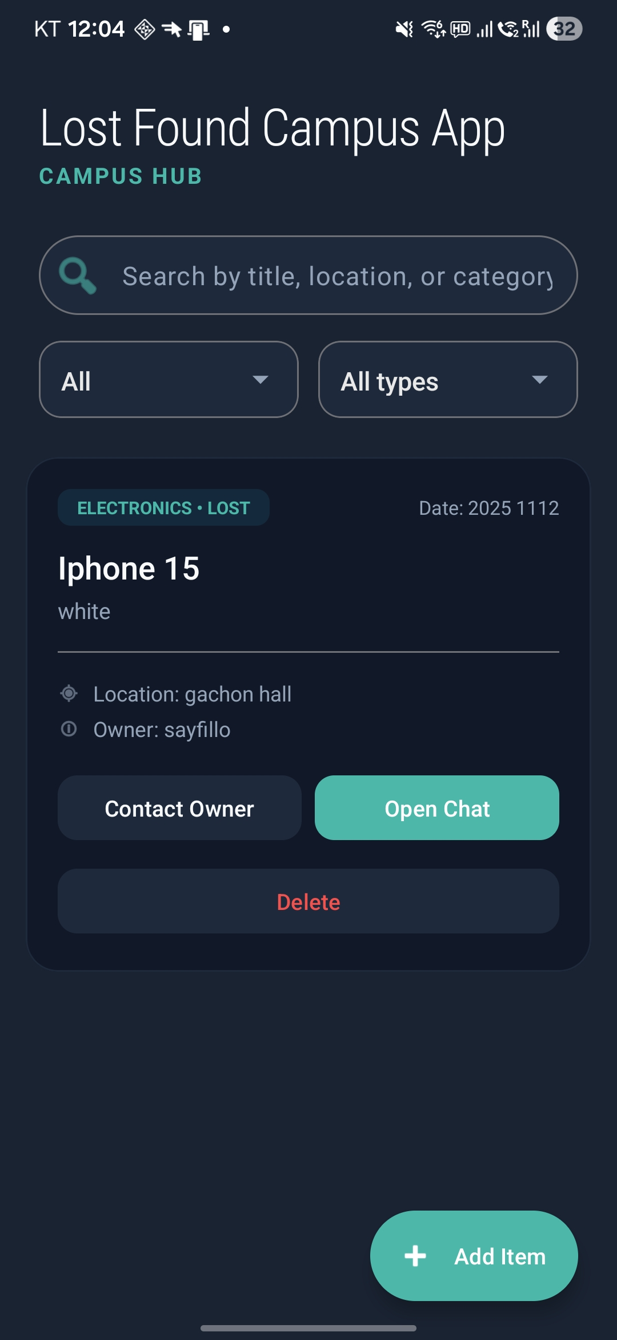
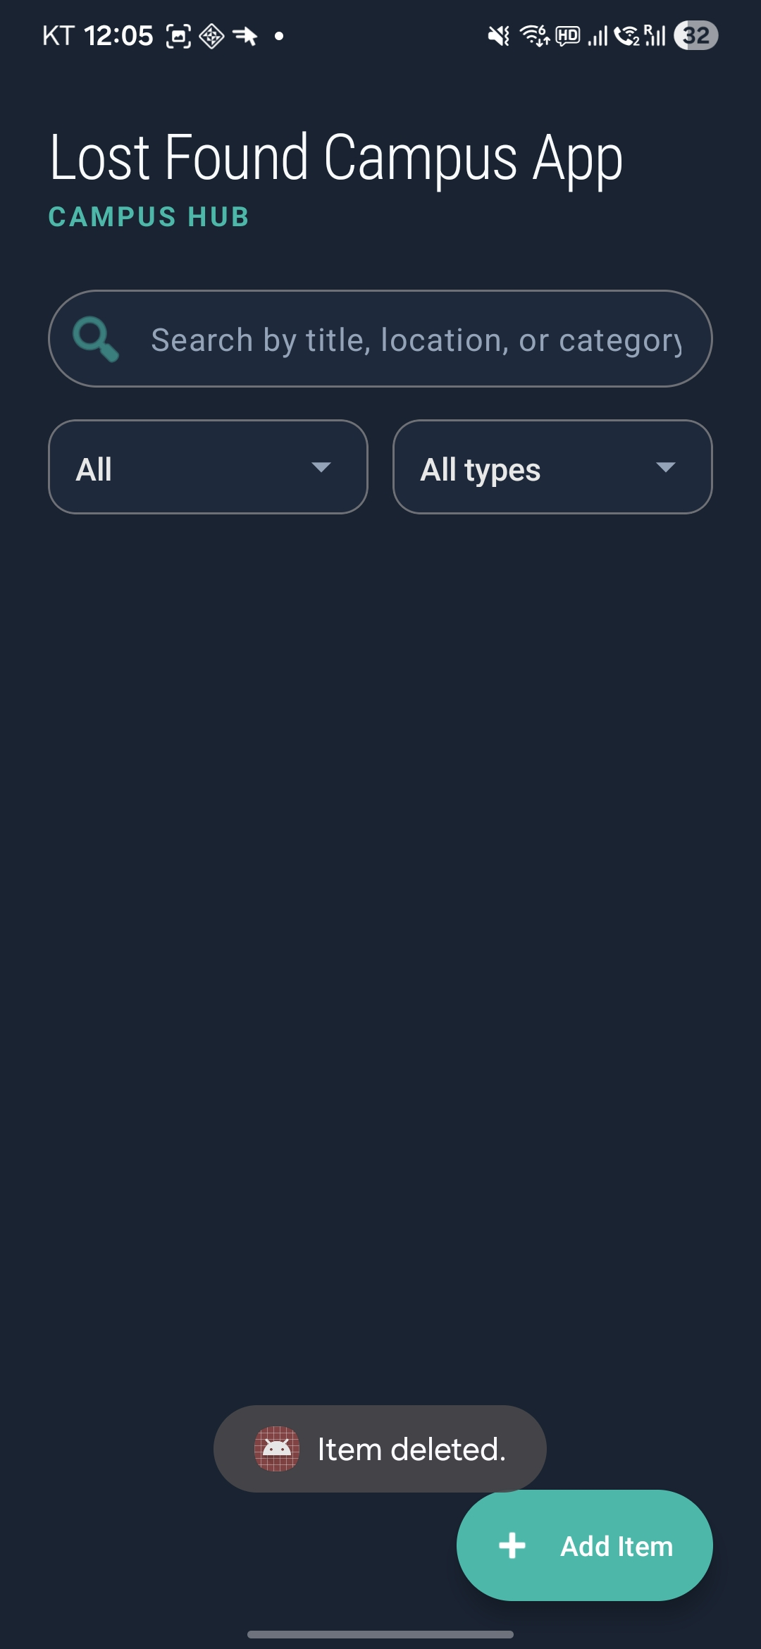
App Screens
Home screen
Upload screen
Items list screen

Slide 7
Cloud Architecture & Data Flow
1
2
3
4
5
👤
📷
💾
📋
💬
User
Upload/Search Item
Cloud Firestore
View Item Details
Contact Owner
User opens the app → uploads or searches for an item → the database stores and retrieves data → user views details → contacts the owner

Slide 8

Live Demo
WITH
Open application
Upload lost item
Browse item list
View item details
Contact owner

Slide 9
Cloud Technologies & Stack
📱
Android Studio
{ }
Kotlin / Java
🔥
Firebase
Development IDE
Programming Languages
Backend & Database
</>
XML Layout
📋
RecyclerView
📷
Image Upload
UI Design
List Component
Media Handling

Slide 10
Future Improvements
Push notifications
Real-time chat
GPS integration
AI image recognition
Student authentication

Slide 11
Conclusion
Conclusion
Delivered a resilient multi-tier cloud platform with native Android APK and Web SPA.
Delivered a resilient multi-tier cloud platform with native Android APK and Web SPA.

