Slide 1



Department of Electronics and Communication Engineering
Team Vibhav
Project Name DTMF
Total Cost of the Project:

Slide 2
About the Project
***Image of hardware assembled***
DTMF based Home Automation System and Automatic Door Locking System
Types of communication- wired and wireless
Controlling home appliances wirelessly through DTMF tones
Lets us operate home appliances like lights, doors and other electrical appliances from anywhere
This system is secure, energy efficient and convenient

Slide 3

Problem the Project Solves
It allows user to control home appliances from anywhere. It is designed to be more user-friendly and quicker than other rotary dial systems. Also it is more cost and energy efficient.
How is it better than other wireless communication techniques?
Gives a quick response
Affordable
High reliability and fast efficient
Multiple appliances can be controlled using a single key
We can control home appliances wirelessly
Lower power consumption and increased power efficiency

Slide 4

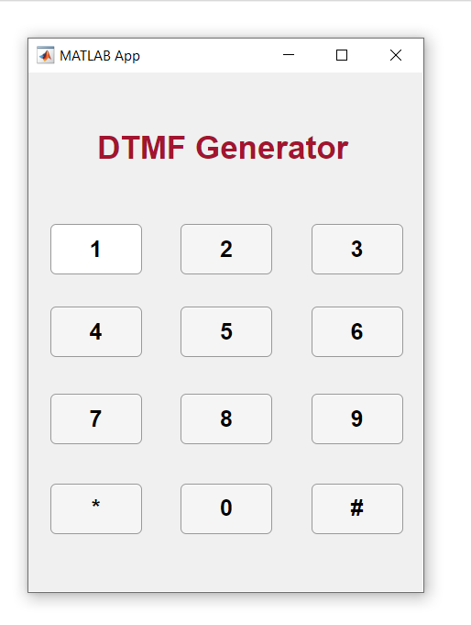
What is DTMF?
DTMF stands for Dual Tone Multi-Frequency
It is a 4*4 matrix where row represents low frequency while column represents high frequency
Composed of two sine waves
In-band telecommunications signals sent over voice frequencies
Commonly used for telecommunication signaling
Applications
Line Switching
Home Automation
Robot Controlling
Military

Slide 5

Execution
Application
At the last stage, different applications of home automation and automatic door locking system are displayed.
Designing Encoder
A DTMF Encoder in form of a keypad UI is made on Matlab which converts input from the key into its respective DTMF tone frequency.
04
01
03
DTMF Decoder
DTMF decoder detects the key pressed by decoding the sine wave frequencies respective to the particular key.
Microcontroller
Arduino is used for programming. Here code is written to assign different tasks to different DTMF keys.
02

Slide 6

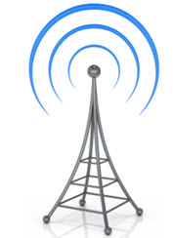
Techstack
MATLAB
MATLAB is a proprietary multi-paradigm programming language and numeric computing environment developed by MathWorks. MATLAB allows matrix manipulations, plotting of functions and data, implementation of algorithms, creation of user interfaces, and interfacing with programs written in other language.
Wireless communication is the transfer of information between two or more points that do not use an electrical conductor as a medium by which to perform the transfer. The most common wireless technologies use radio waves.
Wireless Communication

Slide 7
Novelty of the solution
It is a robust and easy to use system
No need of extra training
No special software requirement
Accessibility is not a limitation
Maximises home security
Multiple devices can be controlled via single input

Slide 8
Social Application

Slide 9
Business Aspects
Cost Efficiency
Since we use low cost IC and microcontroller overall cost of making DTMF home automation is less and there is no cost of softwares used
User Friendly
It is easy to use. There is no special software requirement. Home automation through DTMF could be operated at any location.
Security
DTMF technology uses special encoders and decoders for its applications which makes it safe to use. Decryption of DTMF cannot be done easily.

Slide 10
Thank you!

