Slide 1
The Memory Hierarchy Introduction to Computer Systems 12th Lecture, Oct. 28, 2021
Instructors:
Class 1: Chen Xiangqun, Sun Guangyu, Liu Xianhua
Class 2: Guan Xuetao
Class 3: Lu Junlin

Slide 2
Today
The memory abstraction
RAM : main memory building block
Storage technologies and trends
Locality of reference
Caching in the memory hierarchy

Slide 3
Traditional Bus Structure Connecting CPU and Memory
A bus is a collection of parallel wires that carry address, data, and control signals.
Buses are typically shared by multiple devices.
CPU chip
Register file
ALU
System bus
Memory bus
Main
memory
Bus interface
I/O
bridge

Slide 4
Memory Read Transaction (1)
CPU places address A on the memory bus.
Register file
Load operation: movq A, %rax
ALU
%rax
Main memory
I/O bridge
A
0
Bus interface
x
A

Slide 5
Memory Read Transaction (2)
Main memory reads A from the memory bus, retrieves word x, and places it on the bus.
Register file
Load operation: movq A, %rax
ALU
%rax
Main memory
I/O bridge
x
0
Bus interface
x
A

Slide 6
Memory Read Transaction (3)
CPU read word x from the bus and copies it into register %rax.
Register file
Load operation: movq A, %rax
ALU
%rax
x
Main memory
I/O bridge
0
Bus interface
x
A

Slide 7
Memory Write Transaction (1)
CPU places address A on bus. Main memory reads it and waits for the corresponding data word to arrive.
Register file
Store operation: movq %rax, A
ALU
%rax
y
Main memory
I/O bridge
A
0
Bus interface
A

Slide 8
Memory Write Transaction (2)
CPU places data word y on the bus.
Register file
Store operation: movq %rax, A
ALU
%rax
y
Main memory
I/O bridge
0
y
Bus interface
A

Slide 9
Memory Write Transaction (3)
Main memory reads data word y from the bus and stores it at address A.
Register file
Store operation: movq %rax, A
ALU
%rax
y
main memory
I/O bridge
0
Bus interface
y
A

Slide 10
Today
The memory abstraction
RAM : main memory building block
Storage technologies and trends
Locality of reference
Caching in the memory hierarchy

Slide 11
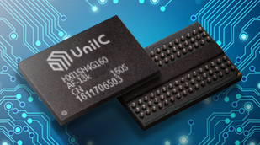
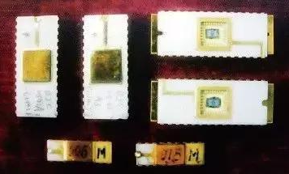
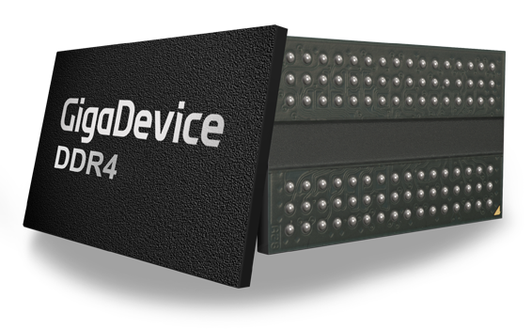
Random-Access Memory (RAM)
Key features
RAM is traditionally packaged as a chip.
Basic storage unit is normally a cell (one bit per cell).
Multiple RAM chips form a memory.
RAM comes in two varieties:
SRAM (Static RAM)
DRAM (Dynamic RAM)

Slide 12
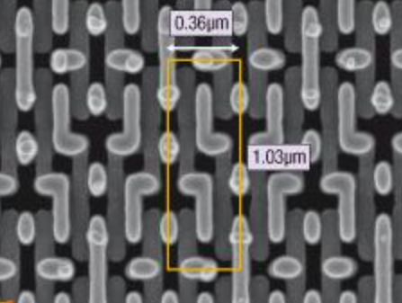
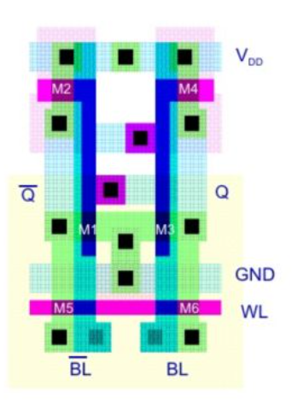
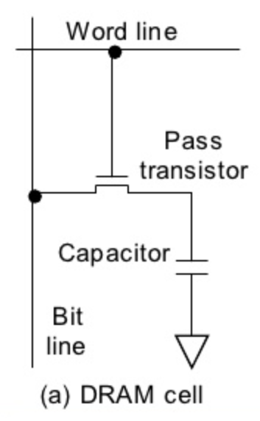
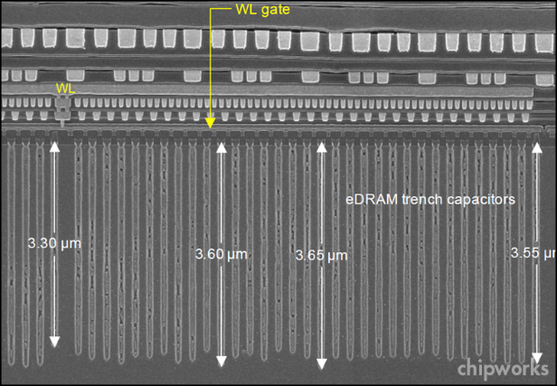
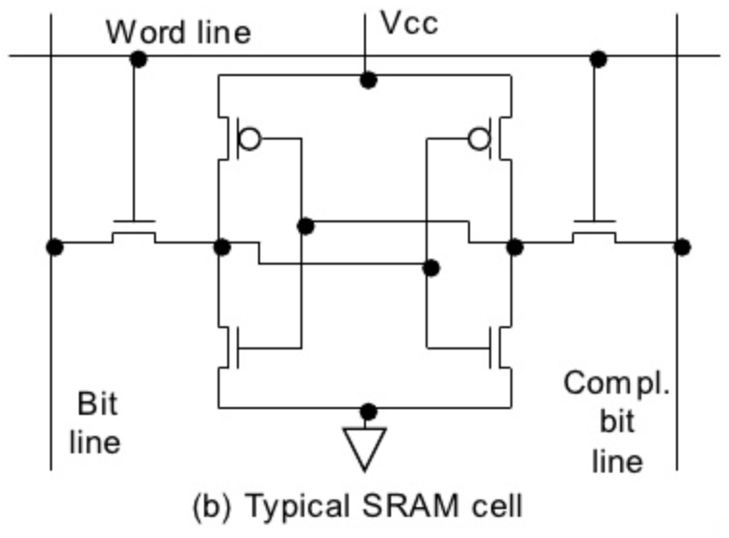
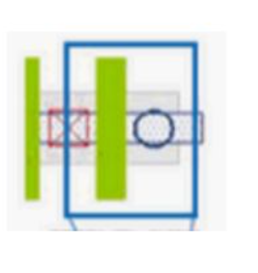
RAM Technologies
DRAM
1 Transistor + 1
capacitor / bit
Capacitor oriented vertically
Must refresh state periodically
SRAM
6 transistors / bit
Holds state indefinitely

Slide 13
SRAM vs DRAM Summary
Trans. Access Needs Needs
per bit time refresh? EDC? Cost Applications
SRAM 6 or 8 1x No Maybe 100x Cache memories, registers
DRAM 1 10x Yes Yes 1x Main memories,
frame buffers
EDC: Error detection and correction
Trends
SRAM scales with semiconductor technology
Reaching its limits
DRAM scaling limited by need for minimum capacitance
Aspect ratio limits how deep can make capacitor
Also reaching its limits

Slide 14
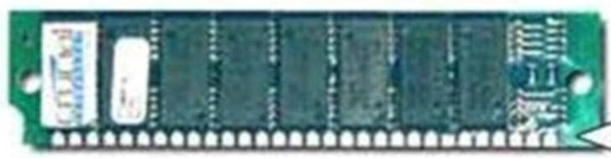
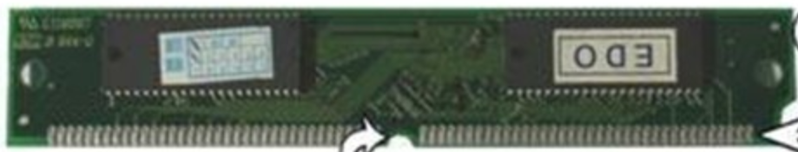
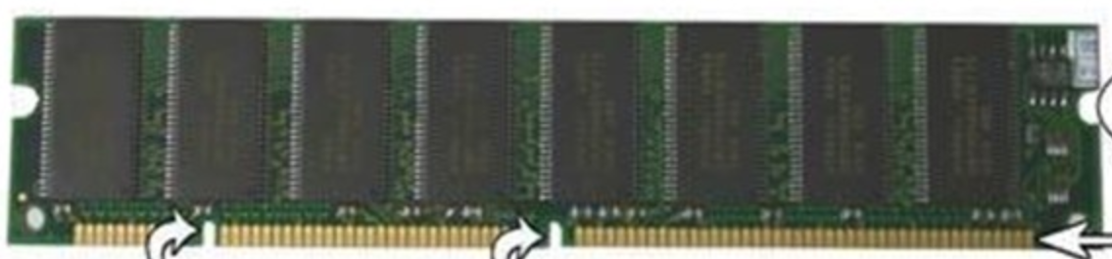
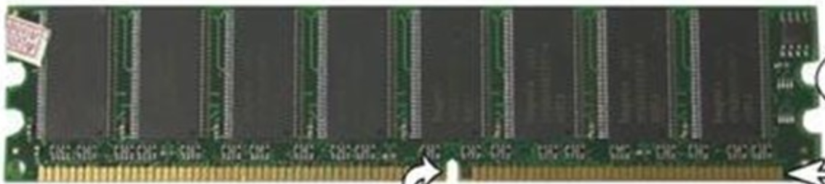
Enhanced DRAMs
Basic DRAM cell has not changed since its invention in 1966.
Commercialized by Intel in 1970.
DRAM cores with better interface logic and faster I/O :
FPM/EDO are outdated.
Synchronous DRAM (SDRAM)
Uses a conventional clock signal instead of asynchronous control
Allows reuse of the row addresses (e.g., RAS, CAS, CAS, CAS)
Double data-rate synchronous DRAM (DDR SDRAM)
Double edge clocking sends two bits per cycle per pin
Different types distinguished by size of small prefetch buffer:
DDR (2 bits), DDR2 (4 bits), DDR3/4 (8 bits), DDR5 (16 bits)
By 2010, standard for most server and desktop systems
Intel Core i7 supports DDR3 and DDR4 SDRAM

Slide 15
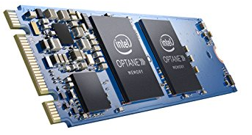
Nonvolatile Memories
DRAM and SRAM are volatile memories
Lose information if powered off.
Nonvolatile memories retain value even if powered off
Read-only memory (ROM): programmed during production
Programmable ROM (PROM): can be programmed once
Eraseable PROM (EPROM): can be bulk erased (UV, X-Ray)
Electrically eraseable PROM (EEPROM): electronic erase capability
Flash memory: EEPROMs. with partial (block-level) erase capability
Wears out after about 100,000 erasings
3D XPoint (Intel Optane) & emerging NVMs
New materials
Uses for Nonvolatile Memories
Firmware programs stored in a ROM (BIOS, controllers for disks, network cards, graphics accelerators, security subsystems,…)
Solid state disks (replace rotating disks in thumb drives, smart phones, mp3 players, tablets, laptops,…)
Disk caches

Slide 16
Conventional DRAM Organization
d x w DRAM:
dw total bits organized as d supercells of size w bits
16 x 8 DRAM chip
cols
Memory
controller
0
1
2
3
2 bits
/
0
addr
1
rows
2
supercell
(2,1)
(to/from CPU)
3
8 bits
/
data
Internal row buffer

Slide 17
Reading DRAM Supercell (2,1)
Step 1(a): Row access strobe (RAS) selects row 2.
Step 1(b): Row 2 copied from DRAM array to row buffer.
16 x 8 DRAM chip
Cols
Memory
controller
RAS = 2
0
1
2
3
2
/
0
addr
1
Rows
2
8
/
3
data
Internal row buffer

Slide 18
Reading DRAM Supercell (2,1)
Step 2(a): Column access strobe (CAS) selects column 1.
Step 2(b): Supercell (2,1) copied from buffer to data lines, and eventually back to the CPU.
16 x 8 DRAM chip
Cols
Memory
controller
CAS = 1
0
1
2
3
2
/
0
addr
To CPU
1
Rows
2
supercell
(2,1)
3
8
/
data
supercell
(2,1)
Internal row buffer

Slide 19
Memory Modules
addr (row = i, col = j)
: supercell (i,j)
DRAM 0
64 MB
memory module
consisting of
eight 8Mx8 DRAMs
DRAM 7
bits
56-63
bits
48-55
bits
40-47
bits
32-39
bits
24-31
bits
16-23
bits
8-15
bits
0-7
63
63
56
56
55
55
48
48
47
47
40
40
39
39
32
32
31
31
24
24
23
23
16
16
15
15
8
8
7
7
0
0
Memory
controller
64-bit word main memory address A
64-bit word

Slide 20
Today
The memory abstraction
RAM : main memory building block
Storage technologies and trends
Locality of reference
Caching in the memory hierarchy

Slide 21
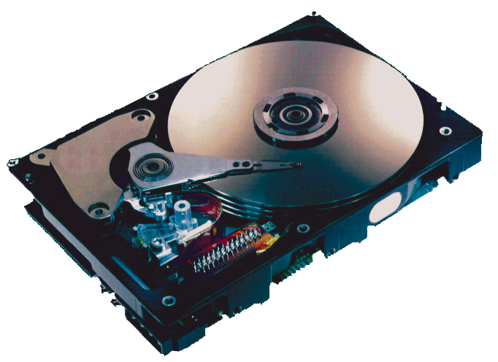
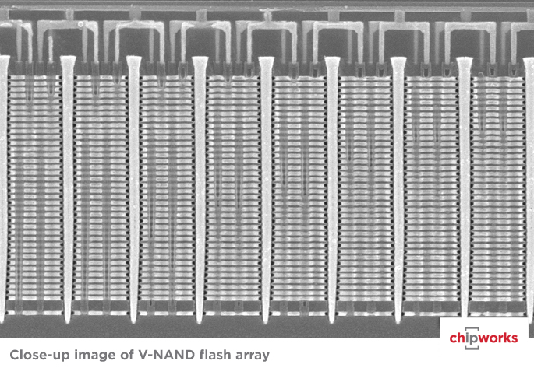
Storage Technologies
Magnetic Disks
Store on magnetic medium
Electromechanical access
Nonvolatile (Flash) Memory
Store as persistent charge
Implemented with 3-D structure
100+ levels of cells
3 bits data per cell

Slide 22
What’s Inside A Disk Drive?
Spindle
Arm
Platters
Actuator
Electronics
(including a
processor
and memory!)
SCSI
connector
Image courtesy of Seagate Technology

Slide 23
Disk Geometry
Disks consist of platters, each with two surfaces.
Each surface consists of concentric rings called tracks.
Each track consists of sectors separated by gaps.
Tracks
Surface
Track k
Gaps
Spindle
Sectors

Slide 24
Disk Geometry (Muliple-Platter View)
Aligned tracks form a cylinder.
Cylinder k
Surface 0
Platter 0
Surface 1
Surface 2
Platter 1
Surface 3
Surface 4
Platter 2
Surface 5
Spindle

Slide 25
Disk Capacity
Capacity: maximum number of bits that can be stored.
Vendors express capacity in units of gigabytes (GB), where 1 GB = 10⁹ Bytes.
Capacity is determined by these technology factors:
Recording density (bits/in): number of bits that can be squeezed into a 1 inch segment of a track.
Track density (tracks/in): number of tracks that can be squeezed into a 1 inch radial segment.
Areal density (bits/in2): product of
recording and track density.
Tracks

Slide 26
Recording zones
Modern disks partition tracks into disjoint subsets called recording zones
Each track in a zone has the same number of sectors, determined by the circumference of innermost track.
Each zone has a different number of sectors/track, outer zones have more sectors/track than inner zones.
So we use average number of sectors/track when computing capacity.
…
Spindle

Slide 27
Computing Disk Capacity
Capacity = (# bytes/sector) x (avg. # sectors/track) x
(# tracks/surface) x (# surfaces/platter) x
(# platters/disk)
Example:
512 bytes/sector
300 sectors/track (on average)
20,000 tracks/surface
2 surfaces/platter
5 platters/disk
Capacity = 512 x 300 x 20000 x 2 x 5
= 30,720,000,000
= 30.72 GB

Slide 28
Disk Operation (Single-Platter View)
The disk surface
spins at a fixed
rotational rate
The read/write head
is attached to the end
of the arm and flies over
the disk surface on
a thin cushion of air.
spindle
spindle
spindle
spindle
spindle
seek: by moving radially, the arm can position the read/write head over any track.

Slide 29
Disk Operation (Multi-Platter View)
Read/write heads
move in unison
from cylinder to cylinder
Arm
Spindle

Slide 30
Disk Structure - top view of single platter
Surface organized into tracks
Tracks divided into sectors

Slide 31
Disk Access
Head in position above a track

Slide 32
Disk Access
Rotation is counter-clockwise

Slide 33
Disk Access – Read
About to read blue sector

Slide 34
Disk Access – Read
After BLUE read
After reading blue sector

Slide 35
Disk Access – Read
After BLUE read
Red request scheduled next

Slide 36
Disk Access – Seek
After BLUE read
Seek for RED
Seek to red’s track

Slide 37
Disk Access – Rotational Latency
After BLUE read
Seek for RED
Rotational latency
Wait for red sector to rotate around

Slide 38
Disk Access – Read
After BLUE read
Seek for RED
Rotational latency
After RED read
Complete read of red

Slide 39
Disk Access – Service Time Components
After BLUE read
Seek for RED
Rotational latency
After RED read
Data transfer
Seek
Rotational
latency
Data transfer

Slide 40
Disk Access Time
Average time to access some target sector approximated by:
T_{access} = T_{avg seek} + T_{avg rotation} + T_{avg transfer}
Seek time (T_{avg seek})
Time to position heads over cylinder containing target sector.
Typical T_{avg seek} is 3—9 ms
Rotational latency (T_{avg rotation})
Time waiting for first bit of target sector to pass under r/w head.
T_{avg rotation} = 1/2 x 1/RPMs x 60 sec/1 min
Typical rotational rate = 7,200 RPMs T_{avg rotation} = 4ms
Transfer time (T_{avg transfer})
Time to read the bits in the target sector.
T_{avg transfer} = 1/RPM x 1/(avg # sectors/track) x 60 secs/1 min，may be 0.02ms
time for one rotation (in minutes)
fraction of a rotation to be read

Slide 41
Disk Access Time Example
Given:
Rotational rate = 7,200 RPM
Average seek time = 9 ms
Avg # sectors/track = 400
Derived:
T_{avg rotation} = 1/2 x (60 secs/7200 RPM) x 1000 ms/sec = 4 ms
T_{avg transfer} = 60/7200 RPM x 1/400 secs/track x 1000 ms/sec = 0.02 ms
T_{access} = 9 ms + 4 ms + 0.02 ms
Important points:
Access time dominated by seek time and rotational latency.
First bit in a sector is the most expensive, the rest are free.
SRAM access time is about 4 ns/doubleword, DRAM about 60 ns
Disk is about 40,000 times slower than SRAM,
2,500 times slower than DRAM.

Slide 42
I/O Bus
CPU chip
Register file
ALU
System bus
Memory bus
Main
memory
Bus interface
I/O
bridge
I/O bus
Expansion slots for
other devices such
as network adapters.
USB
controller
Graphics
adapter
Disk
controller
Mouse
Keyboard
Monitor
Disk

Slide 43
Reading a Disk Sector (1)
CPU chip
CPU initiates a disk read by writing a command, logical block number, and destination memory address to a port (address) associated with disk controller.
Register file
ALU
Main
memory
Bus interface
I/O bus
USB
controller
Graphics
adapter
Disk
controller
Mouse
Keyboard
Monitor
Disk

Slide 44
Reading a Disk Sector (2)
CPU chip
Disk controller reads the sector and performs a direct memory access (DMA) transfer into main memory.
Register file
ALU
Main
memory
Bus interface
I/O bus
USB
controller
Graphics
adapter
Disk
controller
Mouse
Keyboard
Monitor
Disk

Slide 45
Reading a Disk Sector (3)
CPU chip
When the DMA transfer completes, the disk controller notifies the CPU with an interrupt (i.e., asserts a special “interrupt” pin on the CPU)
Register file
ALU
Main
memory
Bus interface
I/O bus
USB
controller
Graphics
adapter
Disk
controller
Mouse
Keyboard
Monitor
Disk

Slide 46
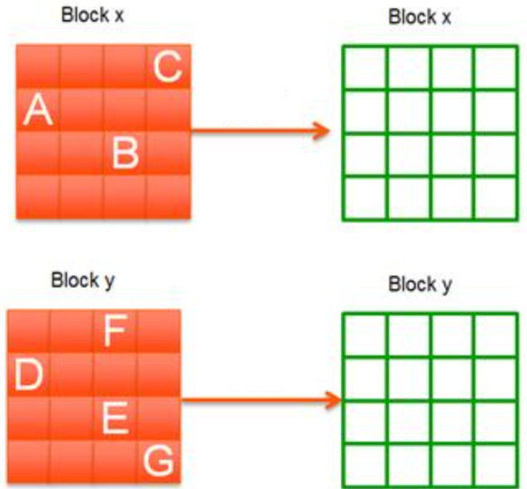
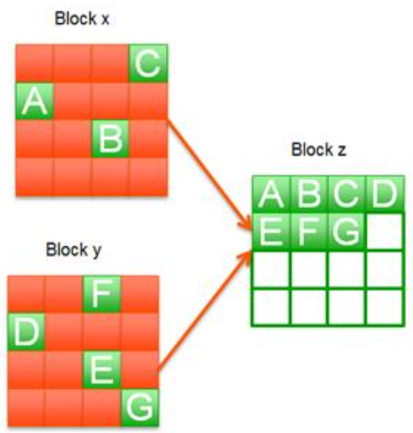
Solid State Disks (SSDs)
I/O bus
Requests to read and
write logical disk blocks
Solid State Disk (SSD)
Flash
translation layer
Flash memory
Block 0
Block B-1
…
…
…
Page 0
Page 1
Page P-1
Page 0
Page 1
Page P-1
Pages: 512KB to 4KB, Blocks: 32 to 128 pages
Data read/written in units of pages.
Page can be written only after its block has been erased
A block wears out after about 100,000 repeated writes.

Slide 47
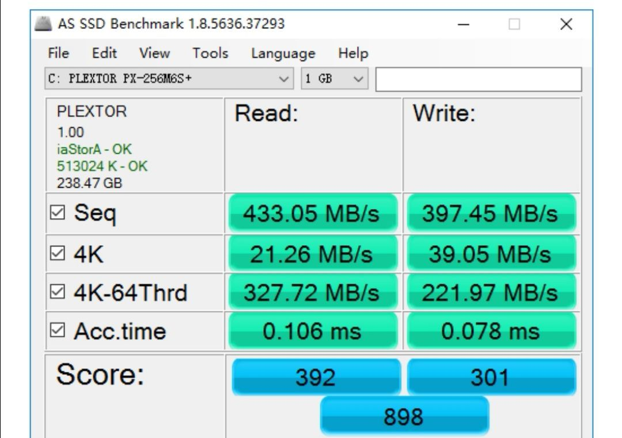
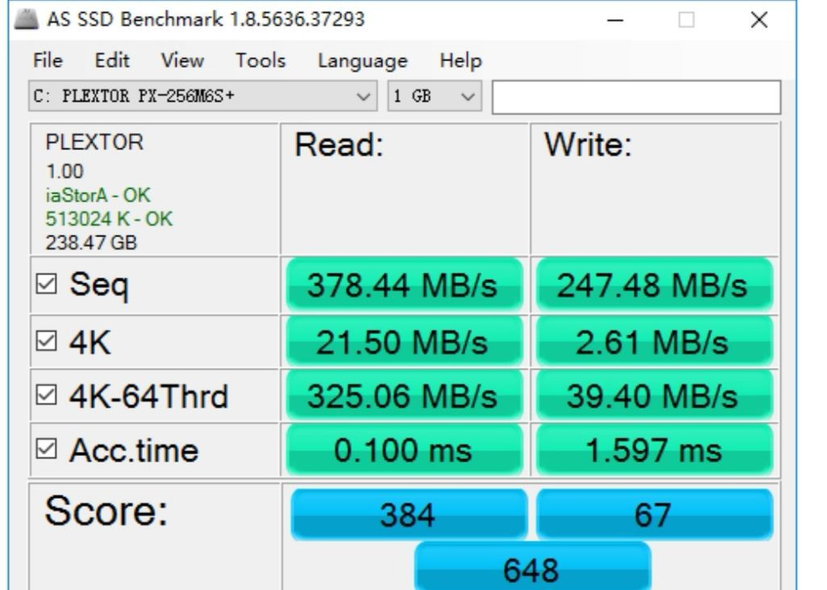
SSD Performance Characteristics
Benchmark of Samsung 940 EVO Plus
Sequential access faster than random access
Common theme in the memory hierarchy
Random writes are somewhat slower
Erasing a block takes a long time (~1 ms).
Modifying a block page requires all other pages to be copied to new block.
Flash translation layer allows accumulating series of small writes before doing block write.
https://ssd.userbenchmark.com/SpeedTest/711305/Samsung-SSD-970-EVO-Plus-250GB
Sequential read throughput 2,126 MB/s Sequential write tput 1,880 MB/s
Random read throughput 140 MB/s Random write tput 59 MB/s
Sequential read throughput 2,206 MB/s Sequential write tput 1,906 MB/s
Random read throughput 61.5 MB/s Random write tput 151 MB/s

Slide 48
SSD Tradeoffs vs Rotating Disks
Advantages
No moving parts → faster, less power, more rugged
Disadvantages
Have the potential to wear out
Mitigated by “wear leveling logic” in flash translation layer
E.g. Samsung 940 EVO Plus guarantees 600 writes/byte of writes before they wear out
Controller migrates data to minimize wear level
In 2021, about 4 times more expensive per byte （in China）
And, relative cost will keep dropping
Applications
MP3 players, smart phones, laptops
Increasingly common in desktops and servers

Slide 49
Storage Trends
SRAM
Metric 1985 1990 1995 2000 2005 2010 2015 2015:1985
$/MB 2,900 320 256 100 75 60 25 116
access (ns) 150 35 15 3 2 1.5 1.3 115
DRAM
Metric 1985 1990 1995 2000 2005 2010 2015 2015:1985
$/MB 880 100 30 1 0.1 0.06 0.02 44,000
access (ns) 200 100 70 60 50 40 20 10
typical size (MB) 0.256 4 16 64 2,000 8,000 16.000 62,500
Disk
Metric 1985 1990 1995 2000 2005 2010 2015 2015:1985
$/GB 100,000 8,000 300 10 5 0.3 0.03 3,333,333
access (ms) 75 28 10 8 5 3 3 25
typical size (GB) 0.01 0.16 1 20 160 1,500 3,000 300,000

Slide 50
CPU Clock Rates
Inflection point in computer history
when designers hit the “Power Wall”
1985 1990 1995 2003 2005 2010 2015 2015:1985
CPU 80286 80386 Pentium P-4 Core 2 Core i7(n) Core i7(h)
Clock
rate (MHz) 6 20 150 3,300 2,000 2,500 3,000 500
Cycle
time (ns) 166 50 6 0.30 0.50 0.4 0.33 500
Cores 1 1 1 1 2 4 4 4
Effective
cycle 166 50 6 0.30 0.25 0.10 0.08 2,075
time (ns)
(n) Nehalem processor
(h) Haswell processor

Slide 51
The CPU-Memory Gap
The gap between DRAM, disk, and CPU speeds is still very wide.
Disk
SSD
DRAM
SRAM
CPU

Slide 52
Locality to the Rescue!
The key to bridging this CPU-Memory gap is a fundamental property of computer programs known as locality

Slide 53
Today
The memory abstraction
RAM : main memory building block
Storage technologies and trends
Locality of reference
Caching in the memory hierarchy

Slide 54
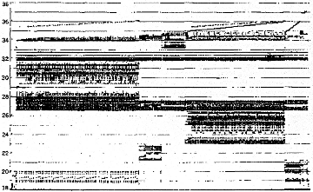
Programs with locality cache well ...
Bad
Temporal
Locality
Memory Address (one dot per access)
Spatial
Locality
Time
Donald J. Hatfield, Jeanette Gerald:
Program Restructuring for Virtual Memory. IBM Systems Journal 10(3): 168-192 (1971)

Slide 55
Locality
Principle of Locality: Programs tend to use data and instructions with addresses near or equal to those they have used recently
Temporal locality:
Recently referenced items are likely to be referenced again in the near future
Spatial locality:
Items with nearby addresses tend to be referenced close together in time

Slide 56
Locality Example
sum = 0;
for (i = 0; i < n; i++)
sum += a[i];
return sum;
Data references
Reference array elements in succession (stride-k reference pattern, k = 1).
Reference variable sum each iteration.
Instruction references
Reference instructions in sequence.
Cycle through loop repeatedly.
Spatial locality
Temporal locality
Spatial locality
Temporal locality

Slide 57
Qualitative Estimates of Locality
Claim: Being able to look at code and get a qualitative sense of its locality is a key skill for a professional programmer.
Question: Does this function have good locality with respect to array a?
int sum_array_rows(int a[M][N])
{
int i, j, sum = 0;
for (i = 0; i < M; i++)
for (j = 0; j < N; j++)
sum += a[i][j];
return sum;
}
Hint: array layout is row-major order
Answer: yes
• • •
a
[0]
[0]
a
[0]
[N-1]
• • •
a
[1]
[0]
a
[1]
[N-1]
• • •
• • •
a
[M-1]
[0]
a
[M-1]
[N-1]

Slide 58
Locality Example
Claim: Being able to look at code and get a qualitative sense of its locality is a key skill for a professional programmer.
Question: Does this function have good locality with respect to array a?
int sum_array_cols(int a[M][N])
{
int i, j, sum = 0;
for (j = 0; j < N; j++)
for (i = 0; i < M; i++)
sum += a[i][j];
return sum;
}
Answer: no, unless…
M is very small
• • •
a
[0]
[0]
a
[0]
[N-1]
• • •
a
[1]
[0]
a
[1]
[N-1]
• • •
• • •
a
[M-1]
[0]
a
[M-1]
[N-1]

Slide 59
Locality Example
Question: Can you permute the loops so that the function scans the 3-d array a with a stride-1 reference pattern (and thus has good spatial locality)?
int sum_array_3d(int a[M][N][N])
{
int i, j, k, sum = 0;
for (i = 0; i < M; i++)
for (j = 0; j < N; j++)
for (k = 0; k < N; k++)
sum += a[k][i][j];
return sum;
}
Answer: make j the inner loop

Slide 60
Memory Hierarchies
Some fundamental and enduring properties of hardware and software:
Fast storage technologies cost more per byte, have less capacity, and require more power (heat!).
The gap between CPU and main memory speed is wide.
Well-written programs tend to exhibit good locality.
These fundamental properties complement each other beautifully.
They suggest an approach for organizing memory and storage systems known as a memory hierarchy.

Slide 61
Today
The memory abstraction
RAM : main memory building block
Storage technologies and trends
Locality of reference
Caching in the memory hierarchy

Slide 62
Example Memory Hierarchy
L0:
Regs
CPU registers hold words retrieved from the L1 cache.
Smaller,
faster,
and
costlier
(per byte)
storage
devices
L1:
L1 cache
(SRAM)
L1 cache holds cache lines retrieved from the L2 cache.
L2:
L2 cache
(SRAM)
L2 cache holds cache lines
retrieved from L3 cache
L3:
L3 cache
(SRAM)
L3 cache holds cache lines
retrieved from main memory.
Larger,
slower,
and
cheaper
(per byte)
storage
devices
L4:
Main memory
(DRAM)
Main memory holds disk blocks retrieved from local disks.
L5:
Local secondary storage
(local disks)
Local disks hold files retrieved from disks
on remote servers
L6:
Remote secondary storage
(e.g., Web servers)

Slide 63


Caches
Cache: A smaller, faster storage device that acts as a staging area for a subset of the data in a larger, slower device.
What am I to you?
Cache.
Why? Do you mean that I am small and fast?
No. You are my hidden treasure, and every time I visit my memory because of missing you.

Slide 64
Caches
Cache: A smaller, faster storage device that acts as a staging area for a subset of the data in a larger, slower device.
Fundamental idea of a memory hierarchy:
For each k, the faster, smaller device at level k serves as a cache for the larger, slower device at level k+1.
Why do memory hierarchies work?
Because of locality, programs tend to access the data at level k more often than they access the data at level k+1.
Thus, the storage at level k+1 can be slower, and thus larger and cheaper per bit.
Big Idea (Ideal): The memory hierarchy creates a large pool of storage that costs as much as the cheap storage near the bottom, but that serves data to programs at the rate of the fast storage near the top.

Slide 65
General Caching Concepts
Smaller, faster, more expensive
memory caches a subset of
the blocks
Level K
8
4
9
14
10
3
Data is copied in block-sized transfer units
4
10
Larger, slower, cheaper memory
viewed as partitioned into “blocks”
Level K+1
0
1
2
3
4
4
5
6
7
8
9
10
10
11
12
13
14
15

Slide 66
General Caching Concepts: Hit
Request: 14
Data in block b is needed
Block b is in cache:
Hit!
Level K
8
9
14
3
14
Level K+1
0
1
2
3
4
5
6
7
8
9
10
11
12
13
14
15

Slide 67
General Caching Concepts: Miss
Request: 12
Data in block b is needed
Block b is not in cache:
Miss!
Level K
8
9
14
3
12
Block b is fetched from
memory
12
Request: 12
Block b is stored in cache
Placement policy: determines where b goes
Replacement policy: determines which block gets evicted (victim)
Level K+1
0
1
2
3
4
5
6
7
8
9
10
11
12
12
13
14
15

Slide 68
General Caching Concepts: Types of Cache Misses
Cold (compulsory) miss
Cold misses occur because the cache is empty.
Conflict miss
Most caches limit blocks at level k+1 to a small subset (sometimes a singleton) of the block positions at level k.
E.g. Block i at level k+1 must be placed in block (i mod 4) at level k.
Conflict misses occur when the level k cache is large enough, but multiple data objects all map to the same level k block.
E.g. Referencing blocks 0, 8, 0, 8, 0, 8, ... would miss every time.
Capacity miss
Occurs when the set of active cache blocks (working set) is larger than the cache.

Slide 69
Examples of Caching in the Mem. Hierarchy
Cache Type
What is Cached?
Where is it Cached?
Latency (cycles)
Managed By
Registers
4-8 bytes words
CPU core
0
Compiler
TLB
Address translations
On-Chip TLB
0
Hardware MMU
L1 cache
64-byte blocks
On-Chip L1
4
Hardware
L2 cache
64-byte blocks
On-Chip L2
10
Hardware
Virtual Memory
4-KB pages
Main memory
100
Hardware + OS
Buffer cache
Parts of files
Main memory
100
OS
Disk cache
Disk sectors
Disk controller
100,000
Disk firmware
Network buffer cache
Parts of files
Local disk
10,000,000
NFS client
Browser cache
Web pages
Local disk
10,000,000
Web browser
Web cache
Web pages
Remote server disks
1,000,000,000
Web proxy server

Slide 70
Summary
The speed gap between CPU, memory and mass storage is still very wide.
Well-written programs exhibit a property called locality.
Memory hierarchies based on caching close the gap by exploiting locality.

