Slide 1
CAPSTONE PROJECT-NBA GAME ANALYSIS
GOLDEN STATE WARRIORS
2003-2022 Dataset

Slide 2
NBA Game Outcome Prediction Model for Team Strategy Enhancement
OUTLINE
Project Goals
Project Process
Data Exploration
Results/Key Findings Visualization
Challenges
Future Goals

Slide 3
PROJECT GOALS
Achieved a highly accurate NBA game outcome prediction model tailored for real team application. The model aligns closely with actual game results, providing valuable insights for strategic decision-making.

Slide 4
Project Process
Explore the NBA data
Data Aggregation and Summarization
Field goal percentage
Win-loss performance analysis
Team assist distribution
Team Performance Dashboard

Slide 5
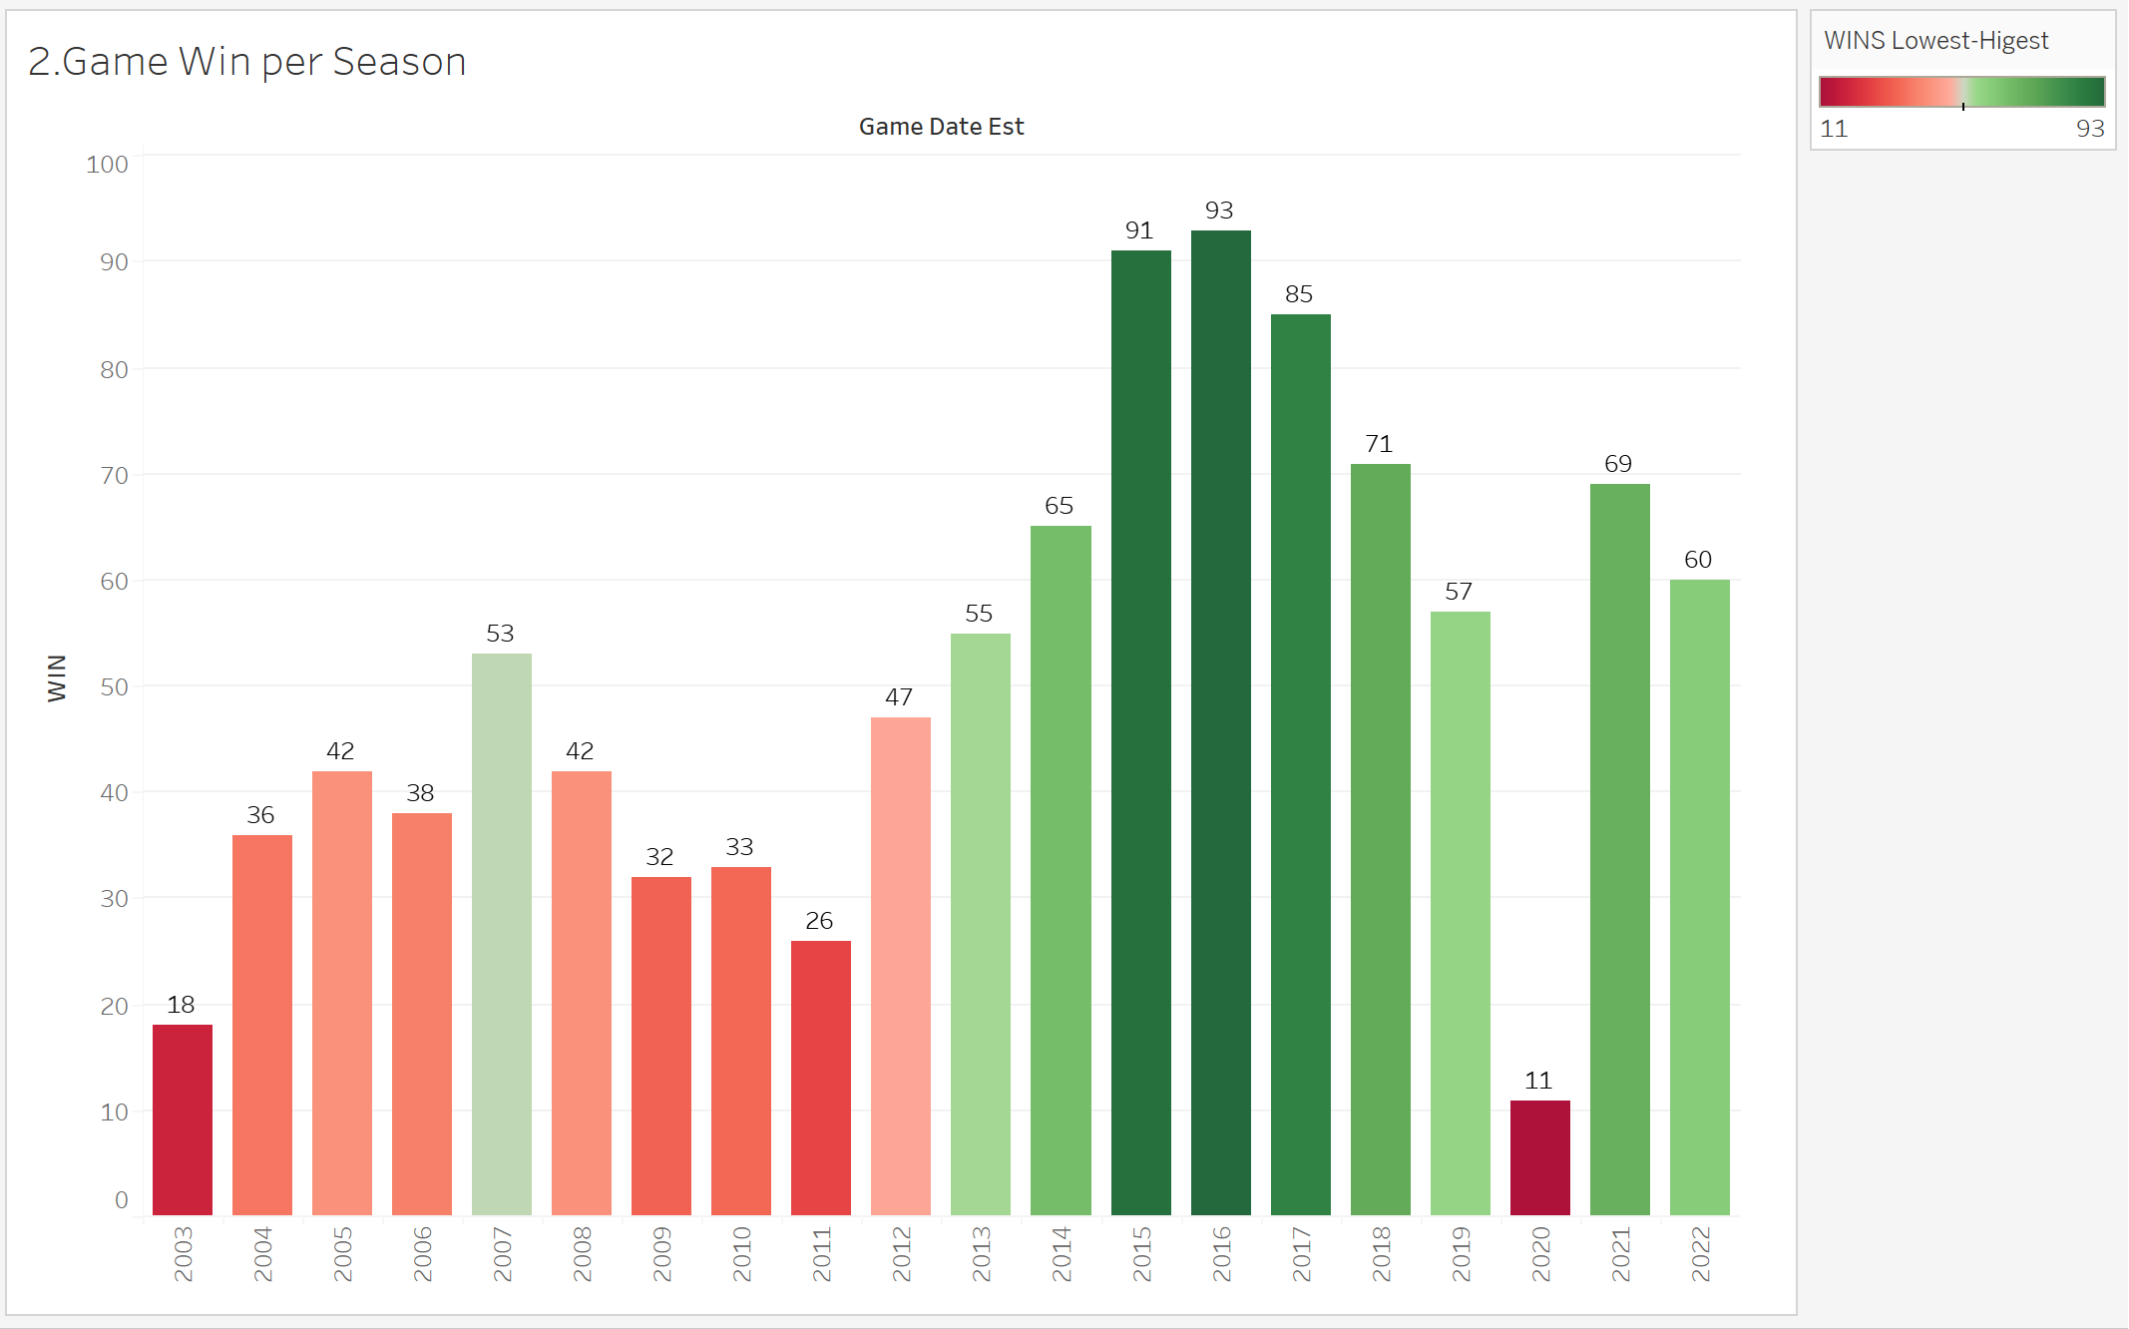

Slide 6
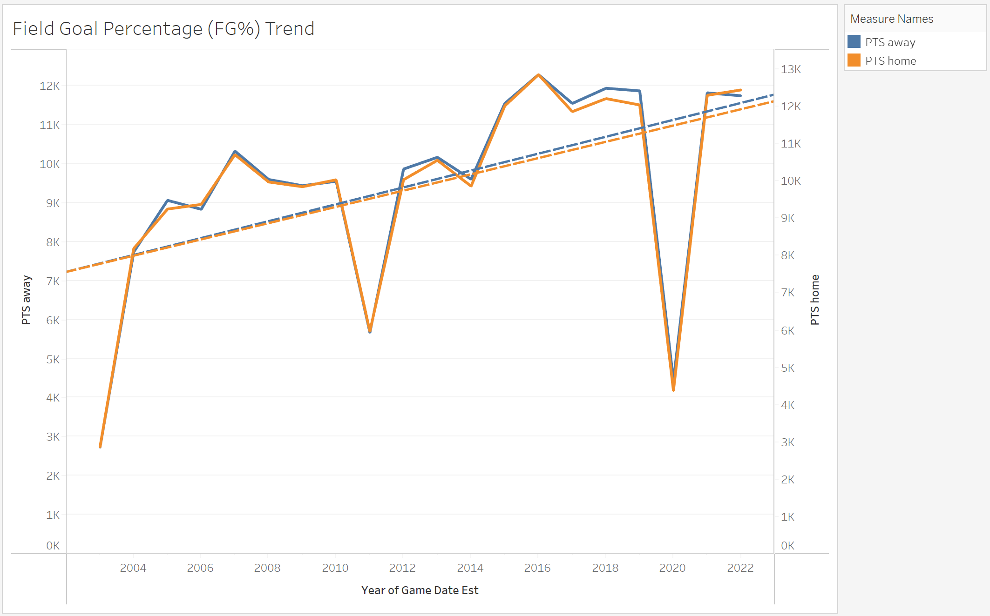

Slide 7
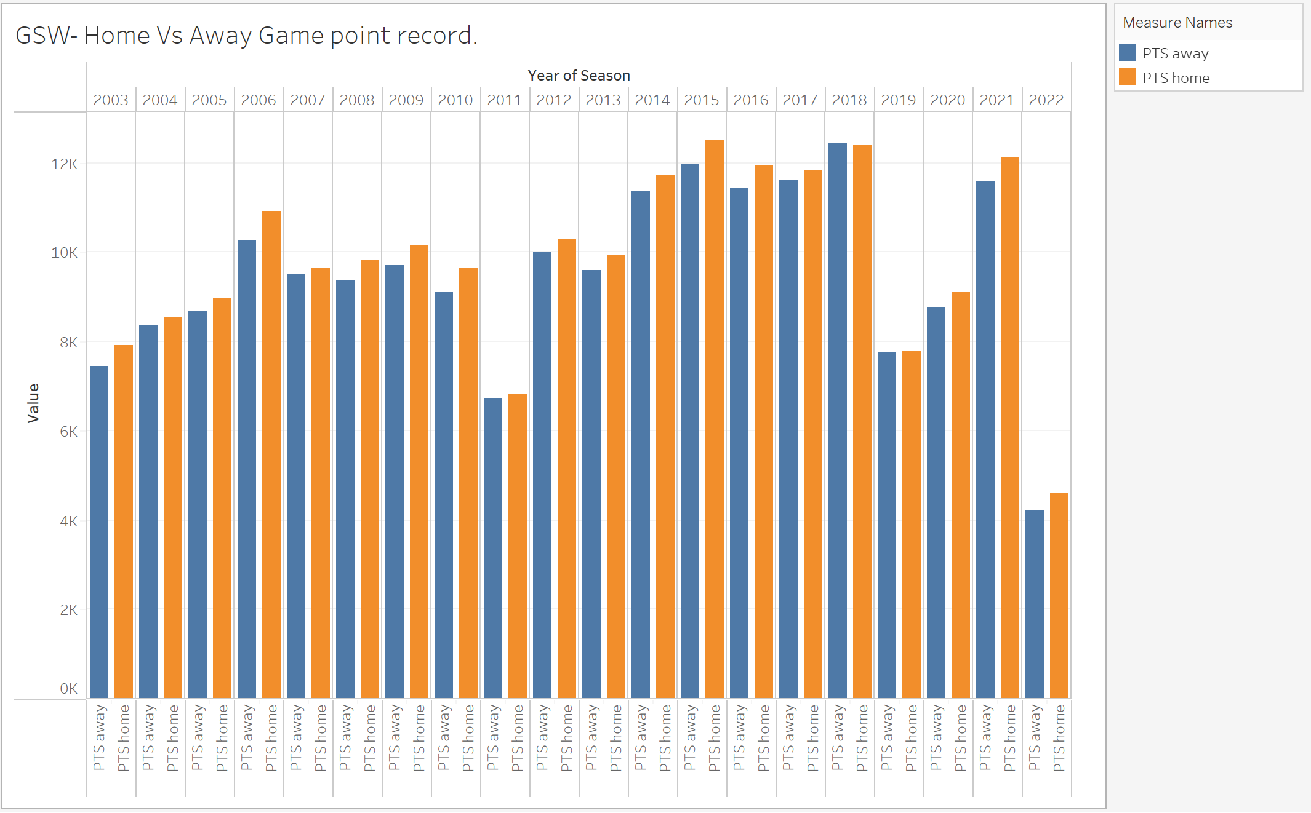

Slide 8
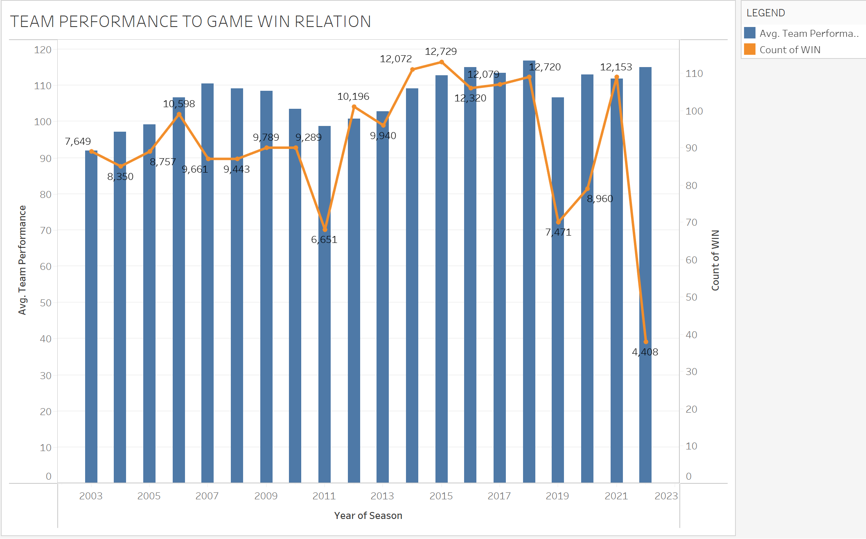

Slide 9
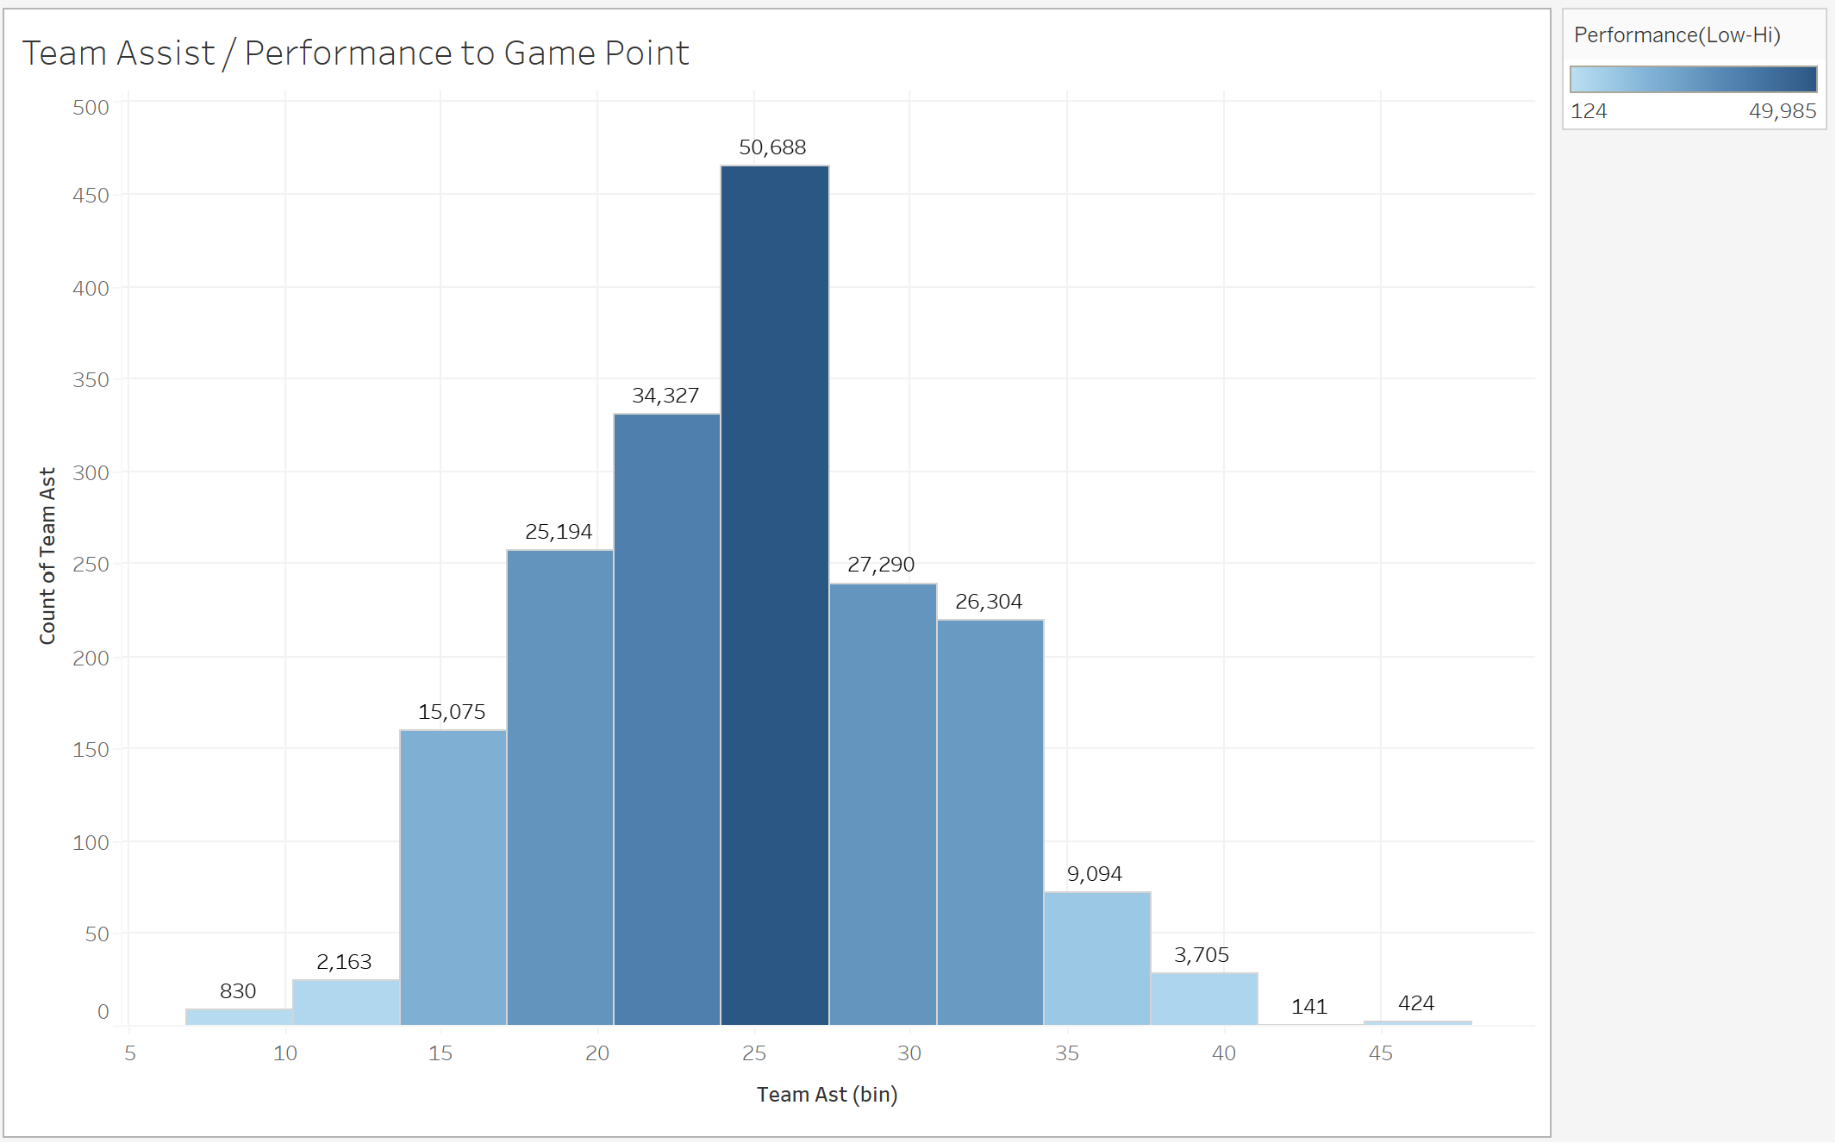
PYTHON EDA VISUALIZATION

Slide 10
CHALLENGES
Ensuring model accuracy and relevance amid the dynamic nature of the NBA.
Ensuring data accuracy and addressing potential outliers demanded careful attention
Working with the large dataset ensuring data quality.

Slide 11
FUTURE GOALS
Continued refinement of the model with new data to maintain predictive accuracy. Ongoing updates to the management dashboard for seamless integration into the team's decision-making processes.

