Slide 1
Databases 1 –Case Study
By Kingsley Chimezie, Kayleigh Coffey and Tim Browning

Slide 2
MyPhone Mobile Phone Service
MyPhone provides a service to the customers on an account bases, where a customer can own one or more phones.
The phone number of a phone is related to a contract and one contract may have more than one phone.
The types of phones is specific to a manufacturer and they may have many models (iPhone6, iPhone6 Plus, etc.) Each individual phone has its own serial number given by the manufacturer.
The phones can be used in different ways so there will be a billing cost for each use(call, foreign call, text message, data usage etc.)
MyPhone has a record of phones they have in stock and the phones which are owned by customers.

Slide 3
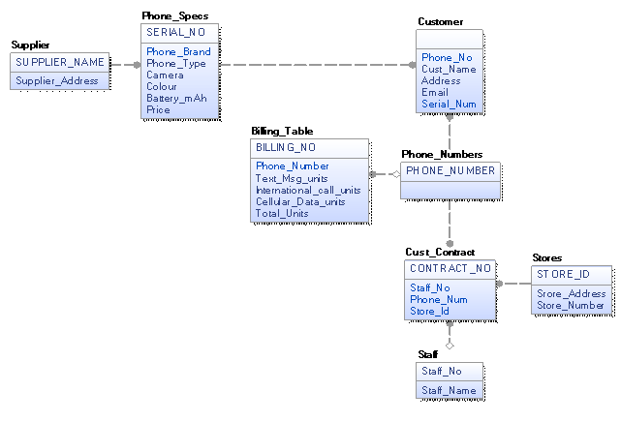

Slide 4
Kayleigh Coffey
Concentrated on the Customer side of the case study.
Created the tables Customer, Cust_Contract, and the Stores.
I inserted data in my tables and related them to other tables in the database using primary and foreign keys and insert statements.

Slide 5
Tim Browning
I did the Phone Specifications, Supplier, Staff and Phone numbers tables.
I commented a lot of the code, I described what each of the tables were doing.
I inserted data into each of the tables using the insert function.

Slide 6
Kingsley Chimezie
Concentrated on portion of the case study that handles all queries relating to the a physical phone.
Created the tables Phone_Brand, Phone_Type, Phone_Spec and Phone.
Inserted data into the tables using the Insert command.

