Slide 1
ASSESSING THE COMPLEMENTARITY AND GRID INTEGRATION POTENTIAL OF WAVE ENERGY IN ORKNEY UNDER CURRENT GRID CONSTRAINTS
Initial Data Visualization And PYPSA Model Inventory

Slide 2
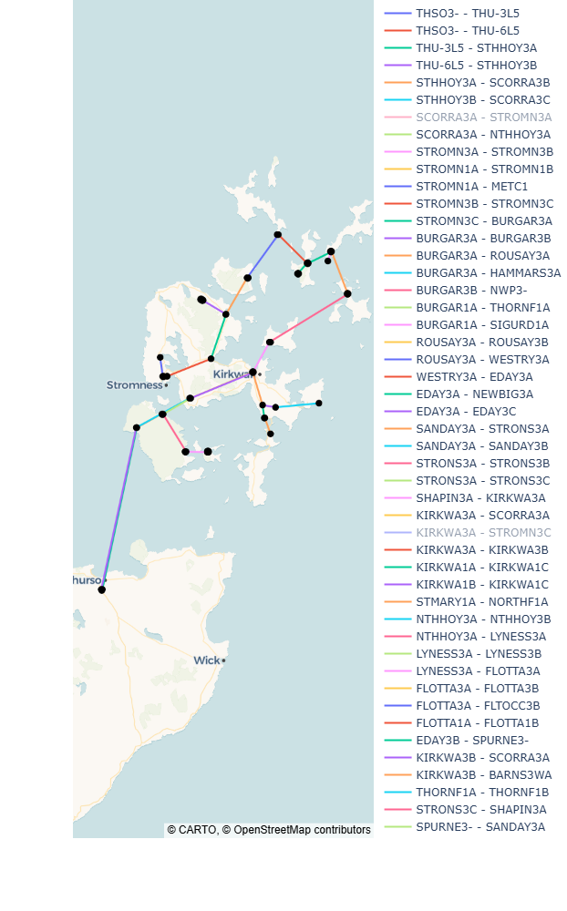
Assessing the Complementarity and Grid Integration Potential of Wave Energy in Orkney Under Current Grid Constraints
Power Topology
This is the real Orkney AC power network modelled in PyPSA. This study runs a full AC power flow — capturing voltage, reactive power and thermal line limits.
The mainland interconnector (bottom of map) is the critical constraint — all surplus generation must flow through it to reach Scottish consumers. This constraint is the novel focus of the dissertation.
Figure 1 — Orkney Power Network Topology | Real PyPSA model: 17 buses, transmission lines, transformers, wind farms, tidal generators and battery storage at Kirkwall

Slide 3
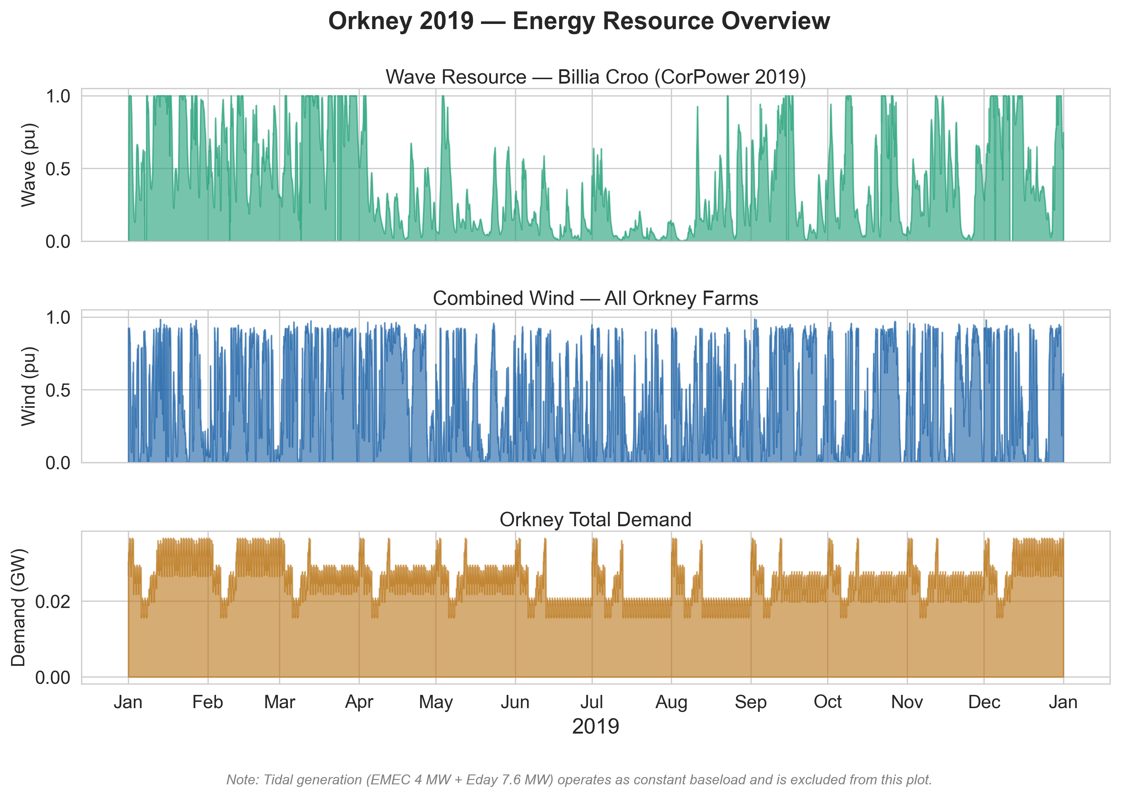
Assessing the Complementarity and Grid Integration Potential of Wave Energy in Orkney Under Current Grid Constraints
Key insight
Wave and wind both peak in winter when Atlantic storms drive high wave heights and wind speeds — and demand also peaks in winter. This seasonal alignment is favourable for Orkney's grid.
From the wave profile, there 86 zero-output wave hours (calm seas or extreme storms) and these are the periods the grid is most exposed. These motivate the Resource Versatility (RV) metric — how often wave fills gaps when wind is also low. To be calculated subsequently.
NOTE: Tidal is excluded from this plot — it operates as a constant 11.6 MW baseload (EMEC 4 MW + Eday 7.6 MW) and adds no temporal information.
Figure 2 — Resource Overview Timeseries | Wave (teal), Combined Wind (blue) and Demand (amber) across all 8,760 hours of 2019. Both wave and wind are winter-peaking. 86 zero-output wave hours visible as flat baseline sections.

Slide 4
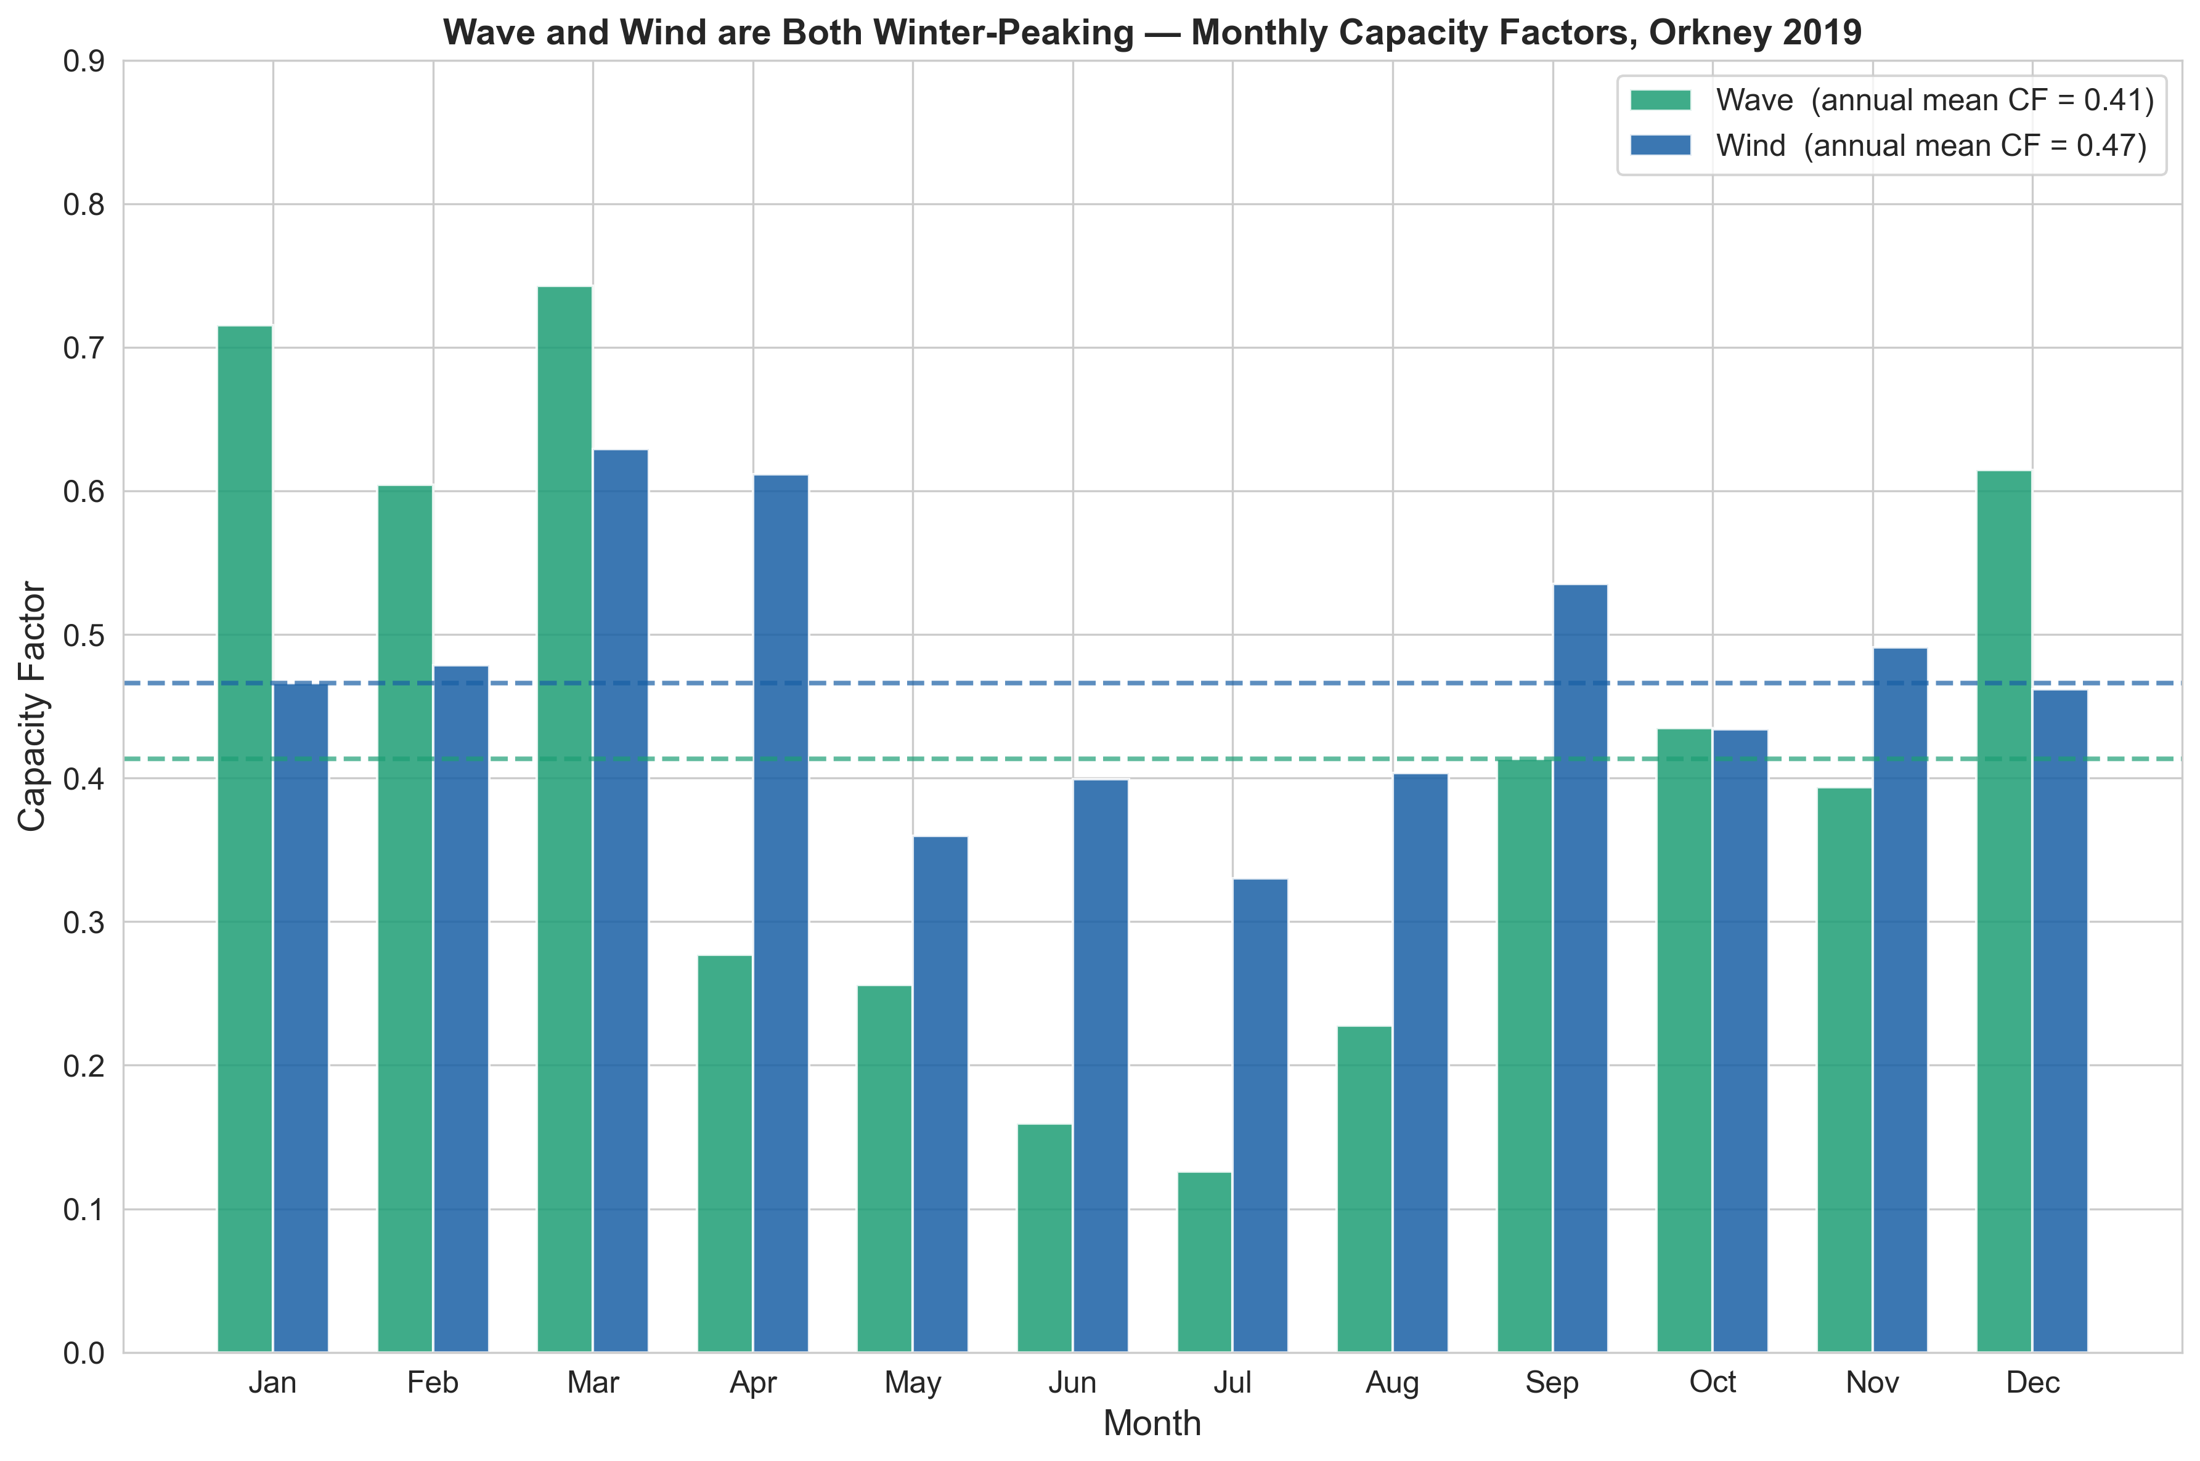
Assessing the Complementarity and Grid Integration Potential of Wave Energy in Orkney Under Current Grid Constraints
Key insight
March 2019 was exceptionally energetic: wave CF of 0.74, the highest month of the year, driven by strong Atlantic storm activity. This matches Figure 5's dark green March column.
Wave shows more extreme seasonal variation than wind (range 0.60 CF units vs 0.35 for wind). Wave capacity is less evenly distributed across the year, a key grid planning consideration.
Both resources peak in winter when demand also peaks, a favourable characteristic. But both weaken simultaneously in summer, creating the vulnerability window shown in Figure 5.
Figure 3 — Monthly Capacity Factors | Wave annual CF = 0.41, Wind annual CF = 0.47. Both winter-peaking. Wave CF drops to 0.13 in July; exceptional March wave CF = 0.74. Dashed lines show annual means. Confirms seasonal complementarity with demand.

Slide 5
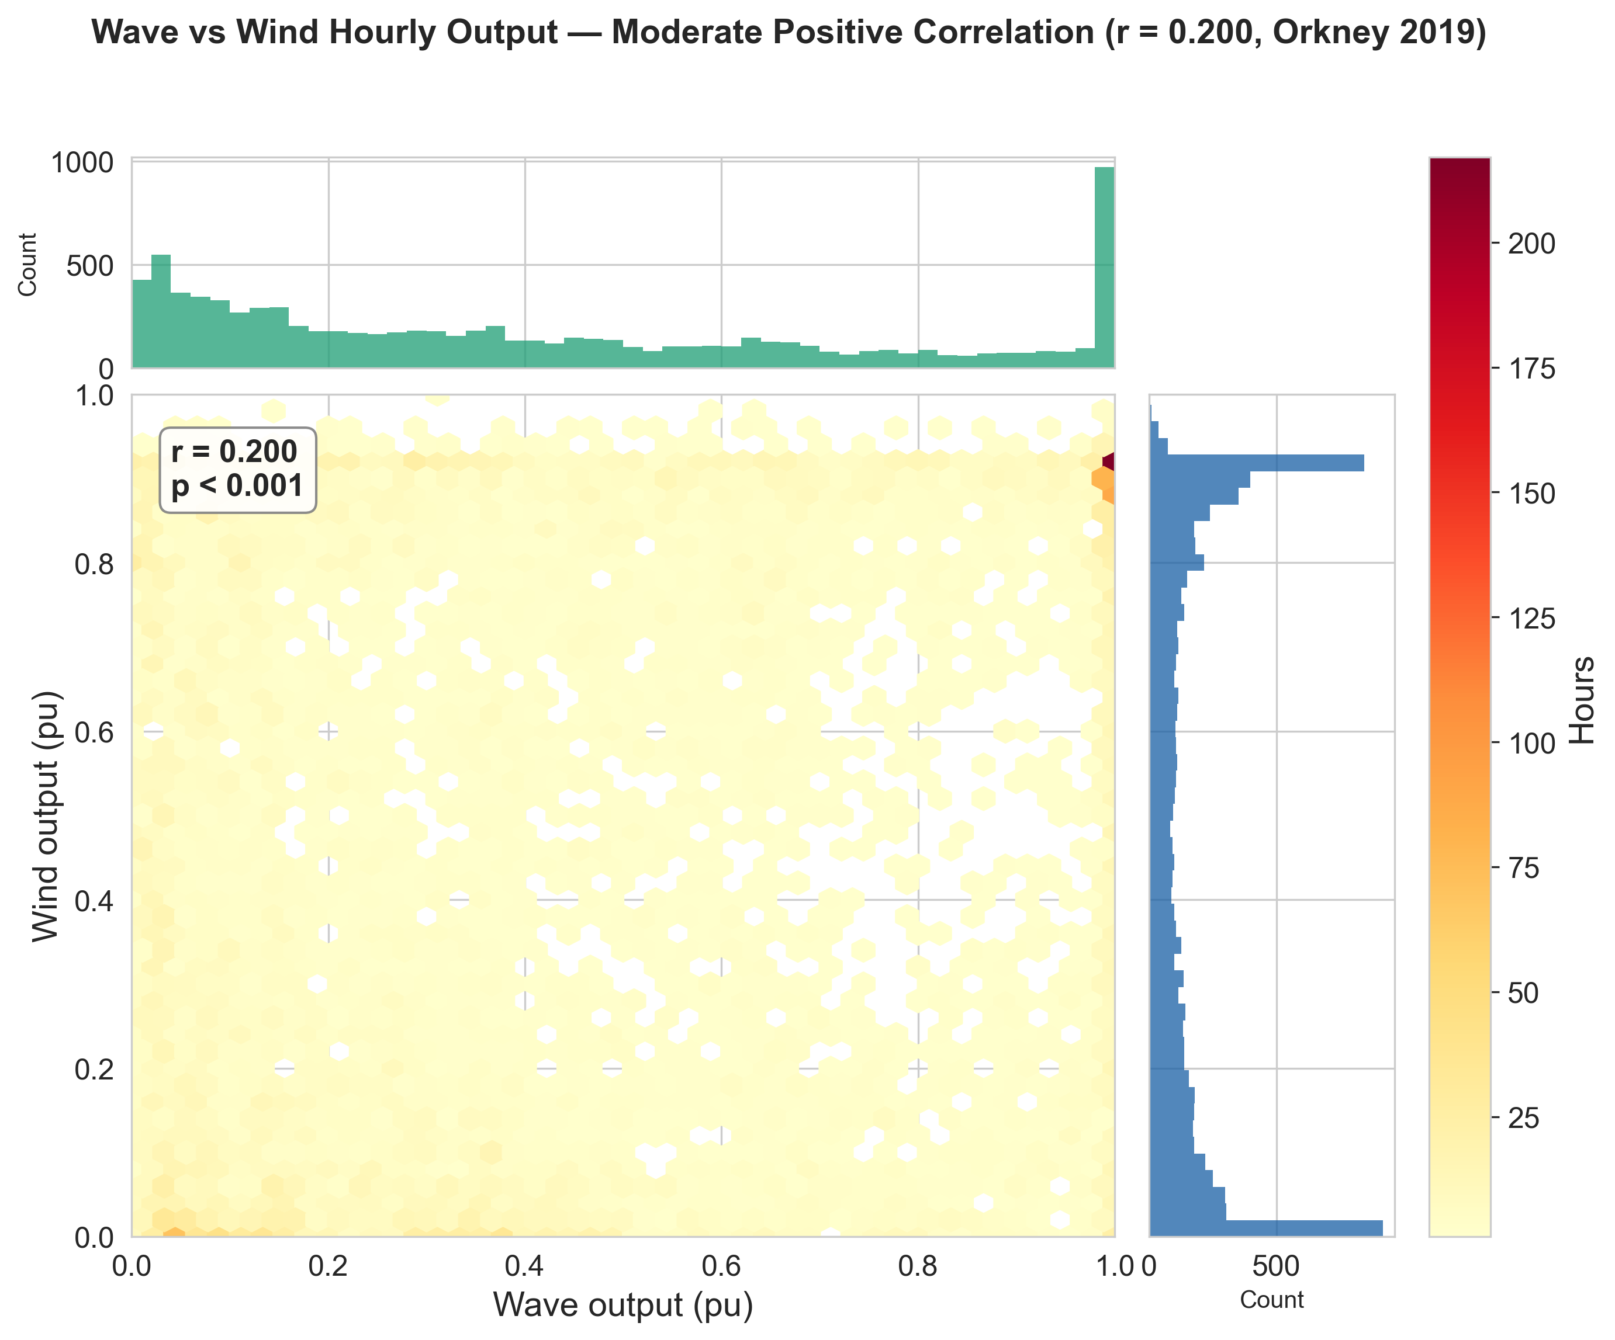
Assessing the Complementarity and Grid Integration Potential of Wave Energy in Orkney Under Current Grid Constraints
Key insights: Wave and wind are correlated at r = 0.200, which is precisely the complementarity property that justifies adding wave capacity to the Orkney wind-dominated grid.
The green bar chart along the top shows how Wave behaves on its own across the year. You can see it has a huge spike on the right, meaning Wave spends a lot of hours near full output. It also has a big bar on the left, meaning it also spends quite a few hours at zero or near zero. There is relatively little in the middle. This is what the CorPower device does: during big Atlantic swells it runs at full power, during calm summers it shuts down, and it moves between the two fairly quickly.
The blue bar chart on the right side shows Wind on its own. Wind has a completely different shape: a tall spike on the left meaning it spends lots of hours at low output, then gradually fewer hours as output increases. Wind is almost never at full rated output.
Figure 4: Wave vs Wind Hourly Scatter | r = 0.200, p < 0.001

Slide 7
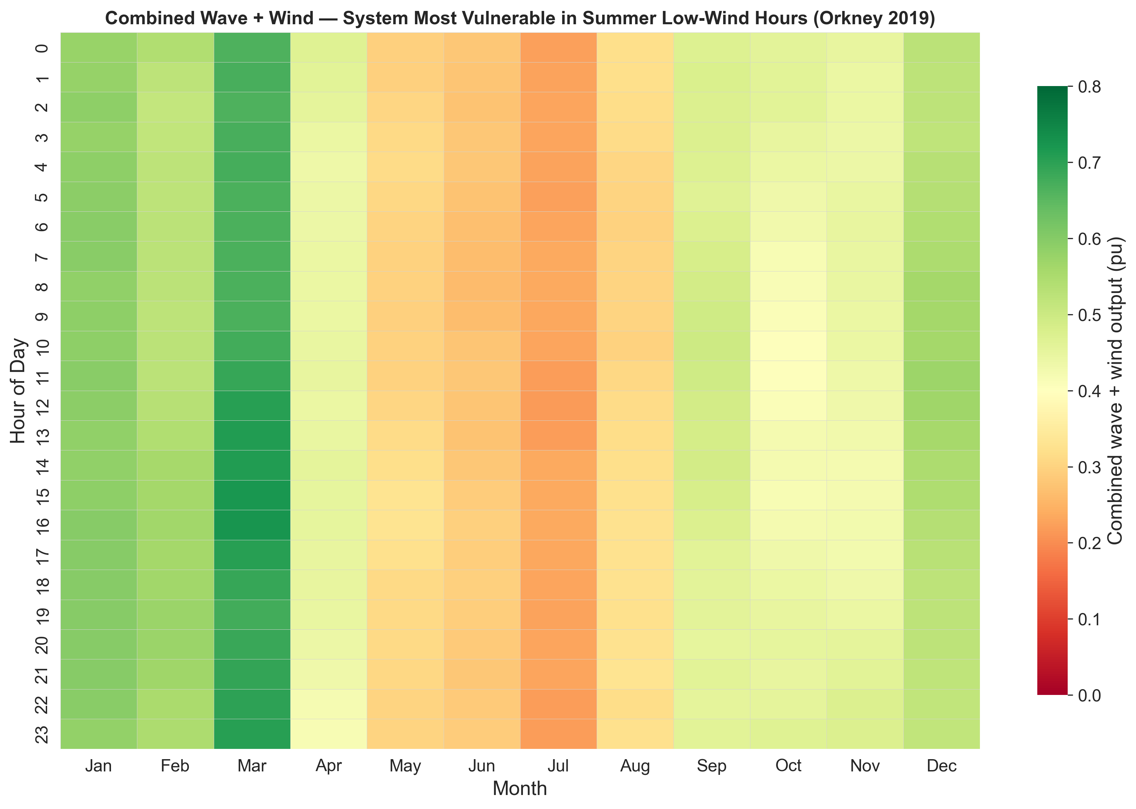
Assessing the Complementarity and Grid Integration Potential of Wave Energy in Orkney Under Current Grid Constraints
Key insights: March is the strongest month of 2019
The darkest green column across the entire heatmap is March, darker than even January and February. This confirms that March 2019 was an exceptionally energetic month for both wave and wind simultaneously, with wave capacity factor reaching 0.74, the highest of the year.
The vulnerability confirms why adding wave is critical in summer
The orange-red cells in June and July directly map onto your grid constraint analysis. Those are precisely the months when Orkney must balance the supply using other generators
Figure 5 — The Combined Output Heatmap

Slide 8
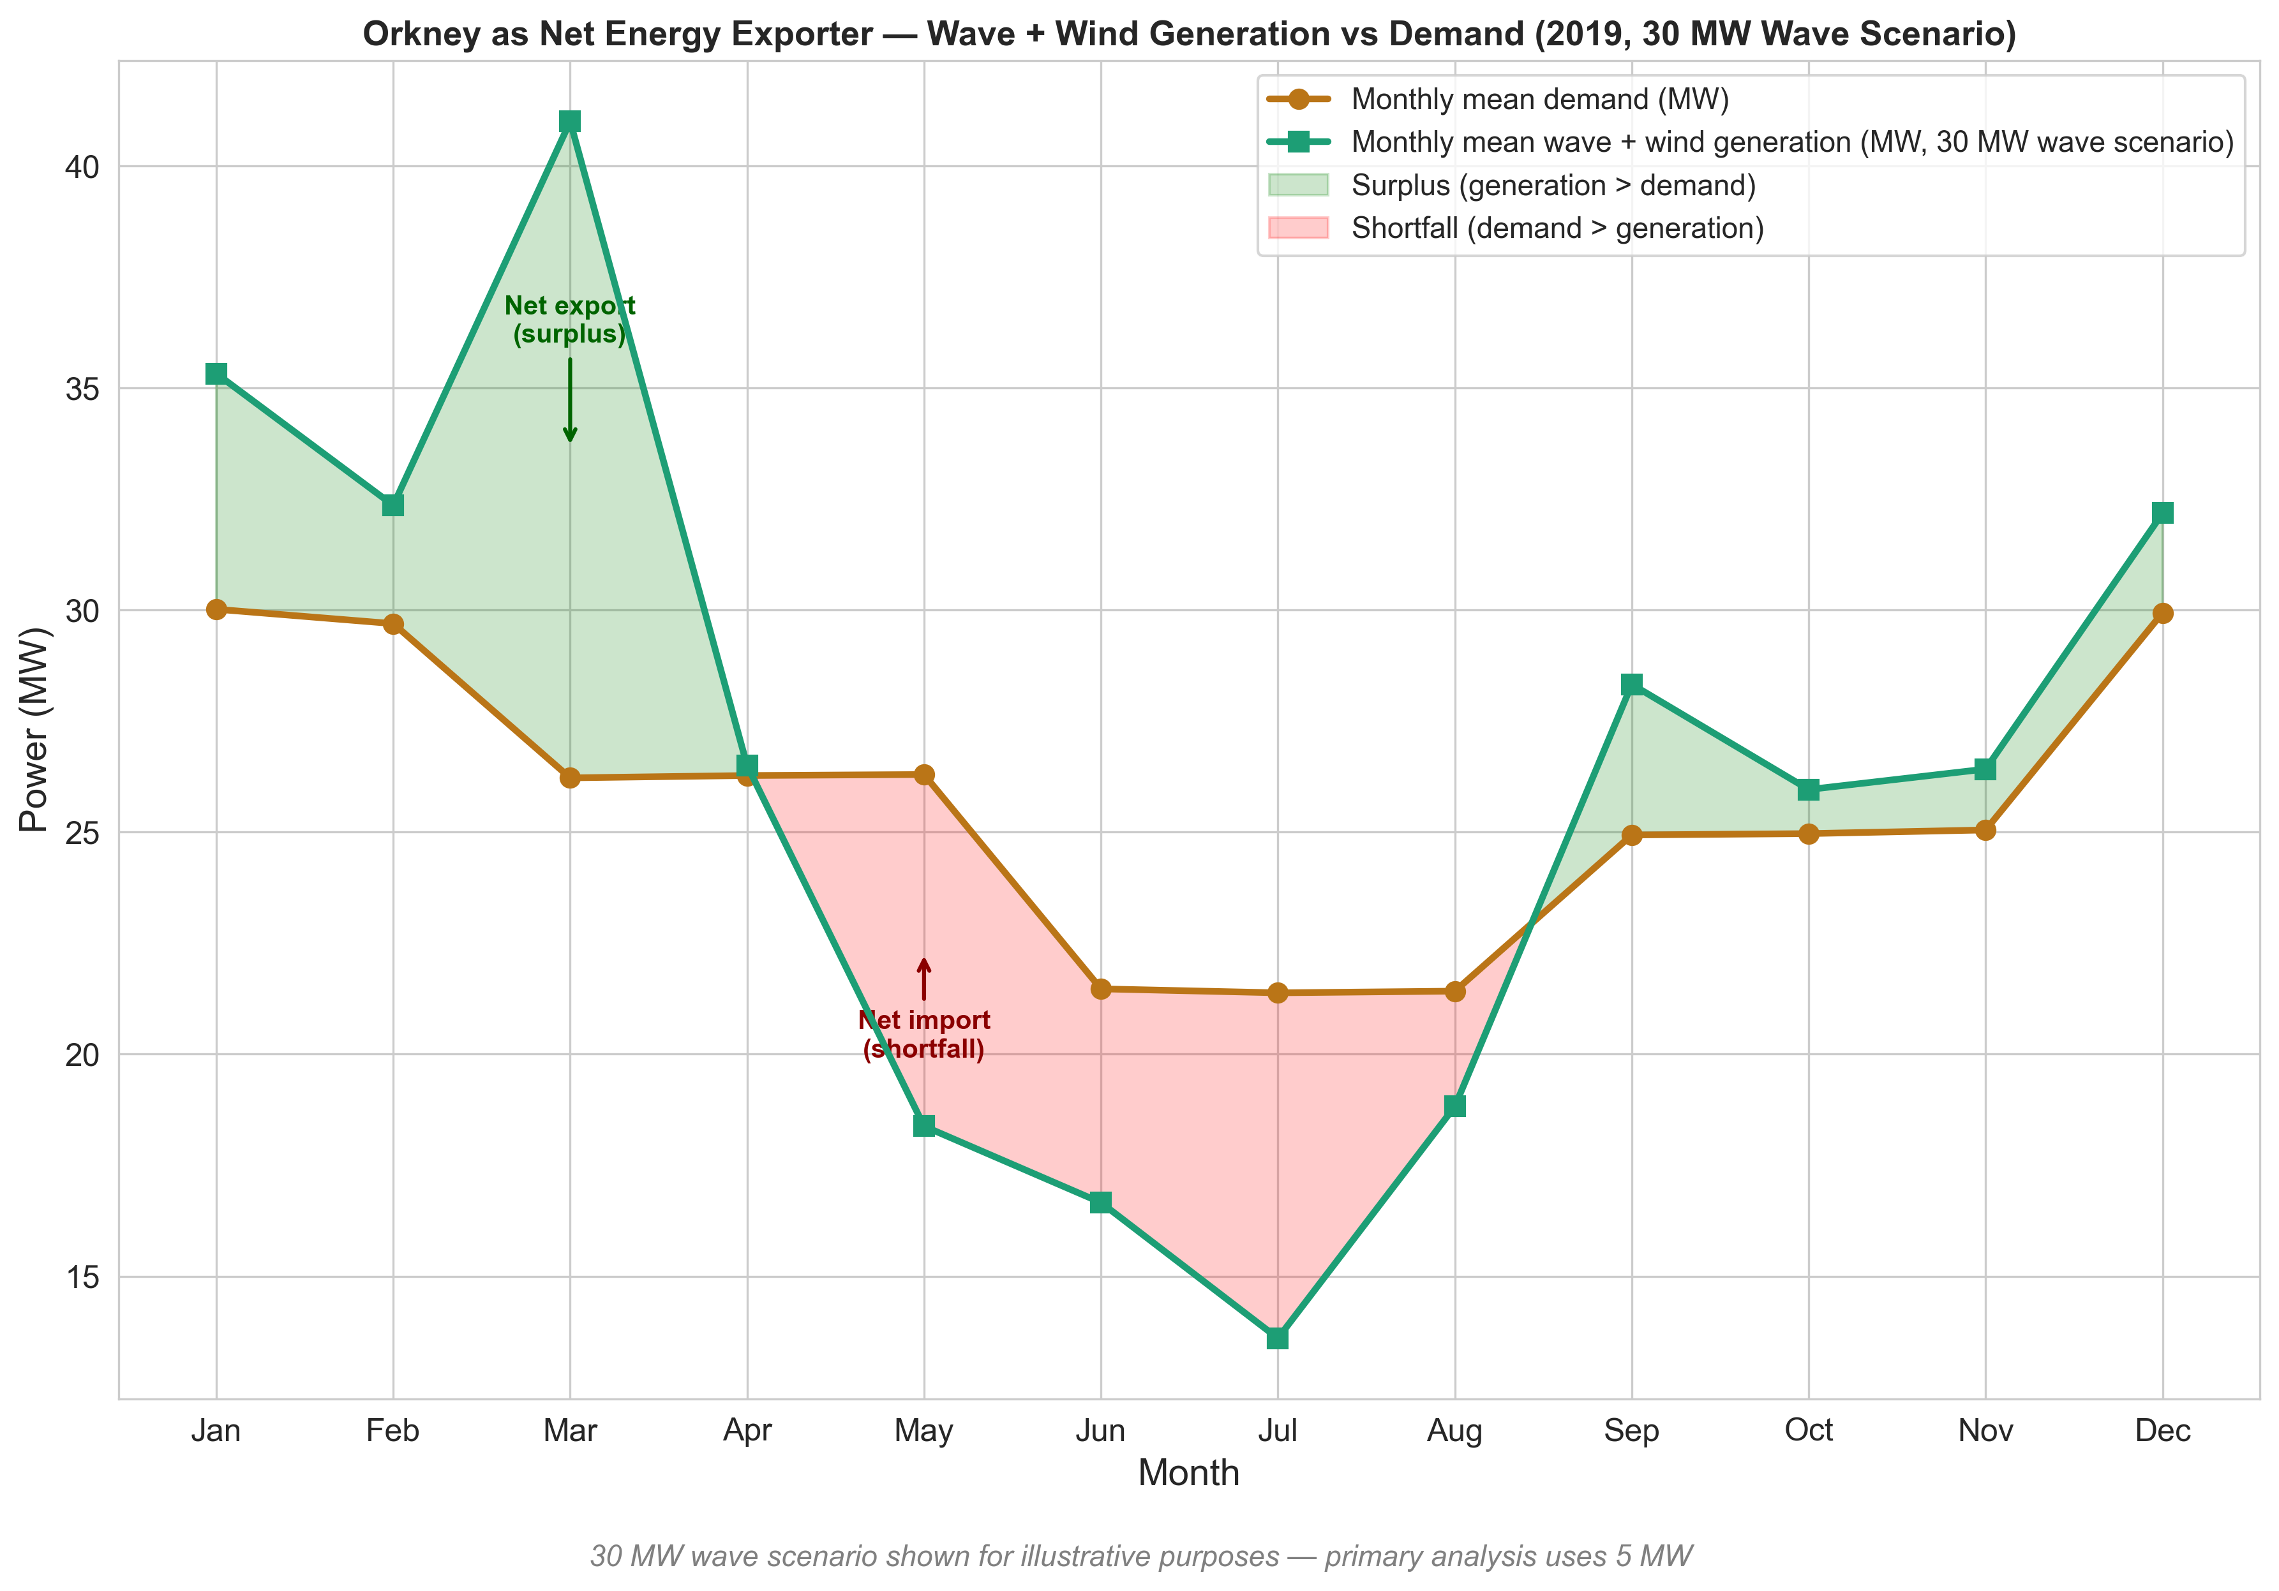
Assessing the Complementarity and Grid Integration Potential of Wave Energy in Orkney Under Current Grid Constraints
Key insight
Figure 6 Isolates the variable renewable contribution showing exactly what wave adds to existing wind before any baseload is counted.
Adding tidal's constant 11.6 MW to every month would shift the green generation line upward uniformly, potentially flipping the summer shortfall into a slight surplus at 30 MW wave capacity.
The real operational question is therefore not whether Orkney can cover demand, but whether the grid can handle the resulting export peaks in winter and variable renewable shortfall in summer.
Figure 6 — Monthly Mean Demand vs Variable Renewable Generation (30 MW wave scenario) | Variable renewables only — wind plus wave. Tidal baseload (EMEC 4 MW + Eday 7.6 MW = 11.6 MW constant) and battery storage not included. Full system balance including all generators and interconnector flows is captured in the PyPSA scenario analysis.

Slide 9
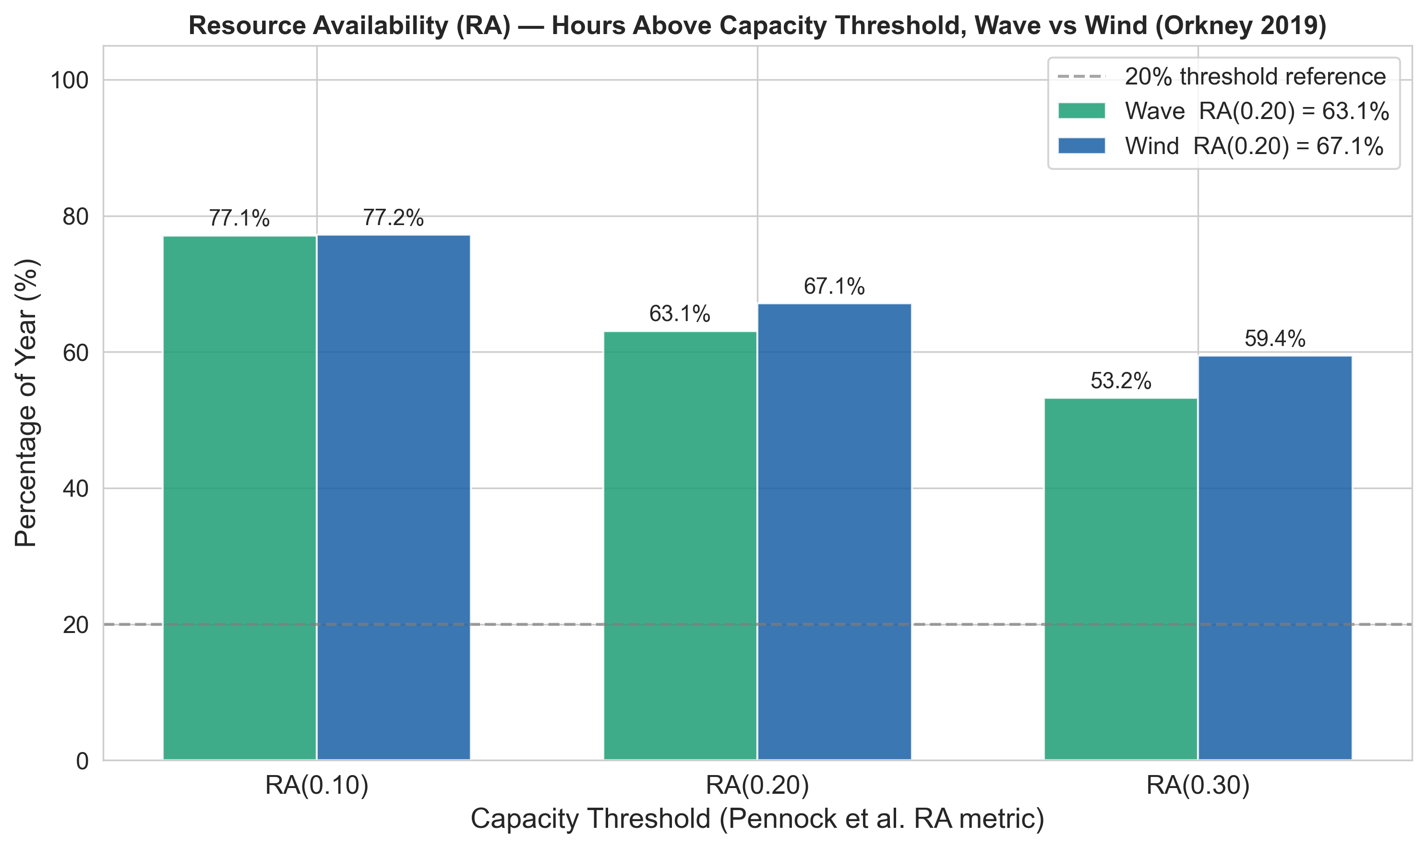
Assessing the Complementarity and Grid Integration Potential of Wave Energy in Orkney Under Current Grid Constraints
Figure 6: Resource Availability (Pennock et al. 2022 RA metric) | Wave RA(0.20) = 63.1%, Wind RA(0.20) = 67.1%. Wind is more consistently available at stricter thresholds due to its steadier output profile.

Slide 10
NEXT TASKS
Complete the CSV incorporation for the wave energy generation (changing from a hardcoded 7MW to time)
Run the wave energy scenarios from 5MW to probably 30MW
Run the complementarity analysis using the selected metrics (8)
Validate demand data for the year
Add tidal data
Voltage implications, demand and supply
Slack generators (Look into how it helps the network)
Use gas, slack, and existing storage
Validate the storages in Orkney (Like a call to validate the data with EMEC). Look online and check if the assets are still there

Slide 11
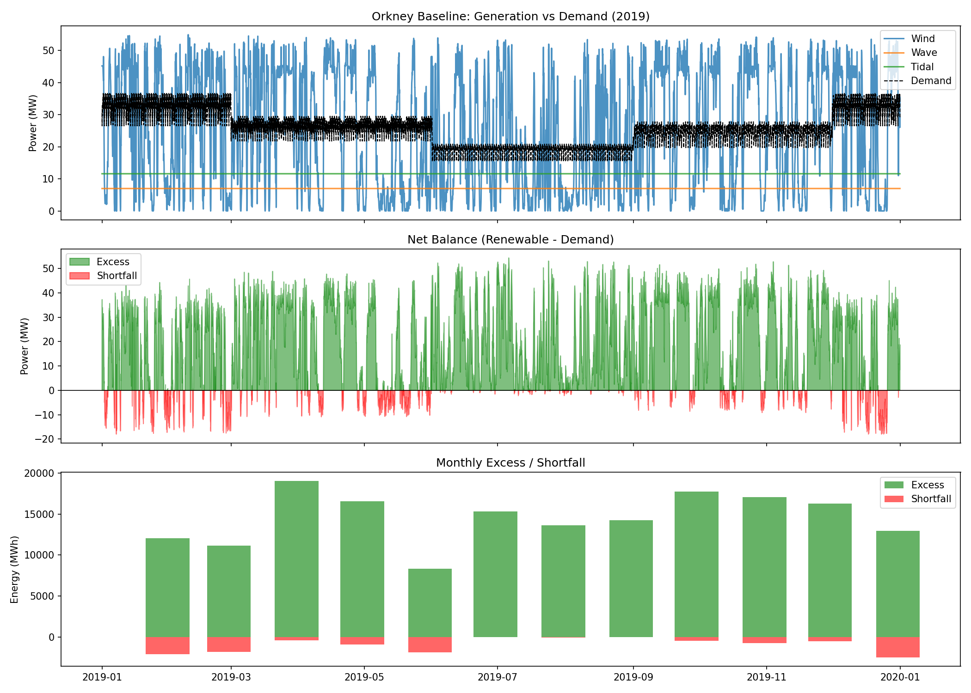

Slide 12
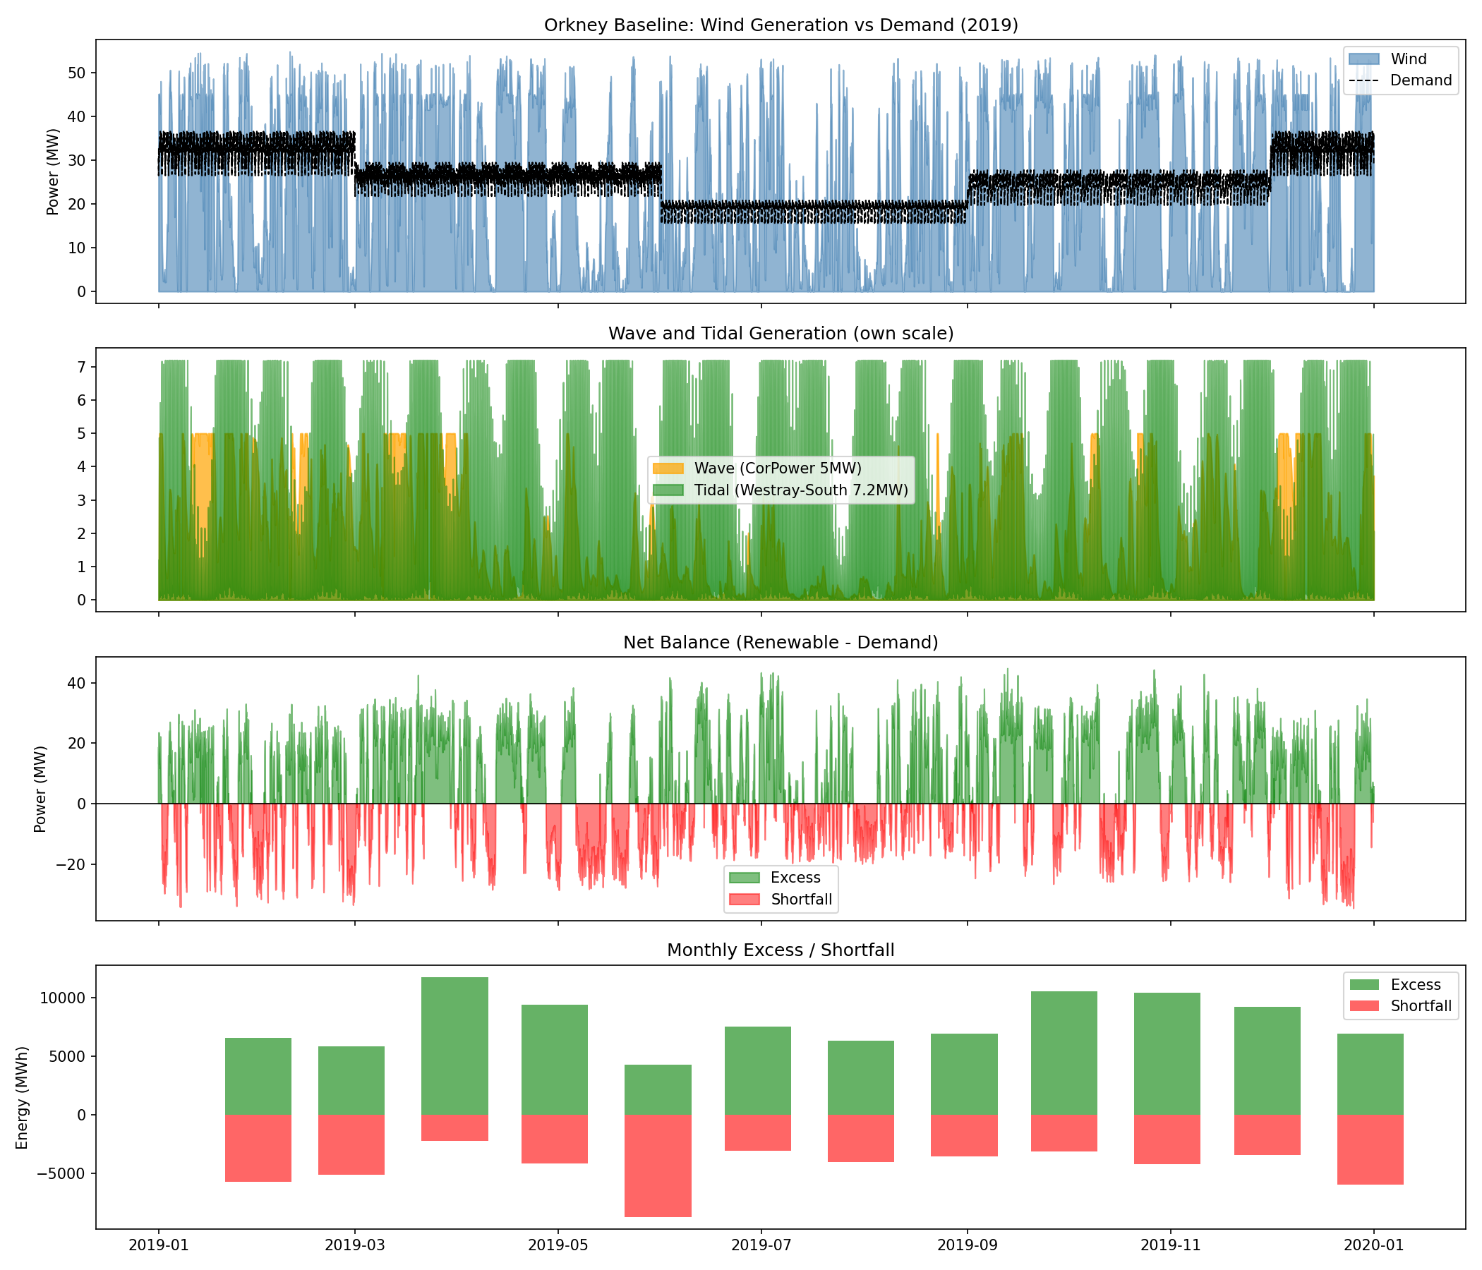
ORKNEY ENERGY BALANCE - CORPOWER 5MW WAVE + REAL TIDAL (2019)
Total wind generation : 224249.4 MWh
Total wave generation : 18101.3 MWh
Total tidal generation : 24817.0 MWh
Total renewable generation : 267167.7 MWh
Total demand : 224420.5 MWh
Annual net balance : 42747.3 MWh
Hours of shortfall : 3799
Hours of excess : 4961
Max excess power : 44.7 MW
Max shortfall power : -34.7 MW
Wave capacity factor : 0.295

