Slide 1











ICT & Software
S o l u t I o n
BluWire Integrated Ltd
I CT & S O F T W A R E S O L U T I O N S
BluWire-il.com
info@bluwire-il.com

Slide 2
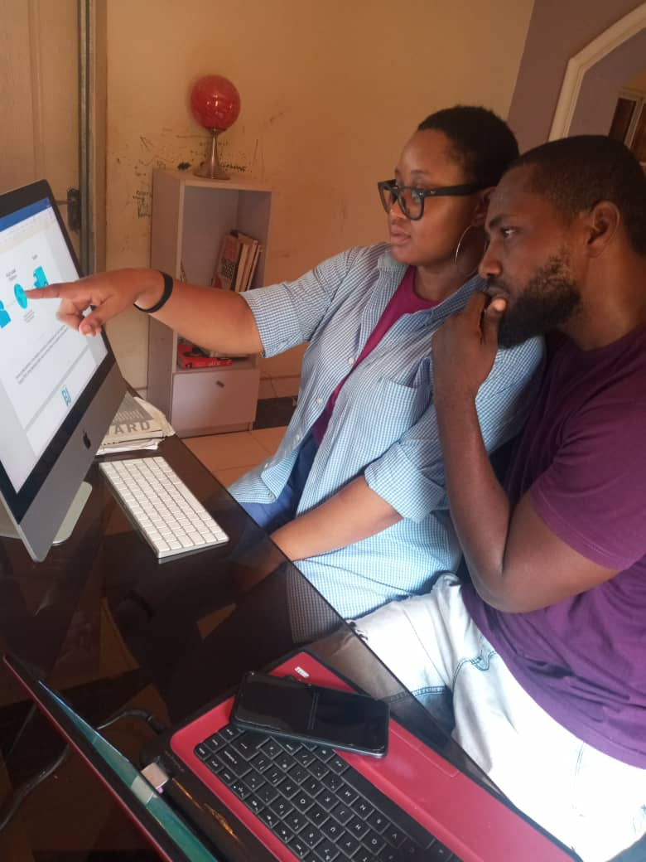
Who We Are?
Who We Are.
Bluwire Integrated Ltd, in the service of your future!
BluWire Integrated Ltd is an international IT Business Solutions and Consultancy firm headquartered in Jabi, Abuja.
Established in 2020, BluWire provides global services to its clients through its offices in Jabi, and Kuje.
BluWire Integrated Ltd. Is company that has strategic business partnerships with many leading and key players in the technology industry.

Slide 3







OUR VISION
O U R V I S I O N
To be the leading service platform at a local and international level.

Slide 4

OUR MISSION
O U R M I S S I O N
To be the most trusted platform for all sorts of home, office and school services needed by consumers at local and international level.

Slide 5


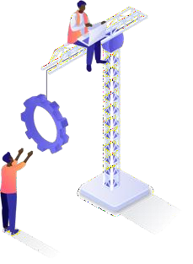



OUR VALUES
A V I S I O N T H AT G I V ES
T H E R I G H T D I R EC T I O N
TRANSPARENCY
O U R V A L U E S
5 fundamental characteristics
Five core characteristics deﬁne who we are
and how we work.
CHALLENGE
They help us continue to build the ﬁnest tailored made digital solutions and custom made apps both on time and within budget for our partners and clients.
I M P A C T
RESPONSABILITY

Slide 6

OUR VALUES
I M P A C T
The benefits of
the community
BluWire believes in beneﬁting the community with its diverse technological knowledge, creativity, and expertise.
In every approach, we create something that can be helpful not only to improve the life of our partners to progress their business but also to create a signiﬁcant impact in the market.

Slide 7

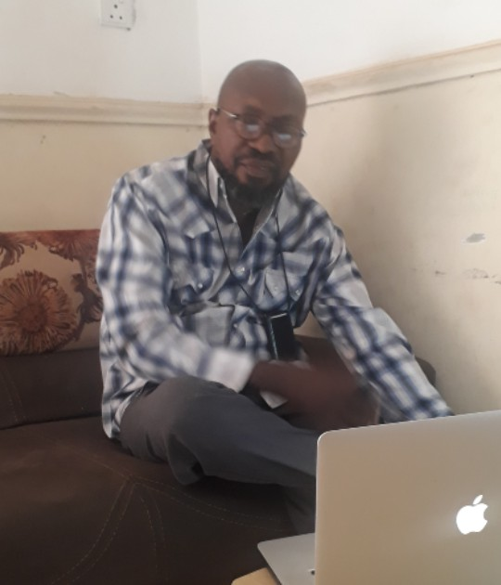


OUR LEADERS
Sunny Williams Ohikhokhai
A large-scale CEO
Sunny Williams Ohikhokhai has more than 15 years of experience in selecting and subcontracting temporary staff in sub- Saharan Africa for multinationals in the ICT, real estate, survey and construction industries.
We a r e t h i s BluWire w h i ch i s ca l l ed t o b e com e a b i g t r ee w i t h m a n y b ranches h a v i ng f o r vo cat i on t o b r i ng
o u r co nt r i bution i n t h e d evelopment o f o u r co untry
i n p a r t i cular a n d o f A f r i ca i n g eneral.

Slide 8
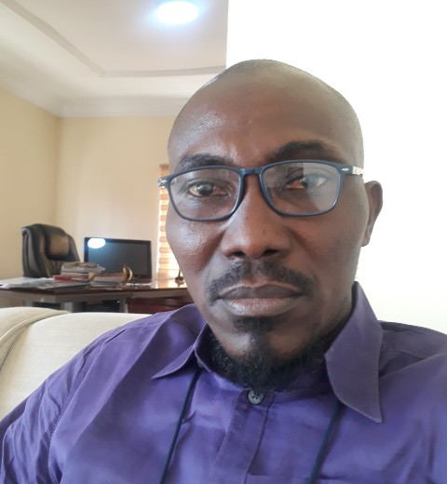
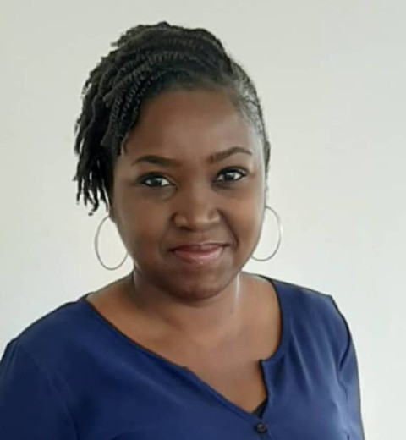
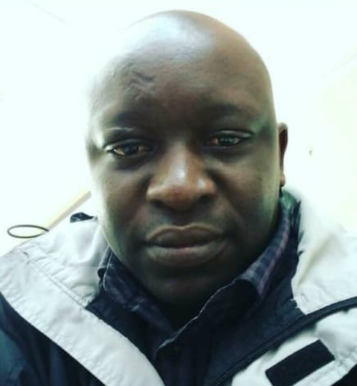
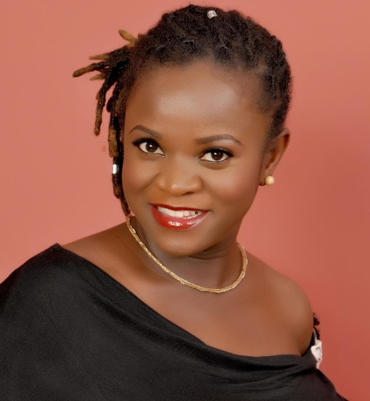
Meet the Team
OUR LEADERS
The positive distinction within the World Inspiring of Success and Connections of People and Organizations.
Kingsley Odume
Programmer
Agnes Audu
Content Manager
Timi Akande
Business Analyst
Ndeya Williams
Human Resource Manager

Slide 9





OUR SERVICES
O U R S E R V I C E S
BluWire, technological solutions for everything!
I C T / I T / I T E S S E R V I C E S
Software solutions Web portal solutions Mobile Applications E-commerce
O U T S O U R C I N G
Business process outsourcing Outsourcing of costs Integrated management
Back-office transaction management
C Y B E R S E C U R I T Y
Cloud support
Spyware Anti-piracy
E D U C A T I O N
Tool training
Coaching on improvements Problem solving
C O N S U L T A N C Y
Personalized advice Analysis and improvement Adapted solutions

Slide 10


I CT / I T / I T ES SERVICES
S O F T W A R E S O L U T I O N S & S E R V I C E S
We develop modern solutions where you need them most.

Slide 11

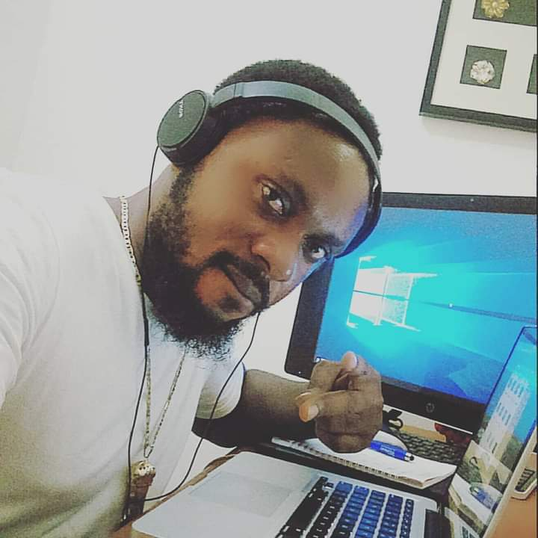

S O F T W A R E S O L U T I O N S
I CT / I T / I T ES SERVICES
T E L ECO M B I L L I N G , T T S ,
C R MS , C A L L C E N T E R A N D
OT H E RS C U STO M
E N T E R P R I S E S O LU T I O NS
A RT I F I CI AL I N T E L L I G E NCE ( A I ) ,
MAC H I N E L EA R N I NG ( ML )
A N D D E E P L EA R N I NG ( D L ) BA S E D TO O L S A N D S O F T WAR E D E V E LO P M E N T
B U S I N ES S P RO C ES S AU TO M AT I ON,
O P T I M I ZAT ION, A R
( AUG ME N TE D R EA L I T Y )
A N D V R ( V I RT UA L
R EA L I T Y ) TO O L S D ES I G N A N D D E V E LO P M E N T
F I N T ECH , C B S , BA N K I NG
S O LU T I O NS A N D M FS ( M O B I L E F I N A NC I A L S E RV I C E )
E - CO M M E RCE A N D
C USTO ME R S O F T WARE
I M P L E M E N TAT ION
& S E RVIC ES

Slide 12



S O F T W A R E
I CT / I T / I T ES SERVICES
S O L U T I O N S
E N T E R P R I S E R ES O U RC E P L A N N I NG ( E R P ) M O D U L ES L I K E
AC CO UN T I NG, F I N A NC E , H R MS , PAY RO L L , O P E R AT IO N A N D
P RO D U C T I O N M O N I TO RI NG A N D Q C M O D U L ES D ES I G N A N D D E V E LO P M E N T
B U S I N ES S P RO M OT IO N, B US I N ES S I N T E L L I GE NC E A N D 3 6 0 D EG R E E
R E P O RT I NG TO O L S D ES I G N A N D
D E V E LO P M E N T
E - H EALT H CAR E ,
H O S P I TAL
M A N AGEM E NT, R EA L - ESTAT E , P O S A N D
VA R I O U S T Y P ES O F M I C RO A N D M AC RO
S E RV I C E AU TO M AT I ON
E - L EA RNI NG, E D U C AT I O N
MA N AGEME NTS A N D E -
G OV E R N ANCE
M A N AGEM E NT SYST E M D ES I G N A N D
D E V E LO P M E N T
SA L ES FO RG E A N D O F F I C E AU TO M AT I ON
M A N AGEM E NT SYST E M FO R PA P E R L ES S
M A N AGEM E NT S E RV I C ES.
E - CO M M E RCE E T
I MP L É ME N TAT ION
D E LO G I C I E L S C L I E N
& S E RVIC ES

Slide 13
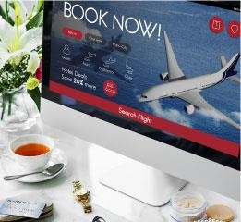

S O F T W A R E S O L U T I O N S
I CT / I T / I T ES SERVICES
E - T I C K ING A N D O N L I N E B O O K I N G/ R ESE RVAT ION M A N AGEM E NT SYST E M FO R B U S , A I R , L AU N C H
A N D A L L T H R E E - TO- F I V E - STA R H OT E L A N D R ES O RT S .
C U STO M E N T E R P RI SE
B US I N ES S A P P L I C AT IO N
A N D S O F T WAR E
S O LU T I O NS C U STO M E R N E E D BA S I S
DATA S C I E N C E , DATA A N A LYS I S , B I G A DATA -
BA S E D B U S I N ES S
D ES C R I P T IV E , P R E D I C T I V E A N D P R ES C R I P T IV E DATA M I N I N G TO O L S D ES I G N
A N D D E V E LO P M E N T
T EC H N OLO GY I N T EGR ATI ON W I T H AG R I C U LT U RAL TO MA X I MI Z E H I G H P RO D UC T I V I T Y A N D B E T T E R S UP P LY C H A N G E M A N AGE M ENT
A N D R E P O RT I N G SYST E M
DATA S EC U R I T Y, I C T
S EC UR I T Y A N D OT H E R
S EC U R I T Y S E RV I C ES
& S E RVIC ES

Slide 14

I CT / I T / I T ES SERVICES
P O R T AL W E B
& S O L U T I O N S A P P L I C A T I O N
We are continually
innovating in web and mobile development technologies.

Slide 15



W E B P O R T A L
I CT / I T / I T ES SERVICES
W E B P O RTA L , W E B S I TE A N D OT H E R CO N T E NT M A N AGEM E NT SYST E M ( C M S ) D ES I G N A N D
D E V E LO P M E N T.
P LU G I N , M O D U L ES A N D CO MP O N EN TS D ES I G N A N D D E V E LO P M E N TS
FO R VA R I O U S W E B A P P L I C ATI ON
W E B A P P L I C AT IO N
T EC H N I CAL S UP P O RT &
M A I N T E NANCE
W E B S I T E A N D W E B
A P P L I C ATI ON D O MA I N &
H O ST I N G S E RV I C E
W E B S I T E A N D DATA
S EC UR I T Y
& APPL IC ATION S S OLU T ION S

Slide 16

I CT / I T / I T ES SERVICES
M O B I L E A P P L I C A T I O N S
We innovate on mobile
platforms in order to always offer the best experiences.

Slide 17



M O B I L E
I CT / I T / I T ES SERVICES
N AT I V E A N D
C RO S S - P L ATFOR M MO B I L E
A P P D E V E LO P M E NT
A N D RO I D
A P P L I C ATI ON
I O S
A P P L I C ATI ON
M O B I L E A P P A P I D ES I G N A N D D E V E LO P M E N T
E - CO M M E RCE E T
I MP L É ME N TAT ION
D E LO G I C I E L S C L I E N
APPL IC ATION S

Slide 18

CYBER S E CU R I TY
C Y B E R S E C U R I T Y S Y S T E M
We ensure the security
of your web media.

Slide 19

S U P PO R T CLOUD
CYBER S E CU R I TY
C Y B E R S E C U R I T Y S Y S T E M
Safety first!
BluWire offers a wide range of cloud support and cyber security services to fit your business applications.
Microsoft for Azure cloud support.
We give you access to our AWS and Microsoft certified professionals and tools to guarantee that your infrastructure is secure and scalable.
C Y B E R S E C U R I T Y

Slide 20


CON S U L TAN CY
S E CU R I TY
C O N S U L T A N C Y S E R V I C E S
We provide our
strategic advice
for better management of your human resources and customers.

Slide 21

CON S U L TAN CY
S E CU R I TY
C O N S U L T A N C Y S E R V I C E S
Beneficial tips
We provide consultancy services to finance institutions, health care sector, government sector and the manufacturing sector.
We pay full attention to customers, whether it concerns a Five-page web site or a fully-fledged ERP to be designed. We also take pride in the fact that customers right from inception have continuously added to our client list.

Slide 22

TRANING SERVICES
F O R M A T I O N S E R V I C E S
We are involved in training
your talents to ensure a sustainable future.

Slide 23


TRANING SERVICES
E D U C A T I O N / T R A I N I N G
B U S I N E S S A N A L Y S I S
C O N S U L T A N C Y S E R V I C E S
Training is ensuring a sustainable
Future
BluWire in association with Silex Secure Lab and offer in-house training of its consultants and new recruits on cutting edge Business Analysis, Consultancy Services, Professional Project Management, Database Administration, Corporate & School Training and Network Administration tools that are being directly used on the job.
P R O F E S S I O N A L P R O J E C T M A N A G E M E N T
D A T A B A S E
A D M I N I S T R A T I O N
N E T W O R K
A D M I N I S T R A T I O N
C O R P O R A T E T R A I N I N G
S C H O O L T R A I N I N G
The impact of such training is high performance of these consultants and new recruits in their respective areas of training.
BluWire therefore will lay special emphasis on training and develop it as a core service to its clients.

Slide 24
OUR PRODUCTS
O U R P R O D U C T S
Provide excellent services in the IT industry by putting
focus on customer satisfaction.

Slide 25
OUR TOOLS
O U R D E V E L O P M E N T T O O L S
In this constantly evolving
technological world, we constantly make sure
to be u p to date with the latest innovations.

Slide 26


OUR TOOLS
O U R D E V E L O P M E N T T O O L S
BluWire, tools at the top of technology!
W E B A P P L I C A T I O N S
& S O F T W A R E U I D E S I G N
D A T A B A S E
S Y S T E M
HTML 5 / XHTML, CSS,
JavaScript, Bootstrap (responsive), JQuery, JSON, AJAX et autres
REACT and NODE JS
Postgres SQL My SQL
SQL Server
P R O G R A M M I N G L A N G U A G E
M O B I L E
& T A B L E T
PHP, PYTHON and JAVA
JavaScript.
IOS Native Android Natifve

Slide 27


















OUR TOOLS
W E B A P P L I C A T I O N & S O F T W A R E U I D E S I G N
P R O G R A M M I N G L A N G U A G E
D A T A B A S E
M O B I L E & T A B L E T

Slide 28

OUR P L AT E F OR M
O U R D E V E L O P M E N T P L A T E F O R M
BluWire, platforms adapted to all your needs!
F R A M E W O R K
Django, CakePHP, CodeIgniter, Laravel, J2SE, j2me (Spring, Maven) JSP, Drupal
C M S / C R M
E - C O M M E R C E
CMS WordPress, Jommla, OS-Commerce, Zencart, X-Cart, Cre-Loaded, Shopify, Magento, Prestashopping card

Slide 29
OUR CLIENTS
O U R C L I E N T S
At BluWire, we see
our customers as our partners and we make it a point of honor to move forward together in the same direction.

Slide 30

“
The website has been working amazingly well since you've gotten it fixed. Amazing and fast service.
“
Linda Okoro

Slide 31



OUR CLIENTS
J A B I
+234 0802 872 0549
info@bluwire-il.com
Plot 24, IT Igbani Stret,
Jabi, Abuja
Nigeria
Kuje
+234 0803 450 4609
sunny@bluwire-il.com
Plot 345A AA1 Layout,
Behind Prison Command
Kuje, Abuja, Nigeria.

