Slide 1
App Inventor Final Project
Michael Nelson

Slide 2
Ideas
Bible Verse app
Student Randomizer (Chosen)
Bible Stories

Slide 3
Some User Stories
User Will be able to put names into a text box
User Will be able to Add names to a list by pressing a button
User Will be able view lists by pressing a button
User will be able edit names in a list
User will be able to press a button to randomly organize students

Slide 4
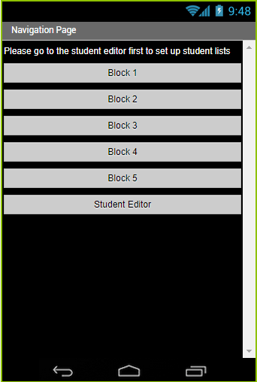
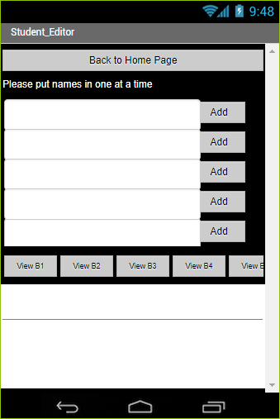
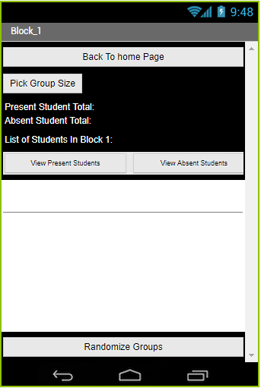
Pages
Nav Page
Student Editor Page
Block 1-5 Randomizer

Slide 5
Sprints
Sprint 1-UI and Layout
Sprint 2-Randomizing
Sprint 3-Student Editing

Slide 6
Challenges
Making the randomizer work
Making it look Decent

Slide 7
Success/ Failures
Successes
Randomizer works well
Made the UI work
Failures
Runs slowly
Sometimes Crashes

