Slide 1
Use complex techniques to develop a digital media outcome
Achievement | Achievement with Merit | Achievement with Excellence
Use complex techniques to develop a digital media outcome. | Use complex techniques to develop an informed digital media outcome. | Use complex techniques to develop a refined digital media outcome.

Slide 2
Use complex programming techniques to develop a computer program
Achievement | Achievement with Merit | Achievement with Excellence
Use complex programming techniques to develop a computer program. | Use complex programming techniques to develop an informed computer program. | Use complex programming techniques to develop a refined computer program.

Slide 3
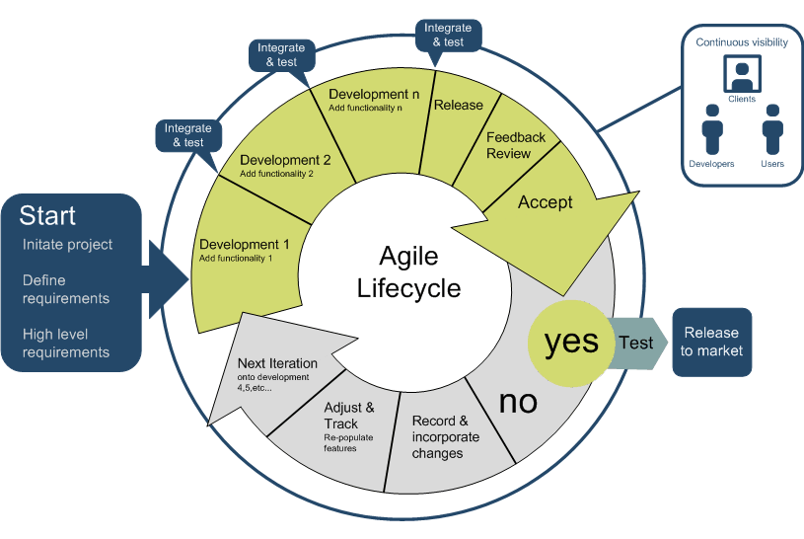
Project Management - Planning
Explain how you plan to manage the project
I plan to manage this product by iteratively working through the website in the order that a user would see it in. Starting with the sign up page, moving on to log in, post creation, etc. This will create an intuitive project creation order.

Slide 4
Describe the purpose and target audience of your website
Describe the purpose of your website?
The purpose of my website is to inform people who are interested in getting into speedrunning Arkham shadow about what is needed and how to do it, as well as allowing current speed runners to discuss strats.
Describe who the target audience are?
The target audience is current speedrunners of Arkham shadow and people who are interested in getting into speedrunning arkham shadow.

Slide 5
Initial Specifications
What are the specifications of your project (must haves). You can add to these as you develop your project.
My client (speak22) has requested that the website
1. Works
2. Allows users to create and log into accounts, make and view posts, and view posts of other users
3. Allow users to edit posts and leave likes
4. There is a page for during speedruns and a page for setting up
5. That aesthetics and information insertion is not completed, because they want to do it themselves
6. Must be finished by August
7. Is easy to edit in future.

Slide 6
Explain the relevant implications (at least 3) Duplicate this slide.
This could include an explanation on why your outcome needs to:
be socially/culturally acceptable
honour legal, ethical and intellectual property obligations
be accessible, usable and functional
be sustainable and future proof
effectively use web design conventions.
Examples of relevant implications include:
● social
● cultural
● legal
● ethical
● intellectual property
● privacy
● accessibility
● usability
● functionality
● aesthetics
● sustainability and future proofing
● end-user considerations
● health and safety.

Slide 7
Relevant Implications
Implication 1: Sustainability and future proofing
Describe the implication?
This implication relates to the outcome being able to adapt to the future and being able to be changed if needed
How does this apply to your project?
This applies to my project because new information in speedruns is always being discovered and because technology changes can sometimes cause something to stop working and my client may want to change things
How do you plan to address this implication?
I will address this implication by commenting my code so that others can more easily tell what does what if it needs to be edited in the future.

Slide 8
Relevant Implications
Implication 2: privacy
Describe the implication?
This implication is about protecting the information of users.
How does this apply to your project?
This applies to my project because when users create an account, they enter a password, and many people use the same or similar passwords for everything, which means that it is important that user passwords are kept safe.
How do you plan to address this implication?
I will address this implication by using an encryption key to encode passwords before storing them in the database, so if there is a data breach it will be difficult to read the password.

Slide 9
Relevant Implications
Implication 3: accessibility
Describe the implication?
This implication relates to the website being able to be used by all users
How does this apply to your project?
This relates to my outcome because some users may be using phones, while some may use computers, and some users may be using different browsers, and it is important that all of them can use the website to keep it accessible
How do you plan to address this implication?
I will address this implication by making the navbar shrink to fit with screen size, and if it is too small it will compress into a dropdown menu, and I won’t use any browser specific features in the code.

Slide 10
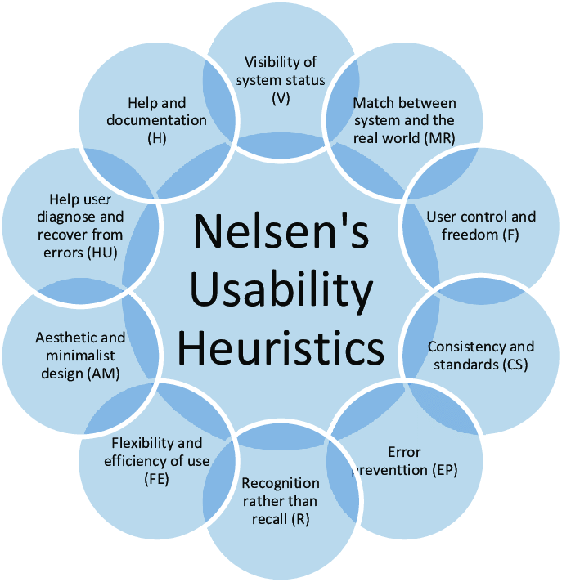
User Experience Principles
Describe the most relevant HCI rules
1. Helps users diagnose and recover from errors
This principle is about letting users know when there is an error, and helping them to fix it
2. Consistency and standards
This principle is about keeping details of the website consistent with the rest of the website as well as with other websites.
3. Visibility of system status
This principle is about telling users what is going on with the system.

Slide 11
HCI
Summarise the most relevant usability rules and how they apply to your project (duplicate slide)
Helps users diagnose and recover from errors.
This principle is about helping users figure out what went wrong after an error has happened and helping them to fix it. This applies to my outcome because when a user is creating an account, or creating posts, there are invalid things that they can do, so it is important to tell them what they are doing wrong if they do. I will address this principle by using flash messages to tell users what they did wrong after they try to do something invalid.

Slide 12
HCI
Summarise the most relevant usability rules and how they apply to your project (duplicate slide)
Consistency and standards
This principle is about keeping details of the website consistent with the rest of the website and other websites to ensure that users are easily able to understand what is what. One area of my outcome that this applies to is my flash messages. I will be making red messages for errors and green messages for successes because that is standard convention and people recognise them.

Slide 13
HCI
Summarise the most relevant usability rules and how they apply to your project (duplicate slide)
Visibility of system status.
This principle is about telling users what's going on with the website, so they can know what is happening and if they need to do anything. I have addressed this principle by using flash messages to tell users what is happening with the website.

Slide 14
Relevant Conventions
These could include:
Coding conventions – HTML, CSS (validated)
Coding conventions – Python (PEP8)
File Naming and file management
Web design conventions
Commenting
Usability Heuristics
Visual Hierarchy

Slide 15
Relevant Conventions
Discuss how you plan to apply relevant conventions to improve the quality of your outcome.
One way I will improve the quality of my outcome is by commenting my code, which will allow others to more easily edit my code in future.
I will also use PEP8 coding conventions for my python files such as indenting to allow users to better know what is happening.
I will also apply the HCL user experience principles as mentioned in previous slides.
As well as these things, I will have different sized headings to make the natural order of the website (what is included in what) more clear.
I will also use file names and variable names intuitively for convenience of later editing.

Slide 16
Design Drawings
Site Map
Since client has requested to do design themselves, I will have to be skipping this

Slide 17
Test Plan
How are you going test your program
to ensure it functions correctly
That the python code is PEP8 compliant
for validation and error correction
Is well structured
Is flexible and robust
Comprehensively tested and debugged
I have been testing the website throughout the creation of the website, and I have a table of all significant bugs that I found while creating the website. I will go through and double check all edge cases, and I will run the code through a PEP8 validator to make sure it is PEP8 compliant. I will then be getting some classmates and friends to test.

Slide 18
Test results
Summarise the results of your testing and how you addressed any issues or problems that arise during testing. Make sure you get others to test your site and get feedback.
Test for: sign up | Expected | Actual
Email blank | Tell user that email is invalid | Tell user that email is invalid
Username blank | Tell user that username must be at least 2 characters | Tell user that username must be at least 2 characters
Password blank | Password must be at least 8 characters | Password must be at least 8 characters
Confirm password blank | Passwords must match (assuming password was entered) | Confirmation password does not match

Slide 19
Test results
Summarise the results of your testing and how you addressed any issues or problems that arise during testing. Make sure you get others to test your site and get feedback.
Test for: sign up | Expected | Actual
Email taken | Tell user that email is taken | Tell user that email is taken
Username taken | Tell user that username is taken | Tell user that username is taken
Differing passwords | Tell the user passwords must match | Tell user that passwords must match
Password length 7 or 21 | Password must be at least 8 characters, or password must be less than 20 characters respectively | Expected

Slide 20
Test results
Summarise the results of your testing and how you addressed any issues or problems that arise during testing. Make sure you get others to test your site and get feedback.
Test for: sign up | Expected | Actual
Password length 8 9 20 or 21 | Work | Work
Length username= 1 or 21 | Tell user that username must be at least 2 characters or tell user it must be at most 20 characters | Didn’t work for 1, did work for 21 Fix: Added max username length 20
Length username= 2, 3, 19, or 20 | Work | Work
Invalid email | Doesn’t let them submit | Expected

Slide 21
Test results
Summarise the results of your testing and how you addressed any issues or problems that arise during testing. Make sure you get others to test your site and get feedback.
This is where I tested deleting stuff, It all works, all deletes everything it should
Test for: log in | Expected | Actual
Leaving a field blank | Tell user the field doesn’t match | Tell user the field doesn’t match
Incorrect email | Tell user email doesn’t exist | Expected
Password | Tell user password incorrect | Expected
Intended | Work | Work

Slide 22
Test results
Summarise the results of your testing and how you addressed any issues or problems that arise during testing. Make sure you get others to test your site and get feedback.
Test for: Post creation | Expected | Actual
Title blank | Tell user they can’t leave title blank | Expected
Content blank | Tell user that they cant leave content blank | Expected
Valid | Works | Works

Slide 23
Test results
Summarise the results of your testing and how you addressed any issues or problems that arise during testing. Make sure you get others to test your site and get feedback.
Test for: Post update | Expected | Actual
No post | Tell the user post doesn’t exist | Expected
Trying to update another users post | Tell user that they can’t update another user’s post | Expected
Making title or content blank | Tells user they can't | Works Fix: added checks
Not changing anything | Tells user they didn’t change anything | Expected, except that it’s a success message Fix: changed success to error

Slide 24
Test results
Summarise the results of your testing and how you addressed any issues or problems that arise during testing. Make sure you get others to test your site and get feedback.
Test for: Comment update | Expected | Actual
No comment | Tell the user comment doesn’t exist | Expected
Trying to update a comment they cant | Tell user that they can’t update another user’s comment not on their post | Expected, except missing the not on their post Fix: added it
Making it blank | Tells user they can't | Works Fix: added check
Not changing anything | Tells user they didn’t change anything | Expected, except that it’s a success message Fix: changed success to error

Slide 25
Test results
Summarise the results of your testing and how you addressed any issues or problems that arise during testing. Make sure you get others to test your site and get feedback.
Test for: Comment creation | Expected | Actual
Leaving empty | Tell the user comment cant be empty | Expected
Trying to comment on a post that does not exist | Tell user that the post they are trying to comment on doesn’t exist | Expected
Valid | Works | Works

Slide 26
Test results
Summarise the results of your testing and how you addressed any issues or problems that arise during testing. Make sure you get others to test your site and get feedback.
Test for: Liking post | Expected | Actual
Leaving a like | Works | Expected
Removing a like | Works | Expected
Liking own post | Works | Works
Removing like from own post | works | works

Slide 27
Other test stuff
Trying to access a page you shouldn’t: Redirects and tells them they shouldn’t be there

Slide 28
User testing
Users felt it was unclear that there is a max username length, so I added an indicator
Users also noticed that the links for the info pages were in the navbar when they weren’t logged in, but it asked them to log in to access the page, so I removed the log in required part

Slide 29
Describe the end user requirements
Describe how the chosen tools and techniques to develop the website were appropriate for the purpose and end users.
End user requirements:
The website must work well
The website must be intuitive to use
The website must be accessible on different devices and browsers
Visual Studio code and git hub were appropriate tools to use because GitHub allowed me to easily work between multiple devices which allowed me to more easily make the deadline and visual studio code allowed me to code in multiple languages (html, java, css, python) in one application, which are languages that work on many different devices and browsers. Some appropriate techniques that I used were commenting, PEP8 formatting, and common sense coding. The techniques of commenting and PEP8 formatting made it easier to edit in future which was one of the things my client wanted. Common sense coding is a technique where you code a website as though you were using it, coding in the natural order. This would start with a sign up page, move onto a log in page, etc. This technique is useful for ensuring that a website in intuitive to use, because you have been using it as you made it. This was a useful technique because my end users wanted it to be intuitive to use which common sense coding did.

Slide 30
Iterative Improvement
Show how you have used iterative improvement throughout the design, development and testing process to produce a high-quality outcome. (through providing screenshots/a screencast)
Will be included in “bug-fixing” document in submission as well as in the github

Slide 31
Version Control
Show how you have used version control throughout the design, development, and testing process.
https://github.com/Kingston-Smith/Year13Digital

Slide 32
GitHub Commits
Show how you have used GitHub throughout the design, development, and testing process.
https://github.com/Kingston-Smith/Year13Digital

Slide 33
Addressing Relevant Implications
Discuss how have you addressed relevant implications?
See slides 8-10

