Slide 1
CONTEXT-AWARE
ROBOT SAFETY
Human–robot ceiling-panel installation
Zenan Wu · Luke Siniakov · Michael Magila
Primary supervisor: Associate Professor Yihai Fang
Technical support: Yizhe (Will) Wang
Notes:
Zenan | 20 seconds
Our project investigates how a robot can support a ceiling panel while a person works around it. We developed a controller that uses movement and task context, and examined its behaviour and the reported experience of the task.
Sources: Canonical paper, title, abstract and acknowledgment; team contributions supplied by Zenan on 19 September 2026.

Slide 2
Why ceiling-panel installation?
The robot supports the panel.
The worker still needs access.
Workers need room to align and fasten the panel.
Stopping too often can interrupt that coordination.
Potential beneficiaries: installation crews and the engineers
who design collaborative construction systems.
Research question: can task context improve coordination
within a fixed geometric command limit?
02
Notes:
Zenan | 45 seconds
The task combines robot-supported handling with human alignment and judgement. A simple distance rule is easy to understand, but it treats different movements similarly. An approaching worker and a retreating worker may be at the same distance while needing different coordination. Our aim was to investigate whether context helps without allowing it to increase the command beyond the geometric limit. Reduced strain, cost and environmental impact are potential motivations, not benefits measured in this study.
Sources: Paper Introduction; Bock (2015), doi:10.1016/j.autcon.2015.07.022; Wei et al. (2023), doi:10.26599/JIC.2023.9180002.

Slide 3
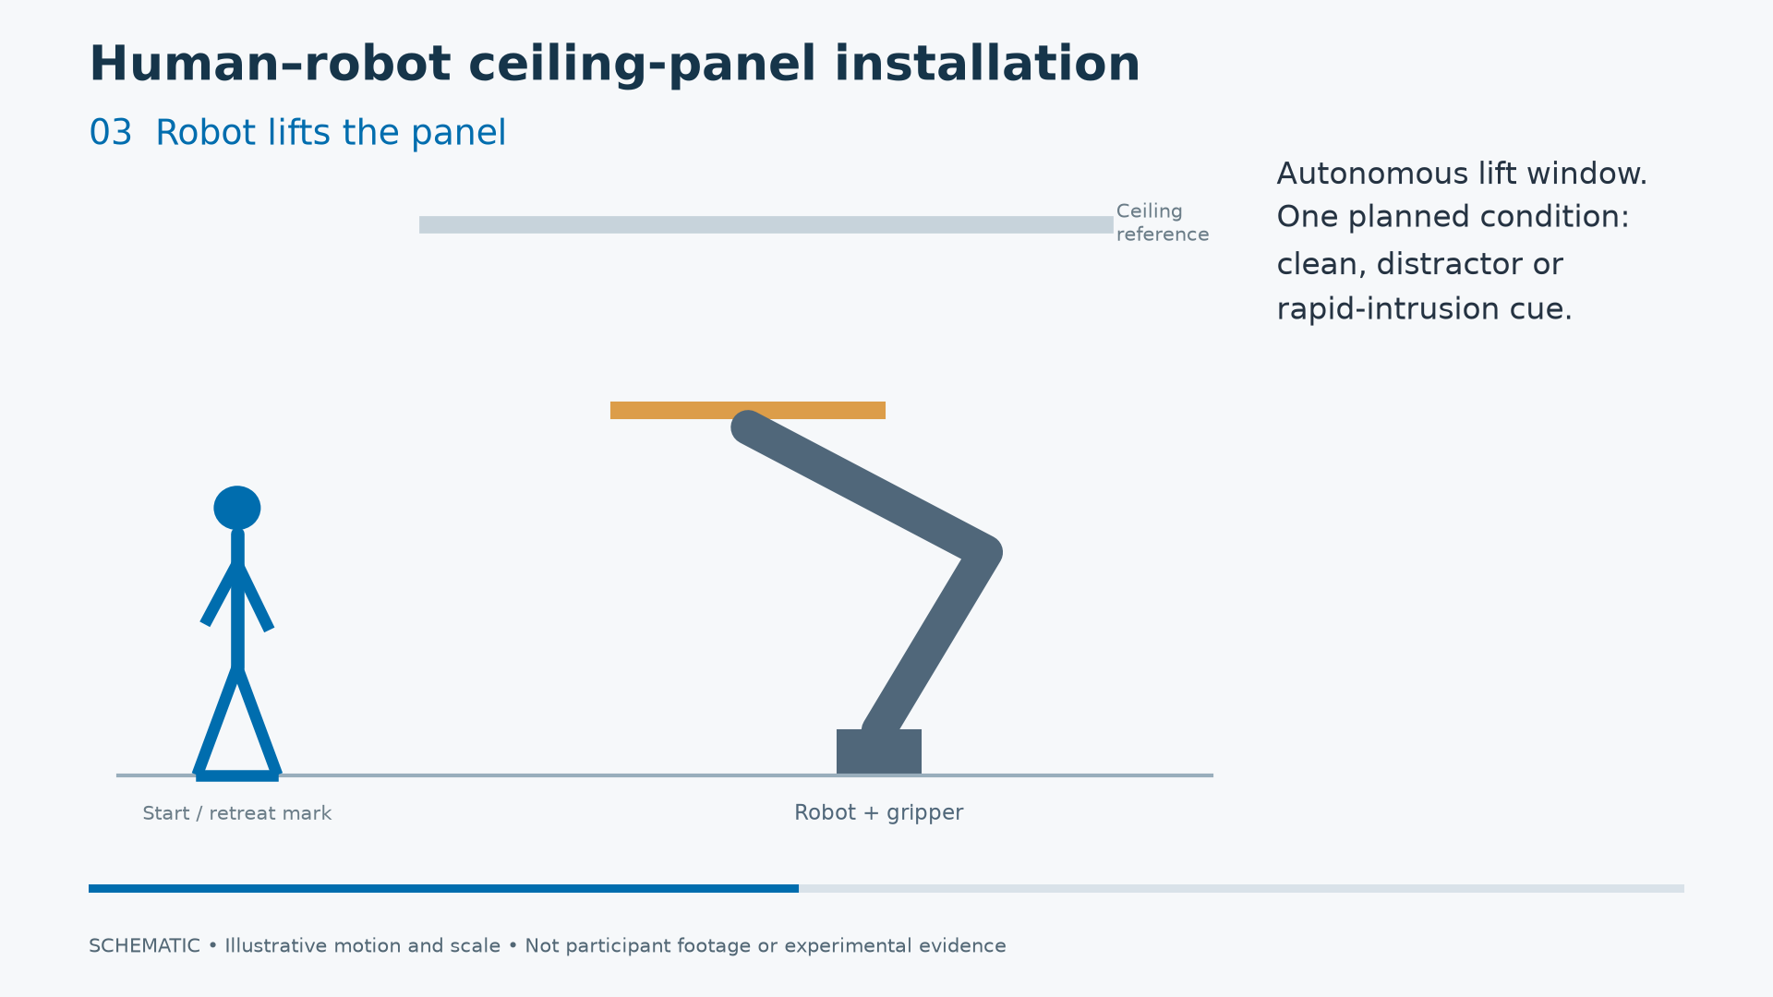
The task and laboratory prototype
UR10 robot
Panel surrogate
Optical head tracking
Body-segment tracking
Load → retreat → lift → work → retreat → lower / unload
Schematic of the procedure; scale and motion are illustrative.
03
Notes:
Zenan | 45 seconds
The laboratory system combines a UR10 robot, a lightweight panel surrogate and two tracking sources. Optical tracking supplies head position; the body-tracking suit supplies segment positions. The worker loads the panel, retreats before the lift, works near the raised panel, and retreats again before lowering. Robot position and joint motion are recorded alongside controller requests. This illustration explains the sequence; it is not experimental footage and does not simulate a measured safety outcome.
Sources: Paper System Design and Experimental Method; docs/experiment_plan.md; existing scenario-poster.png. No video playback is required for the timed presentation.

Slide 4
Why compare three controllers?
Controller | Information used | Why include it?
Fixed zone | Distance | Simple reference
Reactive | Distance + closing speed | Isolate movement information
Predictive | Reactive limit + task phase + predicted boundary approach | Test added context
Speed and separation monitoring: adjust robot motion
according to separation and movement.
Learned context can add caution; it cannot raise the speed limit.
04
Notes:
Zenan | 65 seconds
The three conditions separate the value of distance, movement and context. Fixed zones provide a simple reference. Reactive control adjusts the speed request using distance and closing speed. Predictive control adds recognised task phase and a short look ahead toward a boundary. The learned model recognises approaching, working or retreating; a separate calculation predicts boundary approach. At identical inputs and geometric state, predictive control cannot request a higher speed than reactive control. Any coordination benefit must therefore come from intervention timing or subsequent interaction, not from simply allowing faster movement.
Sources: Paper System Design; src/hrc_safety/controllers/controllers.py; Byner et al. (2019), doi:10.1016/j.rcim.2018.11.002.

Slide 5
How the prototype was evaluated
Three controller conditions, with rotated order
Routine task · Distractor · Cued rapid movement
Measurement | Purpose
Robot and tracking data | Inputs, speed requests and measured motion
After each block | Describe confidence, demand and interruption
Intake and end forms | Compare expected and experienced safety / trust
Analysed: 14 telemetry trials and 31 block responses;
11 matched intake/end sets. Complete individual linkage is unavailable.
05
Notes:
Zenan | 55 seconds
The planned design rotates fixed, reactive and predictive control across three blocks, each scheduling routine, distractor and rapid-movement trials. Objective measurements and questionnaire items address different aspects of collaboration. The analysis currently includes fourteen complete telemetry trials associated with three study IDs, thirty-one block forms associated with eleven IDs, and eleven matched intake/end sets. Nine IDs have all three block forms. Session restarts mean IDs cannot all be treated as distinct people, and telemetry and surveys cover different subsets. We therefore report descriptive findings without a statistical controller ranking.
Sources: Paper Experimental Method; data/analysis/recovered/results.json; data/analysis/questionnaires/results.json. Fourteen trials, 65,697 telemetry rows, 31 block responses, eleven matched intake/end sets.

Slide 6
Task-phase recognition
The model recognises approaching, working and retreating
32 development trials
from 3 operators
Each operator was held
out in turn during
validation.
Recognition used present and past observations.
These are development results, not a physical safety score.
06
Notes:
Zenan | 40 seconds
The model assigns each observation to one of three task phases. For the version that can operate online using only present and past observations, accuracy was 79.4 percent. Giving the three phases equal weight lowers the score to 72.5 percent, so the overall figure hides weaker performance outside the dominant working phase. Validation held out each of three development operators in turn across thirty-two accepted trials. These folds informed development, so this is a diagnostic result rather than an untouched deployment test. Recognition accuracy does not measure hazard detection or stopping safety.
Sources: data/models/pilot_hmm.json validation.online_filter_accuracy and online_filter_balanced_accuracy; paper Model Development and Validation.

Slide 7
Reported safety generally exceeded expectations
Changes between intake and end ratings
8 of 11 safety ratings increased; trust responses were more mixed.
Matched response sets, not a confirmed count of distinct people.
Expected and experienced ratings do not identify a controller effect.
07
Notes:
Zenan | 60 seconds
The safety and trust questions use five-point ratings. Eight of eleven matched safety ratings increased, one was unchanged and two decreased. Trust was more mixed: five increased, three were unchanged and three decreased. Block ratings also indicated strong stopping confidence and low demand, but these are custom individual items rather than validated composite scales. Restricting block analysis to nine complete response sets left twenty-nine of thirty medians unchanged. The paired stopping ratings did not show a uniform improvement. Familiarity and supervised operation may help explain the experience, but the data cannot isolate a predictive-controller benefit. Michael will now explain what the measurements taught us and how we managed the experimental challenges.
Sources: data/analysis/questionnaires/results.json pre_post and complete_case_median_sensitivity; paper Results and Discussion.

Slide 8
Distance measurement affects interpretation
Recorded head distance versus a calculation using robot position
Trials 1–13: earlier reference, 0.41–0.53 m.
Trial 14: live robot reference, approximately zero.
Per-trial 95th percentile. Arithmetic agreement is not validated body/panel clearance.
08
Notes:
Michael | 55 seconds
We checked the head-distance calculation against head position and the robot position recorded at the same instant. Across thirteen earlier-reference trials, the 95th-percentile discrepancy ranged from about 0.41 to 0.53 metres. The later live-reference trial agreed arithmetically. This is a discrepancy between two calculations, not a measured human–robot clearance error. The later controller also used body segment origins, which require separate validation. The practical lesson is that the robot, body, tool and panel occupy volumes: agreement for one point is not sufficient to establish protective clearance.
Sources: data/analysis/recovered/results.json head_geometry_error_p95_m; trials 1–5 P17, 6–13 P22, 14 P24; paper Geometric Inputs and Cued Movements.

Slide 9
Project management and experimental controls
Challenge | Engineering response
Hardware and software integration | Separate sensing, controller and robot interfaces; retain commands alongside measured motion
Changing geometry and variable cues | Compare geometry versions separately; check recorded movement before interpreting events
Incomplete sessions and identifier restarts | Analyse complete trial recordings; retain uncertainty in individual-level comparisons
Scope covered sensing, model development, robot control,
experimental operation and analysis.
09
Notes:
Michael | 55 seconds
The main management challenge was integrating interdependent components, not implementing a classifier alone. The sensing, control and recording interfaces had to work together. Recorded commands and measured robot motion let us examine behaviour rather than relying on command acknowledgements. Geometry differences and variable execution of cues were handled by separating configurations and checking movement evidence. Incomplete sessions and identifier restarts limited the comparisons, so the analysis uses complete trial streams and avoids inventing missing data. These setbacks changed the strength of our conclusions. Luke will now relate those findings to deployment constraints and the team’s contribution.
Sources: Repository architecture and experiment documentation; paper System Design, Methods and Limitations; original questionnaire and telemetry analysis. Controls listed as implemented analysis responses, not a claim of complete pre-experiment validation.

Slide 10
Constraints on construction deployment
Context | What deployment would require
Worker safety | Validated body, tool and panel clearance; measured stopping response and a safety-rated chain
Whole-life cost | Account for tracking equipment, calibration, maintenance and operator training
Worker experience | Assess suit restriction, workflow disruption and suitability beyond the laboratory
Environmental impact | Measure energy and material effects before claiming a carbon or waste benefit
Laboratory feasibility is one step toward a usable construction system.
10
Notes:
Luke | 45 seconds
The installed system would need validated protective geometry and stopping performance; the current software speed command is not a certified safety function. Optical and body tracking also introduce equipment, calibration, maintenance and training costs. The suit may affect movement, and a supervised laboratory task does not represent every construction worker or site. Environmental benefits were not measured: energy use and material effects would need an appropriate comparison before claiming a carbon or waste reduction. These constraints shape the engineering decision about where such a system could be useful.
Sources: Paper Safety and Efficiency Interpretation and Limitations; NIST Marvel and Norcross, doi:10.1016/j.rcim.2016.08.001. Cost and environmental entries are deployment considerations; no quantified benefits are asserted.

Slide 11
Team contribution
Team member | Main contribution
Zenan Wu | Software development and technical integration
Luke Siniakov | Communication and coordination with laboratory staff and supervisors
Michael Magila | Physical setup and assembly support
All team members contributed to experiment design
and preparation of the final report.
AI tools supported coding, analysis and manuscript preparation.
11
Notes:
Luke | 40 seconds
All three of us contributed to designing the experiment and preparing the final report. Our main areas of work differed: Zenan focused on software development and technical integration. I handled communication and coordination with laboratory staff and supervisors. Michael supported the physical setup and assembly. Bringing the technical system, laboratory arrangements and experimental design together was a shared project effort. AI tools supported coding, analysis and manuscript preparation.
Sources: Contribution descriptions and shared-work clarification supplied by Zenan on 19 September 2026; manuscript AI Assistance Declaration.

Slide 12
Contribution and conclusion
A physical test of context-aware coordination
for ceiling-panel installation
Task recognition worked imperfectly. Reported experience
was generally favourable. Geometry strongly affected interpretation.
The study does not yet establish a safety or efficiency
advantage for predictive control.
Next evidence: validated clearance and stopping measurements
with reliably linked controller comparisons.
12
Notes:
Luke | 30 seconds
The contribution is a physical construction-task prototype that separates task recognition from geometric command limits and examines objective behaviour alongside experience. Dynamic speed control and task-aware safety already exist in prior research, so we do not claim to have invented them. We demonstrated integration and obtained useful descriptive findings, but have not established that predictive control improves safety or efficiency. The next comparison needs validated clearance and stopping measurements together with reliable controller exposure. Thank you; we welcome your questions.
Sources: Paper Related Work and Conclusion; Byner et al. (2019), doi:10.1016/j.rcim.2018.11.002; Xiao Lin et al. (2026), doi:10.1016/j.autcon.2026.107067.

