Slide 1
CONTEXT-AWARE
ROBOT SAFETY
Safety and Efficiency of Context-Aware Speed and Separation Monitoring in Human–Robot Ceiling-Panel Installation
Zenan Wu · Luke Siniakov · Michael Magila
Primary supervisor: Associate Professor Yihai Fang
Technical support: Yizhe (Will) Wang
Notes:
ZENAN | 0:30
Good afternoon. We acknowledge the Traditional Owners of the land we are meeting on, and pay our respects to their Elders.
I am Zenan, and with Luke and Michael I will present our project: a context-aware safety system that lets a collaborative robot recognise what a construction worker is doing, so it can keep them safe without stopping unnecessarily. I will introduce the problem and our system, Michael will present our testing and results, and Luke will cover project management and use on site.

Slide 2
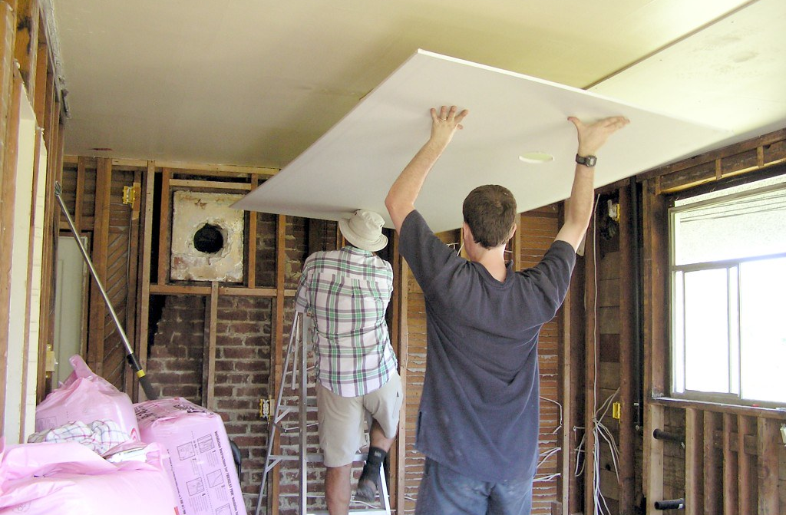
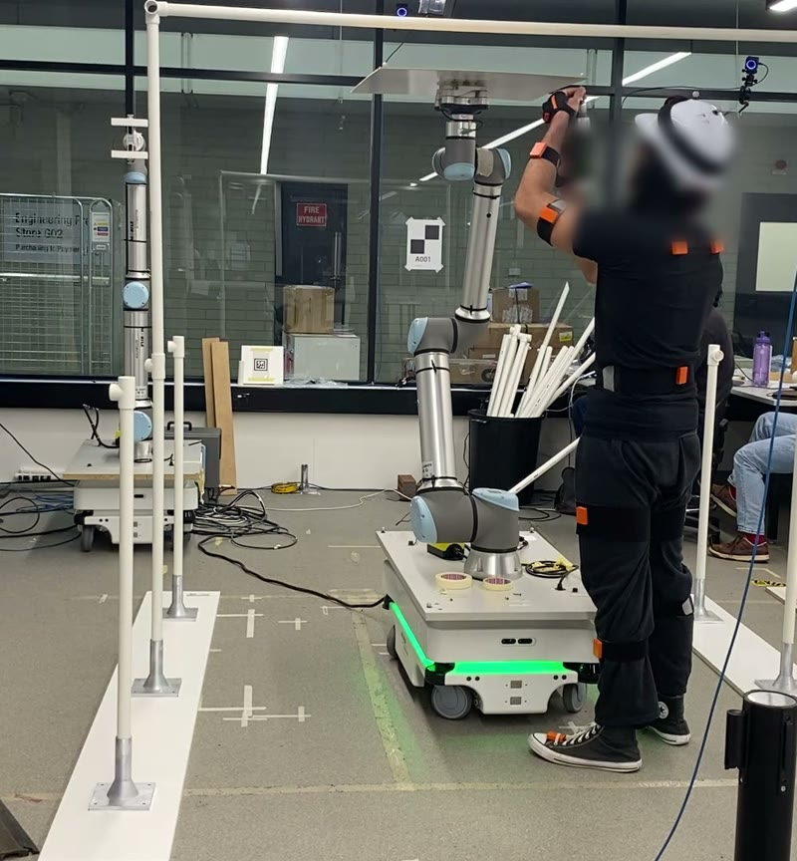
Why this problem matters
On site today
1
Overhead panel work is heavy and awkward
A robot can hold the panel while the worker does the skilled part.
2
So the worker stands next to a moving robot
Safety zones stop the robot whenever someone is close.
3
Stop too late: injury. Stop too often: no one uses it.
Crews and contractors need it right both ways.
Photo: Qole Pejorian, CC BY 2.0
In our lab
The robot holds the panel; the worker aligns and fixes it.
Our question: can a robot that knows the task phase keep workers as safe as fixed zones, and still keep the work efficient?
02
Notes:
ZENAN | 0:50
Installing ceiling panels requires workers to hold heavy boards overhead. On a typical site, shown here, one person simply holds the board while another fixes it. In our laboratory, below, a collaborative robot does the holding.
However, the worker now stands beside a moving robot. Current practice defines fixed safety zones around the robot and stops it whenever a person is inside. These zones cannot distinguish a worker approaching to begin a task from one moving away. If the robot stops too late, the worker may be injured; if it stops too often, crews are likely to disable it. Solving this benefits installation crews, contractors and the engineers who certify these systems.
This leads to our research question, shown in the dark box: can a robot that is aware of the task phase keep workers as safe as fixed zones, while maintaining task efficiency?

Slide 3
Our solution: a robot that knows the task phase
Fixed zones
Reactive
Predictive (ours)
Distance only
Distance + how fast you approach
+ task phase
+ 'about to step in' predictor
Today's practice: the baseline
Shows what movement adds
Shows what context adds
Safety rule: the learned parts can only slow the robot, never speed it up
Why speed and separation?
The robot carries a panel, so contact while moving is not acceptable
Why a hidden Markov model?
Explainable phases, little training data, runs in real time
Why the 'slow-only' rule?
Safety never depends on the machine-learning being right
03
Notes:
ZENAN | 0:50
To answer this, we compared three controllers, each adding one source of information. The fixed-zone controller uses separation distance only; this is current practice and our baseline. The reactive controller also considers approach speed. Our predictive controller adds the task phase, whether the worker is approaching, working or moving away, together with a predictor that anticipates entry into the stop zone.
The key design principle is shown in the dark bar: the learned components can only reduce the robot's speed, never increase it, so safety never depends on the machine-learning model being correct.

Slide 4
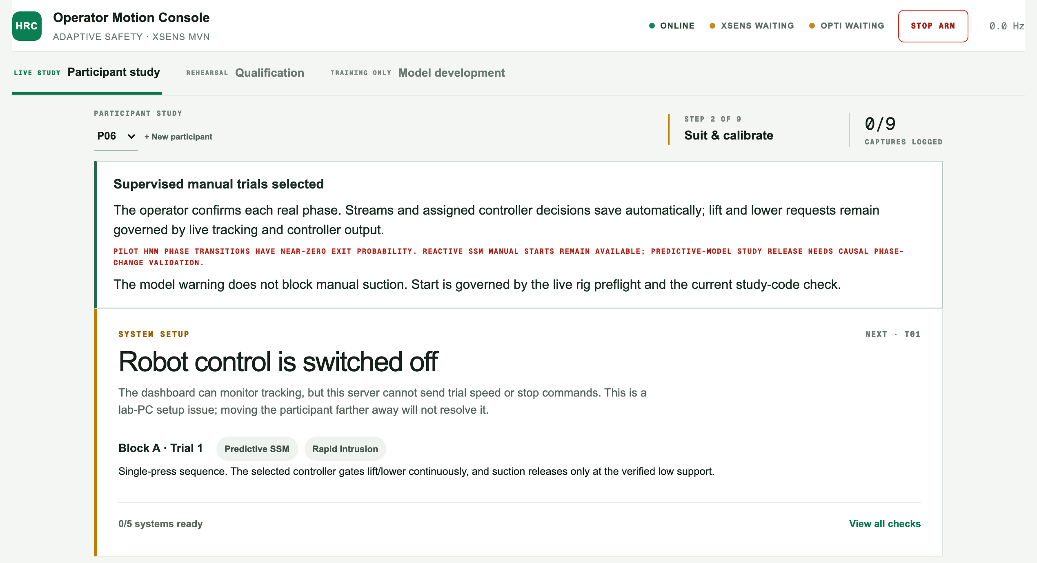
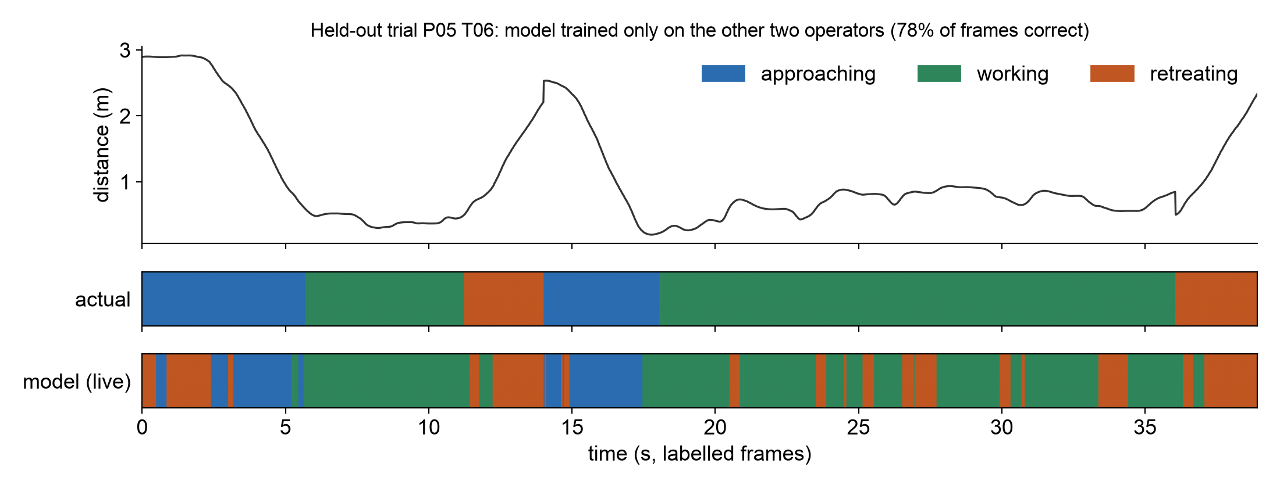
What we built: the console and the trained model
Our operator console
Runs every session: checks the sensors, assigns the controller, records everything.
Our trained phase model on a new person
Top: what they were doing. Bottom: what the model said, live.
Built and trained by the team: 32 labelled trials, about 90,000 motion frames, open on GitHub.
04
Notes:
ZENAN | 0:50
My contribution was the software. On the left is the operator console we developed to run each session. It verifies every sensor, assigns the controller, and records both the robot and the participant.
On the right is our trained phase model, tested on a participant it never saw. The upper bar shows what the participant was actually doing, and the lower bar shows the model's live prediction. It tracks the long working phase closely and is least certain at the transitions.
Michael will now present how we tested the system and what we found.

Slide 5
How we tested it
12
3
105
31
participants (ethics approved)
blocks, one controller each, order rotated
trials of the panel task, with cued moves
questionnaires, one after each block
The key idea: same-input replay
Every sensor input was logged, so we re-ran all three controllers on exactly the same human movement.
Like three referees judging the same match footage: differences come from the controller, not the person.
The replay matched every robot command the live system actually sent.
05
Notes:
MICHAEL | 0:40
Thank you, Zenan. Twelve participants took part under Monash ethics approval. Each completed three blocks of the panel task, with one controller per block in a rotated order. The task included cued movements, such as a quick step towards the robot, and a short questionnaire followed each block.
Our key methodological decision was to log every sensor input. This allowed us to replay all three controllers on identical movement data, much like three referees reviewing the same match footage, so any difference in outcome comes from the controller rather than the participant.

Slide 6
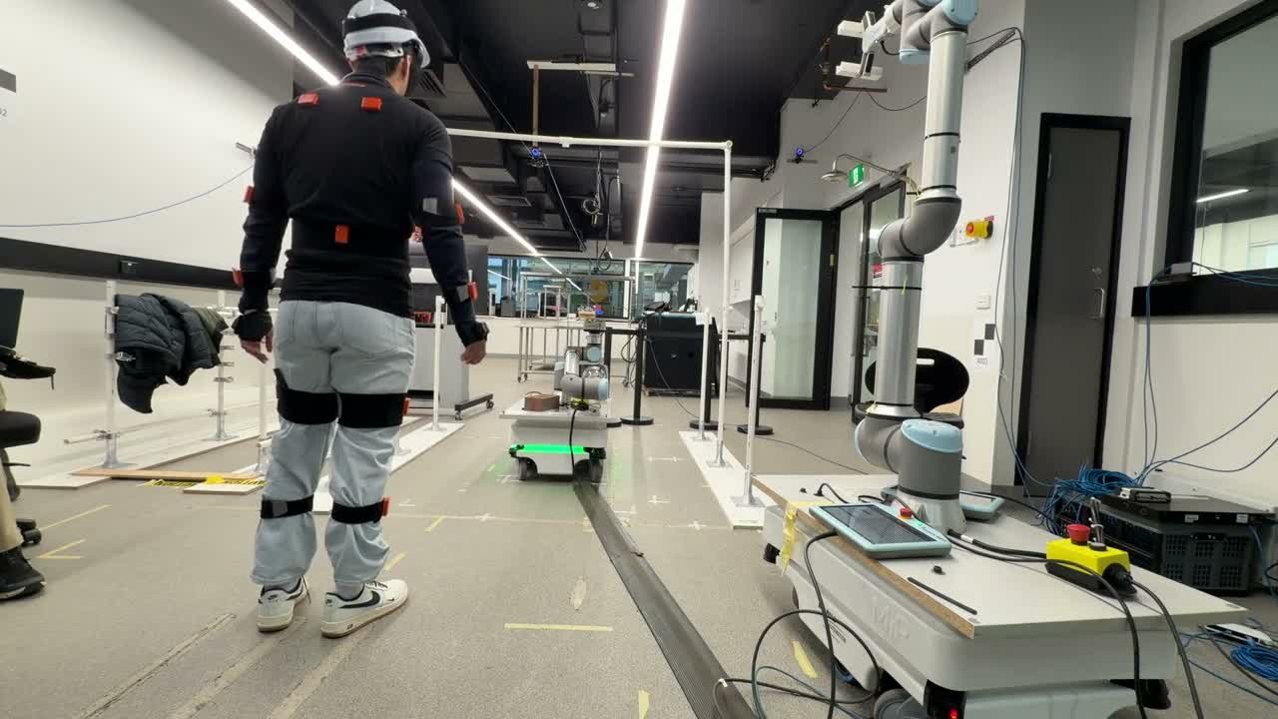
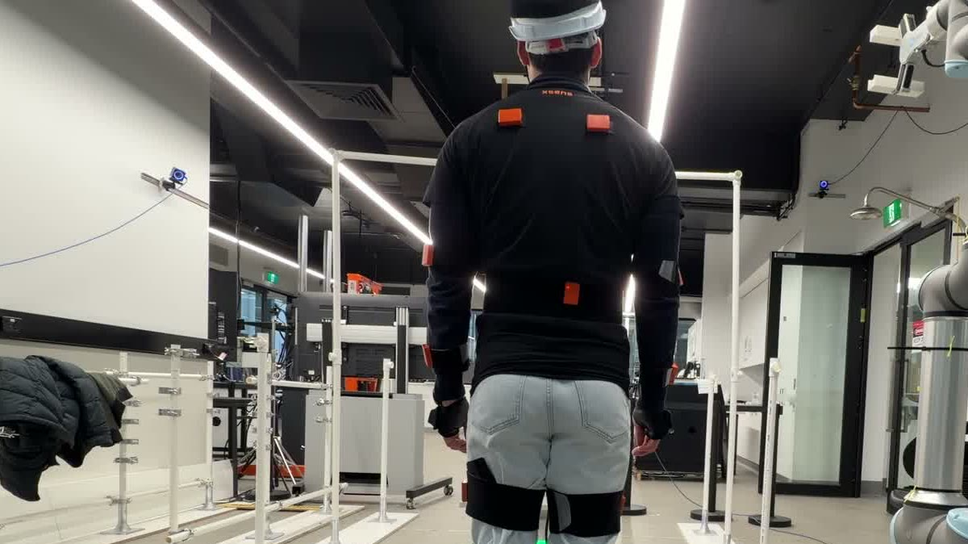
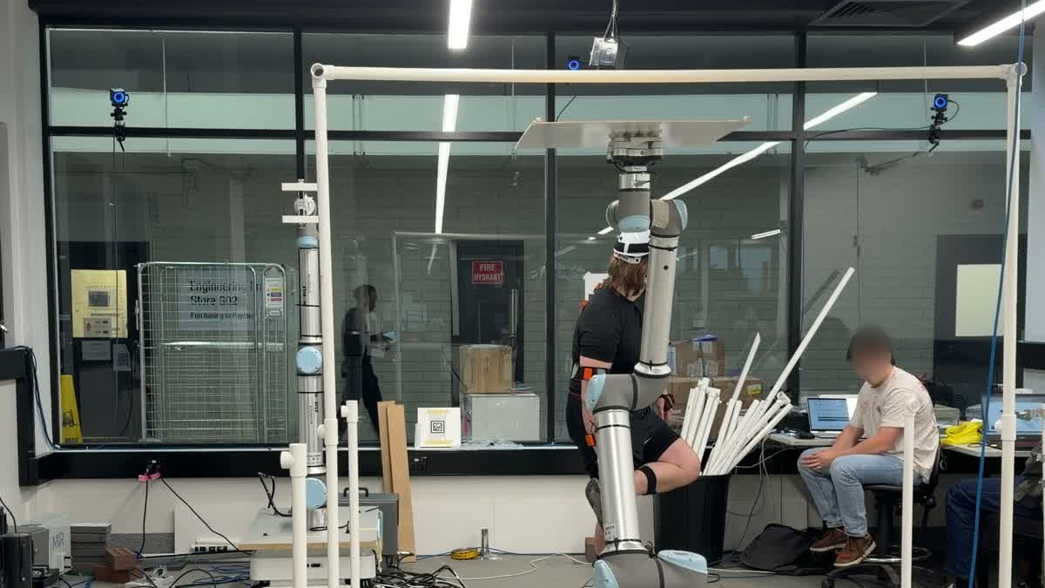
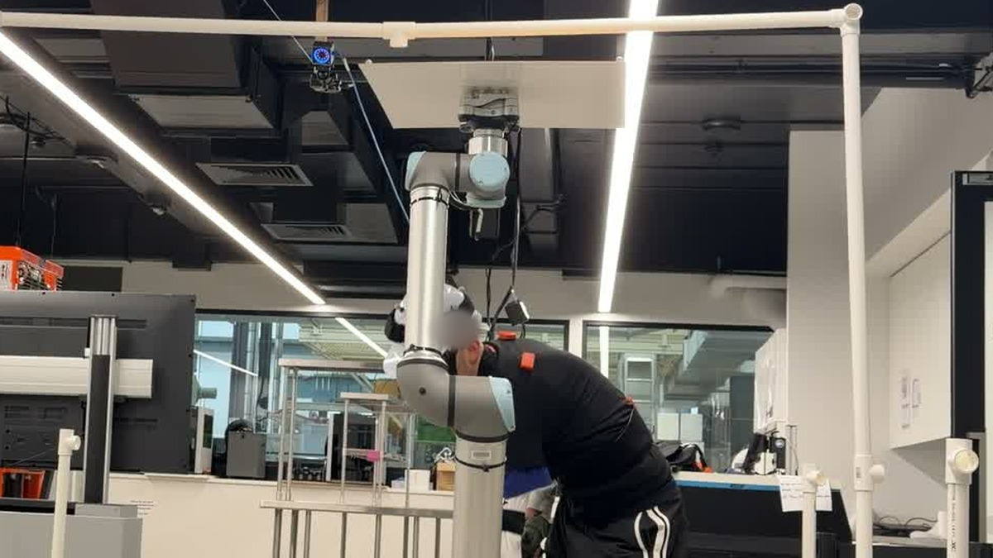
The test rig
Faces blurred
▶ Video: click to play (16 s)
UR10 robot arm
holds a panel stand-in at ceiling height
OptiTrack cameras
head position to about a millimetre
Xsens suit
positions of 23 body segments
06
Notes:
MICHAEL | 0:40
My main contribution was the physical setup: I positioned the robot and built the PVC pipe structure shown here.
The UR10 arm raises a panel substitute to ceiling height and holds it while the participant works beneath it. Cameras on the frame track the participant's head to about one millimetre, and the motion-capture suit records 23 body segments. [Click the video.] This clip shows a participant approaching while the suit streams their movement to the controller. The controller reads these data about sixty times per second and sets the speed the robot is permitted to move at.

Slide 7
Answers: is it as safe?
Result 1: all three stopped in time; ours stopped earliest
970 / 970
entries into the stop zone where a stop had already been requested, for all three controllers
+0.11 s
earlier stop request than fixed zones, for all 12 people
Same-input replay, 12 people, 105 trials
07
Notes:
MICHAEL | 0:50
This answers the first part of our question: is it as safe? Across all 970 entries into the stop zone, every controller had already commanded the robot to stop. On the measured distance, none of them failed.
The difference is timing. Our controller requested the stop about a tenth of a second earlier, for every one of the twelve participants. This matters because distance measurement always carries some error. With a five-centimetre error, the fixed zones would still have covered 31 per cent of entries, compared with 67 per cent for our controller. It is therefore as safe, with a larger margin.

Slide 8
Answers: is it still efficient?
Result 2: the cost was brief, unnoticed extra stops
+0.9 s
of unnecessary stopping per minute, compared with fixed zones
3 · 5 · 3
times each controller was picked as 'safest': perceived equally as safe
0.16 s
median time for the robot to actually stop (max 0.23 s)
08
Notes:
MICHAEL | 0:50
The second part: is it still efficient? Partly. Our controller switched between stopping and resuming more often, because it releases the stop as soon as the estimated risk falls, so noise in the speed estimate causes it to toggle. A short release delay should resolve most of this.
Overall, it added less than one second of unnecessary stopping per minute, and participants did not notice a difference: their choices of the safest block were split three, five and three, consistent with chance. When a stop was commanded, the robot halted within a quarter of a second.
Luke will now discuss what these results mean and how we managed the project.

Slide 9
Answers: where is the real gain?
The bigger limit is the task, not the controller
About a third of every trial was stopped, whichever controller ran.
The worker has to be close to load, work under and unload the panel, so the stop zone is occupied by design.
Next gain: switch to a contact-safe mode while the worker is under the panel
09
Notes:
LUKE | 0:40
Thank you, Michael. Our most important finding was not which controller was best. Under all three, the robot was stopped for about one third of every trial, because the task itself requires the worker to be inside the stop zone: to load the panel, to work beneath it and to unload it.
The next real gain is therefore to switch to a contact-safe mode, such as hand guiding, while the worker is beneath the panel. Because our system already identifies the task phase, it provides the information needed to make that switch.

Slide 10
Project management: plan, setbacks and responses
Jul
Design and simulation
Aug
Rig integration and pilot tests
Sep
12 participant sessions
Oct
Analysis, reviews and paper
Setback | How we responded
Some sessions restarted under new IDs | Checked identity from the data (helmet height, intake answers)
Distance reference changed mid-study | Analysed each version separately; replayed the exact code
Supervisors: paper too technical | Weekly meetings; plain-language rewrite for a civil audience
10
Notes:
LUKE | 0:50
My role was coordinating with the laboratory staff and our supervisors, Yihai and Will. We planned four stages: design and simulation in July, building and pilot testing the rig in August, twelve participant sessions in September, and analysis and writing in October.
Three setbacks shaped the project. First, some sessions were restarted under a new participant ID, so we matched sessions to participants using the recorded data. Second, the distance reference changed midway through testing, so we analysed the two versions separately and replayed the exact code that had run. Third, our paper was initially too technical, so we rewrote it for a broader audience.

Slide 11
What it would take to use this on site
Safety
A research prototype, not a certified safety function. Allow 0.5 s to react, not 0.4.
Whole-life cost
Cameras, body suits, calibration, maintenance and training for every crew.
Worker health
Removes overhead lifting strain; the suit itself was rated low restriction (2 of 5).
People and trust
Participants rated all three as safe. Crews must accept a robot as a co-worker.
Standards
ISO 10218 and ISO/TS 15066 set the bar any site system must meet.
11
Notes:
LUKE | 0:45
Moving from the laboratory to a site introduces real constraints. For safety, this is a research prototype running on the robot's standard speed controls, not a certified safety function, and we would allow half a second to react. For cost, the cameras and suits require calibration, maintenance and training for every crew, weighed against the labour saved. For health, it removes overhead lifting from workers, and participants rated the suit as only mildly restrictive. Finally, crews must accept a robotic co-worker, and any site system must meet the relevant robot safety standards.

Slide 12
Our answer, and what comes next
Can a task-aware robot be as safe as fixed zones and still efficient?
Safety: yes, with more margin against sensing error.
Efficiency: partly. Same trial time, slightly more stopping.
Next
Release delay on the predictor
Contact-safe mode under the panel
Trials with real crews on site
Zenan Wu
Software and technical integration
Luke Siniakov
Coordination with lab staff and supervisors
Michael Magila
Physical setup and assembly
All three designed the experiment and wrote the paper. Thank you; we welcome your questions.
12
Notes:
LUKE | 0:40
To return to our research question: can a task-aware robot be as safe as fixed zones and remain efficient? On safety, yes: it was as safe on every measure, with a larger margin under sensor error. On efficiency, partly: trial times were unchanged, with slightly more stopping. For industry, this shows that task awareness can be layered on top of a standard safety limit without weakening it.
Next steps are a release delay, a contact-safe mode beneath the panel, and trials with real installation crews. For students choosing a final-year project, it combines robotics, sensing, human factors and construction, with plenty left to do. Thank you; we welcome your questions.

