Slide 1
DAB 304 Healthcare Analytics
Musculoskeletal Radiographs Abnormality Detection
GROUP – 17
Kinjal Bhatt - 0773192
Parneet Kaur – 0775610
Jaykumar Patel – 0774878
Uttaran Gangopadhyay - 0768780
Submitted To:
Prof. Muhammad Shahid

Slide 2
Content
Problem Statement
Purpose of this Project
Steps to resolve this problem
Dataset and Source
Tools & Techniques
Data Pre-processing
Models
References

Slide 3
Problem Statement
Radiographic studies are a common technique employed to detect a variety of diseases, in which the detection of musculoskeletal abnormalities has proven to be a crucial task. This thesis proposes the use of deep learning techniques to detect musculoskeletal abnormalities.
The objective of this master’s thesis is to apply deep learning techniques to detect musculoskeletal abnormalities in radiographic studies.

Slide 4
Purpose of this project
Our main purpose of this project is to identify the abnormality in “Elbow” X-ray. We want to make a model which can give accurate result as compared to the radiologist.

Slide 5
Steps to resolve this Problem
Load the Dataset
Data Pre-processing
Train the Model
Evaluate the Model
Access the Dataset
Find and Analyze research papers

Slide 6
Tools & Techniques
Python
Google Colab
TensorFlow Keras
Numpy, Pandas, Matplotlib

Slide 7
Dataset & Source
MURA is a dataset of musculoskeletal radiographs consisting of 14,863 studies from 12,173 patients, with a total of 40,561 multi-view radiographic images. Each study was manually labeled as normal or abnormal by board-certified radiologists from the Stanford Hospital at the time of clinical radiographic interpretation in the diagnostic radiology environment between 2001 and 2012.
Dataset source link:
https://stanfordmlgroup.github.io/competitions/mura/

Slide 8
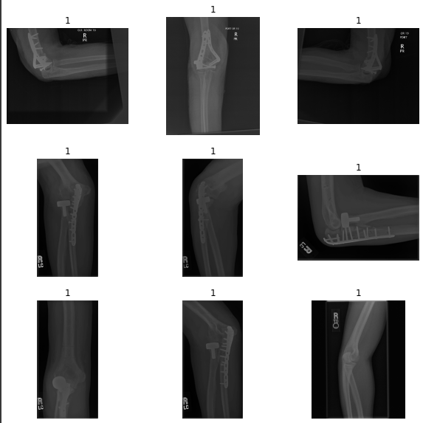
Glimpse of Data

Slide 9
Data Pre-processing
Load Elbow image path
Load and assign labels to the images
Convert Images to the numpy array
Scale the images to the [-0.5, 0.5] range
Reshape the images to [ 177 * 244]

Slide 10
Modeling
Baseline : DenseNet169
Simple Convolutional Neural Network (CNN)
Auto Encoder
Multi-Scale Convolution Neural Network (MSCNN) with fully connected network

Slide 11
Model Accuracy
Model | Accuracy
DenseNet169 | 50.53%
Simple Convolutional Neural Network (CNN) | 67%
Auto Encoder | 19%
Multi-Scale Convolution Neural Network (MSCNN) with fully connected network

Slide 12
References
We have taken dataset from MURA.
We have used information from the research papers that can be related to our project.
Research paper
Research Paper2
AI for Medical Diagnosis Course

