Slide 1
JQUERY | INTRODUCTION
By:- Prof. Kinjal Thakar

Slide 2
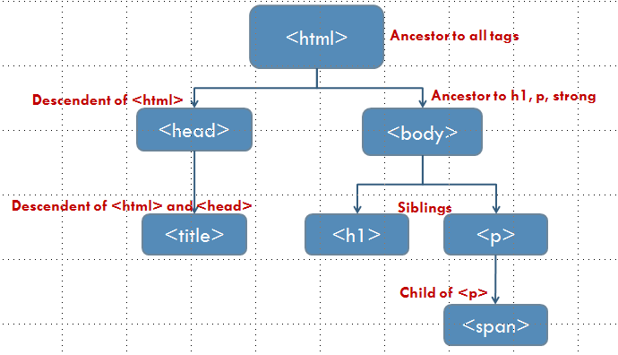
jQuery
Open source JavaScript library
Simplifies the interactions between
  HTML document, or the Document Object Model (DOM), and
  JavaScript.
JAVASCRIPT
Jquery Cookbook, 2010

Slide 3
HTML Tree - DOM
<html>
<head>
<title>My Web Page</title>
</head>
<body>
<h1>Main Topic</h1>
<p>
A web page about the days of the week, specifically<strong>Tuesday.</strong>
</p>
</body>
</html>

Slide 4
HTML Tree - DOM
<html>
Ancestor to all tags
Descendent of <html>
Ancestor to h1, p, strong
<head>
<body>
Descendent of <html> and <head>
Siblings
<title>
<h1>
<p>
Child of <p>
<span>

Slide 5
Why use jQuery
It’s open source. It’s free.
It’s small (30-40 KB minified).
It normalizes differences between web browsers.
It’s documented.
It’s currently tested and optimized for development on modern browsers (Chrome IE , Opera, Safari, Firefox).
It’s powerful.
It’s adopted by large organizations.
Jquery Cookbook, 2010

Slide 6
jQuery Syntax
Basic syntax is: $(selector).action()
A $ sign to define/access jQuery
A (selector) to "query (or find)" HTML elements
A jQuery action() to be performed on the element(s)
Examples:
$(this).hide() - hides the current element.
$("p").hide() - hides all <p> elements.
$(".test").hide() - hides all elements with class="test".
$("#test").hide() - hides the element with id="test".
Jquery Cookbook, 2010

Slide 7
The Document Ready Event
$(document).ready(function(){
// jQuery methods go here...
});
Jquery Cookbook, 2010

Slide 8
The jQuery Foundation
Can be broken down into three concepts:
  Finding elements (via CSS selectors) and doing something with them (via jQuery methods)
  Chaining multiple jQuery methods
Jquery Cookbook, 2010

Slide 9
1. Find some elements and do something with them
Locate a set of elements in the DOM, and then do something with that set of elements.
Scenario – suppose we wanted to
hide a <div> from user
put new text content into the hidden <div>,
change style of the <div>, and
make hidden <div> visible again.
Jquery Cookbook, 2010

Slide 10
1. Find some elements and do something with them
<script>
//hide all divs on the page
jQuery('div').hide();
//update the text contained inside of all divs
jQuery('div').text('This is content for the DIV element');
//add class attribute with value of updatedContent to all divs
jQuery('div').addClass("updatedContent");
//show all divs on the page
jQuery('div').show();
</script>
Jquery Cookbook, 2010

Slide 11
<!doctype html>
<html>
<head>
<script src="http://code.jquery.com/jquery1.9.1.min.js"></script>
</head>
<body>
<div>This is existing content</div>
<script>
  //hide all divs on the page
  jQuery('div').hide();
  //update the text contained inside of all divs
  jQuery('div').text('This is content for the DIV element');
  //add a class attribute of updatedContent to all divs
  jQuery('div').addClass("updatedContent");
  //show all divs on the page
  jQuery('div').show();
</script>
</body>
</html>
Jquery linked library and script at end of document

Slide 12
<!doctype html>
<html>
<head>
<script type="text/javascript" src="js/jquery.min.js"></script>
</head>
<body>
<div>This is old content</div>
<script>
  //hide all divs on the page
  jQuery('div').hide();
  //update the text contained inside of all divs
  jQuery('div').text('This is new content');
  //add a class attribute updatedContent to all divs
  jQuery('div').addClass("updatedContent");
  //show all divs on the page
  jQuery('div').show();
</script>
</body>
</html>
Jquery local library and script at end of document

Slide 13
1. Find some elements and do something with them
What we did:
Use jQuery function (jQuery()) to find all the <div> elements in the HTML page
Use jQuery methods to do something with them (e.g., hide(), text(), addClass(), show()).
  Methods | .hide(), .text(), .addClass(), .show()
Jquery Cookbook, 2010

Slide 14
2. Chaining
jQuery allows methods (e.g., hide(), text(), addClass(), show(), etc.) to be chained.
Find element once and then chain operations onto that element.
Jquery Cookbook, 2010

Slide 15
2. Chaining
There is a technique called chaining, that allows us to run multiple jQuery commands, one after the other, on the same element(s).
Can apply endless chain of jQuery methods on elements that are selected using jQuery function.
Jquery Cookbook, 2010

Slide 16
Not Chained
Chained
jQuery('div').hide();
jQuery('div').text('This is new content');
jQuery('div').addClass("updatedContent");
jQuery('div').show();
jQuery('div')
.hide()
.text('new content')
.addClass("updatedContent")
.show();
Chained
jQuery('div').hide().text('new content').addClass("updatedContent").show();

Slide 17
jQuery function
$(document).ready()
jQuery(document).ready()

Slide 18
Executing jQuery/JavaScript Coded After the DOM Has
Loaded but Before Complete Page Load
ready() event handler method
$(document).ready() or jQuery(document).ready()
Included in your web pages after the stylesheet.
Necessary if JavaScript has to be embedded in the document flow at the top of the page and encapsulated in the <head> element.

Slide 19
Executing jQuery/JavaScript Coded After the DOM Has
Loaded but Before Complete Page Load
$(document).ready(function() {
  $('div').hide().text('new content').addClass("updatedContent").show();
});

Slide 20
What is a Callback Function in jQuery?
A callback is a function that will be executed only after the current effect gets completed.
Since jQuery is a JavaScript library and JavaScript statements are executed sequentially, with animations, it might happen that even before the effect is completed, the following lines of code get executed. This can create errors due to overlapping of effects.

Slide 21
What is a Callback Function in jQuery?
Callbacks in a way ensure that until a given effect is not finished, certain code does not execute.
It is always used as the last argument of a function.

Slide 22
Syntax
$(selector).hide(speed,callback);

Slide 23
Parameters:
speed: An optional parameter which specifies the speed of showing and hiding using the values: “slow”, “fast” or “milliseconds”.
callback: Again, an optional parameter, which specifies the function to be executed after the hide() or show() methods is completed.

Slide 24
Implementation :
$(document).ready(function(){
$("button").click(function(){
$("p").hide("slow", function(){
alert("The paragraph is now hidden");
});
});
});

