Slide 1
JavaScript
Internship @
Silver Oak University
By :- Prof. Kinjal Thakar

Slide 2
Outline
Introduction to JavaScript
Resources
What is JavaScript?
JavaScript in web pages

Slide 3
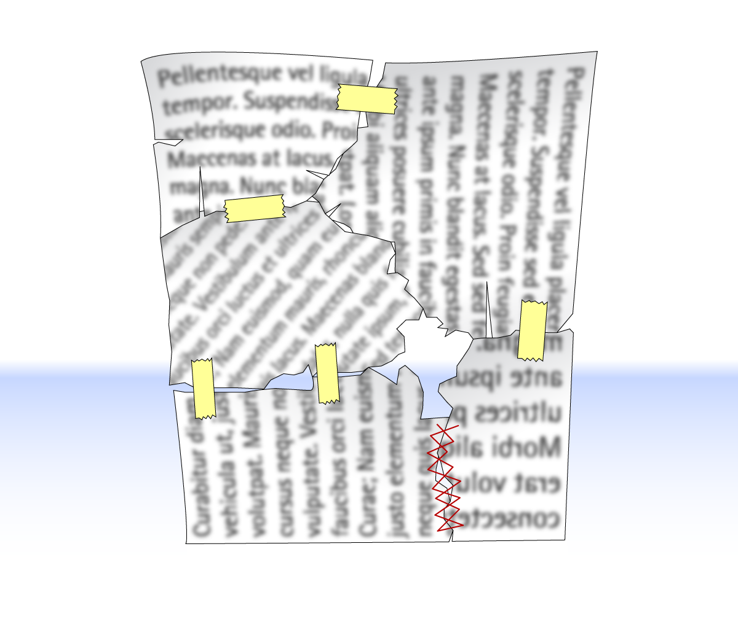
HTML + CSS + JavaScript

Slide 4
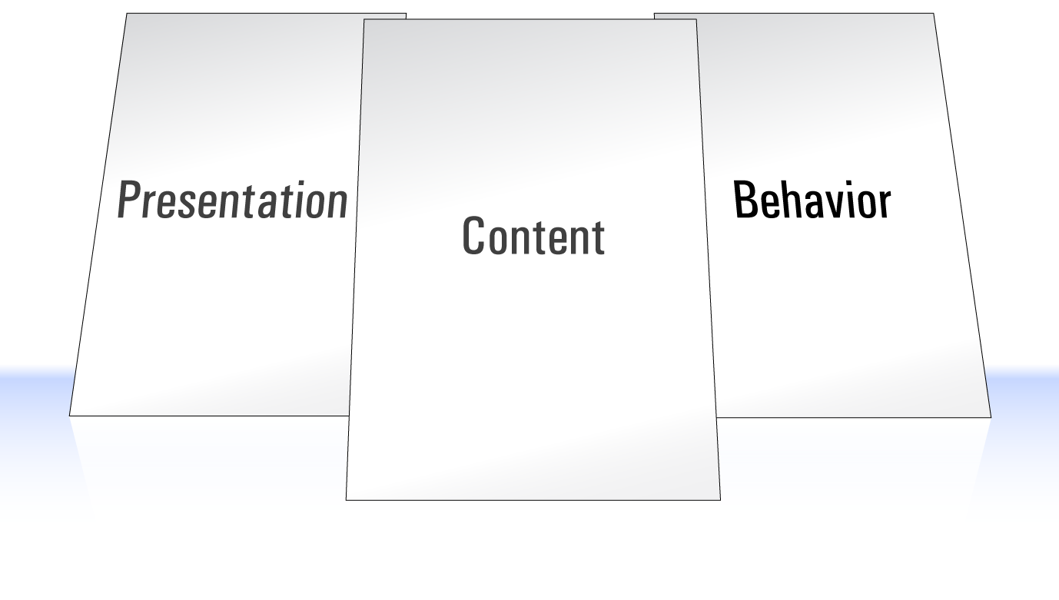
Separation of Concerns

Slide 5
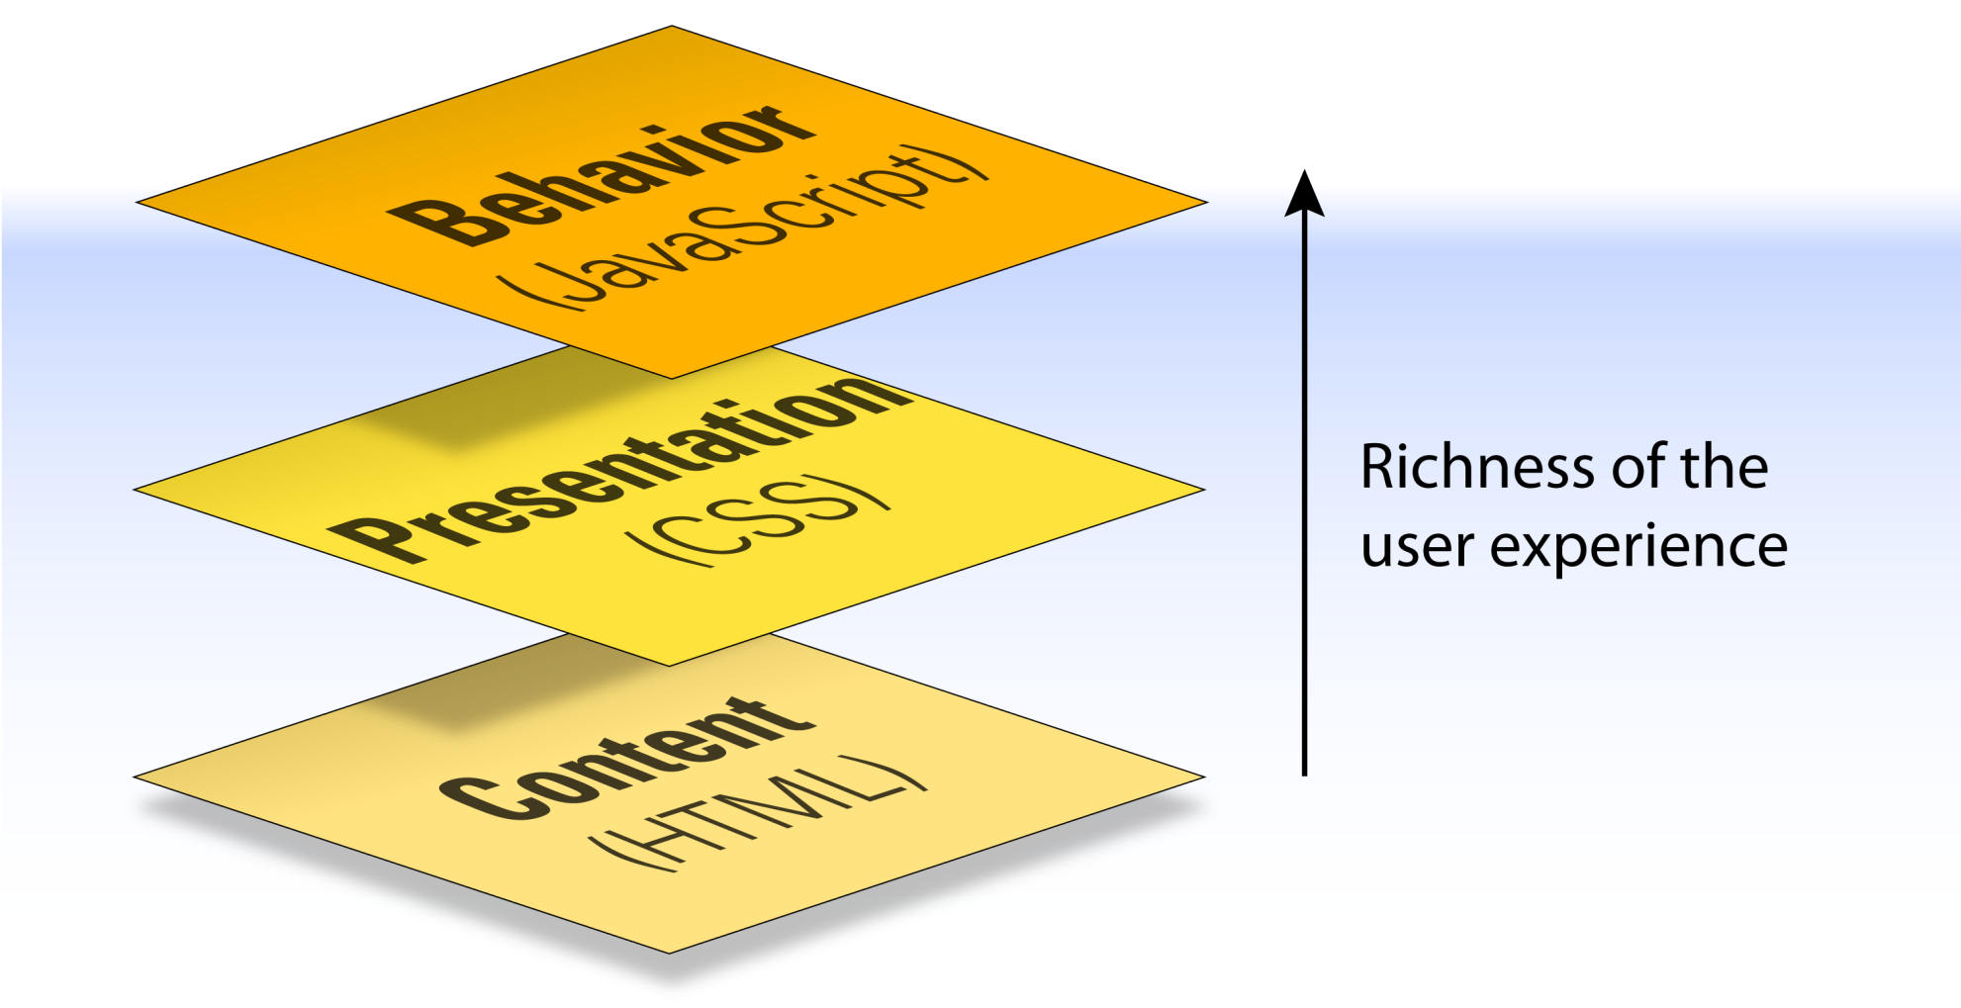
Separation of Concerns

Slide 6
Types of computer languages
High-Level vs. Low Level
Compiled vs. Interpreted
Structured vs. Object Oriented
Scripting vs. Programming

Slide 7
What is Javascript?
JavaScript (js) is a light-weight object-oriented programming language which is used by several websites for scripting the webpages.
It is an interpreted, full-fledged programming language that enables dynamic interactivity on websites when applied to an HTML document.
It was introduced in the year 1995 for adding programs to the webpages in the Netscape Navigator browser.
Since then, it has been adopted by all other graphical web browsers.
With JavaScript, users can build modern web applications to interact directly without reloading the page every time.

Slide 8
Why JavaScript?
JavaScript is used to create interactive websites.
It is mainly used for:
Client-side validation,
Dynamic drop-down menus,
Displaying date and time,
Displaying pop-up windows and dialog boxes (like an alert dialog box, confirm dialog box and prompt dialog box),
Displaying clocks etc.

Slide 9
JavaScript
High-Level vs. Low Level
Compiled vs. Interpreted
Structured vs. Object Oriented
Scripting vs. Programming

Slide 10
History
Need for ‘client side’ interaction
Code executes on the local machine
No need for network connection once script runs
Developed by Netscape in 1995
(Not related to the Java Language)
Actually ECMAScript (ECMA-262)
en.wikipedia.org/wiki/ECMAScript
Several variants (JScript, Action Script…)

Slide 11
What can JavaScript do?
It is a full programming language
API (application programming interface) is specific to working with browsers
Restrictions:
Security-based limitations
No networking
No access to local file system
Limited UI toolkit and graphics
(This is changing with HTML5)

Slide 12
What can JavaScript Do?
JavaScript Can Change HTML Content.
JavaScript Can Change HTML Attribute Values.
JavaScript Can Change HTML Styles (CSS)
JavaScript Can Hide HTML Elements.
JavaScript Can Show HTML Elements.

Slide 13
With the object model, JavaScript gets all the power it needs to create dynamic HTML
JavaScript can change all the HTML elements in the page
JavaScript can change all the HTML attributes in the page
JavaScript can change all the CSS styles in the page
JavaScript can remove existing HTML elements and attributes
JavaScript can add new HTML elements and attributes
JavaScript can react to all existing HTML events in the page
JavaScript can create new HTML events in the page

Slide 14
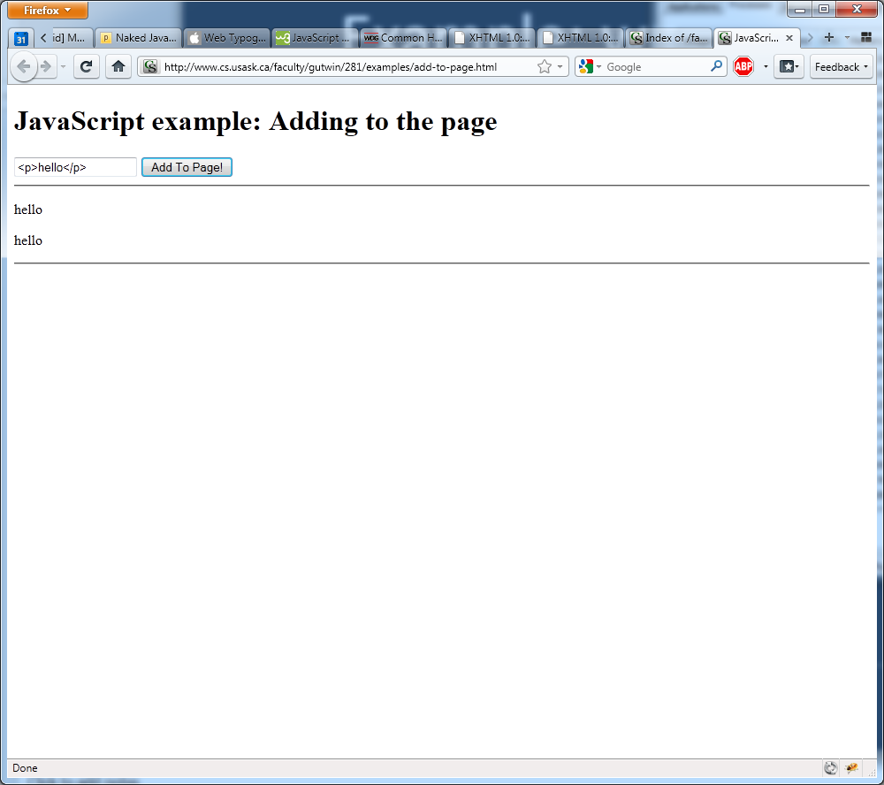
Example: writing to the page

Slide 15
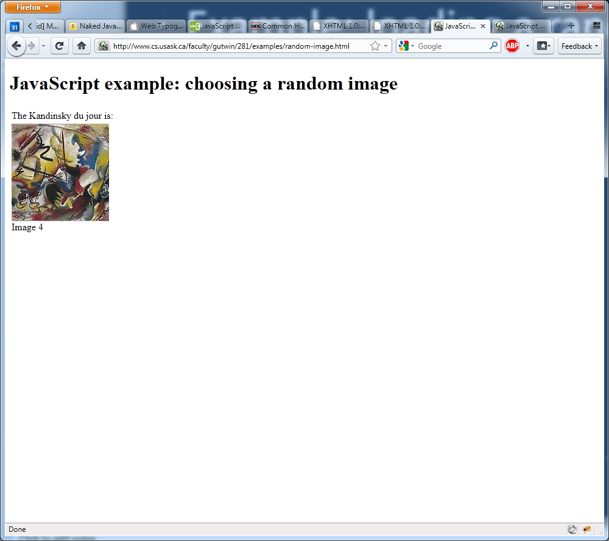
Example: loading a random image

Slide 16
Where do scripts go?
In the HMTL page
Like styles, can be external, internal, or inline
Use these for different situations

Slide 17
Where do scripts go?
For scripts that respond to user events, and for functions:
Either external or internal
In <head>…</head>
For scripts that write document content:
In <body>…</body>

Slide 18
Body example
<html>
<head>
</head>
<body>
<script type="text/javascript">
document.write("This message written by JavaScript");
</script>
</body>
</html>

Slide 19
Internal example
<html>
<head>
<script type="text/javascript">
function message()
{
alert("This alert was called with the onload event");
}
</script>
</head>
<body onload="message()">
</body>
</html

Slide 20
External example
<html>
<head>
<script type="text/javascript" src="xyz.js"></script>
</head>
<body>
</body>
</html>

Slide 21
How does JS access the page?
DOM: Document Object Model
A framework to describe a web page (document) in a tree-like structure

Slide 22
What is the HTML DOM?
Document Object Model
The HTML DOM is a standard object model and programming interface for HTML.
It defines:
The HTML elements as objects
The properties of all HTML elements
The methods to access all HTML elements
The events for all HTML elements
In other words: The HTML DOM is a standard for how to get, change, add, or delete HTML elements.

Slide 23
HTML Tree - DOM
<html>
Ancestor to all tags
Descendent of <html>
Ancestor to h1, p, strong
<head>
<body>
Descendent of <html> and <head>
Siblings
<title>
<h1>
<p>
Child of <p>
<span>

Slide 24

DOM

Slide 25
Simple Program
<html>
<body>
<script type="text/javascript">
alert("Hello Good Morning");
</script>
</body>
</html>

Slide 26
JavaScript Basics
Statements
Variables
Events
Functions
Dialogs

Slide 27
Statements
<script type="text/javascript">
var a = 10;
var b = 11;
var c;
c = a + b;
alert(‘The answer is’ + c);
</script>

Slide 28
JavaScript Variables
Variables are used to store data.
Rules for variable names:
Variable names are case sensitive
They must begin with a letter or the underscore character
strname – STRNAME (not same)

Slide 29
let vs var
let var
let is block-scoped.
var is function scoped.
let does not allow to redeclare variables.
var allows to redeclare variables.

Slide 30
JavaScript Variables
Variables: containers for data
All variables have
Name
Type – JavaScript is loosely typed
Value or “null”
To declare a variable
var variableName
Beware of reserved words:
E.g., ‘if’, ‘Document’, ‘Math’, etc.

Slide 31
JavaScript Operators
Arithmetic Operators
Operator | Description | Example | Result
+ | Addition | x=2 | 4
 |  | y=2
 |  | x+y
- | Subtraction | x=5 | 3
 |  | y=2
 |  | x-y
* | Multiplication | x=5 | 20
 |  | y=4
 |  | x*y
/ | Division | 15/5 | 3
 |  | 5/2 | 2,5
% | Modulus (division remainder) | 5%2 | 1
 |  | 10%8 | 2
 |  | 10%2 | 0
++ | Increment | x=5 | x=6
 |  | x++
-- | Decrement | x=5 | x=4
 |  | x--

Slide 32
JavaScript Operators
Assignment Operators
Operator | Example | Is The Same As
= | x=y | x=y
+= | x+=y | x=x+y
-= | x-=y | x=x-y
*= | x*=y | x=x*y
/= | x/=y | x=x/y
%= | x%=y | x=x%y

Slide 33
JavaScript Operators
Comparison Operators
Operator | Description | Example
= = | is equal to | 5==8 returns false
= = = | is equal to (checks for both value and type) | x=5
 |  | y="5"
 |  | x==y returns true
 |  | x===y returns false
!= | is not equal | 5!=8 returns true
> | is greater than | 5>8 returns false
< | is less than | 5<8 returns true
>= | is greater than or equal to | 5>=8 returns false
<= | is less than or equal to | 5<=8 returns true

Slide 34
JavaScript Operators
Logical Operators
Operator | Description | Example
&& | and | x=6
 |  | y=3
 |  | (x < 10 && y > 1) returns true
|| | or | x=6
 |  | y=3
 |  | (x==5 || y==5) returns false
! | not | x=6
 |  | y=3
 |  | !(x==y) returns true

