Slide 1

THE SHARED FAILURE
01
Career potential is lost when evidence and action arrive too late.
CareerOS connects student evidence, employer demand, and university action so gaps can be addressed earlier.
AI-POWERED CAREER OS
Student evidence
Employer demand
University action
DEMONSTRATED PROTOTYPE · SIMULATED INTELLIGENCE AND DATA
Talentbank AI Hackathon · July 2026
Notes:
[Sources] - CareerOS deck production blueprint: docs/pitch/CAREEROS_DECK_PRODUCTION_BLUEPRINT.md - Hero visual: OpenAI ImageGen, generated 2026-07-25 from user-supplied visual direction

Slide 2
THE SHARED FAILURE
02
The same evidence gap appears as uncertainty, recruiting waste, and late institutional action.
01
02
03
STUDENT
EMPLOYER
UNIVERSITY
Chris, a Year 3 Data Science student, has real projects but weak proof of what they demonstrate—or what to do next.
A recruiter needs talent now, while prior challenge participants and screening context have gone cold.
A programme team sees an MLOps or readiness gap while the current cohort cannot wait for a curriculum cycle.
Different symptoms. One structural failure: useful signals are fragmented, weakly evidenced, and remembered too late.
Notes:
[Sources] - CareerOS deck production blueprint: docs/pitch/CAREEROS_DECK_PRODUCTION_BLUEPRINT.md - CareerOS local prototype and repository documentation

Slide 3
THE SHARED FAILURE
03
Existing tools optimise transactions, not continuity.
Student activity
→
Resume claim
→
Employer event
→
Attendance list
→
Hiring feedback
→
Inbox / ATS
→
Outcome report
CareerOS preserves the context between transactions—it does not try to replace every system.
Notes:
[Sources] - CareerOS deck production blueprint: docs/pitch/CAREEROS_DECK_PRODUCTION_BLUEPRINT.md - CareerOS local prototype and repository documentation

Slide 4
OPERATING MODEL
04
CareerOS turns fragmented signals into a shared sequence of decisions.
SIGNAL
→
EVIDENCE
→
DECISION
→
ACTION
→
OUTCOME
→
LEARNING
Project · challenge · demand
Source · recency · context
Gap · shortlist · priority
Practise · apply · intervene
Progress · hiring · completion
Improve the next decision
The prototype demonstrates each workspace; a live cross-organisation learning network remains future-facing.
Notes:
[Sources] - CareerOS deck production blueprint: docs/pitch/CAREEROS_DECK_PRODUCTION_BLUEPRINT.md - CareerOS local prototype and repository documentation

Slide 5
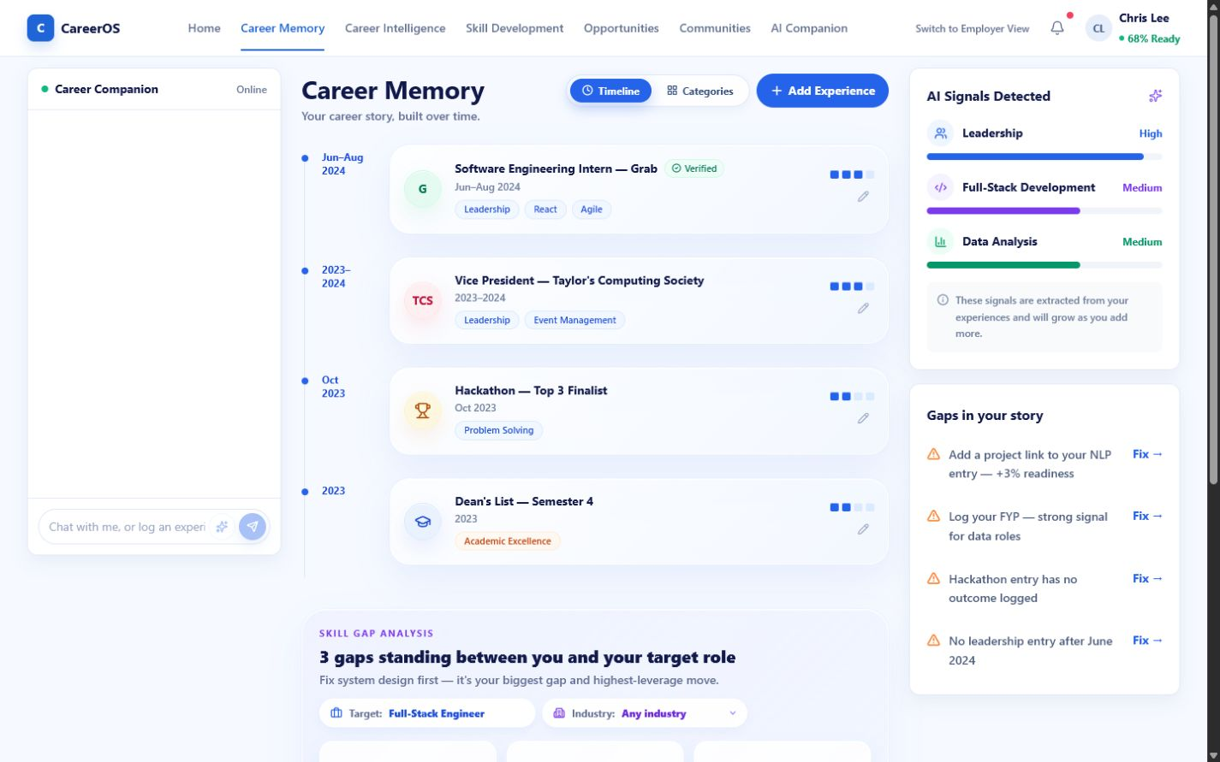
STUDENT
05
Career Memory turns “I did this” into “Here is what it proves—and what is missing.”
Chris Lee · Year 3 · Bachelor of Data Science · Taylor’s University
1
Preserve projects, internships, leadership and achievements.
2
Connect each experience to skills and supporting evidence.
3
Expose missing proof instead of hiding uncertainty.
Behaviour change: maintain reusable evidence continuously—not only when applying.
DEMONSTRATED UI · EXTRACTION / VERIFICATION PARTIAL
Notes:
[Sources] - CareerOS deck production blueprint: docs/pitch/CAREEROS_DECK_PRODUCTION_BLUEPRINT.md - CareerOS local prototype and repository documentation - Product screenshot: outputs/careeros-deck/screenshots/student-memory.png

Slide 6
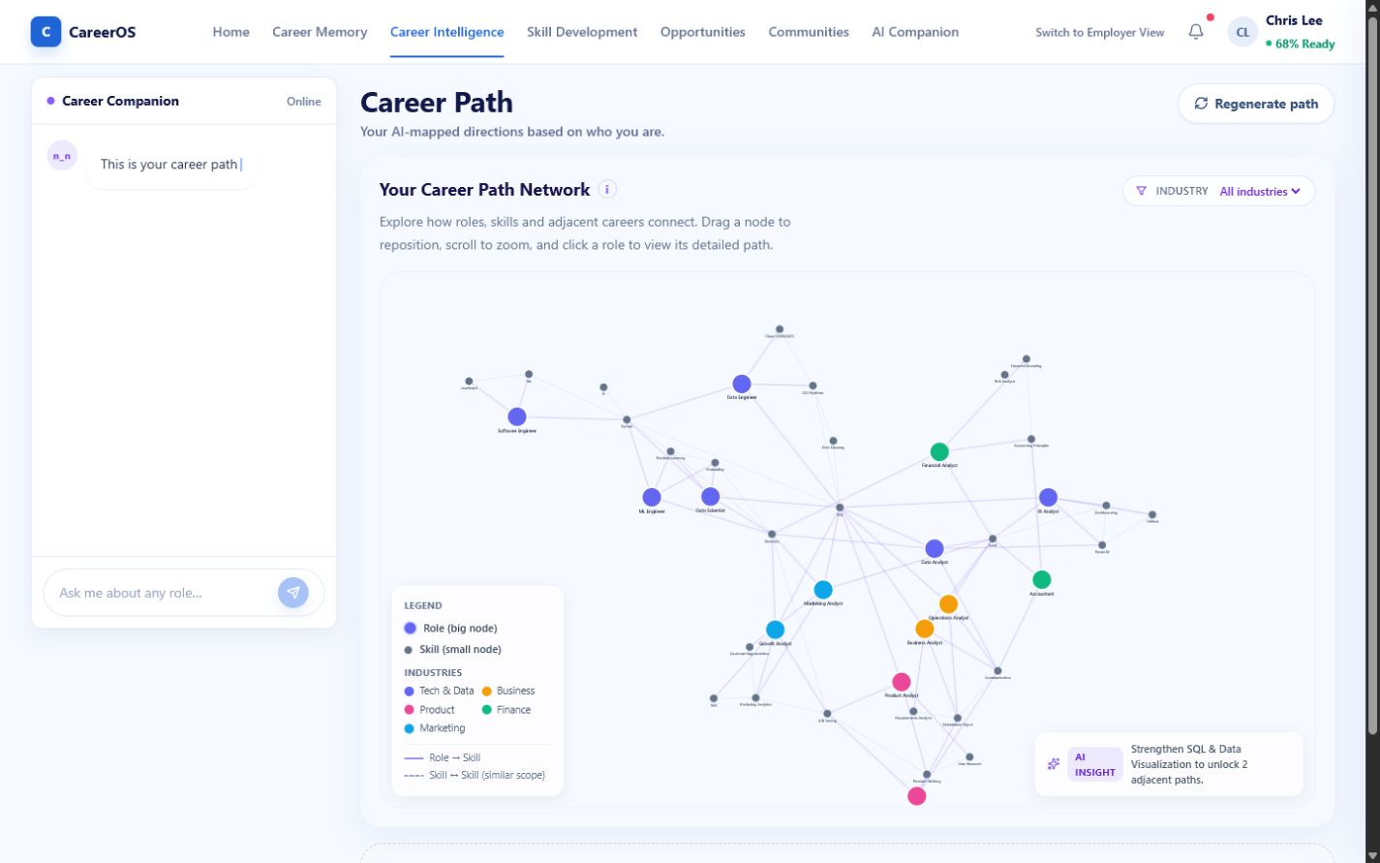
STUDENT
06
The Data Science degree becomes a starting signal—not a career boundary.
1
Interpret existing evidence against possible paths.
2
Reveal adjacent roles and transferable evidence.
3
Prioritise the next missing skill or proof.
Career browsing becomes one evidence-building next step.
DEMONSTRATED INTERACTION · PATHS AND RECOMMENDATIONS ILLUSTRATIVE
Notes:
[Sources] - CareerOS deck production blueprint: docs/pitch/CAREEROS_DECK_PRODUCTION_BLUEPRINT.md - CareerOS local prototype and repository documentation - Product screenshot: outputs/careeros-deck/screenshots/student-intelligence.png

Slide 7
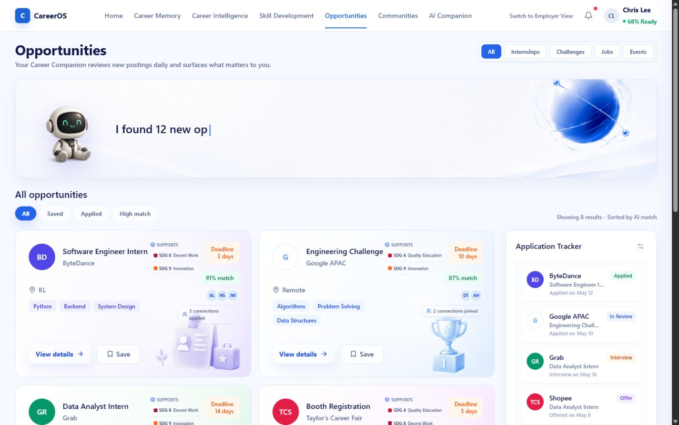
STUDENT
07
Guidance only creates value when it ends in an action.
1
Explain why an opportunity fits—and what is missing.
2
Save, prepare or apply from the same context.
3
Preserve the application stage and next action.
Advice becomes a visible commitment and follow-up state.
DEMONSTRATED LOCAL WORKFLOW · NO LIVE JOB MARKETPLACE
Notes:
[Sources] - CareerOS deck production blueprint: docs/pitch/CAREEROS_DECK_PRODUCTION_BLUEPRINT.md - CareerOS local prototype and repository documentation - Product screenshot: outputs/careeros-deck/screenshots/student-opportunities.png

Slide 8
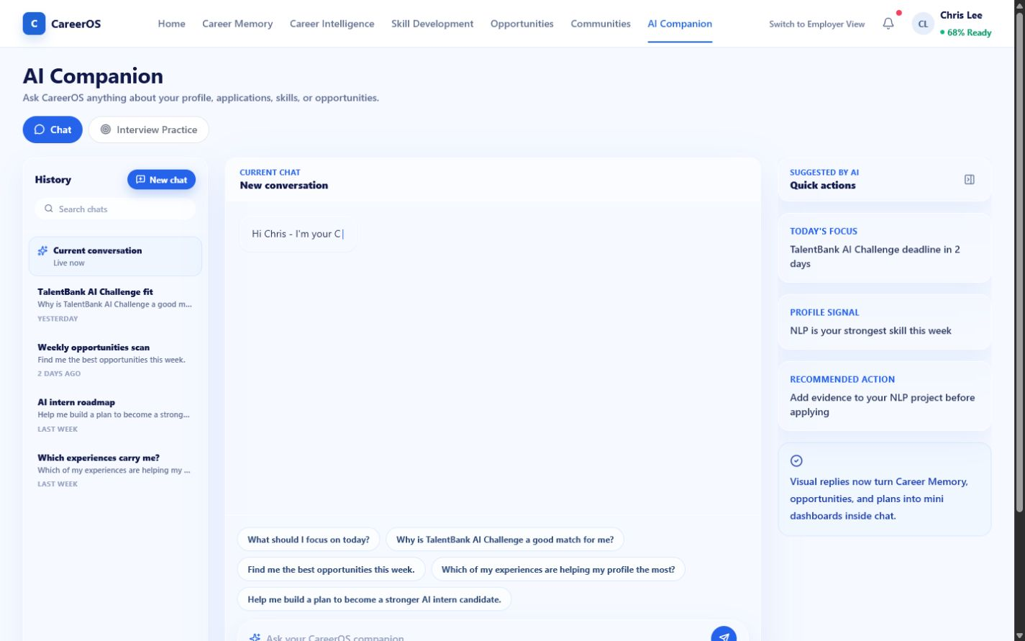
STUDENT
08
Ask from intent, then practise the moment that matters.
COMPANION
Interprets intent and routes the student to relevant CareerOS context.
PRACTICE
Creates repeatable interview preparation around a role and company.
The student moves from uncertainty to a specific preparation task without learning the product’s information architecture.
DEMONSTRATED UI · OPTIONAL / SIMULATED AI · SCORING NOT VALIDATED
Notes:
[Sources] - CareerOS deck production blueprint: docs/pitch/CAREEROS_DECK_PRODUCTION_BLUEPRINT.md - CareerOS local prototype and repository documentation - Product screenshot: outputs/careeros-deck/screenshots/student-companion.png

Slide 9
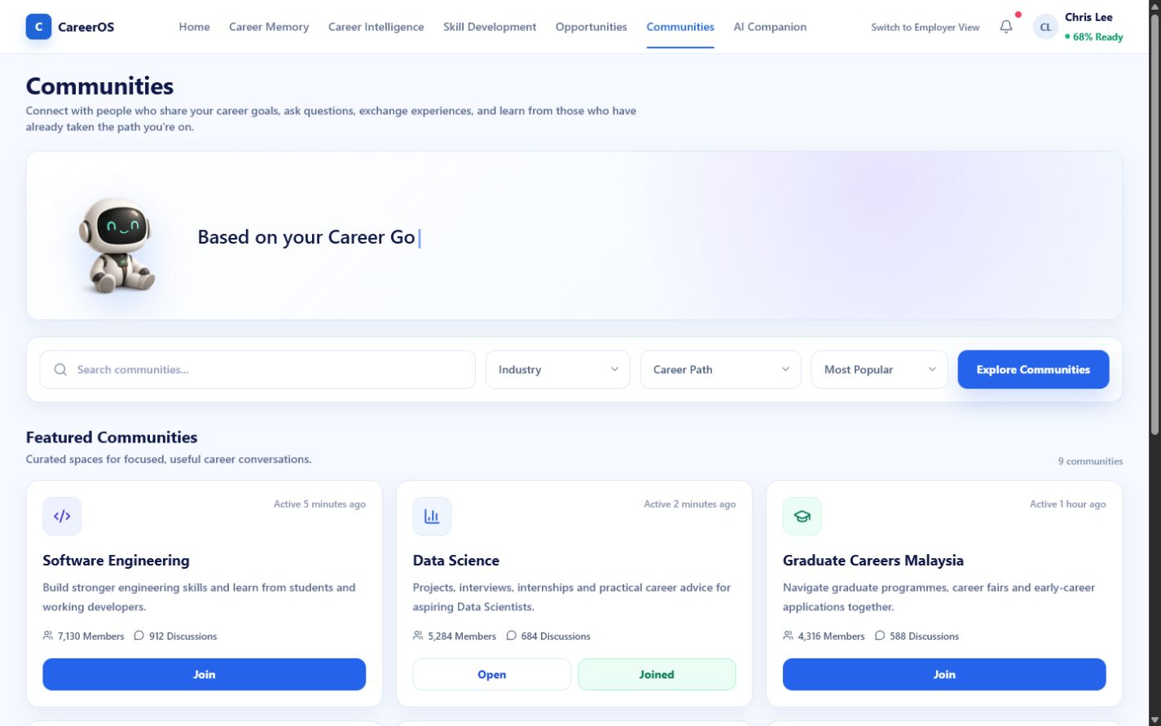
STUDENT
09
CareerOS gives students reasons to return between applications.
1
Community normalises rejection, doubt and skill gaps.
2
Mentorship or learning offers targeted support.
3
New activity can become future Career Memory evidence.
Support and evidence-building continue between vacancies.
LOCAL COMMUNITY DEMONSTRATED · COMPOUNDING LOOP FUTURE
Notes:
[Sources] - CareerOS deck production blueprint: docs/pitch/CAREEROS_DECK_PRODUCTION_BLUEPRINT.md - CareerOS local prototype and repository documentation - Product screenshot: outputs/careeros-deck/screenshots/student-community.png

Slide 10
EMPLOYER
10
Employers need evidence and history—not another candidate database.
HIRING NEED
→
EVIDENCE-BACKED DISCOVERY
→
TARGETED VALIDATION
→
DECISION HISTORY
→
REUSABLE PIPELINE
Ask what supports fit and what must be validated—not merely whether a CV looks right.
CURRENT CANDIDATES, SCORES AND HISTORIES ARE DEMO DATA
Notes:
[Sources] - CareerOS deck production blueprint: docs/pitch/CAREEROS_DECK_PRODUCTION_BLUEPRINT.md - CareerOS local prototype and repository documentation

Slide 11
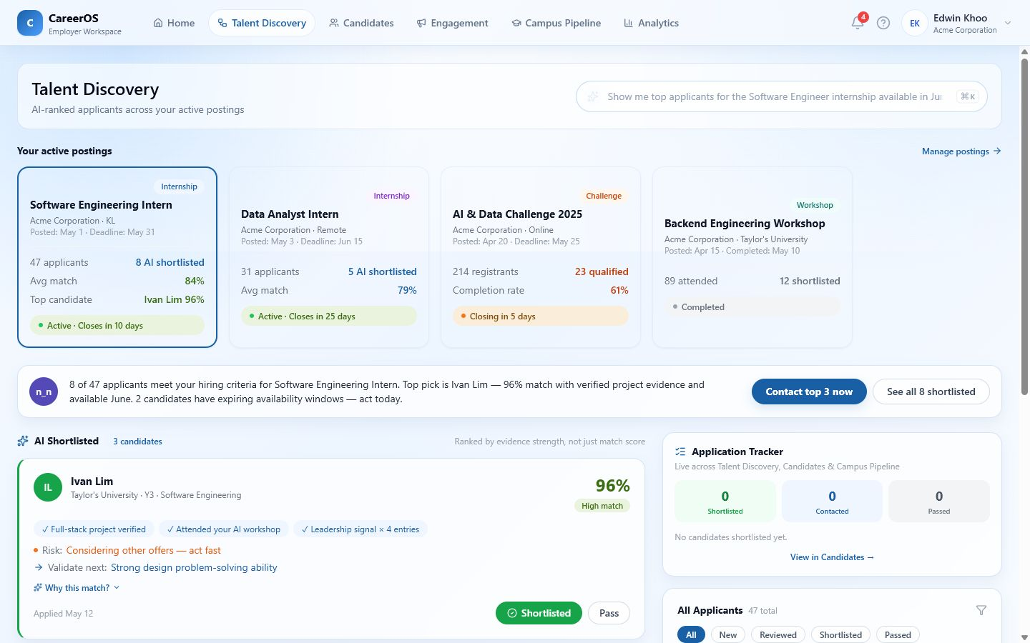
EMPLOYER
11
A match should explain the evidence—and the uncertainty.
1
Start from a specific hiring need.
2
Surface candidates with contextual evidence.
3
Expose strengths, gaps and a validation question.
Shortlist with an explicit rationale and validation plan.
SIMULATED MATCHING AND CANDIDATE DATA · FAIRNESS NOT VALIDATED
Notes:
[Sources] - CareerOS deck production blueprint: docs/pitch/CAREEROS_DECK_PRODUCTION_BLUEPRINT.md - CareerOS local prototype and repository documentation - Product screenshot: outputs/careeros-deck/screenshots/employer-discovery.png

Slide 12
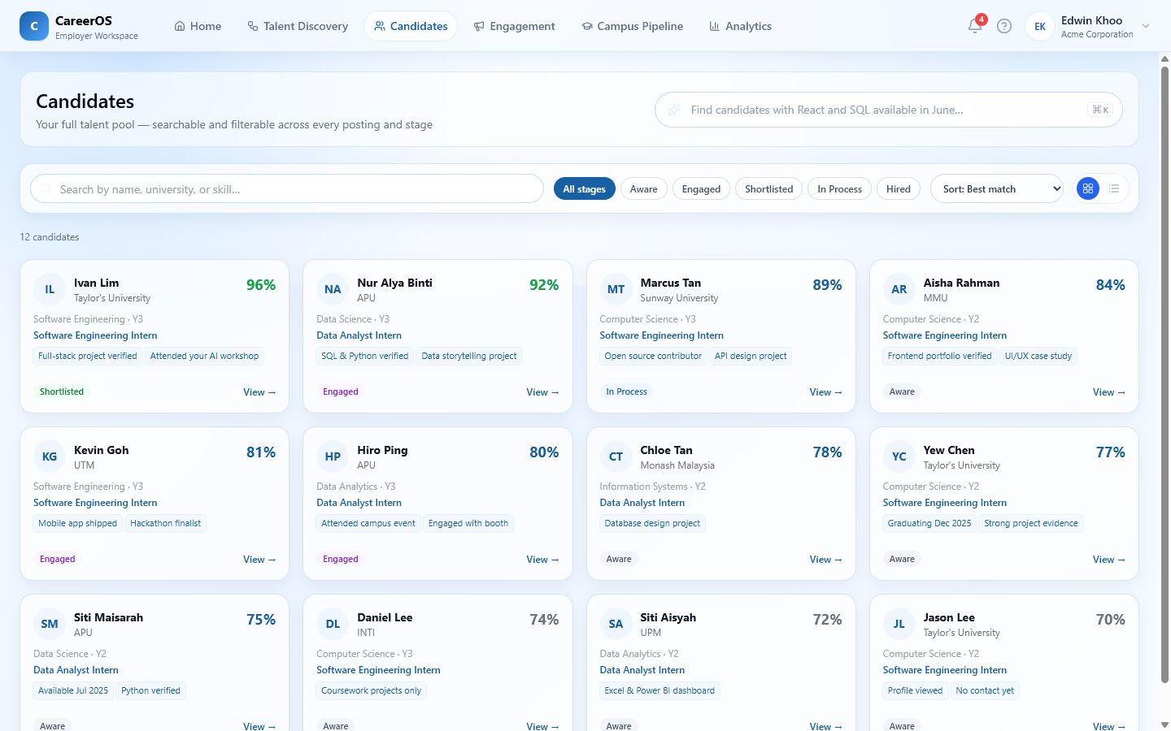
EMPLOYER
12
A candidate profile becomes a decision brief, not a digital CV.
1
Compare fit evidence, source and recency.
2
See what is strong, missing or still uncertain.
3
Carry the rationale into the next hiring step.
Review becomes faster to explain and easier to challenge.
DEMONSTRATED UI · DATA AND SCORES ILLUSTRATIVE
Notes:
[Sources] - CareerOS deck production blueprint: docs/pitch/CAREEROS_DECK_PRODUCTION_BLUEPRINT.md - CareerOS local prototype and repository documentation - Product screenshot: outputs/careeros-deck/screenshots/employer-candidates.png

Slide 13
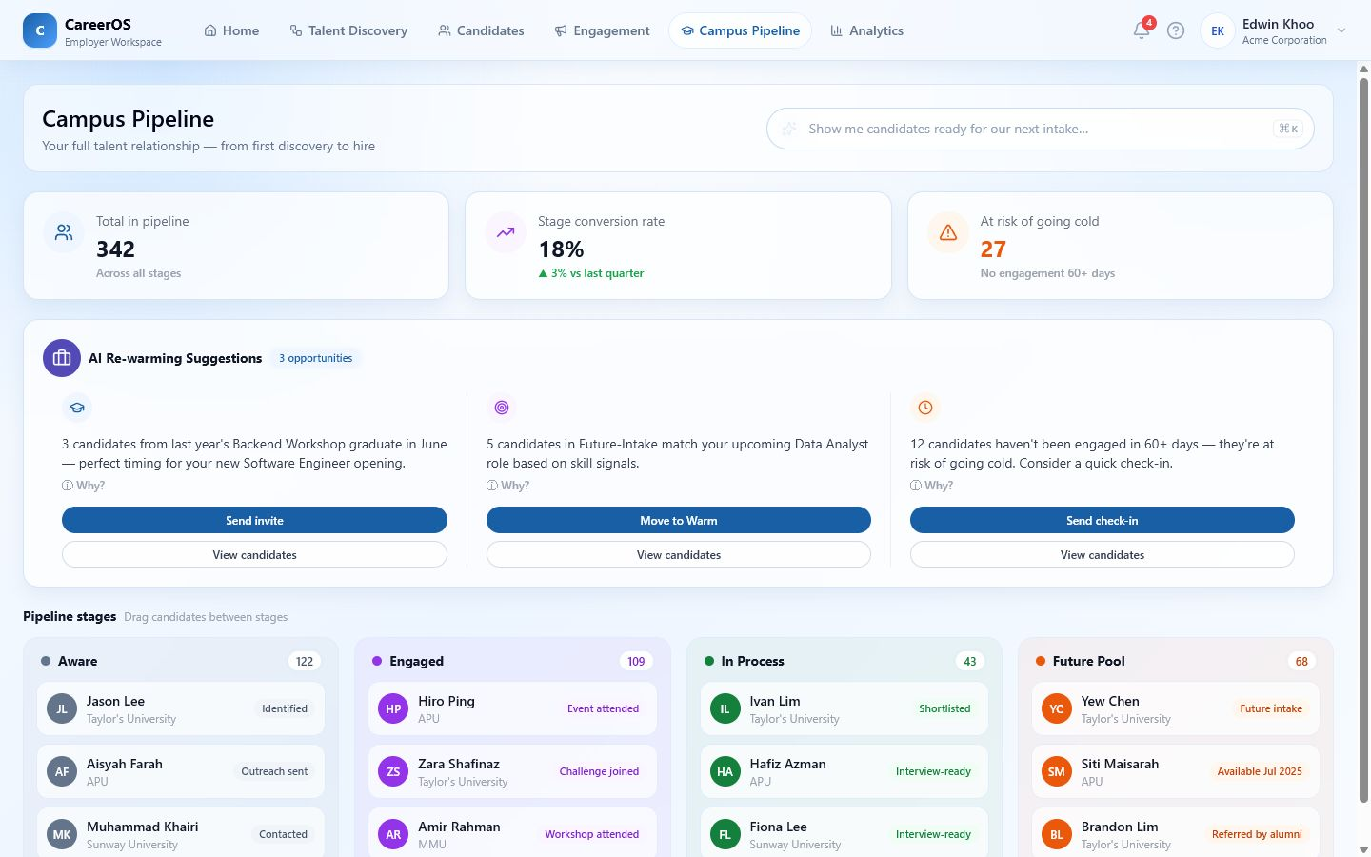
EMPLOYER
13
Every engagement can become reusable talent intelligence.
1
Preserve challenge, event and screening history.
2
Move candidates through an explicit pipeline.
3
Re-engage warm talent instead of restarting sourcing.
Relationships compound across hiring moments.
DEMONSTRATED LOCAL PIPELINE · LIVE CRM / ATS INTEGRATION FUTURE
Notes:
[Sources] - CareerOS deck production blueprint: docs/pitch/CAREEROS_DECK_PRODUCTION_BLUEPRINT.md - CareerOS local prototype and repository documentation - Product screenshot: outputs/careeros-deck/screenshots/employer-pipeline.png

Slide 14
UNIVERSITY
14
Universities need signals early enough to change the current cohort’s trajectory.
01
02
03
READINESS
MARKET ALIGNMENT
EVIDENCE
Which students or programmes need attention now?
Where are employer expectations moving faster than curriculum?
Can interventions, partnerships and accreditation proof be reused?
CareerOS converts fragmented outcomes into governed intervention workflows.
INSTITUTIONAL METRICS AND CASES ARE DEMO DATA
Notes:
[Sources] - CareerOS deck production blueprint: docs/pitch/CAREEROS_DECK_PRODUCTION_BLUEPRINT.md - CareerOS local prototype and repository documentation

Slide 15
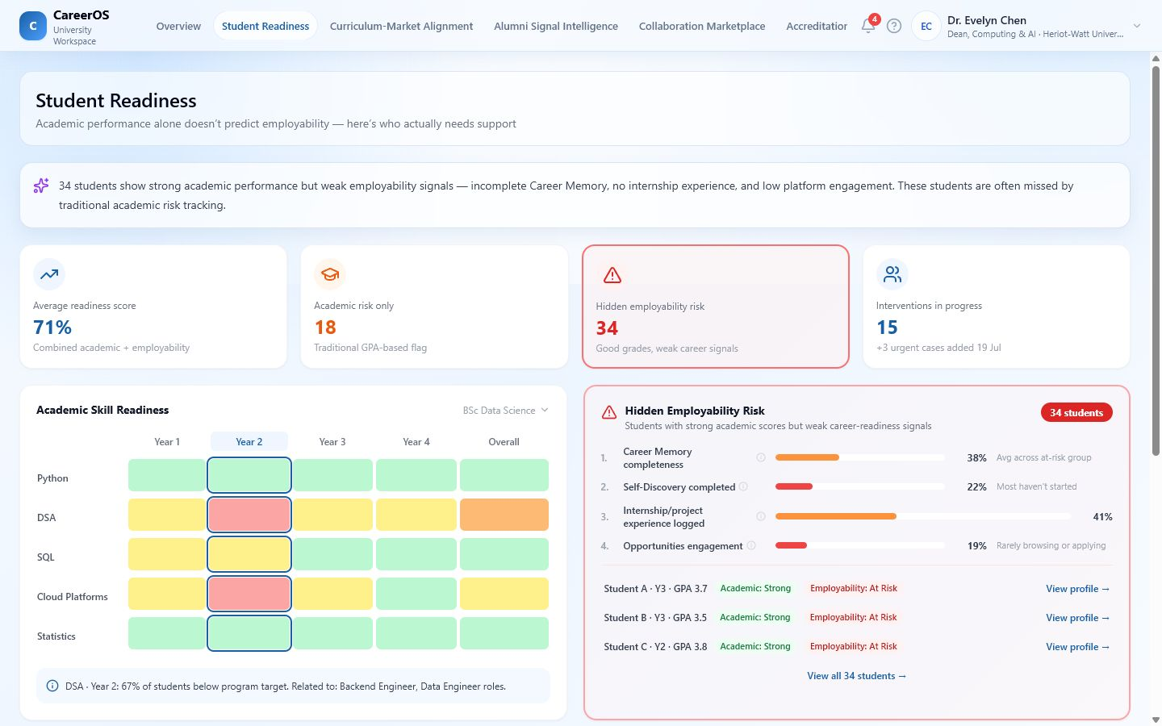
UNIVERSITY
15
Readiness insight should trigger an intervention—not another report.
1
Identify programme and cohort gaps.
2
Trace the signal to affected students or skills.
3
Assign and track a targeted intervention.
Act while the cohort can still benefit.
DEMONSTRATED UI · READINESS SIGNALS ILLUSTRATIVE
Notes:
[Sources] - CareerOS deck production blueprint: docs/pitch/CAREEROS_DECK_PRODUCTION_BLUEPRINT.md - CareerOS local prototype and repository documentation - Product screenshot: outputs/careeros-deck/screenshots/university-readiness.png

Slide 16
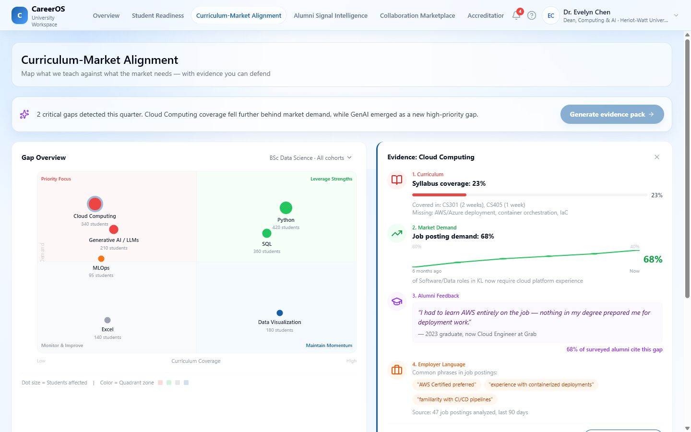
UNIVERSITY
16
Curriculum-market alignment becomes a living prioritisation workflow.
1
Compare curriculum coverage with demand signals.
2
See where gaps are emerging by programme.
3
Prioritise a response without claiming predictive certainty.
Programme teams can discuss one evidenced priority sooner.
DEMONSTRATED UI · MARKET SIGNALS AND ANALYSIS SIMULATED
Notes:
[Sources] - CareerOS deck production blueprint: docs/pitch/CAREEROS_DECK_PRODUCTION_BLUEPRINT.md - CareerOS local prototype and repository documentation - Product screenshot: outputs/careeros-deck/screenshots/university-curriculum.png

Slide 17
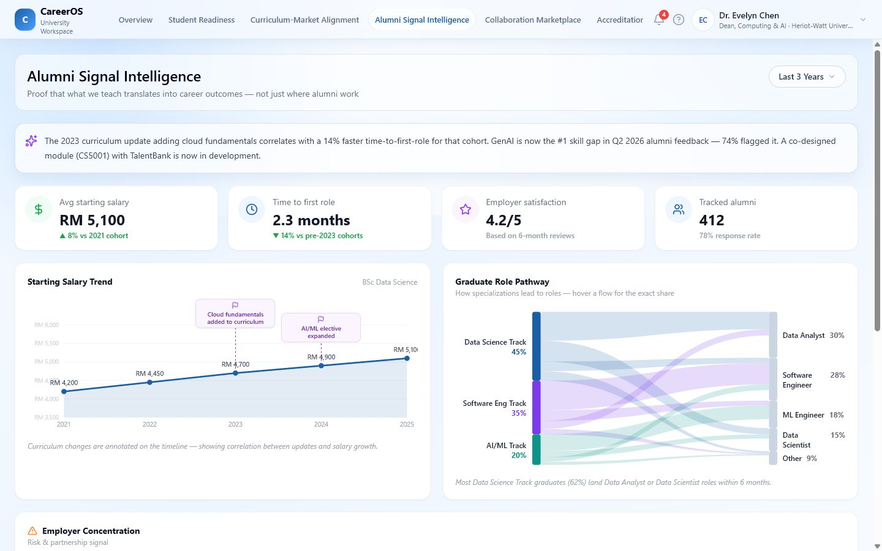
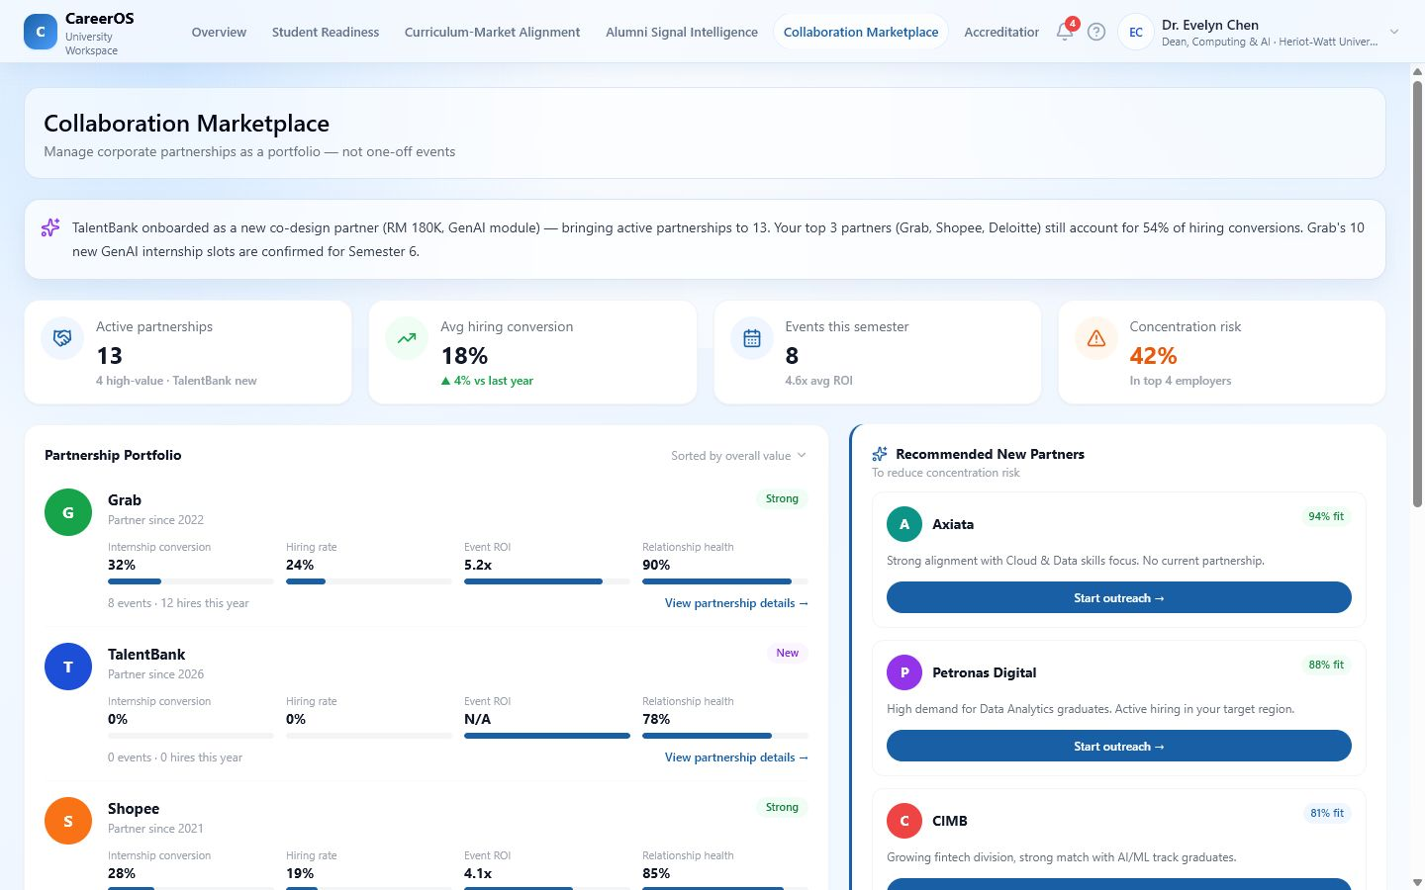
UNIVERSITY
17
Alumni and collaboration signals can shorten the distance from insight to partnership.
1
Use alumni outcomes as directional evidence.
2
Translate an identified gap into a collaboration brief.
3
Preserve partner context for future decisions.
Partnership development starts from an explicit capability need.
DEMONSTRATED UI · NETWORK EFFECTS FUTURE
Notes:
[Sources] - CareerOS deck production blueprint: docs/pitch/CAREEROS_DECK_PRODUCTION_BLUEPRINT.md - CareerOS local prototype and repository documentation - Product screenshot: outputs/careeros-deck/screenshots/university-alumni.png - Product screenshot: outputs/careeros-deck/screenshots/university-collaboration.png

Slide 18
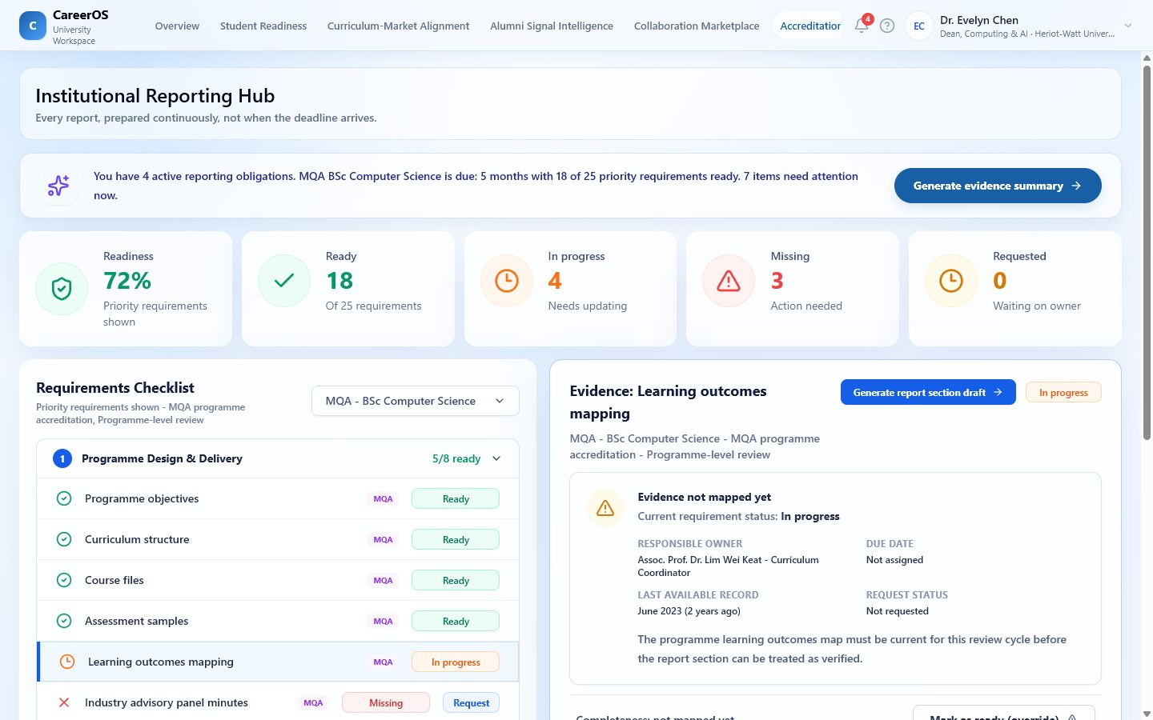
UNIVERSITY
18
Accreditation evidence should be assembled continuously—not reconstructed under deadline.
1
Organise outcomes, activities and supporting artefacts.
2
Link evidence to standards and review tasks.
3
Keep progress and ownership visible.
Institutional memory becomes reusable and auditable.
DEMONSTRATED WORKSPACE · FORMAL SUBMISSION INTEGRATIONS FUTURE
Notes:
[Sources] - CareerOS deck production blueprint: docs/pitch/CAREEROS_DECK_PRODUCTION_BLUEPRINT.md - CareerOS local prototype and repository documentation - Product screenshot: outputs/careeros-deck/screenshots/university-accreditation.png

Slide 19
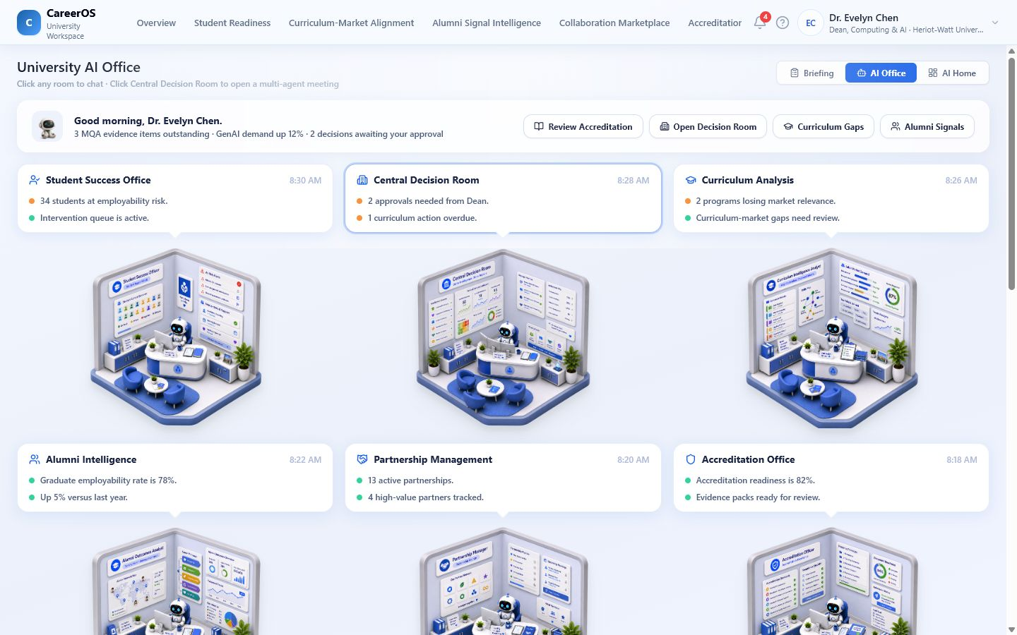
UNIVERSITY
19
The AI Office turns signals into governed institutional action.
1
Coordinate cross-department operating rooms.
2
Align decisions with university priorities.
3
Track intervention ownership, progress and evidence.
AI supports decision preparation; humans retain governance.
DEMONSTRATED UI · AI RECOMMENDATIONS AND OPERATIONS SIMULATED
Notes:
[Sources] - CareerOS deck production blueprint: docs/pitch/CAREEROS_DECK_PRODUCTION_BLUEPRINT.md - CareerOS local prototype and repository documentation - Product screenshot: outputs/careeros-deck/screenshots/university-ai-office.png

Slide 20
CONNECTED SYSTEM
20
Three workspaces create one compounding evidence loop.
STUDENT EVIDENCE
→
EMPLOYER VALIDATION
→
UNIVERSITY INTERVENTION
→
NEW ACTIVITY
→
STRONGER EVIDENCE
CareerOS is more than a portal or dashboard because each decision can preserve context for the next stakeholder.
SELECTED HANDOFFS DEMONSTRATED · SHARED NETWORK FUTURE
Notes:
[Sources] - CareerOS deck production blueprint: docs/pitch/CAREEROS_DECK_PRODUCTION_BLUEPRINT.md - CareerOS local prototype and repository documentation

Slide 21
PRODUCT TRUTH
21
The prototype is broad; its intelligence and network effects are not yet proven.
01
02
03
DEMONSTRATED
SIMULATED / PARTIAL
FUTURE-FACING
Three workspaces
Editable interactions
Local workflows
Rich prototype states
Candidate and market data
Recommendations and scoring
Optional model responses
Selected backend paths
Live integrations
Cross-organisation memory
Validated accuracy / fairness
Production governance
No adoption, customers, partnerships, measured outcomes, ROI or AI accuracy are claimed.
Notes:
[Sources] - CareerOS deck production blueprint: docs/pitch/CAREEROS_DECK_PRODUCTION_BLUEPRINT.md - CareerOS local prototype and repository documentation

Slide 22
TALENTBANK
22
CareerOS could extend Talentbank from moments of engagement into a lifecycle of evidence and action.
01
02
03
STUDENT VALUE
EMPLOYER VALUE
UNIVERSITY VALUE
More continuous reasons to engage, prepare and build proof.
Richer context before and after hiring campaigns or events.
A workflow layer for readiness, collaboration and evidence reuse.
Strategic value is a hypothesis: it depends on consent, trust, integrations, buyer demand and operational ownership.
STRATEGIC FIT TO VALIDATE · NOT AN EXISTING PARTNERSHIP
Notes:
[Sources] - CareerOS deck production blueprint: docs/pitch/CAREEROS_DECK_PRODUCTION_BLUEPRINT.md - CareerOS local prototype and repository documentation

Slide 23
NEXT-STAGE VALIDATION
23
The next step is to prove one consented evidence-to-action loop.
DEFINE PILOT
→
CONNECT MINIMUM DATA
→
RUN ONE LOOP
→
MEASURE BEHAVIOUR
→
REVIEW TRUST
One cohort · role · programme
Only required evidence
Signal to intervention
Action and follow-through
Consent · fairness · governance
Validate workflow value before scaling intelligence, integrations or network claims.
Notes:
[Sources] - CareerOS deck production blueprint: docs/pitch/CAREEROS_DECK_PRODUCTION_BLUEPRINT.md - CareerOS local prototype and repository documentation

Slide 24
CLOSING
24
Remember the signal. Act before potential is lost.
CareerOS is an evidence-memory and action layer connecting students, employers and universities.
01
02
03
WHAT EXISTS
WHAT IT TESTS
WHAT COMES NEXT
A polished, editable multi-workspace prototype.
Whether preserved context improves the next decision.
A bounded pilot with consent, measurable behaviours and explicit governance.
CareerOS — AI-powered career operating system
Notes:
[Sources] - CareerOS deck production blueprint: docs/pitch/CAREEROS_DECK_PRODUCTION_BLUEPRINT.md - CareerOS local prototype and repository documentation

