Slide 1
CAREEROS
Career potential is lost when evidence and action arrive too late.
STUDENT
EMPLOYER
UNIVERSITY
CareerOS connects student evidence, employer demand, and university action so gaps can be addressed earlier.
Signal → Evidence → Decision → Action → Learning
PROTOTYPE • SIMULATED INTELLIGENCE
Talentbank AI Hackathon • 2026

Slide 2
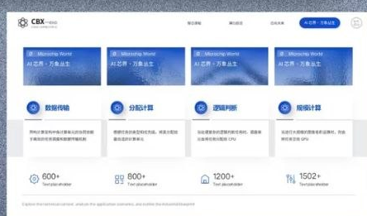
THE SHARED FAILURE
02
The same evidence gap appears as uncertainty, recruiting waste, and late action.
STUDENT
EMPLOYER
UNIVERSITY
Experience exists, but proof and direction do not.
Every urgent search restarts from zero.
The intervention window closes before the report arrives.
Chris is a Year 3 Data Science student with projects and leadership evidence—but weak visibility into what those experiences prove and what to do next.
Prior challenge participants, screening rationale, and relationship history decay across spreadsheets, inboxes, and disconnected systems.
Programme and readiness gaps surface across departments while the current cohort cannot wait for a full curriculum cycle.
Consequence: option loss
Consequence: relationship loss
Consequence: time loss
Different symptoms. One failure: useful signals are fragmented, weakly evidenced, and remembered too late.
CareerOS • Talentbank AI Hackathon
Simulated personas and demo data

Slide 3
THE SHARED FAILURE
STUDENT
EMPLOYER
UNIVERSITY
They discover what they are missing only after rejection
Strong candidates disappear before the vacancy exists
They see the problem only when it is too late to intervene
A student has completed projects, led activities and solved real problems. But when applying, all of it is reduced to a few unproven lines on a CV.
A recruiter meets a promising student through a challenge, workshop or previous interview. but months later, the evidence and relationship are buried across spreadsheets and inboxes.
A student appears academically successful, but has no industry exposure, weak evidence and low career readiness. The university only notices after graduation outcomes decline.
They apply repeatedly, receive silence or rejection, and still do not know whether the problem is their skills, evidence, interview performance or career direction.
When a position suddenly needs to be filled, the team starts from hundreds of similar CVs with no reliable way to see who has actually demonstrated potential.
The university identifies a critical market skill gap, but formal curriculum reform takes months or years. While today’s students graduate without that capability.

Slide 4
THE SHARED FAILURE
03
Existing tools optimise transactions—not continuity between them.
Activity
Engagement
Hiring feedback
Outcomes
becomes a résumé claim
→
becomes an attendance list
→
stays in an ATS or inbox
→
arrive in periodic reports
The next decision begins without the earlier context.
CareerOS preserves context between transactions; it does not pretend to replace every source system.
CareerOS • Talentbank AI Hackathon
Future integrations required

Slide 5
THE OPERATING MODEL
04
CareerOS converts fragmented signals into a sequence of earlier decisions.
SIGNAL
EVIDENCE
DECISION
ACTION
LEARNING
Project, application,
demand, outcome
→
Source, recency,
context, behaviour
→
Next skill, shortlist,
intervention
→
Practise, apply,
re-engage, assign
→
Improve the next
decision
Student evidence
Employer demand
University action
The prototype demonstrates each workspace and selected handoffs. A live shared network remains future-facing.
CareerOS • Talentbank AI Hackathon
Demonstrated model • network future

Slide 6
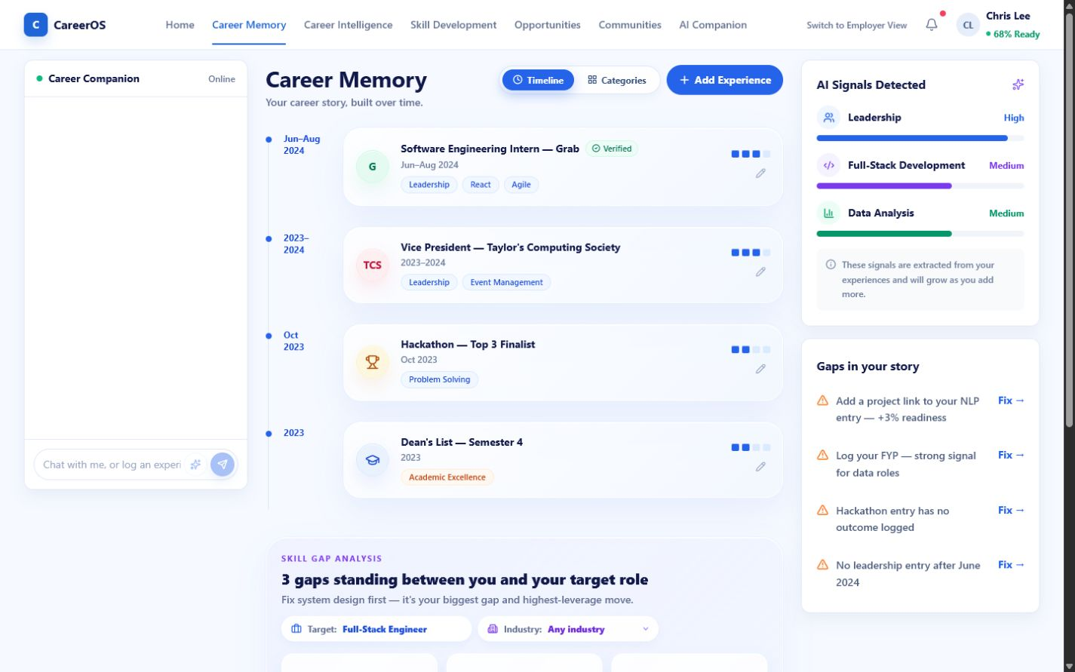
STUDENT • EVIDENCE
05
Career Memory turns “I did this” into “Here is what it proves.”
PAIN → EVIDENCE
Students should not reconstruct their value only when an application opens.
1
01
Preserve projects, internships, leadership, events, and achievements.
02
Connect each experience to skills and supporting context.
03
Expose missing proof instead of hiding uncertainty.
2
Behaviour change: maintain reusable evidence continuously.
CareerOS • Talentbank AI Hackathon
Demonstrated UI • verification partial

Slide 7
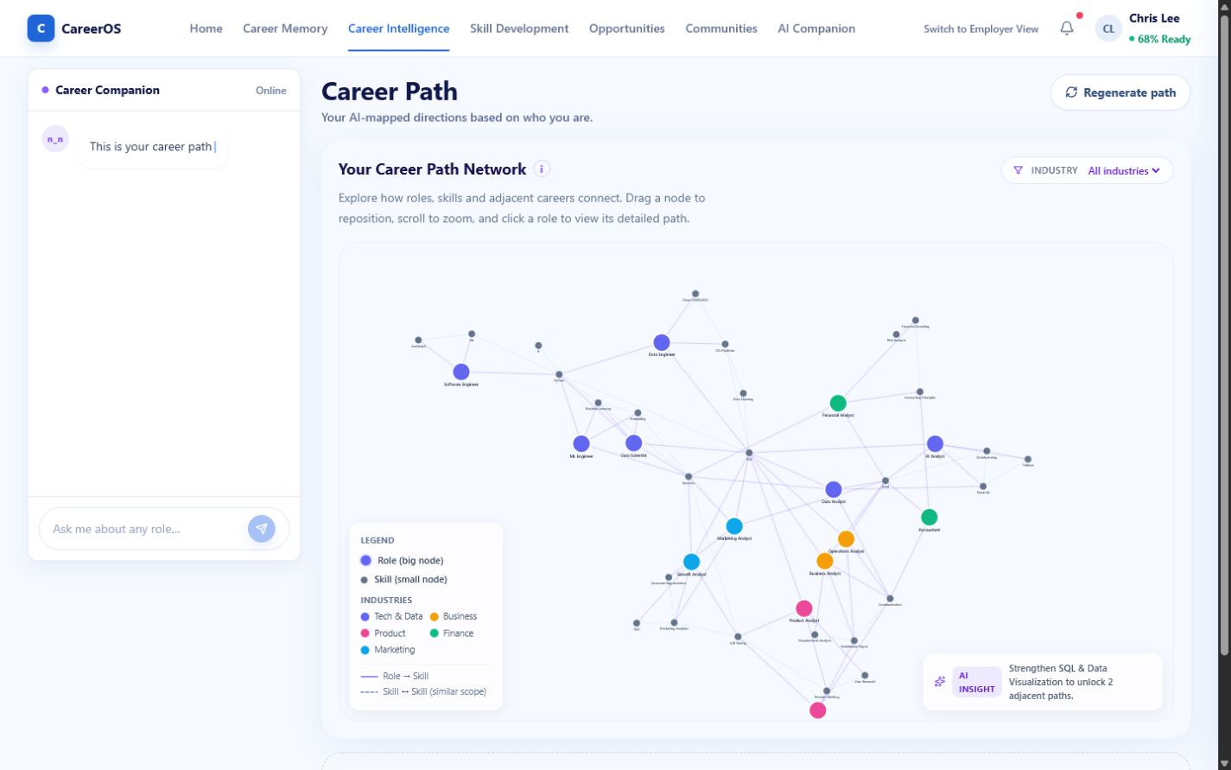
STUDENT • DIRECTION
06
The Data Science degree becomes a starting signal—not a career boundary.
EVIDENCE → DIRECTION
Career Intelligence interprets existing proof against adjacent paths and gaps.
01
Reveal transferable evidence and adjacent career options.
02
Prioritise one missing skill or proof point.
1
03
Connect the gap to learning or market action.
2
Designed impact: clearer choices and less degree lock-in.
CareerOS • Talentbank AI Hackathon
Simulated paths and market logic

Slide 8
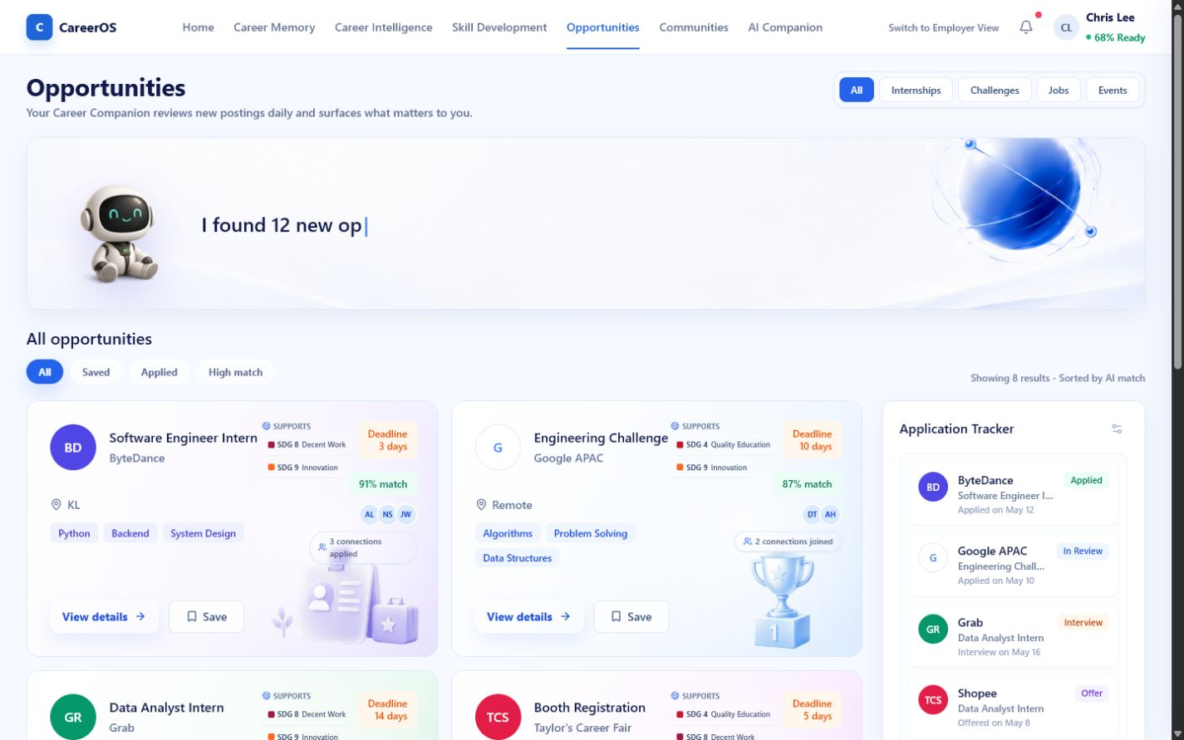
STUDENT • ACTION
07
Guidance matters only when it ends in a visible next action.
DIRECTION → ACTION
Opportunities and applications operationalise the student's next decision.
01
Explain why an opportunity fits—and what evidence is missing.
02
Save, apply, prepare, or build the needed skill.
Preserve status and follow-up instead of losing momentum.
1
03
2
Behaviour change: advice becomes a commitment.
CareerOS • Talentbank AI Hackathon
Demonstrated local workflow

Slide 9
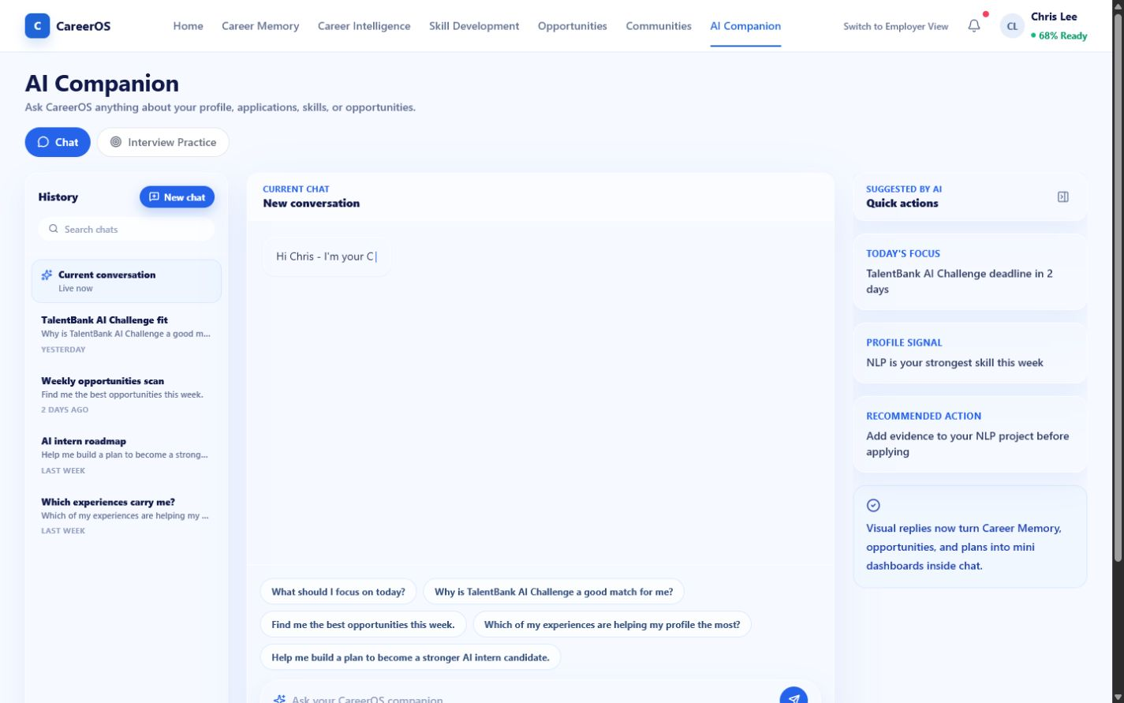
STUDENT • PREPARATION
08
Ask from intent, then practise the moment that matters.
INTENT → PREPARATION
The Companion reduces navigation while practice turns guidance into rehearsal.
01
Interpret the student's question in CareerOS context.
02
Route to evidence, opportunity, or preparation.
03
Practise for a role without learning the product's information architecture.
1
Expected impact: faster movement from uncertainty to preparation.
CareerOS • Talentbank AI Hackathon
Simulated / optional AI

Slide 10
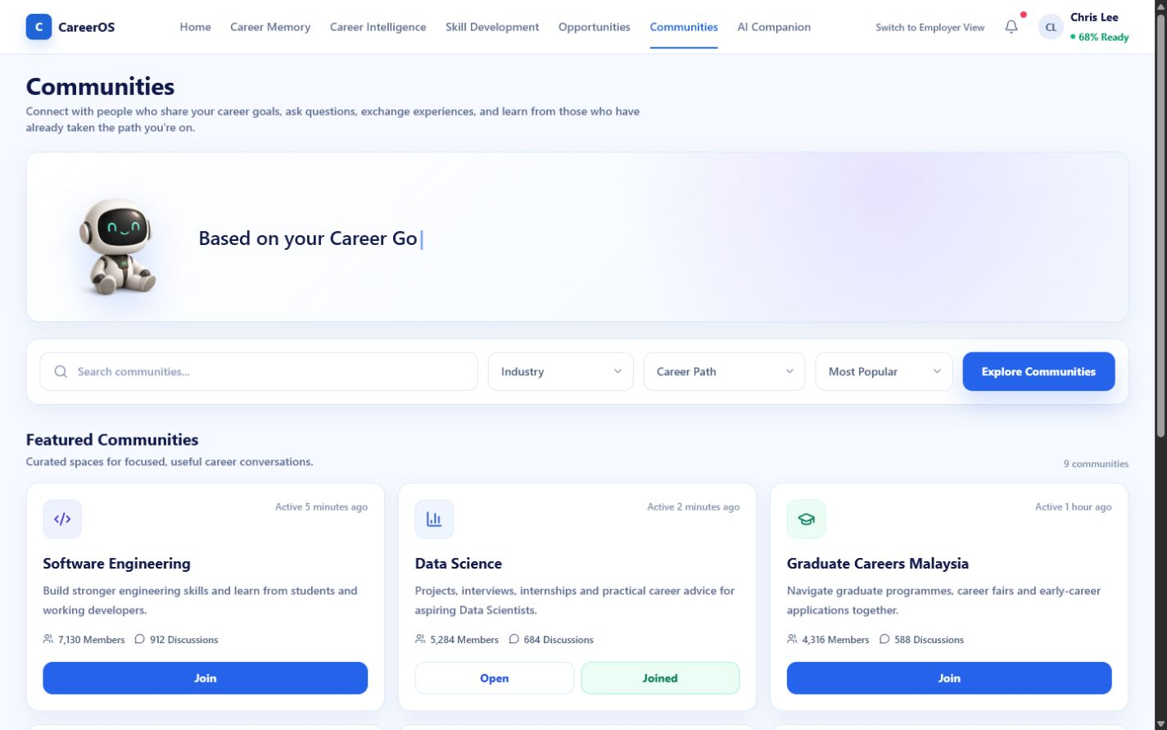
STUDENT • RETENTION
09
CareerOS gives students reasons to return between applications.
SETBACK → RETURN
Community, mentorship, and learning can extend the relationship beyond vacancy browsing.
01
Normalise rejection and uncertainty through relevant peers.
02
Find targeted support, advice, or mentorship.
03
Turn new activity into future Career Memory evidence.
Designed impact: continued evidence-building—not measured retention.
CareerOS • Talentbank AI Hackathon
Community demo • loop future

Slide 11
EMPLOYER • DECISION MODEL
10
Employers need evidence and history—not another candidate database.
THE CURRENT FAILURE
THE CAREEROS EMPLOYER MODEL
Early-talent decisions are weakest when every search starts from CV claims and zero context.
Need
Evidence-backed discovery
Targeted validation
Similar claims • limited work history • lost event context • urgent sourcing
Decision history
Reusable pipeline
Behaviour change: ask what supports fit—and what must be validated.
CareerOS • Talentbank AI Hackathon
Simulated candidate and match data

Slide 12
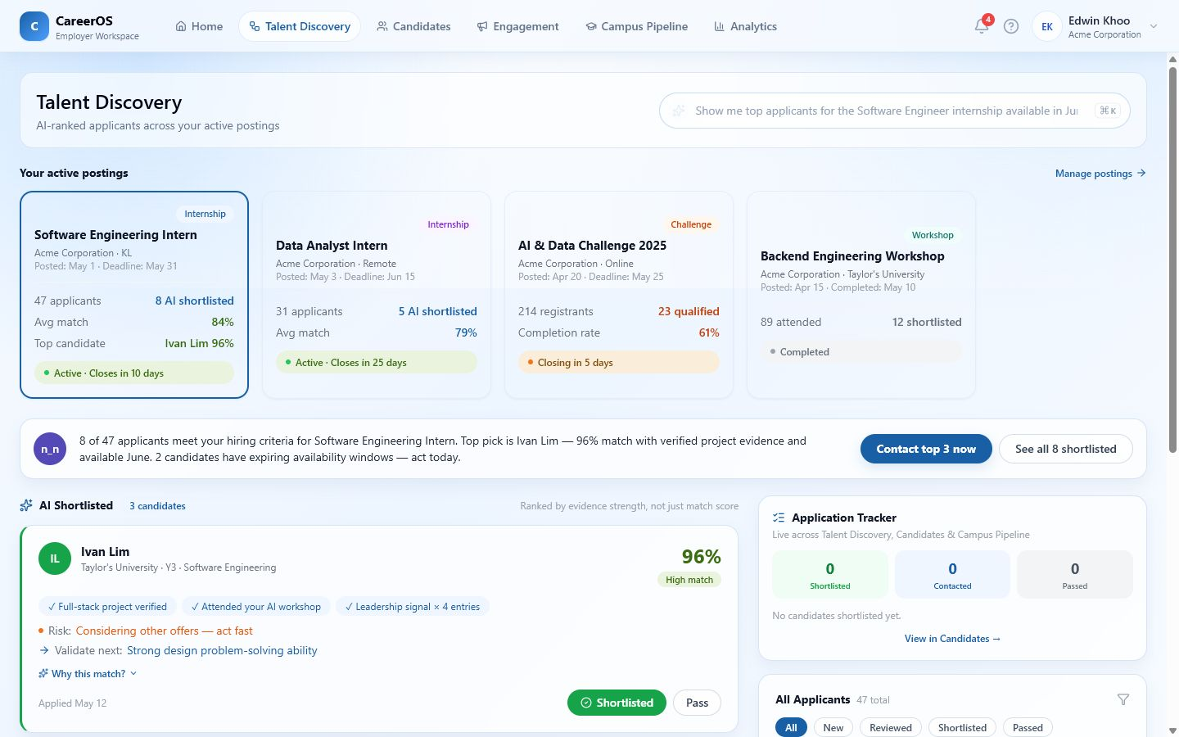
EMPLOYER • DISCOVERY
11
A match should explain the evidence—and the uncertainty.
NEED → EXPLAINABLE FIT
Talent Discovery reframes ranking as an evidence-led validation plan.
01
Start from a hiring need, not a generic candidate search.
02
Show supporting evidence, strengths, and gaps.
1
03
Prepare the next validation question before shortlisting.
2
Designed impact: more structured, accountable screening.
CareerOS • Talentbank AI Hackathon
Simulated matching and candidates

Slide 13
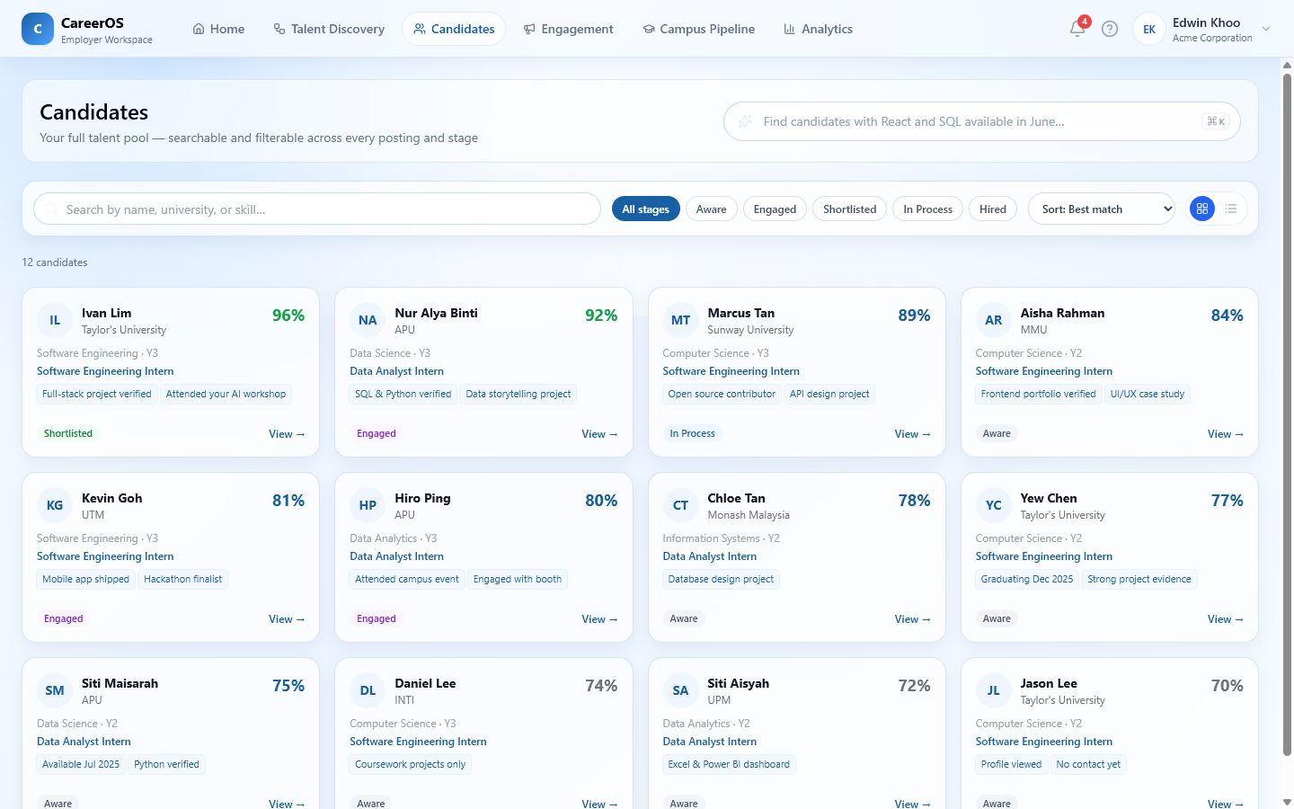
EMPLOYER • WORKFLOW
12
CareerOS preserves why a candidate moved—not only where they are.
FIT → DECISION HISTORY
Evidence rationale must survive the handoff into candidate stages and team review.
01
Retain shortlist or pass decisions with context.
02
Carry gaps and validation questions forward.
03
Keep the next decision-maker from repeating the same review.
Expected impact: cleaner handoffs; ATS integration remains future.
CareerOS • Talentbank AI Hackathon
Demonstrated local state

Slide 14
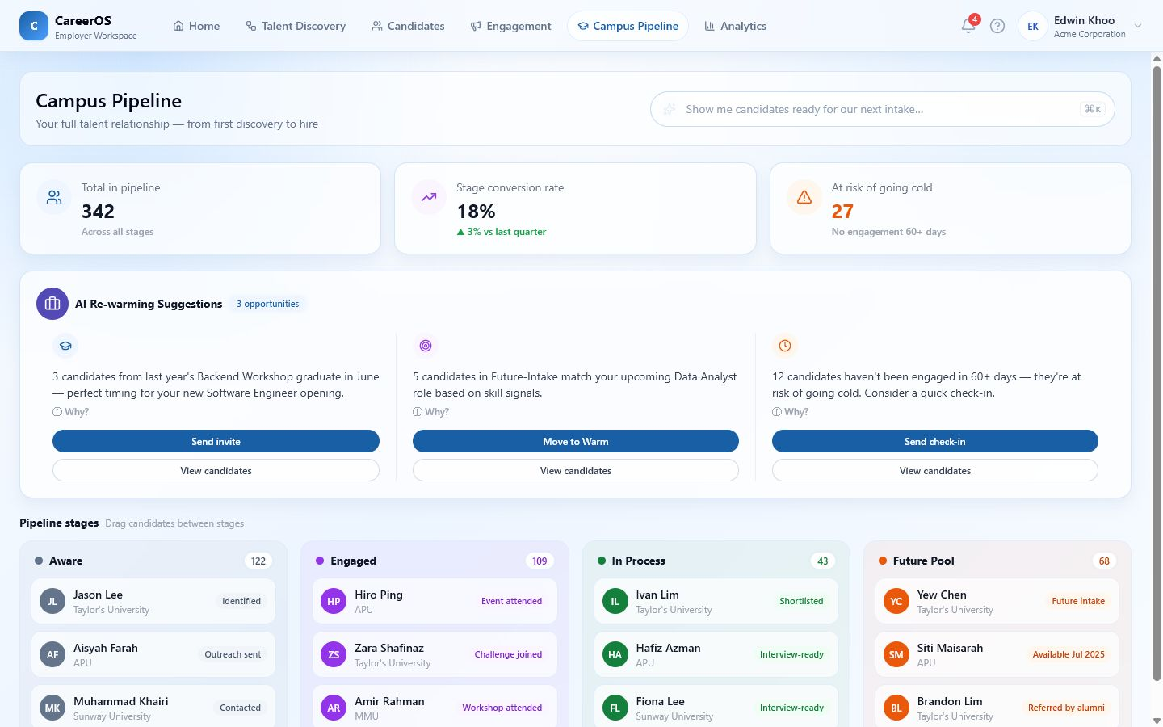
EMPLOYER • RELATIONSHIP VALUE
13
Prior engagement becomes a renewable talent asset.
HISTORY → REACTIVATION
An urgent vacancy should not erase every previous challenge or candidate interaction.
1
01
Surface warm candidates with prior relationship context.
02
Explain why the renewed need matches earlier evidence.
03
Reconnect engagement design, pipeline action, and learning.
Designed impact: restart from context—not from zero.
CareerOS • Talentbank AI Hackathon
Simulated rewarming and sending

Slide 15
UNIVERSITY • DECISION MODEL
14
Universities need time to act—not another annual report.
By the time an outcome appears in a report, the current cohort may already have lost the intervention window.
DETECT
ASSIGN
INTERVENE
EVIDENCE
REVIEW
Readiness and market signals
Named owner and deadline
Current-cohort action
Reusable institutional record
Learn and govern change
Critical principle: help the current cohort now while governing longer-term programme change.
CareerOS • Talentbank AI Hackathon
Simulated institutional data

Slide 16
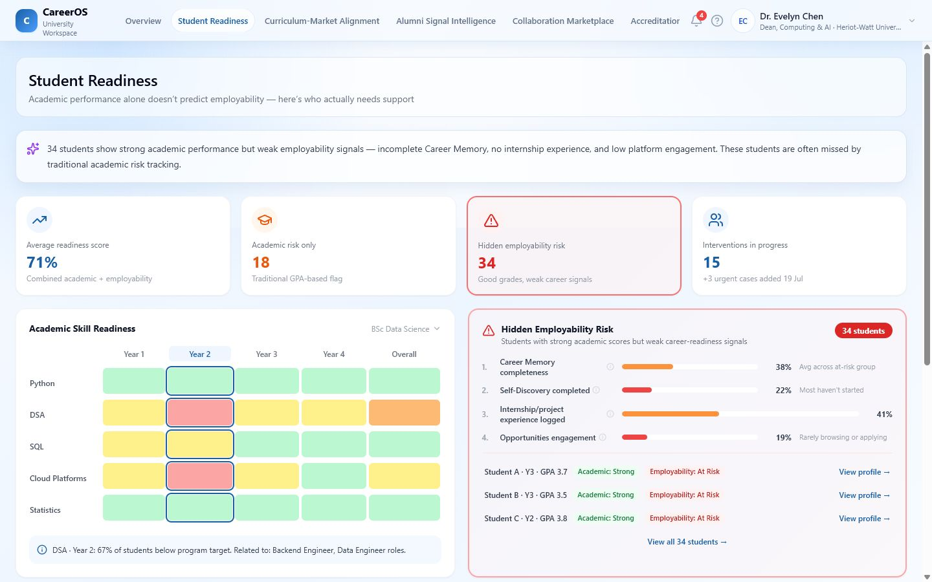
UNIVERSITY • STUDENT READINESS
15
A risk signal matters only when someone owns the next intervention.
SIGNAL → OWNERSHIP
Student Readiness links cohort evidence to an accountable action.
01
Separate academic and employability signals.
02
Drill into a cohort or student risk context.
03
Assign an intervention, owner, deadline, and status.
1
2
Safeguards required: consent, access, correction, and fairness.
CareerOS • Talentbank AI Hackathon
Demo workflow • mock data

Slide 17
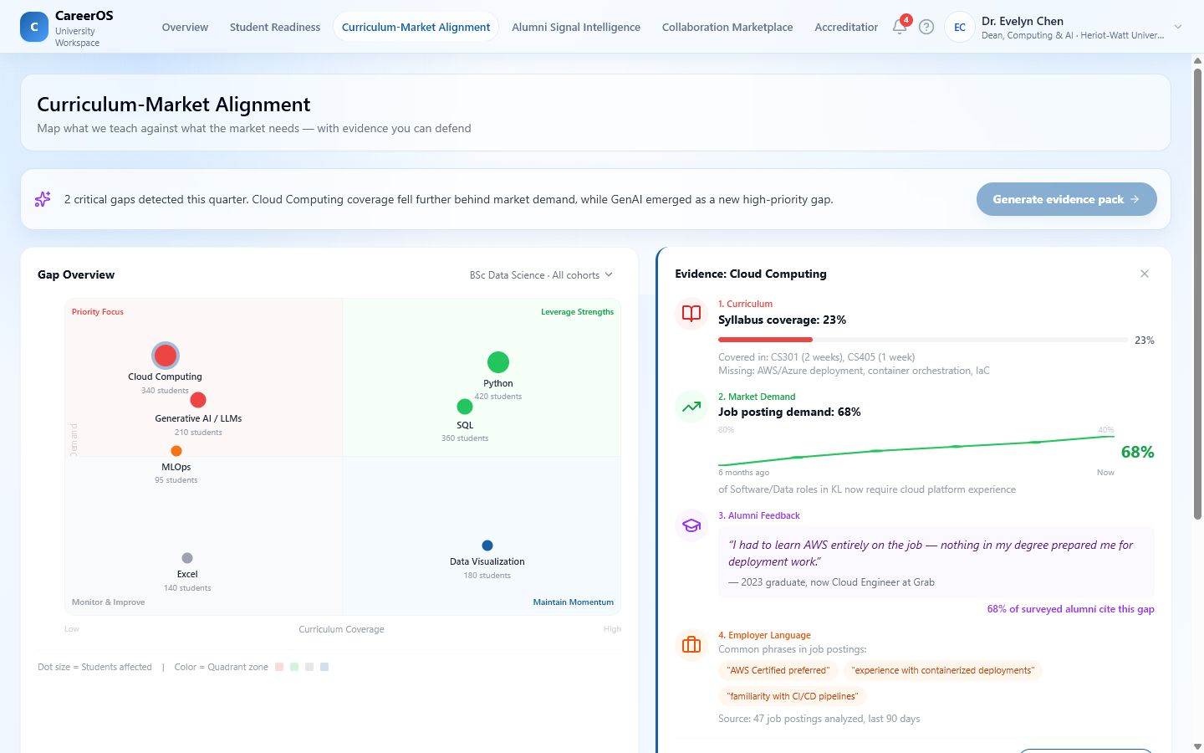
UNIVERSITY • CURRICULUM
16
A curriculum gap needs two clocks: help now, reform properly.
DEMAND → TWO ACTIONS
Curriculum-Market Alignment separates current-cohort support from governed programme change.
01
Trace the gap to demand, coverage, and outcome signals.
2
02
Act now through workshops, challenges, or partnerships.
03
Build the evidence pack and roadmap for formal reform.
1
Behaviour change: market intelligence becomes a prioritised response.
CareerOS • Talentbank AI Hackathon
Simulated demand and coverage data

Slide 18
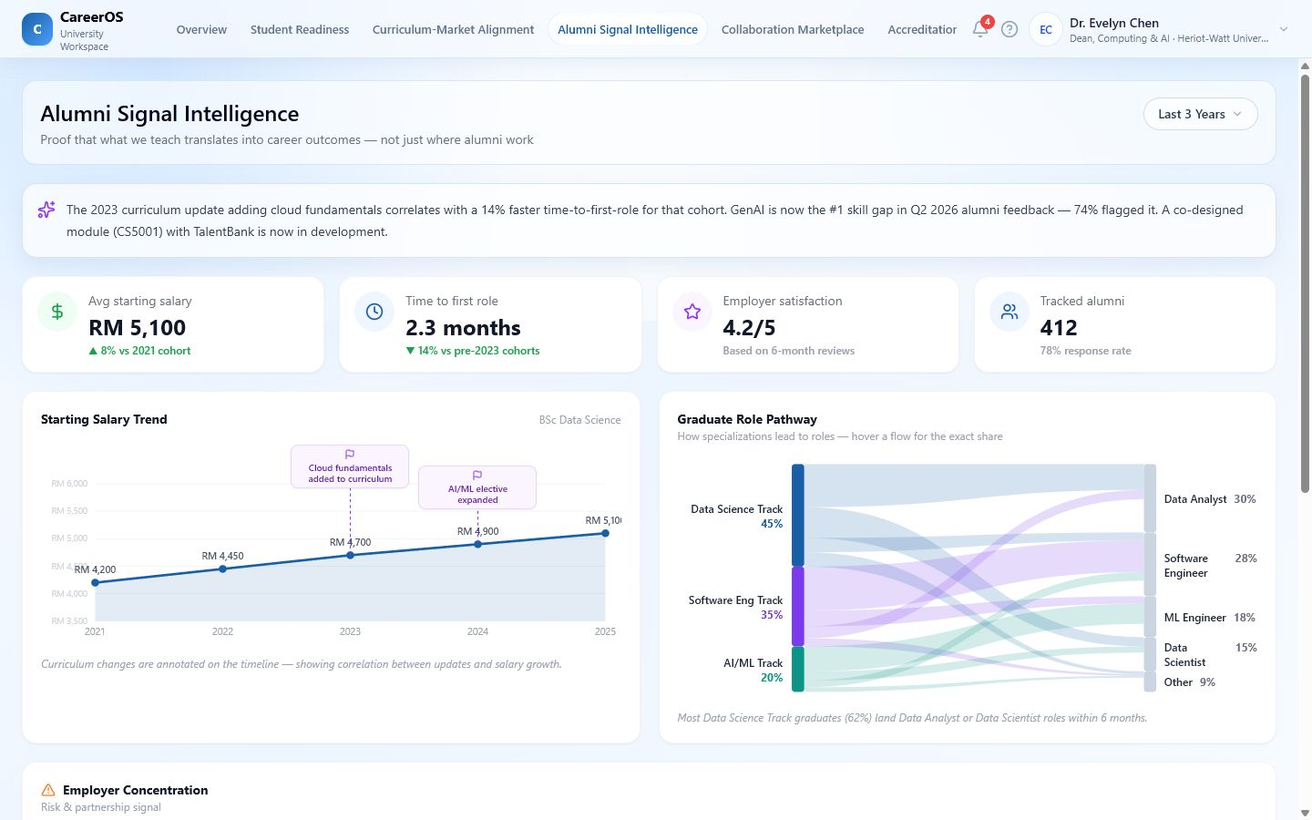
UNIVERSITY • LEARNING AND ACTION
17
Alumni feedback needs an action channel—not another endpoint.
OUTCOME → PARTNERSHIP
Alumni Signals and collaboration workflows connect learning to a named response.
01
Identify patterns worth investigating, not causal proof.
02
Route findings into curriculum or partnership decisions.
03
Design collaborations against a gap and preserve event evidence.
Designed impact: more purposeful partnerships and outcome learning.
CareerOS • Talentbank AI Hackathon
Illustrative analytics • outreach simulated

Slide 19
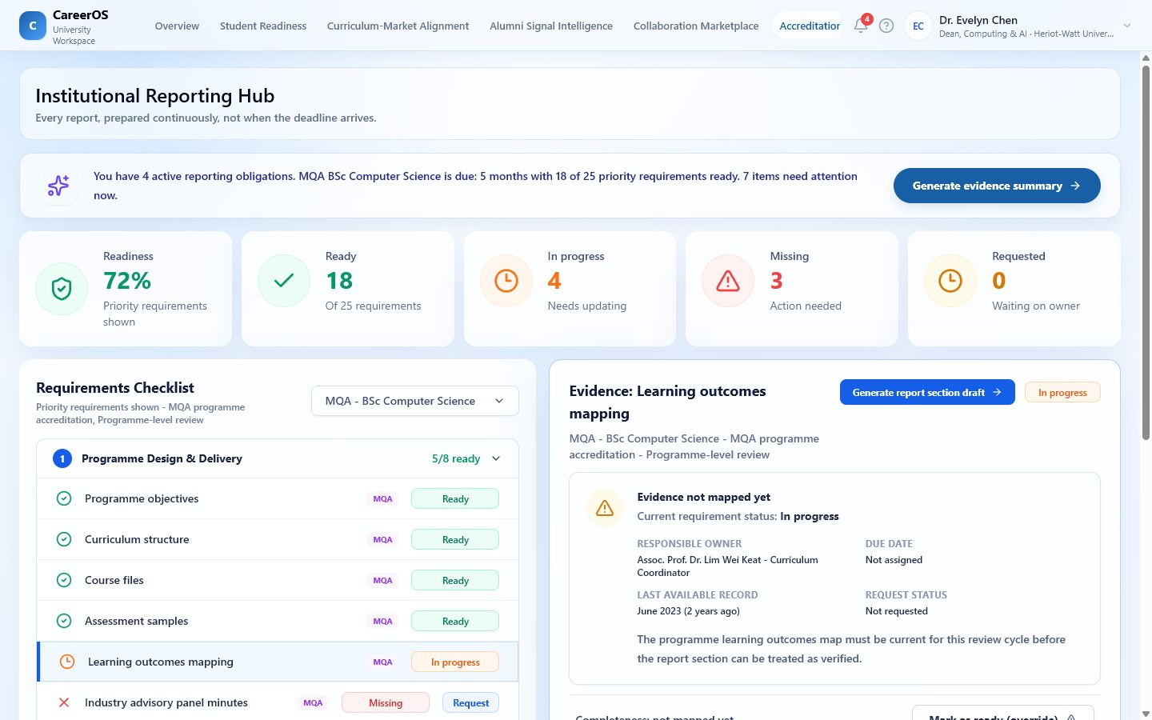
UNIVERSITY • EVIDENCE REUSE
18
Institutional evidence should not be rebuilt for every deadline.
ACTION → REUSABLE EVIDENCE
The Accreditation Hub models readiness, ownership, gaps, and evidence reuse.
01
Map requirements to source, owner, period, and completeness.
02
Expose missing evidence and the responsible person.
03
Reuse curriculum, readiness, alumni, and partnership evidence.
1
Designed impact: less repeated preparation; savings are not measured.
CareerOS • Talentbank AI Hackathon
Simulated operational effects

Slide 20
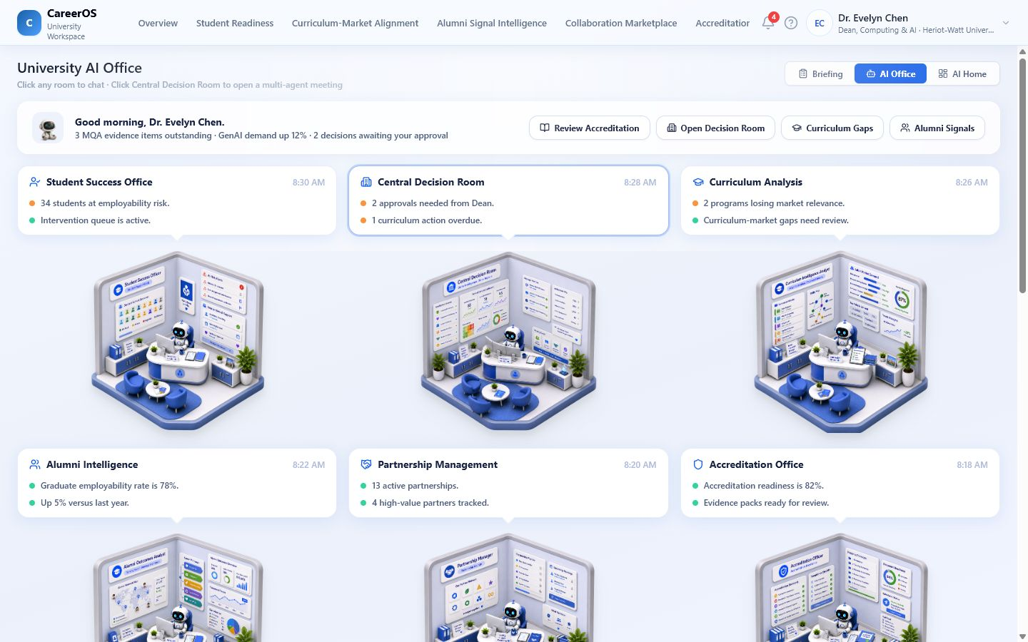
UNIVERSITY • GOVERNED AI
19
Leaders need prepared decisions—not another page of charts.
GOAL → HUMAN DECISION
The AI Office reframes institutional intelligence as job-shaped work with approval.
2
01
Route goals to Student Success, Curriculum, Alumni, Partnerships, or Accreditation.
02
Prepare context and trade-offs across functions.
1
03
Require human approval before external effect.
Interaction model demonstrated; persistent autonomous work is future.
CareerOS • Talentbank AI Hackathon
Scripted / optional AI • autonomy future

Slide 21
CONNECTED ECOSYSTEM
20
CareerOS becomes more than three workspaces when evidence survives the handoff.
EMPLOYER
STUDENT
EMPLOYER
UNIVERSITY
defines an evidence-producing challenge
turns participation into Career Memory
uses evidence as explainable context
assigns an intervention and preserves evidence
→
→
⇢
Solid handoffs are represented in the repository. Dashed propagation requires permissions, provenance, and integrations.
Potential moat: permissioned longitudinal evidence and relationship history—not dashboards or generic AI.
CareerOS • Talentbank AI Hackathon
Demonstrated in parts • network future

Slide 22
IMPLEMENTATION TRUTH
21
The prototype proves product logic—not adoption, accuracy, or integration.
DEMONSTRATED
SIMULATED
FUTURE
Working prototype interactions
Intelligence and operational effects
Production trust and network
Three compiled workspaces; rich local interactions; selected cross-page state; partial FastAPI routes; evidence-to-action UX.
Recommendations, scores, cohort and candidate data, sends, exports, uploads, generated drafts, and most persistence.
Permissions, provenance, verification, integrations, validated models, cross-organisation propagation, and autonomous monitoring.
Inspect today
Label clearly
Validate next
No customers, partnerships, adoption, measured outcomes, ROI, or AI accuracy are claimed.
CareerOS • Talentbank AI Hackathon
Product-truth boundary

Slide 23
TALENTBANK STRATEGIC VALUE
22
CareerOS could extend Talentbank from episodic transactions to relationship infrastructure.
STUDENTS
EMPLOYERS
Engage before, between, and after applications through evidence, guidance, practice, and community.
Add evidence-led discovery, warm-pipeline recovery, and engagement design to listings.
UNIVERSITIES
ECOSYSTEM
Add readiness, alignment, collaboration, outcome, accreditation, and decision workflows.
Compound permissioned evidence and relationship history across repeated interactions.
Strategic condition: data rights, distribution, buyer demand, consent, trust, integration cost, and ownership must be validated.
CareerOS • Talentbank AI Hackathon
Strategic potential • not current traction

Slide 24
NEXT-STAGE VALIDATION
23
Prove one repeated workflow before scaling the network.
VALIDATION HYPOTHESIS
MEASURE TO LEARN—NOT TO CLAIM
Can one computing/data faculty detect two employability gaps, launch a current-cohort intervention, capture student evidence, and produce a reusable summary?
01
Career Memory evidence completion
02
Intervention uptake and completion
03
Employer participation
04
Time from signal to assigned action
05
Staff time to prepare an evidence summary
Recommended path—not an announced pilot or partnership.
Decision gates: consent, buyer ownership, data availability, adoption, and operational value.
CareerOS • Talentbank AI Hackathon
Future validation path

Slide 25
CAREEROS
Remember the signal.
Prove it.
Act earlier.
Learn.
STUDENTS
Preserve evidence and choose clearer next actions.
EMPLOYERS
Retain context and make explainable talent decisions.
UNIVERSITIES
Act on gaps while there is still time to change the outcome.
The evidence memory and action layer between education and employment.
Prototype • network to validate
Talentbank AI Hackathon • 2026

