Slide 1
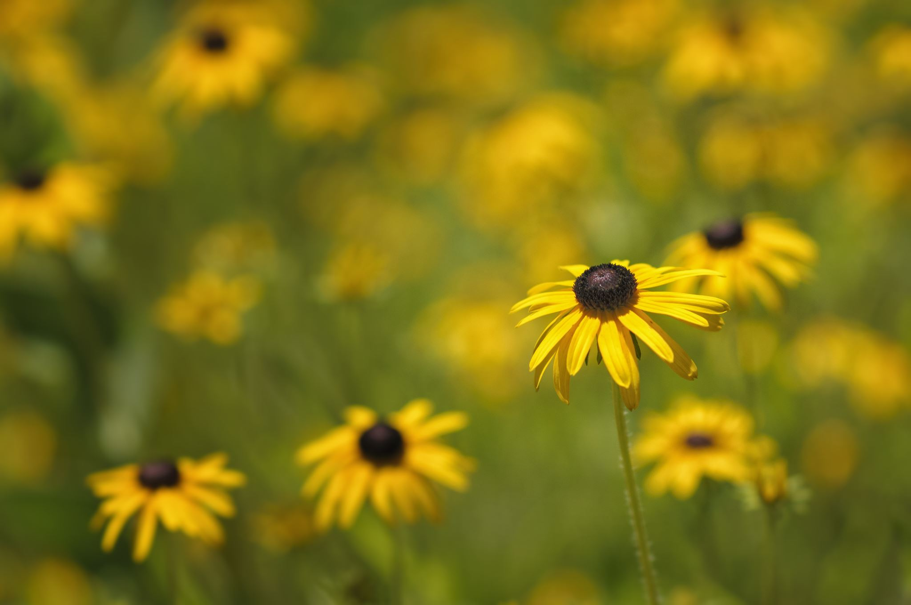
Title
Flowers

Slide 2
Chapter #1 Flowers Cycle

Slide 3
Indoor Plants
The quick brown fox jumps over the lazy dog. The quick brown fox jumps over the lazy dog. The quick brown fox jumps over the lazy dog. The quick brown fox jumps over the lazy dog. The quick brown fox jumps over the lazy dog.

Slide 4
Outdoor Plants
The quick brown fox jumps over the lazy dog. The quick brown fox jumps over the lazy dog. The quick brown fox jumps over the lazy dog. The quick brown fox jumps over the lazy dog. The quick brown fox jumps over the lazy dog.

