Slide 1
Nested Relation Extraction with Iterative Neural Network
Yixuan Cao, Dian Chen, Hongwei Li, and Ping Luo
Institute of Computing Technology, Chinese Academy of Sciences (ICT, CAS)
Notes:
Good morning
Im CYX from….
The paper I intro is Nested …. with INN
This work was carried out with xxx

Slide 2
Outline
Nested relation
Formulation
Solution Framework
Iterative neural network
Experiment

Slide 3
1. Nested Relation
Relation extraction
Flat relations
Nested relations
In finance, economic, science fields
Notes:
Relation extraction is a very important problem in NLP and information extraction, and it’s the data source of many downstream tasks like knowledge base construction
Most existing RE task extract flat relations, that is relation among entities.
Sometimes, multiple parts in a sentence compose a concept, and that concept is used in other relation / event / concept, then it becomes a nested relation structure.
For example, in this sentence the GDP….
And such nested relation …

Slide 4
1. Nested Relation

Slide 5
1. Nested Relation
Nested relations as an ordered DAG structure
Notes:
So we can regard NRE as a DAG structure extraction problem

Slide 6
2. Extraction Task schema
We need a schema which will
specify what to extract
guide how to extract
ACE 2005 relation extraction task
7 types of entities:
ORG
PER
…
6 types of relations:
PART-WHOLE
GEN-AFF
…
Notes:
When facing with a RE task,
For example ACE 05 defines x types of entities,
and x types of relations between two entities, relations beyond the scope are not annotated and not extracted by model.
schema for flat relation is simple. neglect the schema.
Because to generate the candidate to classify, we just enumerate all the binary combinations of entities.
but for nested relation extraction, such enumeration might result in a huge number of candidates, and most of them are invalid.
Thus we need a more systematic and detailed task schema

Slide 7
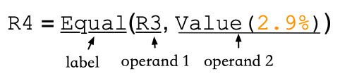
2. Formulation
Definitions
Entity:
Relation:
Configuration:
Notes:
We formulate this nested relation extraction as follows.
An entity consists of a span of words and a label
which is a leaf node in the structure
A relation is composed of a tuple of operands and a label, where each operand could be a relation or an entity
a relation is a non-leaf node in the structure
the configuration of a relation type is used to regulate what kinds of operands it may have
For this example, the first operand of Equal relation must have type EI , or subtraction, … the second operand or an Equal relation must have type…
Thus Equal relation between two time entities is invalid according to this configuration

Slide 8
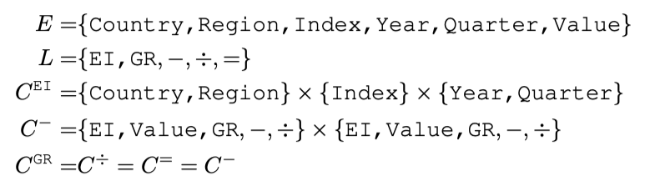
2. Formulation
Task Schema:
E={Country, Region, Index, Year, Quarter, Value}
L ={Economic-Index(EI), Growth-Rate(GR), −, ÷, =}
Notes:
So, when facing with a real world task, we need to specify the task schema.
That includes a list of all kind of entities in this task
A list of all kinds of relations in this task
And for each relation type, we need to specify its configuration

Slide 9
3. Solution Framework
Extract layer by layer iteratively:
For each layer:
(1) generate candidates according to configurations
(2) classify candidates by neural network model
(3) record new-relations to generate next layer candidates
if not new-relations:
break
Notes:
Now we introduce our solution framework of nested relation extraction
generate all candidates according to configuration.
That are all candidates that satisfy the configuration
Then we classify these candidates by a neural network
The candidates that are expressed semantically in the sentence become relations.
We record the new relations, and these new relations will be used to generate next layer candidates
a tuple (e₁, …, e_{k})
is a l candidate if it satisfies C^{l}
has l relation if
1) it satisfies C^{l} , and
2) is expressed semantically.

Slide 10
the GDP of the U.S. in 2018 grew 2.9% compared with 2017
Notes:
We go through this process with the example.

Slide 11
the GDP of the U.S. in 2018 grew 2.9% compared with 2017
Notes:
For biefty, I only draw four types of relation

Slide 12
the GDP of the U.S. in 2018 grew 2.9% compared with 2017

Slide 13
the GDP of the U.S. in 2018 grew 2.9% compared with 2017

Slide 14
the GDP of the U.S. in 2018 grew 2.9% compared with 2017

Slide 15
the GDP of the U.S. in 2018 grew 2.9% compared with 2017

Slide 16
the GDP of the U.S. in 2018 grew 2.9% compared with 2017

Slide 17
the GDP of the U.S. in 2018 grew 2.9% compared with 2017

Slide 18
the GDP of the U.S. in 2018 grew 2.9% compared with 2017

Slide 19
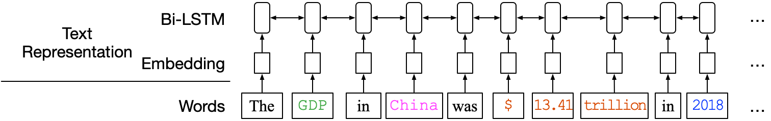
4. Iterative Neural Network
Notes:
One component we did not introduce is the neural network

Slide 20
4. Iterative Neural Network
Notes:
One component we did not introduce is the neural network

Slide 21
4. Iterative Neural Network
Notes:
So far, we introduce
the nested relation extraction problem
its formulation. task schema
and a solution with iterative network
Next we introduce our experiment on two datasets.

Slide 22
5. Experiment 1 cause-and-effect
Example:
Notes:
The first on is semantic cause-and-effect relation
This sentence has 3 clauses.
read it
the 2nd clause is the cause of the 3rd clause
and the last two clauses are the cause of the 1st clause.
So, this is a nested structure

Slide 23
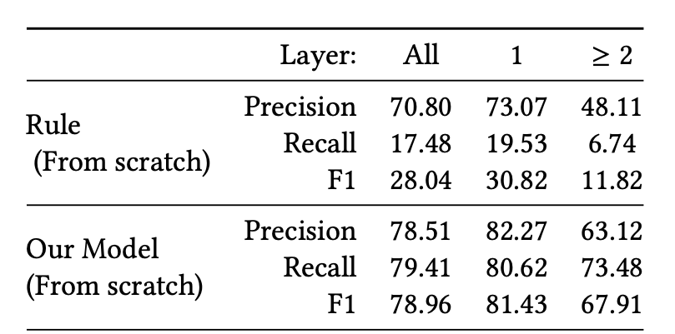
5. Experiment 1 cause-and-effect
Result
~ 10k sentences
Notes:
14.62% of sentences have nested relations.
Our model performs will on the first layer relations, as well as on high layer relations.
% The percentage of sentences that have 0, 1, 2, and ≥ 3 layers of relations are 4.25% , 81.13%, 13.72%, and 0.90% respectively.

Slide 24
5. Experiment 2 Formula
Notes:
The second dataset comes from financial documents
This sentence

Slide 25
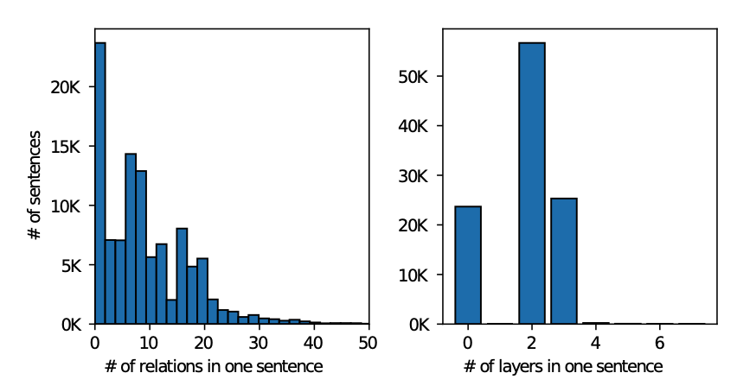
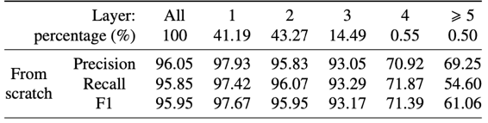
5. Experiment 2 Formula
~100k sentences
The upper-bound of a flat model is extracting 63.85% of all relations
Notes:
We find at least 30% of relations cannot be extract by a normal flat relation extraction model.
And as we can see, our model ‘s recall is more than 95%
By separately evaluate the result on different layers, we can see that the performance on each layer drops as the layer increase.

Slide 26
Experiment 2 Formula
Error propagation
Notes:
One important reason for the decline of performance is error propagation.
The red line is the F1 score of our model on each layer
the green line is the F1 score if we use the annotation result to generate next layer candidates
We can see the decline of green line is much slower than the red line.
that means, although our model is capable to classify high layer candidates, the error from lower layers will dramatically harm the performance in high layers.

Slide 27
Experiment 2 Formula
Error propagation
Notes:
How to fill the gap between them might be an interesting future work

Slide 28
Thank you

