Slide 1
FAIR Loans
Kiona Bijker (s1979418)
ragunath seenivasagan ( s3482820)
24-10-2025

Slide 2
Lending club dataset
Loans
27 columns
+/- million rows
Reduced 1000 rows, 15 columns
CC0 license

Slide 3
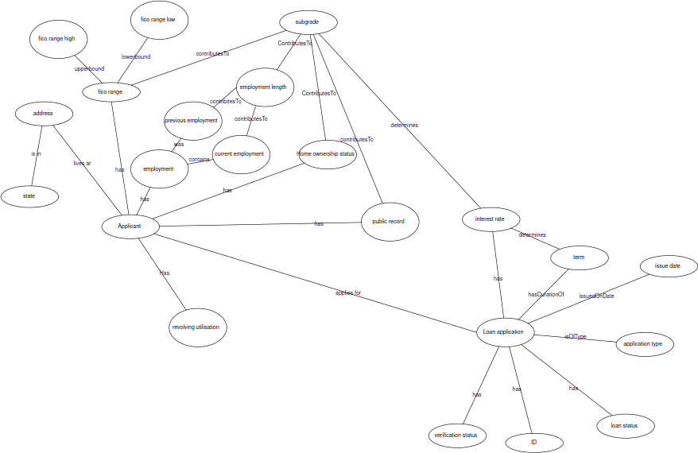
Data model (sketched)

Slide 4
Metadata
Contact person
  Check relevancy

Slide 5
FAIR improvements
Original:
  Unique ID
  Provenence
  License
  HTTP protocol
  Found on Kaggle & Figshare, also in Google dataset search
Done:
  FIBO & wiki ontology
  Linked rdf
  SHACL data validation
  Metadata SHACL
To do:
  Persistent ID (W3ID)
  FairDataPoint publication

Slide 6
Questions

Slide 7
Template license
This work is licensed under a Creative Commons Attribution-ShareAlike 3.0 Unported License.
It makes use of the works of Mateus Machado Luna.

Slide 8
Columns kept
issue_d
sub_grade
term
home_ownership
fico_range_low
pub_rec
revol_util
int_rate
application_type
verification_status
addr_state
fico_range_high
id
emp_length
loan_status

