Slide 1
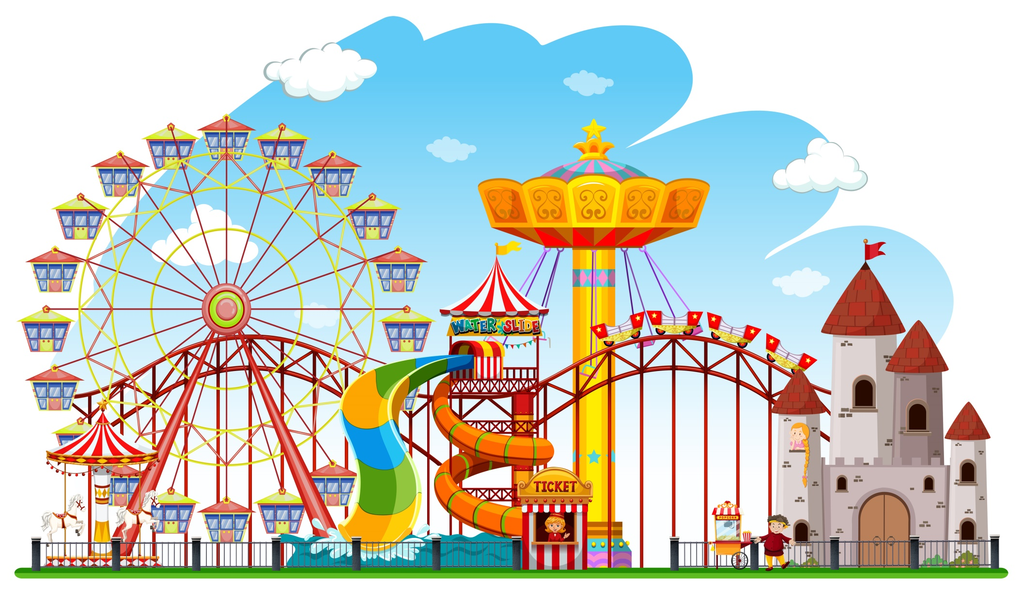
AMUSEMENT PARK DATABASE MANAGEMENT SYSTEM

Slide 2
PROJECT NAME:
AMUSEMENT PARK DATABASE MANAGEMENT SYSTEM
TEAM OF THE PROJECT:
NAME : M AJAY KUMAR
ROLL NO. : 21EEB0B37
G-MAIL :
ma21EEB0B37@STUDENT.NITW.AC.IN
NAME : K MANOJ
ROLL NO. : 21EEB0B45
G-MAIL :
mk21EEB0B45@STUDENT.NITW.AC.IN

Slide 3
ABOUT THE PROJECT
-- The designed AMUSEMENT PARK DATABASE MANAGEMENT
SYSTEM provides the data about :
-> Users who are registered to park applications.
-> Feedbacks on particular rides registered by user.
-> Different types of rides present in that park like :
- Land Rides
- Water Rides ..etc.
-> Payment details of each trip that has been successfully completed.
-> Details of Restaurants present in this park;

Slide 4
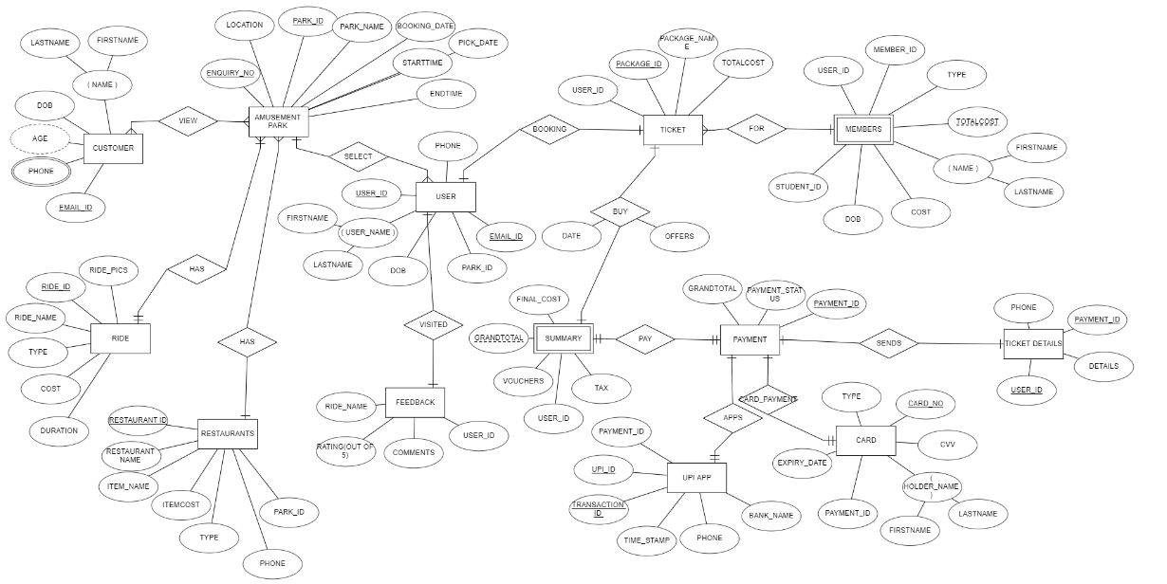
ENTITY RELATIONSHIP MODEL

Slide 5

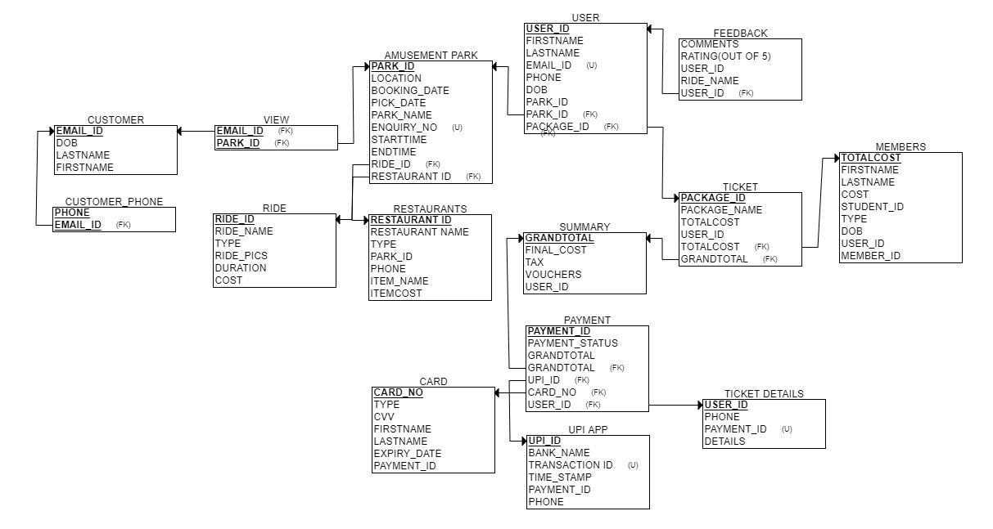
RELATIONAL SCHEMA OF THE ER MODEL

Slide 6
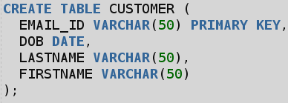


ENTITIES :
-- CUSTOMER : This table provides the details of customer like :
Attributes :
- Email ID (PRIMARY KEY)
- Date of Birth(DOB)
- First Name
- Last Name
-- CUSTOMER_PHONE : This table provides the phone numbers for given user like :
Attributes :
- Phone (PRIMARY KEY)
- Email ID(FOREIGN KEY)
-- VIEW : Relational table for viewing different parks by user.
Attributes :
- Email ID(FOREIGN KEY)
- Park ID(FOREIGN KEY)

Slide 7
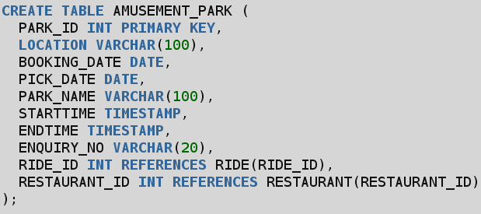
ENTITIES :
-- AMUSEMENT_PARK : This tables provides us details of park.
Attributes :
- Park ID(PRIMARY KEY)
- Location
- Booking Date
- Pick Date
- Park Name
- Timings :
- Opening Time
- Closing Time
- Enquiry Number
- Ride ID(FOREIGN KEY)
- Restaurant ID(FOREIGN KEY)

Slide 8
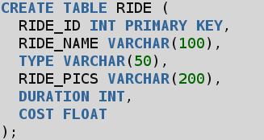
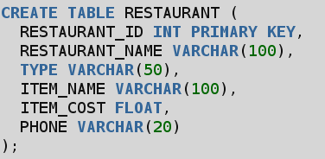
ENTITIES :
-- RIDE : Ride tables provides about the types of rides and their cost per duration.
Attributes :
- Ride ID(PRIMARY KEY)
- Ride Name
- Type
- Ride Pics
- Duration
- Cost
-- RESTAURANTS : This tables about restaurants and their menus in their park.
Attributes:
- Restaurant ID (PRIMARY KEY) - Restaurant Name
- Type
- Item Name - Item Cost
- Phone Number

Slide 9
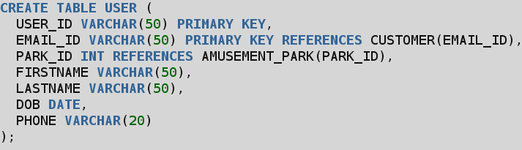
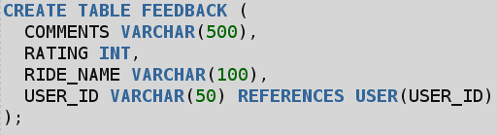
ENTITIES :
-- USER : User table the customer has login to this application for booking of tickets.
Attributes :
- User ID(PRIMARY KEY)
- First Name
- Last Name
- Email ID(Unique)
- Phone Number
- Date of Birth(DOB)
- Park ID(FOREIGN KEY)
- Package ID(FOREIGN KEY)
-- FEEDBACK : This table provides about Reviews and Ratings of Particular Rides.
Attributes :
- Comments - Ratings
- Ride Name - User ID(FOREIGN KEY)

Slide 10
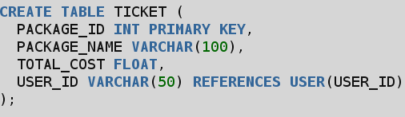
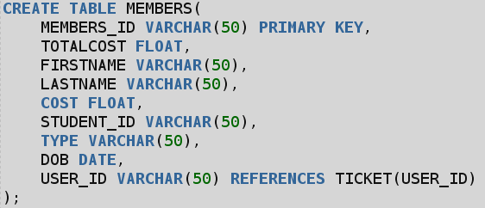
ENTITIES :
-- TICKET : This table provides about cost of packages and their details
Attributes :
- Package ID(PRIMARY KEY)
- Package Name
- Total Cost
- User ID(FOREGIN KEY)
-- MEMBERS : This table provides about Members are coming to park.
Attributes :
- MEMBERS_ID
- TOTALCOST
- FIRSTNAME
- LASTNAME
- COST
- STUDENT_ID
- TYPE
- Date of Birth(DOB)
- USER_ID

Slide 11
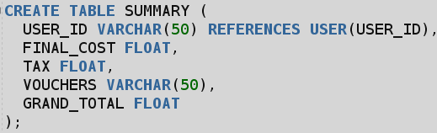
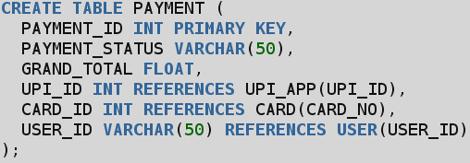
ENTITIES :
-- SUMMARY : This table provides about summary of cost of package
Attributes :
- Grand Total
- FINAL COST
- TAX
- VOUCHERS
- USER ID (FOREIGN KEY)
-- PAYMENT : This table provides payment details(id,status,pay through..)
Attributes :
- Payment ID(PRIMARY KEY)
- Payment Status
- Grand Total
- UPI ID(FOREIGN KEY)
- CARD ID(FOREIGN KEY)
- USER ID(FOREIGN KEY)

Slide 12
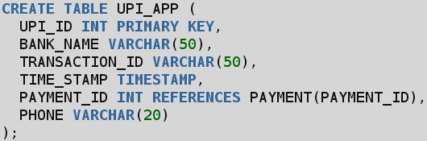
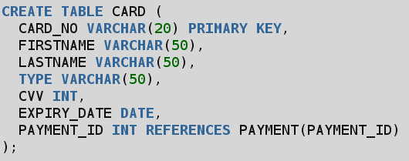
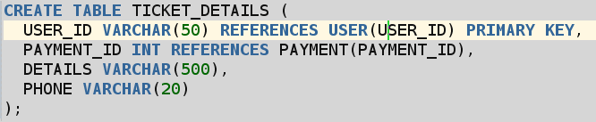
ENTITIES :
-- UPI APP : details of UPI of users account.
Attributes :
- UPI ID(PK) - BANK NAME
- TRANSACTION ID
- TIME_STAMP - PAYMENT ID(FK)
- PHONE
-- CARD : Card details of Users account.
Attributes :
- CARD NO.(PK) - FIRSTNAME
- LASTNAME - TYPE
- CVV - EXPIRY DATE
- PAYMENT ID(FK)
-- TICKET DETAILS : All details of Successful details sent to your respective phone no.
Attributes :
- USER ID(PK,FK) - PAYMENTID(FK)
- DETAILS - PHONE

Slide 13
FUNCTIONAL DEPENDENCIES AND NORMALISTAON OF EACH TABLE
-- CUSTOMER :
- EMAIL_ID -> DOB, LASTNAME, FIRSTNAME
Here, there are no partial and transitive dependencies and email_id is the primary key and email ID is the candidate or the super key. Hence it is in the BCNF.
-- CUSTOMER PHONE:
- PHONE -> EMAIL_ID
- EMAIL_ID -> PHONE
Here, the primary key is PHONE, and EMAIL_ID is a foreign key referencing the EMAIL_ID attribute in the CUSTOMER table. Since both functional dependencies are fully dependent on the primary key, the table is already in BCNF form.
-- VIEW :
- EMAIL_ID -> PARK_ID
- PARK_ID -> EMAIL_ID
Here, both dependencies are trivial and also, the table only has two attributes, so it is already in BCNF form.

Slide 14
FUNCTIONAL DEPENDENCIES AND NORMALISTAON OF EACH TABLE
-- AMUSEMENT PARK :
- PARK_ID → LOCATION, BOOKING_DATE, PICK_DATE, PARK_NAME, STARTTIME, ENDTIME, ENQUIRY_NO, RIDE_ID, RESTAURANT_ID
- RIDE_ID → PARK_ID
- RESTAURANT_ID → PARK_ID
A relation is in BCNF if and only if every determinant is a candidate key.
RHS is candidate key . So , this FD’s are in BCNF.
-- RIDE :
- RIDE_ID -> RIDE_NAME, TYPE,RIDE_PICS,DURATION,COST
A relation is in BCNF if and only if every determinant is a candidate key.
RHS is candidate key . So , this FD’s are in BCNF.
-- RESTAURANTS :
- RESTAURANT_ID -> NAME,ITEMNAME,ITEMCOST,PHONE
A relation is in BCNF if and only if every determinant is a candidate key.
RHS is candidate key . So , this FD’s are in BCNF.

Slide 15
FUNCTIONAL DEPENDENCIES AND NORMALISTAON OF EACH TABLE
-- USER :
- USER_ID → EMAIL_ID, PARK_ID, FIRSTNAME, LASTNAME, DOB, PHONE
- PARK_ID → No non-trivial functional dependencies
USER_ID determines every attributes in this table.so User Id is candidate key.
RHS is a candidate key . So , Given FD’s are in BCNF form.
-- FEEDBACK :
- USER_ID → COMMENTS, RATING, RIDE_NAME
Here , USER ID is primary key of user table. so it uniquely determines the comments, rating, and ride name associated with that user. Therefore, the table is already in BCNF.
-- TICKET :
- PACKAGE_ID → PACKAGE_NAME, TOTAL_COST, USER_ID
Since the TICKET table only has one functional dependency,it is already in BCNF form.

Slide 16
FUNCTIONAL DEPENDENCIES AND NORMALISTAON OF EACH TABLE
-- MEMBERS :
- MEMBERS_ID → TOTALCOST, FIRSTNAME, LASTNAME, COST, STUDENT_ID, TYPE, DOB, USER_ID
- USER_ID → MEMBERS_ID
Members Id determines every attribute in the given table. So , Members Id
Is primary key in this table(candidate key).RHS is candidate key(BCNF). So,
Given FD’s is present in BCNF form.
-- SUMMARY : - USER_ID -> FINAL_COST, TAX, VOUCHERS, GRAND_TOTAL
This indicates that the final cost, tax, vouchers, and grand total for each entry in the SUMMARY table are determined by the user ID associated with that entry. So , User Id determines every attribute . Given FD’s is present in BCNF form.

Slide 17
FUNCTIONAL DEPENDENCIES AND NORMALISTAON OF EACH TABLE
-- PAYMENT :
- PAYMENT_ID -> PAYMENT_STATUS, GRAND_TOTAL, UPI_ID,CARD_ID, USER_ID
- UPI_ID -> USER_ID
- CARD_ID -> USER_ID
Payment ID uniquely determines every attributes in this given table. Payment Id is primary key and candidate key also . RHS is Candidate key . So , this Given
FD’s is in BCNF form.
-- UPI APP :
- UPI_ID -> BANK_NAME, TRANSACTION_ID, TIME_STAMP, PAYMENT_ID, PHONE
Assuming that each payment has only one corresponding UPI transaction, and each UPI transaction has only one corresponding payment . UPI Id
Is candidate key . So , it is in BCNF.

Slide 18
FUNCTIONAL DEPENDENCIES AND NORMALISTAON OF EACH TABLE
-- CARD :
- CARD_NO → FIRSTNAME, LASTNAME, TYPE, CVV, EXPIRY_DATE, PAYMENT_ID
candidate keys (CARD_NO,PAYMENT_ID) are present, and all non-prime attributes are fully functionally dependent on the keys. Hence, the table is in BCNF.
-- TICKET DETAILS :
- USER_ID -> PAYMENT_ID, DETAILS, PHONE
- PAYMENT_ID -> (all other attributes)
candidate keys (user ID) are present, and all non-prime attributes are fully functionally dependent on the keys . All Attributes are already declared in before table. Hence, the table is in BCNF.

Slide 19
INSERTING VALUES FOR EACH TABLE
-- Customer table :
INSERT INTO CUSTOMER VALUES('abc@gmail.com', TO_DATE('1990-01-01', 'YYYY-MM-DD'), 'Kumar', 'Amit');
INSERT INTO CUSTOMER VALUES('xyz@gmail.com', TO_DATE('1991-02-02', 'YYYY-MM-DD'), 'Sharma', 'Ajay');
INSERT INTO CUSTOMER VALUES('pqr@gmail.com', TO_DATE('1992-03-03', 'YYYY-MM-DD'), 'Gupta', 'Amit');
INSERT INTO CUSTOMER VALUES('def@gmail.com', TO_DATE('1993-04-04', 'YYYY-MM-DD'), 'Sinha', 'Ajay');
INSERT INTO CUSTOMER VALUES('ghi@gmail.com', TO_DATE('1994-05-05', 'YYYY-MM-DD'), 'Singh', 'Amit');
-- Customer_Phone table :
INSERT INTO CUSTOMER_PHONE VALUES('9876543210', 'abc@gmail.com');
INSERT INTO CUSTOMER_PHONE VALUES('1234567890', 'xyz@gmail.com');
INSERT INTO CUSTOMER_PHONE VALUES('2345678901', 'pqr@gmail.com');
INSERT INTO CUSTOMER_PHONE VALUES('3456789012', 'def@gmail.com');
INSERT INTO CUSTOMER_PHONE VALUES('4567890123', 'ghi@gmail.com');

Slide 20
INSERTING VALUES FOR EACH TABLE
-- View table :
INSERT INTO VIEW1 VALUES('abc@gmail.com', 1);
INSERT INTO VIEW1 VALUES('xyz@gmail.com', 2);
INSERT INTO VIEW1 VALUES('pqr@gmail.com', 3);
INSERT INTO VIEW1 VALUES('def@gmail.com', 4);
INSERT INTO VIEW1 VALUES('ghi@gmail.com', 5);
-- Amusement_Park table :
INSERT INTO AMUSEMENT_PARK VALUES
(1, 'Delhi','15 JAN 2023', '16 JAN 2023', 'Agra Fort', '10:00:00 AM', '6:00:00 PM', '123456', 1, 1);
INSERT INTO AMUSEMENT_PARK VALUES
(2, 'Mumbai','17-06-2023','18-06-2023','Taj Mahal', '10:00:00 AM', '6:00:00 PM', '789012', 2, 2);
INSERT INTO AMUSEMENT_PARK VALUES
(3, 'Bangalore', TO_DATE('2023-06-19', 'YYYY-MM-DD'), TO_DATE('2023-06-20', 'YYYY-MM-DD'), 'Mysore Palace', '10:00:00 AM', '6:00:00 PM', '345678', 3, 3);
INSERT INTO AMUSEMENT_PARK VALUES
(4, 'Chennai', TO_DATE('2023-06-21', 'YYYY-MM-DD'), TO_DATE('2023-06-22', 'YYYY-MM-DD'), 'Brihadeeswarar Temple', '10:00:00 AM', '6:00:00 PM', '987654', 4, 4);
INSERT INTO AMUSEMENT_PARK VALUES
(5, 'Kolkata', TO_DATE('2023-06-23', 'YYYY-MM-DD'), TO_DATE('2023-06-24', 'YYYY-MM-DD'), 'Victoria Memorial', '10:00:00 AM', '6:00:00 PM', '654321', 5, 5);

Slide 21
INSERTING VALUES FOR EACH TABLE
-- Restaurant table :
INSERT INTO RESTAURANT VALUES
(1, 'Taj Mahal Restaurant', 'Indian', 'Chicken Tikka Masala', 200, '9876543210');
INSERT INTO RESTAURANT VALUES
(2, 'Mysore Palace Restaurant', 'Indian', 'Dosa', 100, '1234567890');
INSERT INTO RESTAURANT VALUES
(3, 'Brihadeeswarar Temple Restaurant', 'Indian', 'Biryani', 150, '2345678901');
INSERT INTO RESTAURANT VALUES
(4, 'Victoria Memorial Restaurant', 'Indian', 'Naan', 50, '3456789012');
INSERT INTO RESTAURANT VALUES
(5, 'Agra Fort Restaurant', 'Indian', 'Samosa', 25, '4567890123');
-- User table :
INSERT INTO USER1 VALUES('abc@gmail.com', 'abc@gmail.com', 1, 'Amit', 'Kumar', '1990-01-01', '9876543210');
INSERT INTO USER1 VALUES('xyz@gmail.com', 'xyz@gmail.com', 2, 'Ajay', 'Sharma', '1991-02-02', '1234567890');
INSERT INTO USER1 VALUES('pqr@gmail.com', 'pqr@gmail.com', 3, 'Amit', 'Gupta', '1992-03-03', '2345678901');
INSERT INTO USER1 VALUES('def@gmail.com', 'def@gmail.com', 4, 'Ajay', 'Sinha', '1993-04-04', '3456789012');
INSERT INTO USER1 VALUES('ghi@gmail.com', 'ghi@gmail.com', 5, 'Amit', 'Singh', '1994-05-05', '4567890129');

Slide 22
INSERTING VALUES FOR EACH TABLE
-- Feedback1 table :
INSERT INTO FEEDBACK1 VALUES('This ride was amazing!', 5, 'Roller Coaster', 'abc@gmail.com');
INSERT INTO FEEDBACK1 VALUES('This ride was a bit too scary for me.', 3, 'Bumper Cars', 'xyz@gmail.com');
INSERT INTO FEEDBACK1 VALUES('This ride was perfect for my kids.', 4, 'Tea Cups', 'pqr@gmail.com');
INSERT INTO FEEDBACK1 VALUES('This ride was a bit too wet for me.', 2, 'Water Slide', 'def@gmail.com');
INSERT INTO FEEDBACK1 VALUES('This ride was very relaxing.', 5, 'Lazy River', 'ghi@gmail.com');
-- Members table :
INSERT INTO MEMBERS VALUES(1, 1000, 'Amit', 'Kumar', 500, '1234567890', 'Adult', DATE '1990-01-01', 'abc@gmail.com');
INSERT INTO MEMBERS VALUES(2, 1500, 'Ajay', 'Sharma', 1000, '2345678901', 'Student', DATE'1991-02-02', 'xyz@gmail.com');
INSERT INTO MEMBERS VALUES(3, 2000, 'Amit', 'Gupta', 1500, '3456789012', 'Senior Citizen', DATE'1992-03-03', 'pqr@gmail.com');
INSERT INTO MEMBERS VALUES(4, 2500, 'Ajay', 'Sinha', 2000, '4567890123', 'Disabled', DATE'1993-04-04', 'def@gmail.com');
INSERT INTO MEMBERS VALUES(5, 3000, 'Amit', 'Singh', 2500, '5678901234', 'Group', DATE'1994-05-05', 'ghi@gmail.com');

Slide 23
INSERTING VALUES FOR EACH TABLE
-- Ride table :
INSERT INTO RIDE VALUES(1, 'Roller Coaster', 'Thrill Ride', 'R1',3,10);
INSERT INTO RIDE VALUES(2, 'Bumper Cars', 'Family Ride', 'R2', 2, 5);
INSERT INTO RIDE VALUES(3, 'Tea Cups', 'Kiddie Ride', 'R3', 1, 2);
INSERT INTO RIDE VALUES(4, 'Water Slide', 'Water Ride', 'R4', 3, 3);
INSERT INTO RIDE VALUES(5, 'Lazy River', 'Water Ride', 'R5', 4, 4);
-- Ticket table :
INSERT INTO TICKET VALUES(1, 'Basic Package', 1000, 'abc@gmail.com');
INSERT INTO TICKET VALUES(2, 'Premium Package', 1500, 'xyz@gmail.com');
INSERT INTO TICKET VALUES(3, 'Deluxe Package', 2000, 'pqr@gmail.com');
INSERT INTO TICKET VALUES(4, 'Platinum Package', 2500, 'def@gmail.com');
INSERT INTO TICKET VALUES(5, 'VIP Package', 3000, 'ghi@gmail.com');

Slide 24
INSERTING VALUES FOR EACH TABLE
-- Summary table :
INSERT INTO SUMMARY VALUES('abc@gmail.com', 1100, 100, '100', 1200);
INSERT INTO SUMMARY VALUES('xyz@gmail.com', 1600, 150, '200', 1850);
INSERT INTO SUMMARY VALUES('pqr@gmail.com', 2100, 200, '300', 2400);
INSERT INTO SUMMARY VALUES('def@gmail.com', 2600, 250, '400', 2850);
INSERT INTO SUMMARY VALUES('ghi@gmail.com', 3100, 300, '500', 3600);
-- Payment table :
INSERT INTO PAYMENT VALUES(1, 'Success', 1200, 1, null, 'abc@gmail.com');
INSERT INTO PAYMENT VALUES(2, 'Success', 1850, null, 2, 'xyz@gmail.com');
INSERT INTO PAYMENT VALUES(3, 'Success', 2400, null, null, 'pqr@gmail.com');
INSERT INTO PAYMENT VALUES(4, 'Success', 2850, null, 3, 'def@gmail.com');
INSERT INTO PAYMENT VALUES(5, 'Success', 3600, null, null, 'ghi@gmail.com');

Slide 25
INSERTING VALUES FOR EACH TABLE
-- UPI_APP table :
INSERT INTO UPI_APP VALUES(1, 'ICICI Bank', '123456', '2023-05-15 10:00:00', 1, '9876543210');
INSERT INTO UPI_APP VALUES(2, 'State Bank of India', '789012', '2023-05-16 10:00:00', 2, '1234567890');
INSERT INTO UPI_APP VALUES(3, 'HDFC Bank', '345678', '2023-05-17 10:00:00', 3, '2345678901');
INSERT INTO UPI_APP VALUES(4, 'Kotak Mahindra Bank', '987654', '2023-05-18 10:00:00', 4, '3456789012');
INSERT INTO UPI_APP VALUES(5, 'Axis Bank', '654321', '2023-05-19 10:00:00', 5, '4567890123');
-- Card table :
INSERT INTO CARD VALUES(1234567890, 'Amit', 'Kumar', 'Visa', 123, '2023-12-31', 1);
INSERT INTO CARD VALUES(2345678901, 'Ajay', 'Sharma', 'Mastercard', 456, '2024-12-31', 2);
INSERT INTO CARD VALUES(3456789012, 'Amit', 'Gupta', 'American Express', 789, '2025-12-31', 3);
INSERT INTO CARD VALUES(4567890123, 'Ajay', 'Sinha', 'Discover', 012, '2026-12-31', 4);
INSERT INTO CARD VALUES(5678901234, 'Amit', 'Singh', 'JCB', 345, '2027-12-31', 5);
-- Ticket_Details table :
INSERT INTO TICKET_DETAILS VALUES('abc@gmail.com', 1, '2 tickets for Roller Coaster', '9876543210');
INSERT INTO TICKET_DETAILS VALUES('xyz@gmail.com', 2, '1 ticket for Bumper Cars and 1 ticket for Tea Cups', '1234567890');
INSERT INTO TICKET_DETAILS VALUES('pqr@gmail.com', 3, '3 tickets for Water Slide', '2345678901');
INSERT INTO TICKET_DETAILS VALUES('def@gmail.com', 4, '2 tickets for Lazy River', '3456789012');
INSERT INTO TICKET_DETAILS VALUES('ghi@gmail.com', 5, '1 ticket for Roller Coaster and 1 ticket for Bumper Cars', '4567890123');

Slide 26
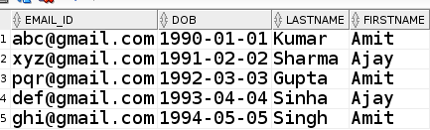
SQL QUERIES
1 . CONTENTS OF TABLE CUSTOMER
SQL CODE :
SELECT * FROM CUSTOMER
OUTPUT:

Slide 27
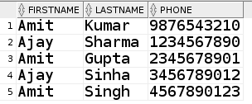
SQL QUERIES
2.PRINT ALL LINKED PHONES NUMBER OF ALL CUSTOMERS
SQL CODE:
SELECT FIRSTNAME,LASTNAME,PHONE
FROM CUSTOMER,CUSTOMER_PHONE
WHERE CUSTOMER.EMAIL_ID = CUSTOMER_PHONE.EMAIL_ID
OUTPUT:

Slide 28

SQL QUERIES
3. NUMBER OF CUSTOMERS WHO DID GIVE FEEDBACK
SQL CODE:
(SELECT * FROM USER1 UNIQUE)-(SELECT COUNT(USER_ID) FROM USER1,FEEDBACK1 WHERE USER1.USER_ID = FEEDBACK1.USER_ID)
OR
SELECT COUNT(USER_ID) AS COUNT FROM USER1,FEEDBACK1 WHERE USER1.USER_ID= FEEDBACK1.USER_ID
OUTPUT:

Slide 29
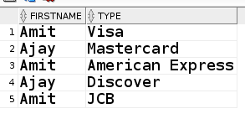
SQL QUERIES
4 .WHAT DIFFERENT TYPE OF CARDS PRESENT WITH CUSTOMERS
SQL CODE :
SELECT CUSTOMER.FIRSTNAME,CARD.TYPE
FROM CUSTOMER,CARD
WHERE CUSTOMER.FIRSTNAME=CARD.FIRSTNAME AND CUSTOMER.LASTNAME = CARD.LASTNAME
OUTPUT:

Slide 30
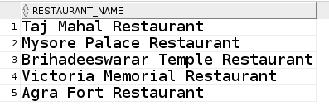
SQL QUERIES
5.LIST ALL RESTAURANTS NAMES(UNQIUE) FROM ALL AMUSEMENT PARS
SQL CODE:
SELECT RESTAURANT_NAME
FROM RESTAURANT,AMUSEMENT_PARK
WHERE RESTAURANT.RESTAURANT_ID = AMUSEMENT_PARK.RESTAURANT_ID
GROUP BY RESTAURANT_NAME
OUTPUT:

Slide 31
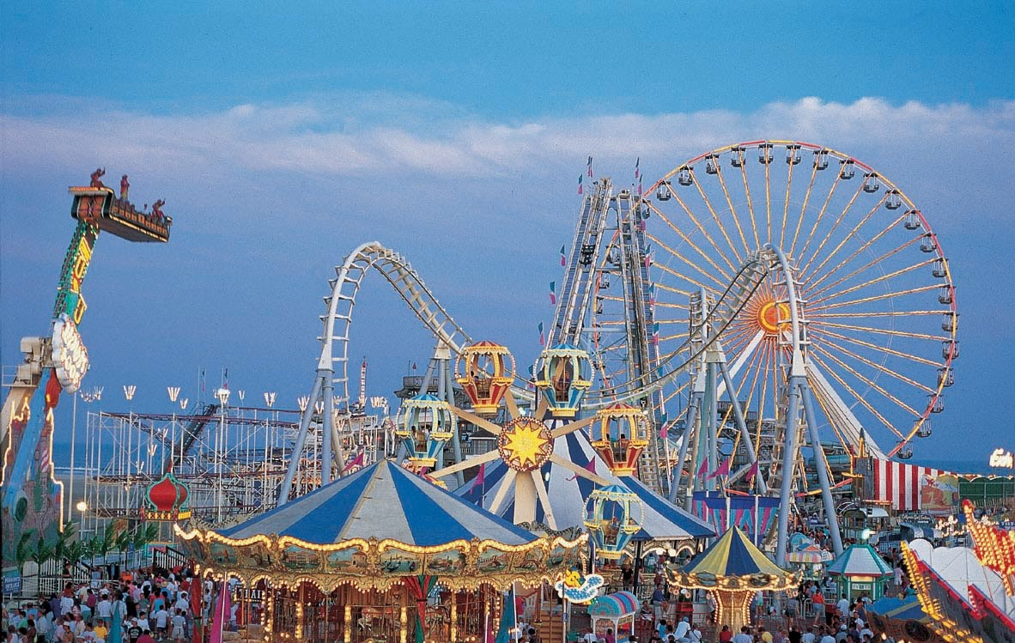
------------ THE END ----------
--------- THANK YOU ---------

