Slide 1
Tanzania Water Pump Project
Water Pump Functionality Modelling Project for the Ministry of Water, Tanzania.
Presentation by;
Erick .M. Okacha- Data Scientist
Moringa School
Email: erick.okacha@student.moringaschool.com
Linkedin: Eric Maiben

Slide 2
Predictive Modeling for Water Pump Functionality
Objective: Predict water pump functionality to improve service delivery in rural Tanzania.
Key Outcomes:
• Achieved 81% model accuracy
• Identified high-risk pumps and regions
• Enabled data-driven maintenance planning

Slide 3
Explatory Data Analysis
In Analyzing our data we use Python Liabraries-Pandas,Numpy,Matplotlib,Scikit Learn and Seaborn
The Water Pump data is derived from the DataDriven open source platform for data science.
We check the relationship between pump functionality and number of waterpoints by plotting bar graphs

Slide 4
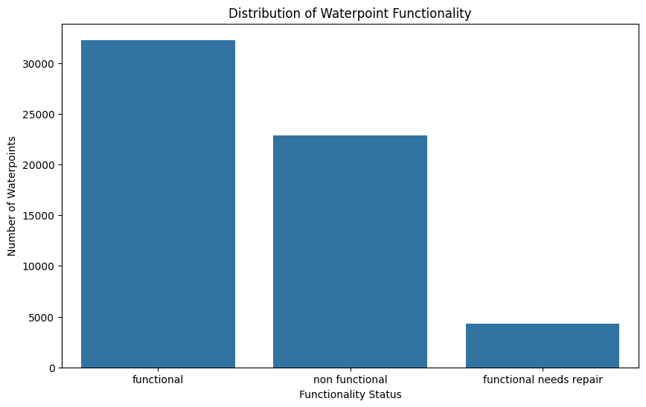
Bar Graph

Slide 5
Model Performance
Model Used: Random Forest Classifier
Accuracy: 81%
Key Metrics:
• Functional – F1: 0.85 | Precision: 0.81 | Recall: 0.89
• Needs Repair – F1: 0.41 | Precision: 0.55 | Recall: 0.33
• Non-Functional – F1: 0.81 | Precision: 0.84 | Recall: 0.78
Observation: 'Needs Repair' class is hardest to predict.

Slide 6
Model Perfomance
Label | Meaning | F1-Score | Comments
0 | Functional | 0.85 | High precision & recall
1 | Functional needs repair | 0.41 | 🚨 Low recall (33%) → often misclassified
2 | Non-functional | 0.81 | Balanced, good performance

Slide 7
Business Insights
• Many non-functional pumps could have been preemptively fixed.
• Key predictors of failure: construction year, region, management type, installer.
• Model allows forecasting of high-risk pumps before failure.

Slide 8
Recommendations
1. Proactive Maintenance: Prioritize high-risk pumps.
2. Targeted Investment: Allocate budgets to high-failure areas.
3. Improve Data Collection: Train field workers and standardize reports.
4. Digital Monitoring: Use sensors or mobile apps for real-time updates.
5. Stakeholder Dashboard: Visualize pump status and model predictions.

Slide 9
Impact Potential
Short-Term:
• Reduce pump downtime and water scarcity
• Optimize maintenance scheduling
Long-Term:
• Lower repair costs
• Improve infrastructure planning and community trust
• Scalable model for broader utility systems

Slide 10
Thank You
Q& A
Eric Maiben Okacha- Data Scientist
Moringa School
Linkendin Profile : Maiben Eric
Email:eric.okacha@student.moringaschool.com

