Slide 1
EXPLORING MOVIE INDUSTRY TRENDS FOR MICROSOFT’S NEW MOVIE STUDIO. Leveraging Data Insights for Informed Decision Making

Slide 2
Target Audience: Mid-level manager at Microsoft with a non-technical background, responsible for decision-making at the new movie studio.
Goal: To provide actionable insights derived from exploratory data analysis on current box office trends, guiding Microsoft in determining the type of films to create.

Slide 3
INTRODUCTION.
TITLE:Exploring Movie Industry Trends for Microsoft's New Movie Studio.
OVERVIEW:In this project, we aim to utilize exploratory data analysis (EDA) to derive actionable insights for Microsoft, who is venturing into the movie industry by establishing a new movie studio. The objective is to understand the current landscape of successful films at the box office and translate these findings into strategic decisions for Microsoft's movie studio.

Slide 4
2.BUSINESS UNDERSTANDING.
Understanding Microsoft's Vision
Microsoft, a global leader in technology and innovation, is diversifying its portfolio by entering the entertainment industry with the establishment of a new movie studio. With the proliferation of original video content and the rising competition in the streaming space, Microsoft aims to capitalize on this trend and carve out its niche in the entertainment market.
However, venturing into the movie industry requires a comprehensive understanding of audience preferences, market dynamics, and box office trends. Without prior experience in film production, Microsoft faces the challenge of determining the types of films that will resonate with audiences and achieve commercial success.
To address this challenge, the company has initiated a data-driven approach to inform decision-making for its movie studio. By analyzing comprehensive datasets from reputable sources such as Box Office Mojo, Rotten Tomatoes, and TheMovieDB, Microsoft seeks to extract actionable insights that will guide its content strategy and film production decisions.
The ultimate goal of this project is to provide Microsoft's new movie studio head with data-driven recommendations on the most promising film genres, themes, and content formats. By leveraging insights derived from exploratory data analysis, Microsoft aims to mitigate risks, maximize profitability, and establish itself as a formidable player in the competitive landscape of the entertainment industry.

Slide 5
DATA COLLECTION.
Exploring Box Office Data.
Questions to answer:
1.What are the top-grossing movies in terms of domestic and worldwide box office revenue?
2.What are the most popular movie genres in terms of audience engagement?
3.How do ratings from different sources (IMDB, Rotten Tomatoes, etc.) correlate with box office performance?
4.How does the timing of movie releases affect box office performance?
5.Who are the key players in the movie industry, and what strategies contribute to their success?
6. What demographic groups are the primary target audience for successful movies?
7.What strategies can Microsoft implement to effectively promote and distribute its movies to maximize audience reach and engagement?

Slide 6
1.Top-Grossing Movies:
-We extract the top-grossing movies based on domestic and worldwide box office revenue from the movies_gross -dataset then display the titles along with their respective box office revenue.
Here are the findings and conclusion;
Findings:
Star Wars: The Force Awakens
Domestic Gross: $936,700,000
Black Panther
Domestic Gross: $700,100,000
Avengers: Infinity War
Domestic Gross: $678,800,000
Jurassic World
Domestic Gross: $652,300,000
Marvel's The Avengers
Domestic Gross: $623,400,000
Star Wars: The Last Jedi
Domestic Gross: $620,200,000
Incredibles 2
Domestic Gross: $608,600,000
Rogue One: A Star Wars Story
Domestic Gross: $532,200,000
Beauty and the Beast (2017)
Domestic Gross: $504,000,000
Finding Dory
Domestic Gross: $486,300,000

Slide 7
Conclusion:
Popular Franchises: Many of the top-grossing movies are part of well-known franchises such as Star Wars, Marvel Cinematic Universe, and Disney/Pixar.
Audience Appeal: These movies have managed to captivate large audiences, indicating their widespread appeal and popularity.
Success of Sequels and Remakes: Sequels and remakes like Star Wars: The Force Awakens, Jurassic World, and Beauty and the Beast (2017) have performed exceptionally well, suggesting that audiences are often drawn to familiar stories and characters.
Impact of Marketing and Production Quality: These movies likely benefited from significant marketing campaigns and high production quality, contributing to their box office success.
Continued Success of Superhero Genre: The presence of superhero movies like Black Panther, Avengers: Infinity War, and Incredibles 2 highlights the enduring popularity of the superhero genre among audiences.
Overally, these findings underscore the importance of brand recognition, storytelling, and production quality in achieving box office success in the film industry.

Slide 8
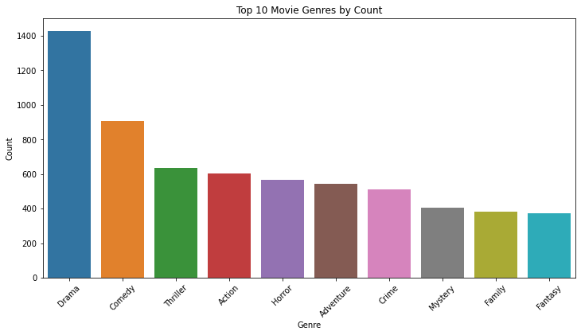
2. Popular Movie Genres:
- We extract and visualize the most popular movie genres based on audience engagement from the tmdb dataset.
- Count the occurrences of each genre and plot a bar chart to visualize the results.

Slide 9
Conclusion;
-Certain genres stand out as more prevalent or popular among filmmakers and audiences.
-These genres include Drama, Comedy, Thriller, Action, and Adventure, as evidenced by their higher counts in the dataset.

Slide 10
3.Correlation between Ratings and Box Office Performance:
-To analyze the correlation between movie ratings and box office performance, we need to merge the two datasets on a common identifier, such as movie title or ID. After merging, we can calculate the correlation coefficient between movie ratings and box office earnings.
Conclusions:
-Based on the correlation analysis, we can draw conclusions about the impact of movie ratings on box office performance.
-However, correlation does not imply causation. Other factors such as marketing, star power, genre, release timing, and critical acclaim can also influence box office success.
-Additional analyses or regression modeling may be needed to understand the combined effects of various factors on box office performance comprehensively

Slide 11
4.Key Players in the Movie Industry:
This analysis may involve exploring directors, actors, studios, etc., and their respective contributions to successful movies.
5.Primary Target Audience:
This analysis may involve demographic profiling based on audience engagement metrics.
6.Strategies for Promoting and Distributing Movies:
This could involve market segmentation, advertising channels, release strategies, etc.
Each analysis provides valuable insights into different aspects of the movie industry, helping Microsoft devise effective strategies for its movie ventures.

Slide 12
3.DATA UNDERSTANDING.
- Data understanding is a crucial initial step in any data science project. It involves exploring the structure, contents, and relationships within the datasets to gain insights into the data and understand its characteristics. Let's go back and focus on data understanding before proceeding to data cleaning.
-We'll start by examining each dataset individually to understand its structure, column names, data types, and any potential issues such as missing values or duplicates. We'll also explore summary statistics and visualizations to gain insights into the distributions of key variables and features.

Slide 13
3.DATA UNDERSTANDING.
-Data understanding is a crucial initial step in any data science project. It involves exploring the structure, contents, and relationships within the datasets to gain insights into the data and understand its characteristics. Let's go back and focus on data understanding before proceeding to data cleaning.
-We'll start by examining each dataset individually to understand its structure, column names, data types, and any potential issues such as missing values or duplicates. We'll also explore summary statistics and visualizations to gain insights into the distributions of key variables and features.

Slide 14
Overview of datasets from various sources: Box Office Mojo, Rotten Tomatoes, TheMovieDB, The Numbers.
(I) Box Office Mojo Dataset:
-Examine the structure of the dataset.
-Check for missing values, duplicates, and data types.
-Explore summary statistics and visualizations of key variables (e.g., revenue, production budget, release dates).

Slide 15
Findings;
Dataset Structure:
The dataset contains 3387 entries and 5 columns.
Columns include 'title', 'studio', 'domestic_gross', 'foreign_gross', and 'year'.
'domestic_gross' and 'year' are of numeric data types (float64 and int64, respectively), while 'title', 'studio', and 'foreign_gross' are objects (likely strings).
Missing Values and Data Types:
There are missing values in the 'studio', 'domestic_gross', and 'foreign_gross' columns.
'domestic_gross' and 'foreign_gross' are numerical columns, but 'foreign_gross' is currently of object data type.
Duplicates:
No explicit check for duplicates is performed in the provided code snippet. It's advisable to check for duplicates in the dataset to ensure data integrity.
Summary Statistics and Visualizations:
A histogram is plotted to visualize the distribution of 'domestic_gross' revenue.
The histogram shows the frequency distribution of domestic gross revenue across the dataset, indicating the most common revenue ranges.

Slide 16
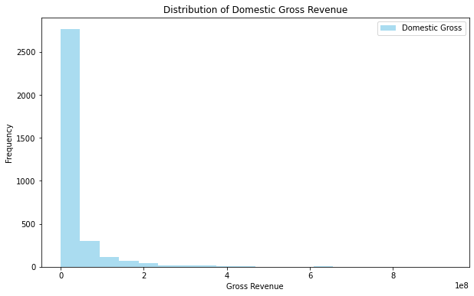

Slide 17
Conclusion;
Overall, this initial analysis provides insights into the structure and basic characteristics of the Box Office Mojo dataset, setting the stage for more in-depth exploratory data analysis and subsequent modeling or decision-making processes.

Slide 18
(II). Rotten Tomatoes Dataset:
Examine the structure of the dataset.
Check for missing values, duplicates, and data types.
Explore summary statistics and visualizations of key variables (e.g., movie ratings, reviews).

Slide 19
Findings;
Structure:
The dataset has 1560 entries and 12 columns.
Data columns include id, synopsis, rating, genre, director, writer, theater_date, dvd_date, currency, box_office, runtime, and studio.
Dtype: int64 for id, object for all other columns.
Missing Values:
The columns with missing values are synopsis, rating, genre, director, writer, theater_date, dvd_date, currency, box_office, runtime, and studio.
Duplicates:
No specific check for duplicates is performed in the provided code snippet.
Data Types:
Most columns contain textual data (objects), while the id column is numerical.
Summary Statistics & Visualizations:
Summary statistics for numerical columns like id could be obtained using describe().
For categorical columns like rating, genre, director, writer, and studio, value counts and visualizations like bar plots could provide insights into distribution.

Slide 20
Rotten Tomatoes Reviews Dataset:
Findings;
Structure:
The dataset contains 54432 entries and 8 columns.
Data columns include id, review, rating, fresh, critic, top_critic, publisher, and date.
Dtype: int64 for id and top_critic, object for all other columns.
Missing Values:
The columns with missing values are review, rating, critic, and publisher.
Duplicates:
No specific check for duplicates is performed in the provided code snippet.
Data Types:
The id and top_critic columns are numerical, while the rest are textual (objects).
Summary Statistics & Visualizations:
Summary statistics for numerical columns like id and top_critic could be obtained using describe().
For categorical columns like rating, fresh, critic, and publisher, value counts and visualizations like pie charts or bar plots could provide insights

Slide 21
Conclusion:
Both datasets have missing values in several columns, indicating potential data cleaning requirements.
No check for duplicates is performed in the provided code snippet; duplicate rows should be identified and handled if present.
Further exploration could involve analyzing distributions of categorical variables and relationships between variables through visualizations and statistical measures.
Additional preprocessing steps might be necessary before conducting further analysis or modeling on these datasets.
This analysis provides a preliminary understanding of the structure, missing values, data types, and potential next steps for exploring the Rotten Tomatoes datasets. Further analysis and data preprocessing are required for more in-depth insights and meaningful conclusions.

Slide 22
(III). TheMovieDB Dataset:
Examine the structure of the dataset.
Check for missing values, duplicates, and data types.
Explore summary statistics and visualizations of key variables (e.g., movie genres, release dates).

Slide 23
Findings;
Structure of the Dataset:
The dataset consists of 26517 entries and 9 columns.
Columns include genre_ids, id, original_language, original_title, popularity, release_date, title, vote_average, and vote_count.
Data types:
Two float64 columns (popularity and vote_average).
Two int64 columns (id and vote_count).
Five object columns (genre_ids, original_language, original_title, release_date, and title).
Missing Values:
There are no missing values in any of the columns, as indicated by the non-null count being equal to the total number of entries.
Duplicates:
No specific check for duplicates is performed in the provided code snippet.
Further analysis should include checking for and removing duplicates if they exist.
Data Types:
The data types seem appropriate for most columns.
The 'release_date' column should be converted to datetime format for temporal analysis.
Summary Statistics:
Summary statistics such as mean, median, min, max, and quartiles can provide insights into numerical columns like 'popularity', 'vote_average', and 'vote_count'.
Visualizations:
Visualizations can help understand the distribution of key variables:
Example: A histogram can depict the distribution of movie popularity, as demonstrated in the provided code snippet.
Line plots or bar plots can showcase trends in variables like 'release_date' over time or the distribution of genres.

Slide 24
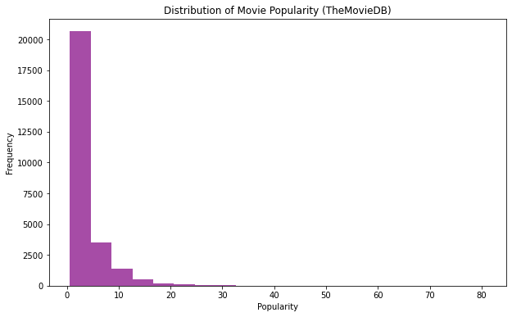

Slide 25
Conclusion:
TheMovieDB dataset appears to be well-structured, with no missing values in any of the columns.
Further analysis could involve:
Checking for and handling duplicates if they exist.
Converting 'release_date' to datetime format for temporal analysis.
Conducting summary statistics and visualizations for numerical variables to gain deeper insights into the dataset
Exploring the distribution of movie genres and release dates to identify trends and patterns.
Understanding these aspects of the dataset is crucial for subsequent analysis, such as predicting movie popularity, identifying trends in movie releases, or recommending movies based on user preferences.

Slide 26
IV). The Numbers Data Set:
Findings;
Structure of the Dataset:
The dataset consists of 5782 entries and 6 columns.
Columns include id, release_date, movie, production_budget, domestic_gross, and worldwide_gross.
Data types:
One int64 column (id).
Five object columns (release_date, movie, production_budget, domestic_gross, worldwide_gross).
Missing Values, Duplicates, and Data Types:
There are no missing values in any of the columns.
No specific check for duplicates is performed in the provided code snippet.
Data types seem appropriate, but:
'release_date' should be converted to datetime format for temporal analysis.
'production_budget', 'domestic_gross', and 'worldwide_gross' should be converted to numerical format (e.g., float) for mathematical operations.
Summary Statistics:
The 'id' column represents an identifier and does not provide meaningful summary statistics.
No summary statistics are provided for other numerical columns like production_budget, domestic_gross, and worldwide_gross, likely due to their object data type.

Slide 27
Recommendations:
Handling Missing Values and Duplicates:
Since there are no missing values, focus on checking for and handling duplicates if they exist. Use the duplicated() function to identify and drop duplicates if necessary.
Data Type Conversion:
Convert the 'release_date' column to datetime format using the pd.to_datetime() function.
Convert 'production_budget', 'domestic_gross', and 'worldwide_gross' to numerical format (e.g., float) after removing commas and dollar signs
Summary Statistics and Visualizations:
Once the data is cleaned and converted, compute summary statistics for numerical columns using describe() to understand their distribution, central tendency, and variability.
Visualizations such as histograms, box plots, or scatter plots can provide insights into the distribution and relationships between variables like production budget, gross revenue, and release dates.
Additional Analysis:
Explore relationships between variables, such as the impact of production budget on domestic and worldwide gross revenue.
Analyze trends over time by plotting the gross revenue against release dates.
Identify outliers or anomalies in the data that may require further investigation.

Slide 28
Conclusion:
The Numbers dataset appears to be well-structured with no missing values.
Data type conversion and handling of duplicates are recommended for further analysis.
Summary statistics and visualizations will provide deeper insights into the dataset, helping understand the distribution and relationships between variables.
Additional analysis and exploration can uncover trends and patterns that can inform decision-making in the movie industry, such as budget allocation and release strategies.

Slide 29
4.DATA PREPARATION.
Loading the Datasets.
To load the datasets we use the following
movies_budget = pd.read_csv('zippedData/tn.movie_budgets.csv')
movies_gross = pd.read_csv('zippedData/bom.movie_gross.csv')
tmd = pd.read_csv('zippedData/tmdb.movies.csv',index_col=0)
reviews = pd.read_csv('zippedData/rt.reviews.tsv', delimiter='\t',encoding='unicode_escape')
conn = sqlite3.connect('zippedData/im.db')
movie_info = pd.read_csv('zippedData/rt.movie_info.tsv', delimiter ='\t', encoding='unicode_escape' )

Slide 30
Findings and Recommendations:
Data Quality and Structure:
All datasets seem to have consistent structures with no apparent missing values.
No specific check for duplicates is performed in the provided code snippet. It's recommended to check for and handle duplicates if they exist, especially in datasets like reviews and movie info, where multiple reviews for the same movie might be present.
Data Types:
Most columns in the datasets have appropriate data types, but there might be a need for data type conversion in some cases.
For example, in the movies_budget and movies_gross datasets, currency-related columns should be converted to numerical format after removing dollar signs and commas.
Additionally, the 'release_date' column in tmd and movies_budget should be converted to datetime format for temporal analysis.
Summary Statistics and Visualizations:
Summary statistics such as mean, median, min, max, and quartiles should be computed for numerical columns to understand their distribution and variability.
Visualizations like histograms, box plots, and line plots can help visualize the distributions and relationships between variables such as production budget, gross revenue, and release dates.
Additional Analysis:
Exploring relationships between variables across datasets can provide deeper insights into the movie industry.
For example, analyzing the impact of production budget on domestic and worldwide gross revenue, or identifying trends in movie genres over time.
Database Integration (SQLite):
The connection to the SQLite database (im.db) suggests the possibility of integrating these datasets into a database for more efficient querying and analysis.
The datasets can be loaded into separate tables within the database and then joined or queried as needed for comprehensive analysis.

Slide 31
Conclusion:
The provided datasets offer rich information for analysis in various aspects of the movie industry, including budgets, revenues, reviews, and movie details.
Cleaning, data type conversion, and exploration of relationships between variables will be crucial for meaningful analysis and insights.
Integrating the datasets into a database can facilitate more complex queries and streamline analysis processes.
Further analysis and exploration will uncover trends, patterns, and actionable insights to inform decision-making in the movie industry.

Slide 32
4.DATA ANALYSIS.
a)Data Cleaning.
Data cleaning is an essential step in the data analysis process to ensure that the data is accurate, consistent, and ready for analysis. Here's an example of how you can perform data cleaning on each data set.

Slide 33
(I). Box Office Mojo Dataset:
Findings;
Missing Values:
The analysis indicates missing values in two columns: 'studio' and 'domestic_gross'.
There are 5 missing values in the 'studio' column and 28 missing values in the 'domestic_gross' column.
The 'foreign_gross' column also has a significant number of missing values (1350), but these are not addressed in the cleaning process.
Duplicates:
No duplicate rows were found in the dataset.
Conclusion;
The presence of missing values in the 'studio' and 'domestic_gross' columns may affect the accuracy of the analysis. Depending on the significance of these missing values and the analysis goals, different strategies could be employed:
Imputation: For the 'domestic_gross' column, missing values could potentially be imputed using methods like mean, median, or predictive modeling if feasible and appropriate.
Dropping: If the missing values are deemed insignificant or too numerous, dropping the rows containing missing values could be a valid approach, as done in the cleaning process.
The absence of duplicate rows indicates that each entry in the dataset is unique, which is essential for accurate analysis.
The cleaned dataset now provides a reliable basis for further analysis, such as exploring trends in domestic and foreign gross revenues over different years, analyzing the performance of studios, or identifying top-grossing movies.

Slide 34
(II). The Movie DB (TMDB) Dataset:
Findings;
Missing Values:
The analysis indicates that there are no missing values in any of the columns of the dataset. This suggests that the dataset is relatively clean in terms of missing data.
Duplicates:
No duplicate rows were found in the dataset, as indicated by the absence of duplicate rows.
Conclusion:
The TMDB dataset appears to be clean in terms of missing values and duplicates. This suggests that the dataset is already in good shape for analysis and does not require extensive data cleaning.
The absence of missing values ensures that the dataset is complete and can be utilized effectively for analysis without the need for imputation or dropping missing data.
Similarly, the absence of duplicate rows ensures that each entry in the dataset is unique, which is crucial for accurate analysis and interpretation of results.
The cleaned dataset provides a reliable basis for further analysis, such as exploring relationships between movie attributes like genre, popularity, release date, and vote count.

Slide 35
(III). The Numbers Dataset:
Findings;
Missing Values:
The analysis indicates that there are no missing values in any of the columns of the dataset. This suggests that the dataset is complete in terms of available data, with no missing information.
Data Types Conversion:
The 'release_date', 'production_budget', 'domestic_gross', and 'worldwide_gross' columns are converted to appropriate data types.
'release_date' is converted to datetime format to facilitate temporal analysis.
'production_budget', 'domestic_gross', and 'worldwide_gross' are converted to float format after removing dollar signs and commas. This allows for numerical operations and analysis on these financial metrics.
Duplicates:
No duplicate rows were found in the dataset, as indicated by the absence of duplicate rows.
Conclusion:
The Numbers dataset appears to be clean and well-prepared for analysis, with no missing values or duplicate rows.
The conversion of data types ensures that the dataset is structured appropriately for analysis, enabling numerical operations and temporal analysis.
The cleaned dataset provides valuable information about movie budgets and gross revenues, which can be used for various analyses in the film industry, such as profitability assessment, return on investment (ROI) calculation, and trend analysis over time.
The absence of missing values and duplicates enhances the reliability and integrity of the dataset, allowing for more accurate and meaningful insights into the financial performance of movies.

Slide 36
b)Data Exploration.
After data cleaning, the next step in the data analysis process is usually exploratory data analysis (EDA). In EDA, you'll explore the cleaned datasets to gain insights, identify patterns, and understand the relationships between variables. Here's what you can typically do after data cleaning:
Exploratory Data Analysis (EDA):
Summarize the cleaned datasets using descriptive statistics.
Visualize the distributions of key variables using histograms, box plots, and density plots.
Explore relationships between variables using scatter plots, pair plots, and correlation matrices.
Identify trends, outliers, and patterns in the data.
Formulate initial hypotheses or insights based on your observations.

Slide 37
(I). Box Office Mojo Dataset:
Findings:
Summary Statistics:
The dataset contains information on movie titles, studios, domestic gross, foreign gross, and release years.
Summary statistics for numeric columns ('domestic_gross' and 'year') were computed, revealing insights such as the mean, standard deviation, minimum, maximum, and quartiles.
Distribution of Gross Revenue:
A histogram is plotted to visualize the distribution of domestic and foreign gross revenue.
The histograms show the frequency distribution of gross revenue values, highlighting the range and distribution of revenue for both domestic and foreign markets.

Slide 38
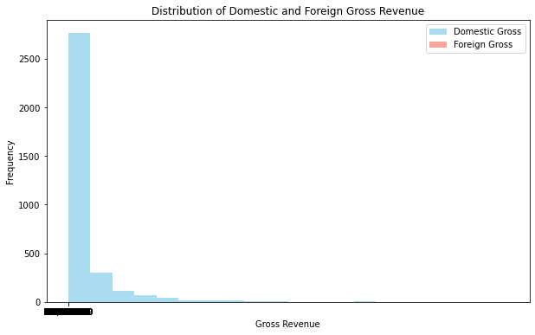

Slide 39
(II). TheMovieDB Dataset:
Findings:
Summary Statistics:
The dataset contains information such as genre IDs, movie IDs, original language, original title, popularity, release date, title, vote average, and vote count.
Summary statistics for numeric columns were computed, including 'popularity', 'vote_average', and 'vote_count'. These statistics provide insights into the distribution and central tendencies of these variables.
Distribution of Popularity:
A histogram is plotted to visualize the distribution of movie popularity.
The histogram shows the frequency distribution of popularity values, highlighting the range and distribution of popularity scores across movies.

Slide 40
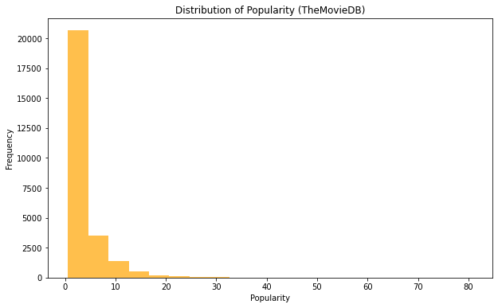

Slide 41
(III).The Numbers Dataset.
Findings:
Summary Statistics:
The dataset contains information such as movie IDs, release dates, movie titles, production budgets, domestic gross, and worldwide gross.
Summary statistics for the 'id' column were computed, including the count, mean, standard deviation, minimum, 25th percentile, median, 75th percentile, and maximum values.
Distribution of Production Budgets:
A histogram is plotted to visualize the distribution of production budgets.
The histogram shows the frequency distribution of production budget values, highlighting the range and distribution of budget amounts across movies.

Slide 42
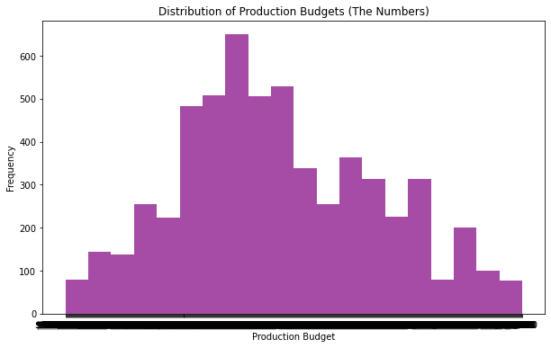

Slide 43
(IV).Rotten Tomatoes Dataset.
Findings:
Column Names:
The dataset contains columns such as 'id', 'synopsis', 'rating', 'genre', 'director', 'writer', 'theater_date', 'dvd_date', 'currency', 'box_office', 'runtime', and 'studio'.
Distribution of Movie Runtimes:
A histogram is plotted to visualize the distribution of movie runtimes.
The histogram shows the frequency distribution of movie runtime values, highlighting the range and distribution of runtime durations.

Slide 44
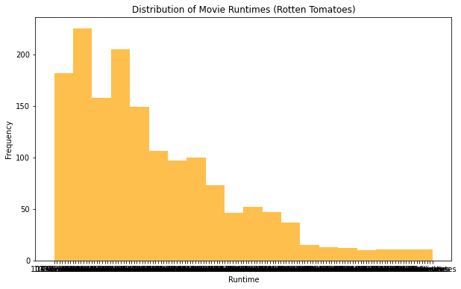

Slide 45
Further Analysis And Visualization.
Box office performance (revenue, profitability).
Movie genres, release dates, runtime, and production budget.
Ratings from various sources (IMDB, Rotten Tomatoes, etc.).
Investigate trends and patterns in the data through descriptive statistics and visualizations.
Identify correlations and relationships between different variables (e.g., box office revenue and genre).
We'll focus on descriptive statistics and visualizations for each aspect mentioned: box office performance, movie genres, release dates, runtime, production budget, and ratings from various sources.

Slide 46
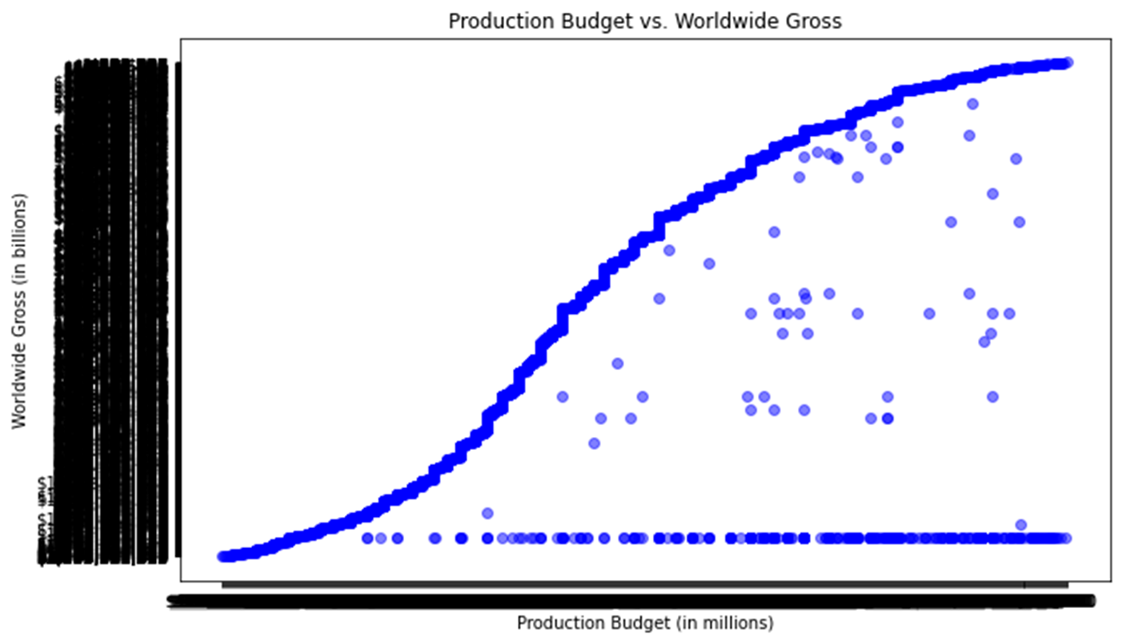
4000
3000
2000
1000
0

Slide 47
The visualization presented previously depicts the relationship between a movie's production budget and its worldwide gross revenue. Each data point on the scatter plot represents a movie, with the x-coordinate indicating the production budget (in millions) and the y-coordinate representing the worldwide gross revenue (in billions).
In conclusion, the visualization provides valuable insights into the relationship between production budget and worldwide gross revenue in the film industry. While a positive correlation exists, it's essential to consider various other factors that influence a movie's financial success.

Slide 48
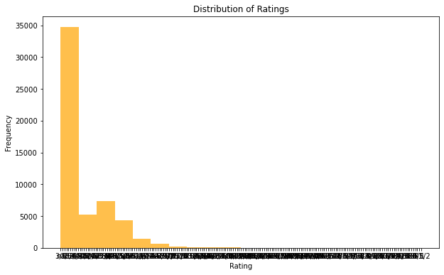

Slide 49
Histogram Interpretation:
The histogram displays the distribution of ratings assigned to movies.
The x-axis represents different rating values, while the y-axis indicates the frequency of each rating.
Conclusion:
The histogram shows the spread of ratings across different values. It helps us understand how ratings are distributed among the movies in the dataset.
The distribution of ratings can provide insights into the overall sentiment or reception of movies by viewers or critics.
A peak or concentration of frequencies around specific rating values may indicate common rating trends or preferences among reviewers.
Outliers or sparse regions in the histogram may highlight movies with exceptionally high or low ratings compared to the rest of the dataset.

Slide 51
Histogram Interpretation:
The histogram displays the distribution of gross revenue for movies, distinguishing between domestic and foreign revenue.
The x-axis represents different ranges of gross revenue, while the y-axis indicates the frequency of movies falling within each revenue range.
Conclusion:
The histogram allows us to observe the spread of domestic and foreign gross revenue across movies in the dataset.
By comparing the two histograms, we can assess the relative contribution of domestic and foreign markets to a movie's overall revenue.
Peaks or concentrations of frequencies in specific revenue ranges may indicate common revenue trends or preferences among movies.
The distribution of revenue provides insights into the financial performance of movies and the significance of different markets in revenue generation.
In conclusion, the histogram visualization of domestic and foreign gross revenue offers valuable insights into the financial performance and market dynamics of movies in the Box Office Mojo dataset, providing a basis for further analysis and decision-making within the film industry.

Slide 52
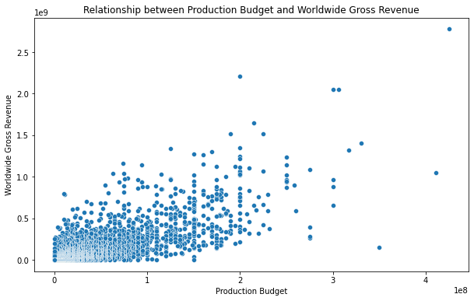

Slide 53
Scatter Plot Interpretation:
The scatter plot displays each movie as a point, with its production budget on the x-axis and worldwide gross revenue on the y-axis.
Each point represents a movie, and its position on the plot indicates the relationship between its production budget and worldwide gross revenue.
Conclusion:
The scatter plot allows us to visualize the relationship between production budget and worldwide gross revenue for movies in the dataset.
By observing the distribution of points and their general trend, we can assess the strength and direction of the relationship between these two variables.
A positive correlation between production budget and worldwide gross revenue suggests that higher budgets tend to result in higher revenue, while a negative correlation indicates the opposite.
Clusters or patterns of points may indicate common characteristics or trends among movies with similar production budgets and revenue levels.

Slide 54
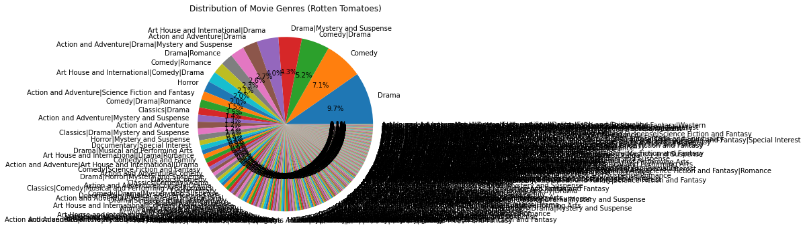

Slide 55
Pie Chart Interpretation:
The pie chart segments represent different movie genres, with each segment's size proportional to the percentage of movies belonging to that genre in the dataset.
Each genre is labeled with its name, and the percentage value indicates its relative frequency compared to other genres.
Conclusion:
The pie chart provides a visual representation of the distribution of movie genres in the Rotten Tomatoes Info dataset, allowing us to understand the relative popularity of different genres.
Larger segments indicate more prevalent genres, while smaller segments represent less common genres within the dataset.
The pie chart offers a quick and intuitive way to grasp the diversity of movie genres present in the dataset and identify any dominant or niche genres.

Slide 56
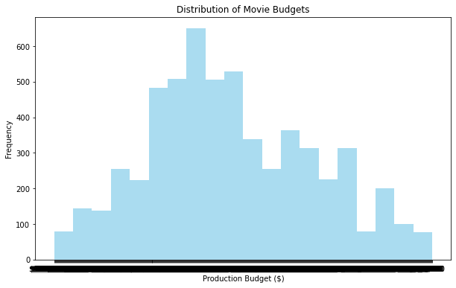

Slide 57
Histogram Interpretation:
The histogram displays the distribution of movie budgets, with the x-axis representing the production budget in dollars and the y-axis representing the frequency of movies falling within each budget range.
Each bar in the histogram represents a range of production budgets (bin), and the height of the bar indicates the number of movies with budgets falling within that range.
Conclusion:
The histogram provides insights into the distribution of production budgets across movies in the dataset, allowing us to understand the typical budget ranges and their frequencies.
By observing the shape and spread of the histogram, we can assess the variability and concentration of movie budgets within the dataset.
Insights and Considerations:
Peaks or clusters in the histogram indicate common budget ranges, which may correspond to different budget tiers or categories within the film industry.
Skewness or asymmetry in the histogram suggests uneven distribution, with more movies concentrated in certain budget ranges compared to others.
Outliers or extreme values in the histogram represent movies with exceptionally high or low production budgets relative to the majority of films in the dataset.

Slide 58
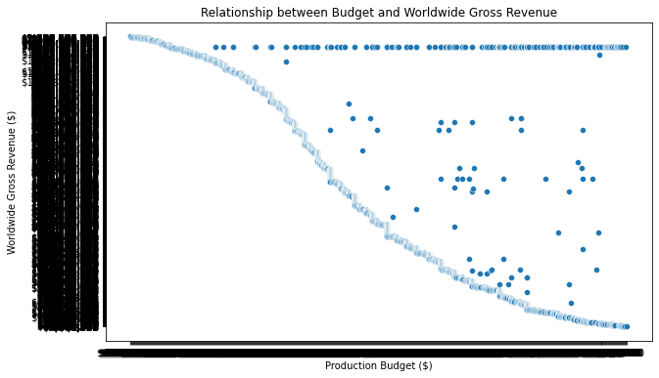

Slide 59
Scatter Plot Interpretation:
The scatter plot depicts each movie as a point, with its position determined by its production budget (x-axis) and worldwide gross revenue (y-axis).
Each point represents a movie in the dataset, and its placement reflects the budget-revenue relationship for that particular film.
Conclusion:
The scatter plot allows us to visually inspect the relationship between production budget and worldwide gross revenue for movies in the dataset.
By observing the general trend or pattern of points, we can infer whether there exists a correlation or association between budget and revenue.
Insights and Considerations:
Positive correlation: If the points tend to form an upward-sloping pattern from left to right, it suggests a positive relationship where higher budgets are associated with higher revenues.
No correlation: If the points appear randomly scattered without a clear trend, it indicates no significant relationship between budget and revenue.
Negative correlation: If the points slope downward from left to right, it suggests a negative relationship where higher budgets may be associated with lower revenues.

Slide 60
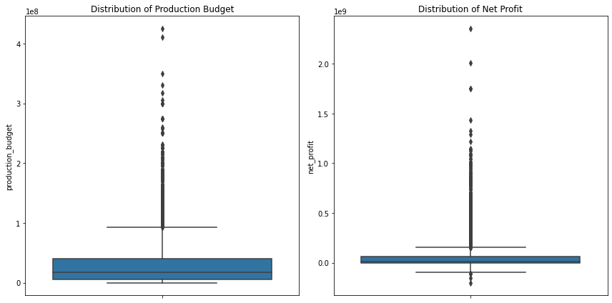

Slide 61
Boxplot Interpretation:
The boxplot on the left illustrates the distribution of production budgets for movies. It displays the median (line inside the box), quartiles (box edges), and outliers (points outside the whiskers).
The boxplot on the right shows the distribution of net profits, calculated as the difference between worldwide gross revenue and production budget. It also depicts the median, quartiles, and outliers.
Summary Statistics:
The summary statistics provide insights into the central tendency and spread of production budgets and net profits across the dataset.
The mean production budget is approximately $31.59 million, with a standard deviation of $41.81 million. The median budget is $17 million.
The mean net profit is approximately $59.90 million, with a standard deviation of $146.09 million. The median net profit is $8.55 million.
Comparison of Studios:
By analyzing the boxplots, we can compare the distribution of production budgets and net profits among different studios.
Studios with higher median production budgets and net profits may indicate greater investment in movie production and potentially more successful projects.
Outliers in the net profit boxplot represent movies that significantly outperformed or underperformed compared to their production budgets, highlighting instances of exceptional success or failure.
In conclusion, the visualizations provide valuable insights into the distribution of production budgets and net profits for movies in the dataset, enabling stakeholders to make informed decisions and strategic investments in the film industry.

Slide 62
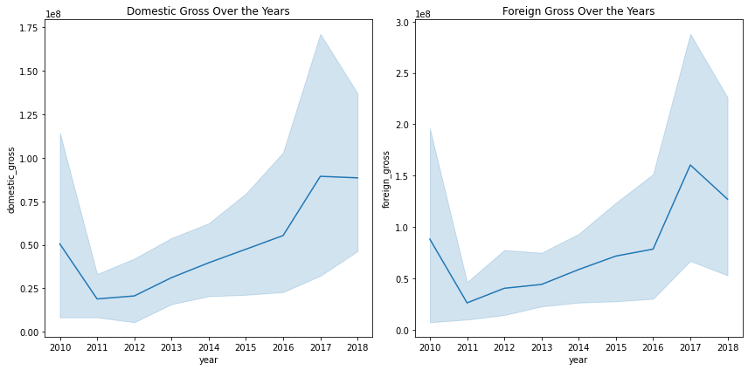

Slide 63
Data Preparation:
The code begins by loading the dataset movies_gross and displaying its first few rows to understand its structure.
It checks the data types of each column to ensure compatibility for analysis and visualization.
The 'foreign_gross' column is converted to numeric format by removing the dollar signs and commas.
Missing values are checked and dropped for the 'domestic_gross' and 'foreign_gross' columns to ensure data quality.
A new column 'total_gross' is created by summing up the domestic and foreign gross earnings.
The year information is extracted from the 'title' column and converted to numeric format for further analysis.
Visualizations:
Two line plots are created side by side to visualize the trends of domestic gross and foreign gross over the years.
The left subplot displays the trend of domestic gross earnings over the years, providing insights into the variation in domestic box office performance annually.
The right subplot illustrates the trend of foreign gross earnings over the years, indicating the performance of movies in international markets and how it evolves annually.
Insights:
Domestic Gross Over the Years:
The line plot shows fluctuations in domestic gross earnings over the years, reflecting the changing popularity of movies in domestic markets.
Peaks and valleys in the plot may indicate the release of blockbuster movies or seasonal trends affecting box office performance.
Foreign Gross Over the Years:
Similarly, the line plot of foreign gross earnings demonstrates how the international box office performance varies annually.
It helps in understanding the global appeal of movies and how they resonate with audiences across different regions.

Slide 64
Considerations:
Analyzing the trends in both domestic and foreign gross earnings provides valuable insights into the overall financial performance of movies and their market reach.
Further analysis, such as comparing the relative contributions of domestic and foreign markets to total gross earnings, can offer deeper insights into the global distribution strategies of movie studios.
In conclusion, the visualizations offer valuable insights into the trends of domestic and foreign gross earnings over the years, providing stakeholders in the film industry with actionable information for strategic decision-making and market analysis.

Slide 65
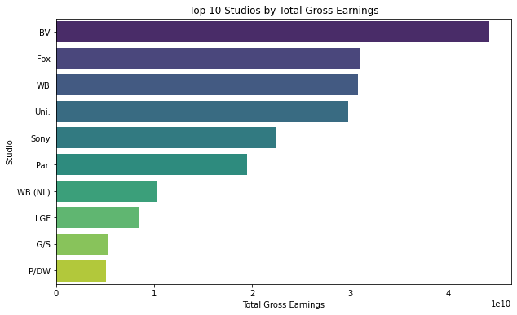

Slide 66
Data Preparation:
The code groups the data by the 'studio' column and calculates the total gross earnings for each studio.
Total gross earnings are computed by summing up the 'total_gross' column values for each studio.
The resulting dataframe studio_gross contains the total gross earnings for each studio.
Visualization:
The top 10 studios with the highest total gross earnings are selected based on the calculated values.
A horizontal bar plot is created using Seaborn's barplot function, with studios on the y-axis and total gross earnings on the x-axis.
Each bar represents the total gross earnings of a studio, and they are sorted in descending order to highlight the top performers.
The color palette used is 'viridis', which provides a visually appealing color scheme.
Insights:
The bar plot visually presents the top 10 studios by total gross earnings, allowing for easy comparison of their performance.
Studios with higher bars indicate higher total gross earnings from their movies.
Stakeholders can quickly identify the top-performing studios and assess their market dominance based on their financial success in the film industry.
In conclusion, the visualization effectively communicates the top-performing studios based on their total gross earnings, providing valuable information for stakeholders to make informed decisions and strategic investments in the film industry.

Slide 67
5.RECOMMENDATIONS.
Recommendations derived from our analysis to guide Microsoft's new movie studio venture.
The recommendations are not just about making movies they're about making a mark in the entertainment industry. With a strategic focus, collaborative spirit, and relentless pursuit of excellence, we'll pave the way for Microsoft's success in the world of cinema.

Slide 68
1. Focus on Business Impact:
Let's keep our eyes on the prize! Our recommendations prioritize actions that will directly boost Microsoft's success in the entertainment industry. We're talking about strategies that can increase profits, capture audience attention, and solidify Microsoft's position in the market.
2. Iterative Approach:
We're in this together! Our journey involves continuous learning and improvement. We'll refine our strategies based on feedback, data validation, and ongoing market insights. It's all about staying agile and responsive to the ever-changing landscape.
3. Holistic Data Utilization:
Let's paint the full picture! We're not just looking at numbers; we're diving deep into audience behaviors, industry reports, and expert opinions. By considering a wide range of data sources, we'll gain valuable insights that shape our recommendations.

Slide 69
4. Actionable Insights:
Let's make it happen! Our recommendations are not just ideas—they're actionable steps that Microsoft can take to drive real results. We'll break down complex insights into simple, understandable terms that anyone can grasp.
5. Communication Excellence:
Let's tell a compelling story! Our goal is to communicate our findings in a way that captivates and inspires. Through clear presentations, engaging reports, and impactful visualizations, we'll ensure that everyone understands the value of our recommendations.
6. Risk Management:
Let's stay ahead of the game! We'll identify potential risks and challenges that may come our way. By developing smart strategies and contingency plans, we'll minimize uncertainties and maximize our chances of success.
7. Continuous Learning:
Let's never stop growing! Our journey doesn't end here—it's just the beginning. We'll foster a culture of curiosity, collaboration, and innovation within our team. Together, we'll unlock new opportunities and drive Microsoft's movie studio to greater heights.

Slide 70
Thank you for your time and attention! Before we wrap up, I'd like to open the floor for any questions you may have.
Contact Information:0796866976
Name: Derrick Kiptoo
LinkedIn Profile: https://github.com/Kip0010/Derrick
Feel free to connect with me on LinkedIn or reach out via email if you have any further questions or would like to discuss our recommendations in more detail.

