Slide 1

Data Exploration & Visualisation
Christine Ock

Slide 2
Contents
Introduction
Analysis of Precipitation
Koppen Climate Classification analysis
Explore and Visualize Rainfall and Sunshine with Folium Library

Slide 3
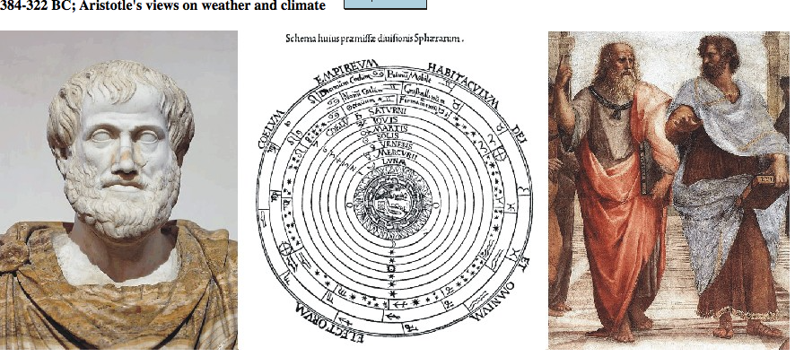




Slide 4
Objective
Predict whether it will rain or now on the next day
Method: Machine Learning

Slide 5
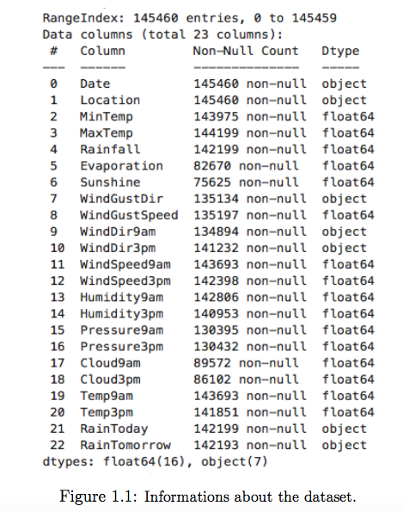
Dataset
-Target Variable: RainTomorrow (Y/N)
22 Feature Variable A. 16 Quantitative variable
B. 6 Qualitative variable

Slide 6
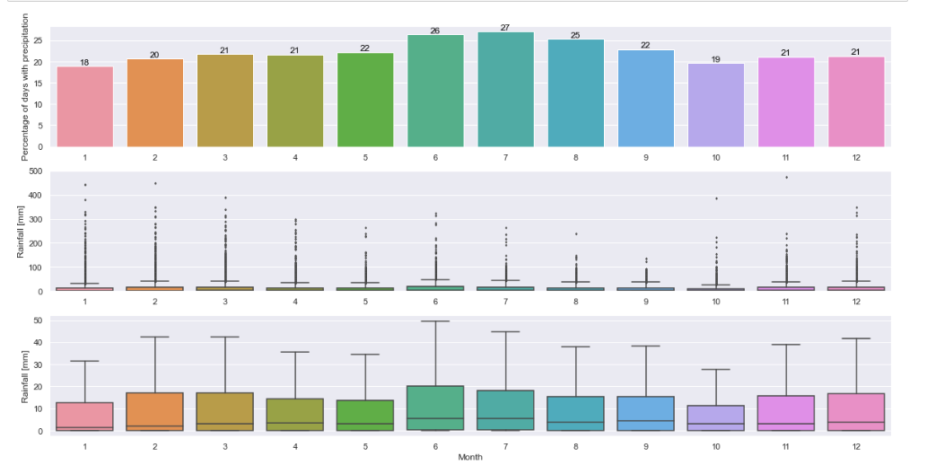
Analysis of Precipitation
Percentage of days with precipitation and amount(mm) of rainfall
< by Monthly>

Slide 7
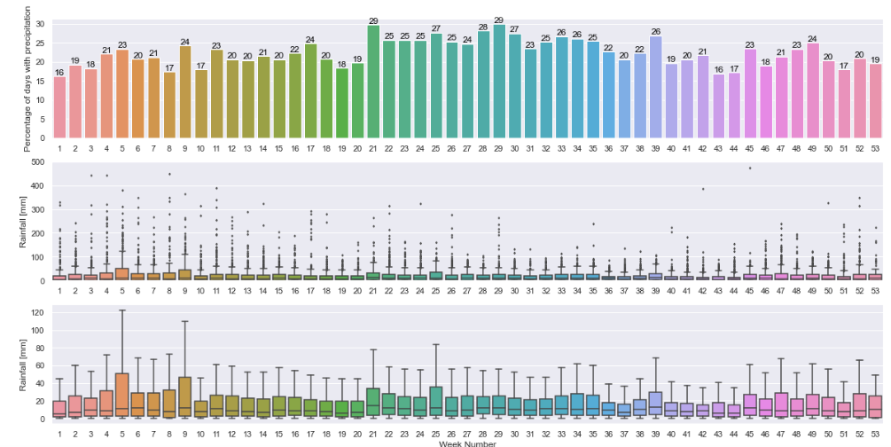
Analysis of Precipitation
Percentage of days with precipitation and amount(mm) of rainfall
< by Weekly>

Slide 8
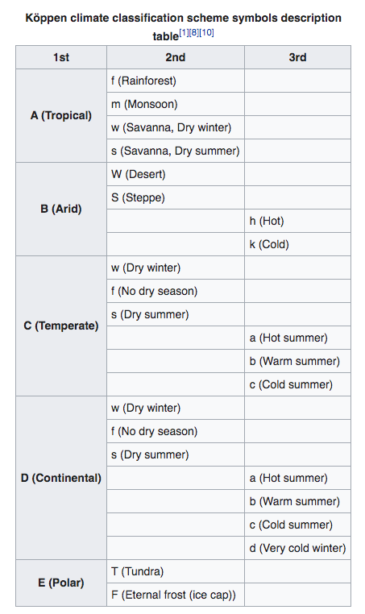
Koppen Climate Classification
- Divides climate into 5 main climate groups with each group being divided again based on precipitation and temperature.
- In Australia, there are 8 type of different climate group based on Koppen Climate Classification.

Slide 9
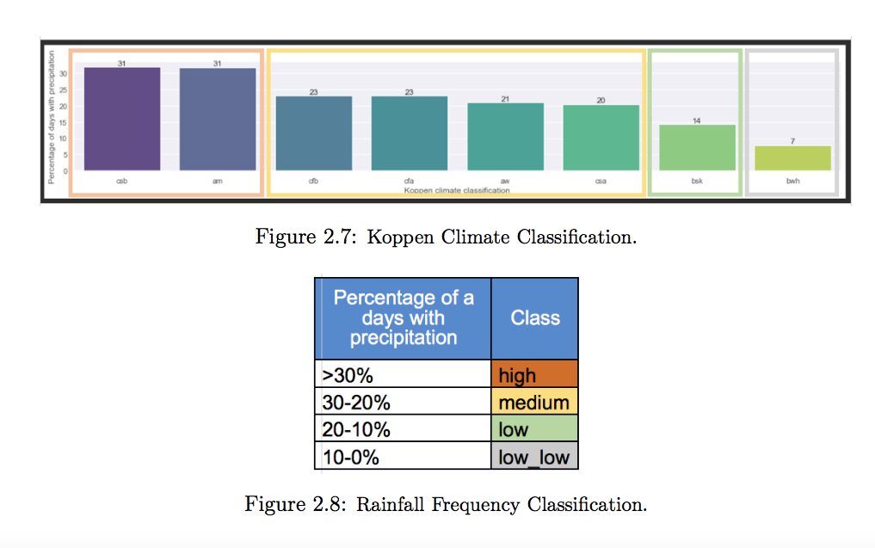
Koppen Climate Classification

Slide 10
Analysis and Visualisations of Rainfall and Sunshine
Folium Library : - if the mean is far below the country’s average - if the mean is below the country’s average - if the mean is above the country’s average - if the mean is far above the country’s average

Slide 11
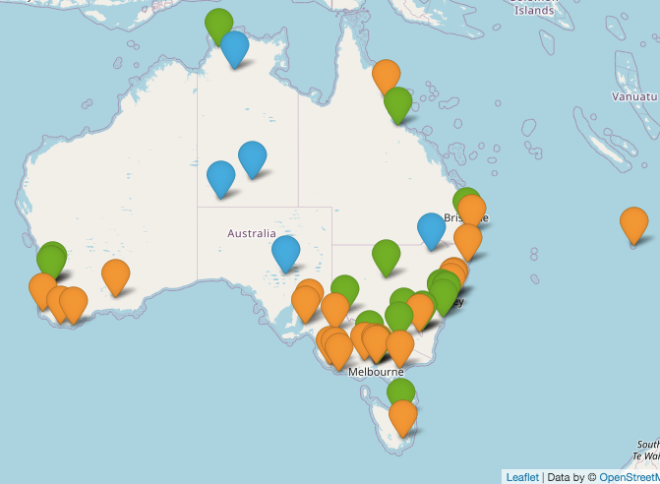
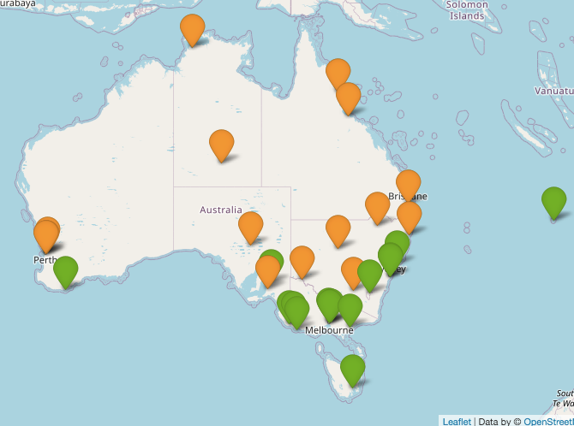
Rainfall and Sunshine by different location
<Heatmap of the Rainfall based on whole dataset>
<Heatmap of the Sunshine based on whole dataset>

Slide 12
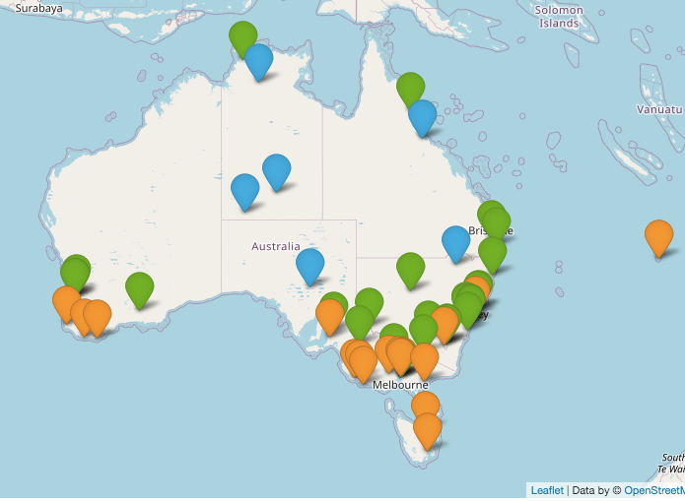
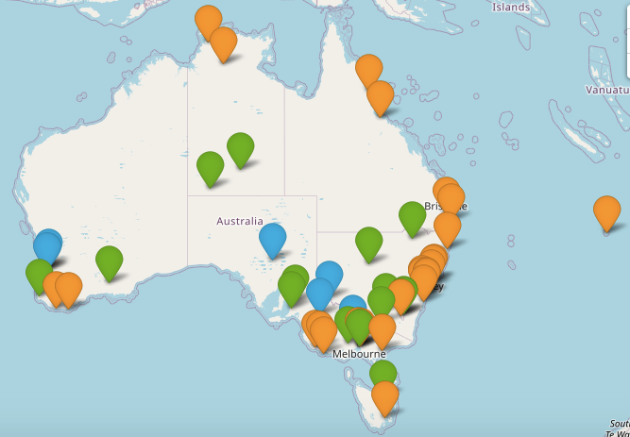
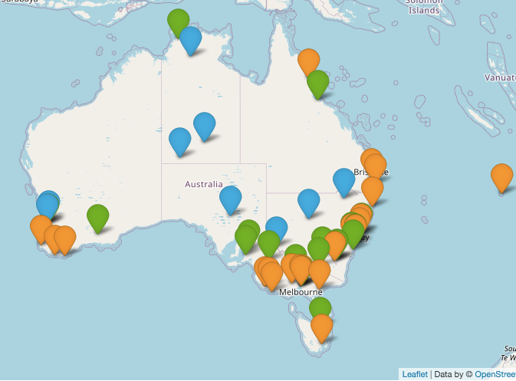

Rainfall with Seasonal Granularities
<Spring>
<Summer>
<Autumn>
<Winter>

Slide 13
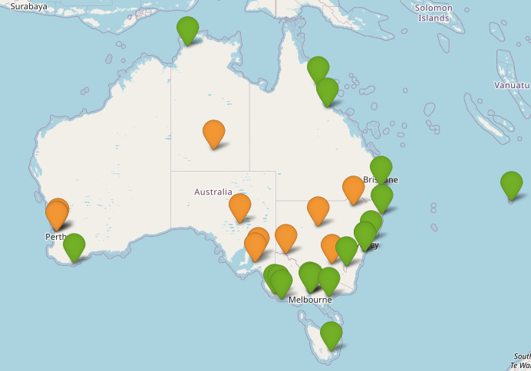
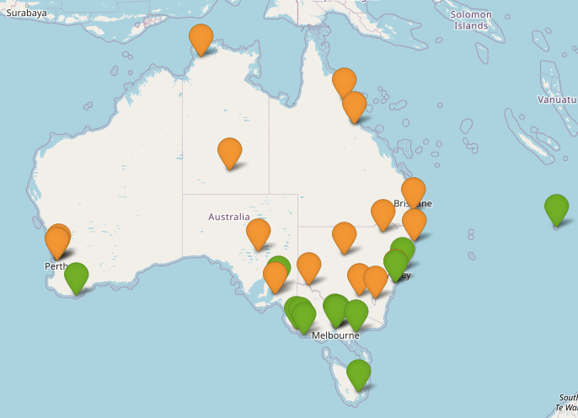
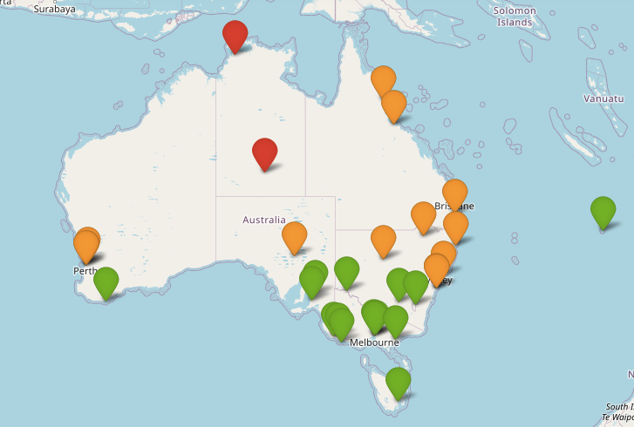
Sunshine with Seasonal Granularities
<Spring>
<Summer>
<Autumn>
<Winter>

