Slide 1


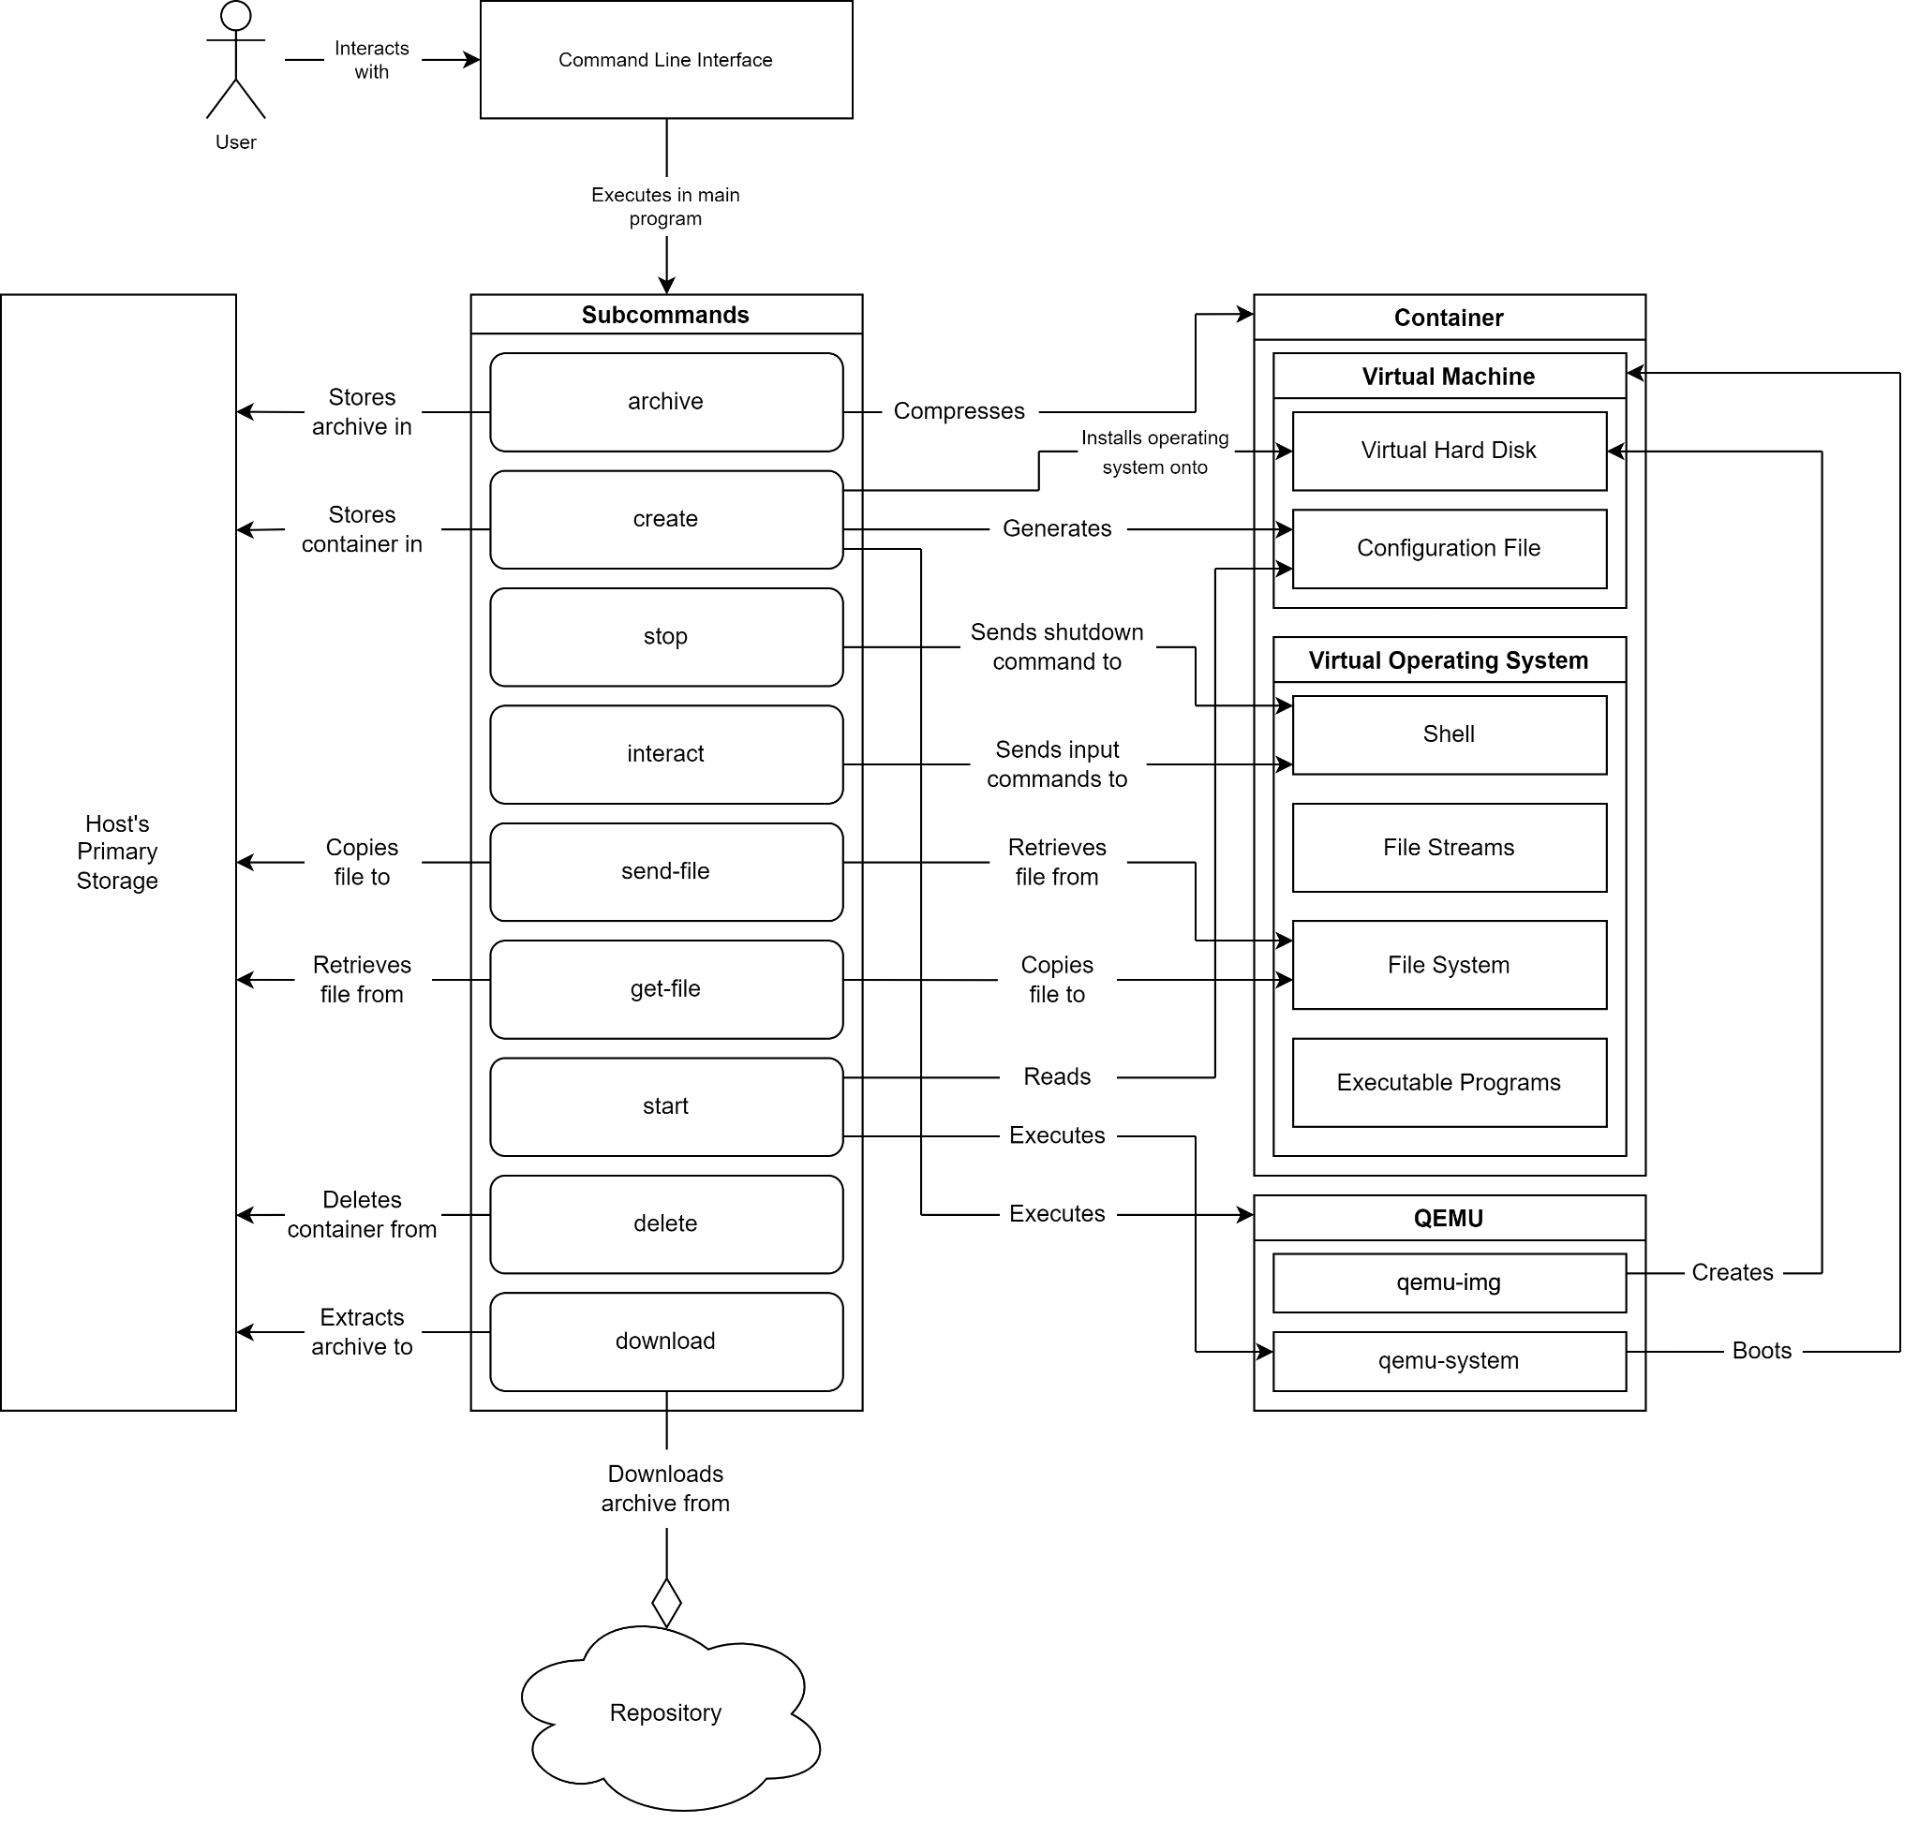
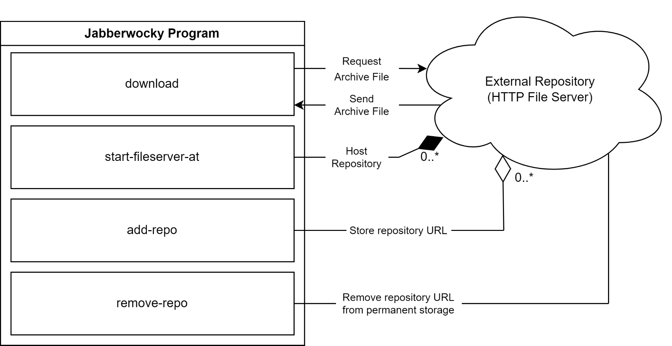
Jabberwocky: Managing Virtual Environments in a Box
Ian Orzel, Dylan McDougall
Faculty Advisor(s):Dr. Ryan Stansifer, Dept. of Computer Engineering & Sciences, Florida Institute of Technology
Motivation
Student coursework can require the installation of special software and environments, sometimes even requiring exotic hardware.
Setting up these environments can create an undue burden on both students and faculty.
Students can also run into issues where something they create works on their own environment but not on the environment being used by faculty, making it difficult for faculty to replicate student results.
Specifically, in the Compiler Theory course, students need to be able to produce and run SPARC executables, which is problematic as it is very likely that the student's machine does not natively use a SPARC architecture.
Goal
Create a virtual environment manager that allows students and faculty to easily activate custom virtual environments for interacting with their coursework.
Create virtual environments for certain pre-existing courses to assist students with their existing coursework.
Allow faculty to easily create new virtual environments for their courses.
Features
Use on-demand virtual development environments custom-tailored to your courses. These virtual environments contain all the necessary custom software you need to develop programs for assignments, as well as to test and debug your software, all wrapped up in a tidy container that you install once.
Use the pre-made environments created for the Compiler Theory, Programming Languages, and Operating Systems courses.
Easily emulate foreign guest architectures other than that of your host machine without even having to think about it.
Run these development environments on all the major platforms: Windows, macOS, and Linux.
Transfer files between your host’s native filesystem and the container’s virtual filesystem in an intuitive manner.
Access and interact with the virtual shell of the container just as you would your own.
Be able to create containers with whatever custom software you need to distribute to your students for a specific course.
Future Ideas
More Containers: There are other courses that could have containers made for them, which would assist students in these courses with their work.
Scriptability: Students and faculty may want to create scripts that automatically interact with their containers, but there has been no testing into how well command-line scripting would work. Students may find scripting helpful in automatically building their projects, and faculty may find scripting helpful in automatically grading assignments.
TRACKS login: It would be great if there was a Florida Tech server online that integrated with TRACKS in order to have one central place that allows student and faculty to upload and download containers.
Container Status: Create a way for users to easily check for status information on the containers that are currently running. Currently, users have no way of knowing the state of containers other than using their memory and intuition. It would be great if they had an easy way to check on information about the current containers.
Acknowledgements
Dr. Stansifer and Dr. Chan for their guidance.
Students of the Spring 2023 CSE4250 course for their feedback from using the tool.
Classmates for their advice and feedback on the tool.

