Slide 1
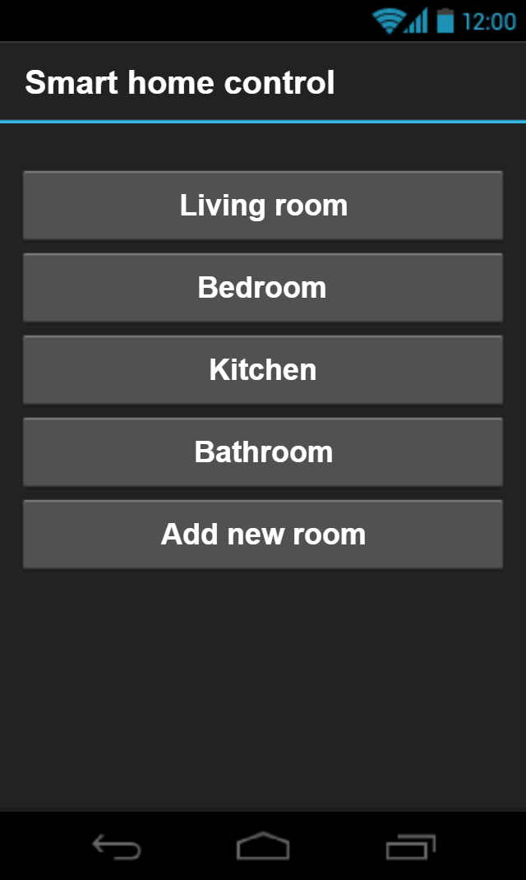
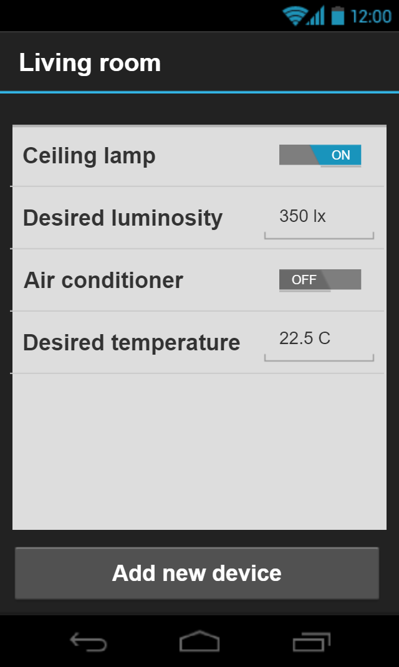
Smart-home system
Mikiška Kipras
Mockus Ugnius
Saročka Tomas
Žaromskis Lukas
It is a smart home device control system.
Parts:
sensors (light, temperature),
camera,
switches/dimmers,
blinds,
heaters,
controller
Rules:
Keep luminosity at a desired level
Keep the same temperature
Keep the same humidity
https://github.com/Kipronzo/SmartHome

