Slide 1
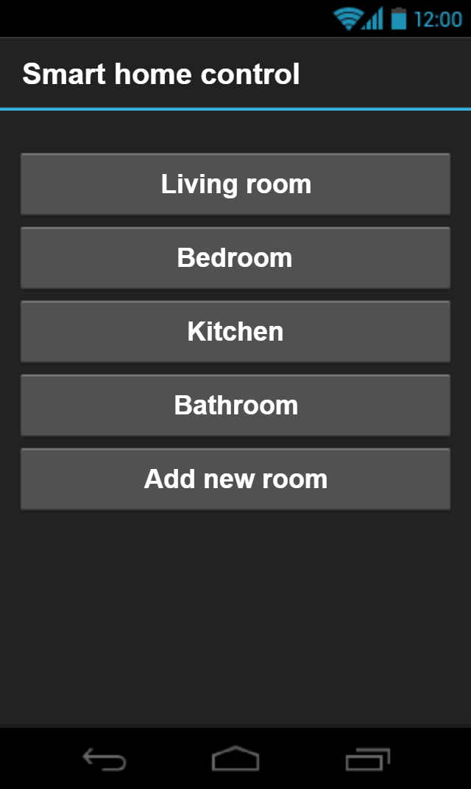
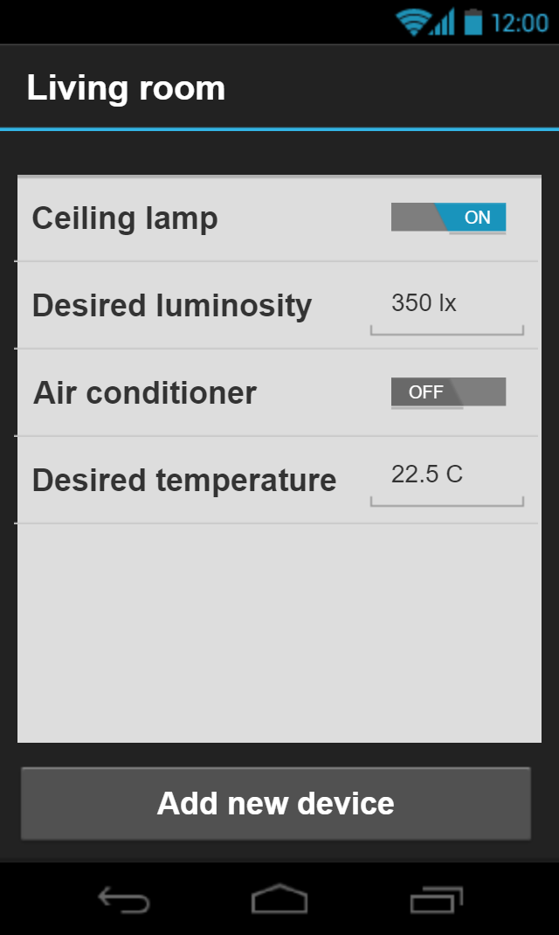
Smart-home system
Mikiška Kipras
Mockus Ugnius
Žaromskis Lukas
It is a smart home device control system.
Parts: light sensor, camera, switches/dimmers, blinds, heaters, controller
Rules:
Keep luminosity at a desired level
Keep the same temperature
Keep the same humidity
https://github.com/Kipronzo/SmartHome

