Slide 1
Compiler 2017
Kipsora Lawrence

Slide 2
Overview
Rank 7th regardless of the penalty of overdue
User-friendly semantic checker
Command parameters
SSA Constructor and SSA Destructor
Desperately implemented Liveliness analyzer and global allocator

Slide 3
Program
Intermediate.Builder
ANTLRInputStream
HLIRTransformer
CommonTokenStream
MLIRTransformer
MiracleParser
Middle Level IR Code
CSTree
ASTree.Builder
LivelinessAnalyser
ScopeBuilder
GlobalAllocator
ClassFetcher
Middle Level IR Code
SemanticAnalyser
LLIRTransformer
ASTree
X64Printer
Assembly

Slide 4
Semantic Checker
ANTLR are a very useful tool.
is

Slide 5
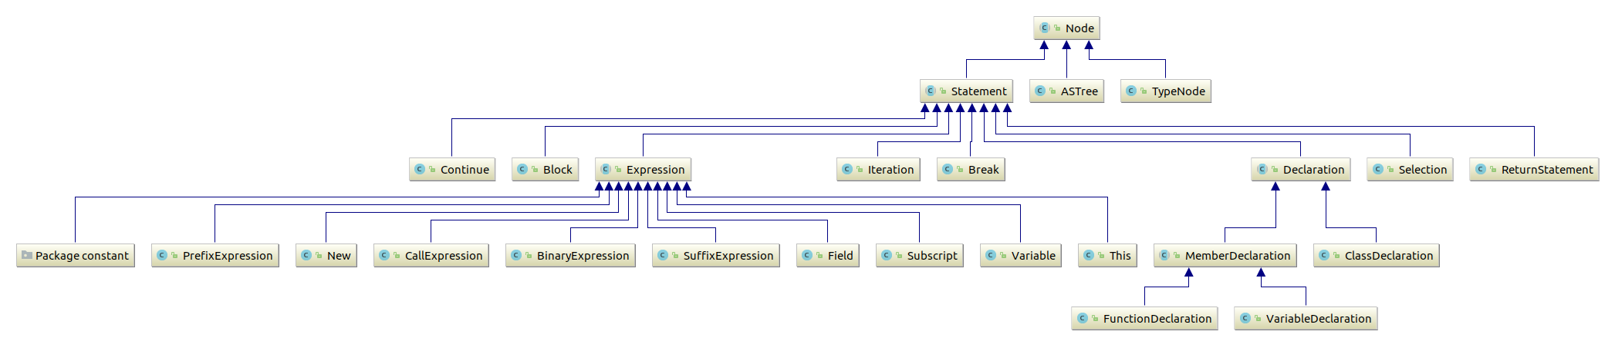
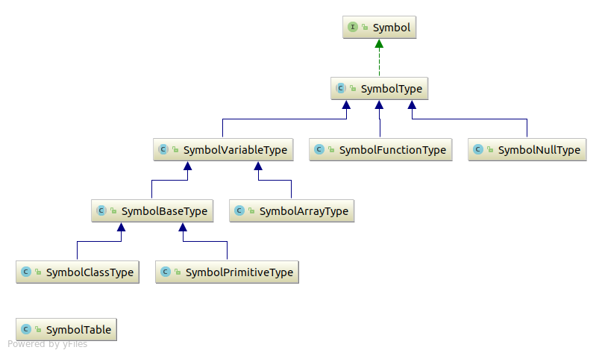
Extending Graph

Slide 6
The 1st Version of Semantic Analyzer
Considering the principle that simple is fast, reduced ANTLR G4 file is used:
Construct abstract syntax tree with semantic checker first
expression: constant #constantExpression
| 'this' #thisExpression
......
| expression operator='.' IDENTIFIER #fieldExpression
| expression operator=('*' | '/' | '%') expression #binaryExpression
| expression operator=('+' | '-') expression #binaryExpression
| expression operator=('<<' | '>>') expression #binaryExpression
......
| expression operator=('==' | '!=') expression #binaryExpression
......

Slide 7
The 2nd Version of Semantic Analyzer
Feeling WTF after a few days when implementing linear intermediate representation
Constructing the whole abstract syntax tree first, then applying class fetcher and other checkers
Checkers becoming relatively easy to implement
Omitting some redundant details

Slide 8
Semantic Analyzer
User-friendly error reports:
Miracle:2:5: error: cannot declare a variable of type `void`
void a;
^
Miracle:3:9: error: cannot find identifier named "a"
return a;
^
Miracle:3:9: error: identifier "a" is not declared as a valid expression
return a;
^
Miracle:5:8: error: the rawval of left operand is not mutable
true = false;
^

Slide 9
Symbols
Function are treated as a special type of variables
Every type is virtually treated as a class with member variables and member methods
NULL is a special type with only one instance null.
Built-in methods and type comparator should be carefully implemented due to the abstractions above

Slide 10
Symbol Table
Tried O(1) symbol table first
Complicated implementations
Re-write with O(n) symbol table
Remember parent scope in each scope
Performs well in practice

Slide 11
Tricks in Symbol Table
Normal variables are not able to be accessed before definition
But member variables can be accessed anywhere
Checking order is needed
Class identifiers, function identifiers and variable identifiers are stored in one map
Resolving process should be carefully implemented

Slide 12
Intermediate Representation
The cat ran at the rat
call cat.run target=rat

Slide 13
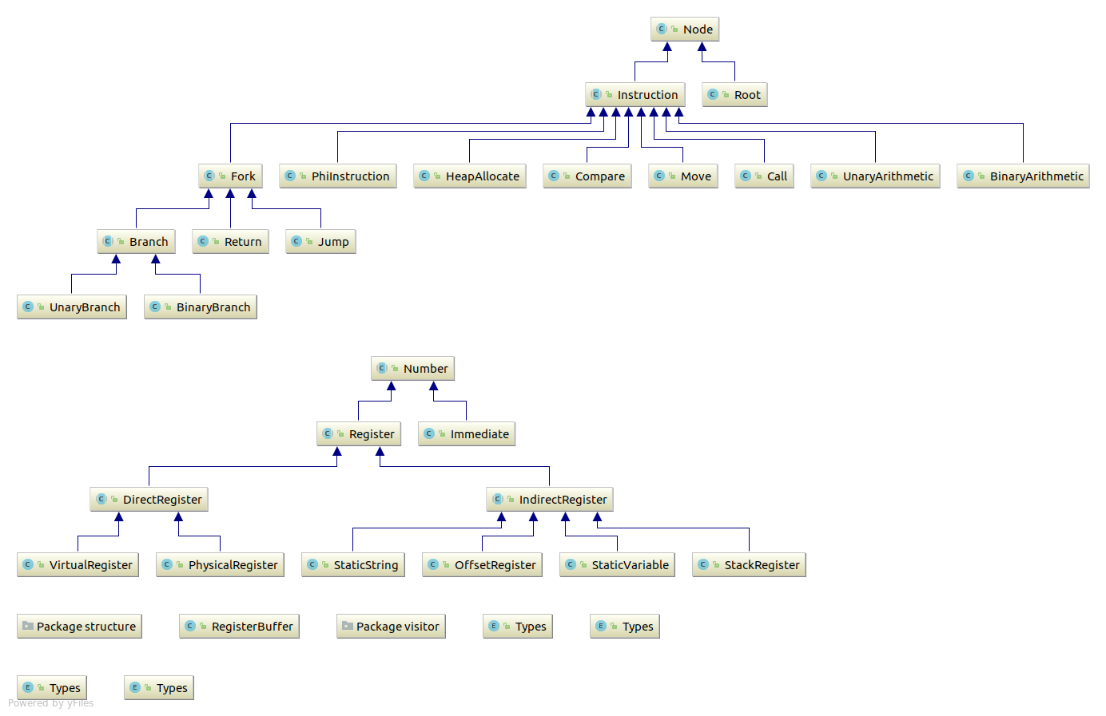
Extending Graph

Slide 14
LLVM IR
Confused by the conception of intermediate representation
Look for a standard IR
LLVM IR with SSA Form!
Having a view of “standard IR”
define i32 @main() nounwind {
entry:
%retval = alloca i32, align 4
%a = alloca i32, align 4
%b = alloca i32, align 4
store i32 0, i32* %retval
%0 = load i32* %a, align 4
%1 = load i32* %b, align 4
%d = add nsw i32 %0, %1
ret i32 %d
}
https://www.zhihu.com/question/40032931

Slide 15
Single Static Assignment Form
Fascinated by LLVM, I decide to use SSA form directly after the construction of abstract syntax tree
Some paper discovered some simple methods to construct SSA form from abstract syntax tree
Time limited, I decided to finish basic test first and then transform the code to SSA form
https://www.zhihu.com/question/40032931
https://pp.info.uni-karlsruhe.de/uploads/publikationen/braun13cc.pdf

Slide 16
Single Static Assignment Form
I think I should use Tarjan’s methods to construct dominator tree first and then construct SSA Form
I have looked up many materials of SSA form to find a efficient implementation
Find a simple method in Lequn Chen’s report, which suggest a book named Engineering a Compiler(EAC) and also SSA Books
http://ssabook.gforge.inria.fr/latest/book.pdf
https://www.cs.cmu.edu/~fp/courses/15411-f08/lectures/09-ssa.pdf

Slide 17
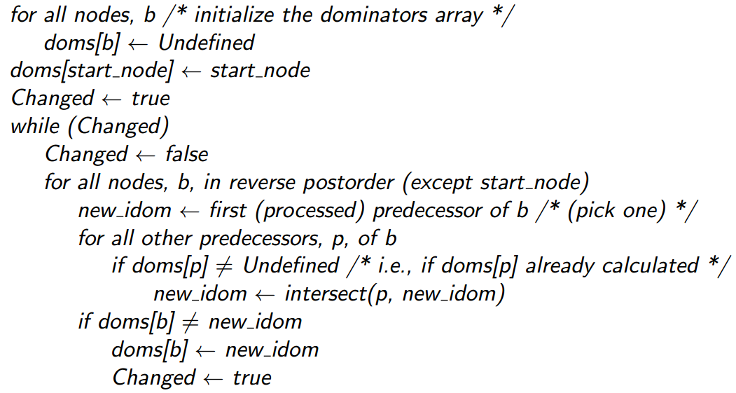
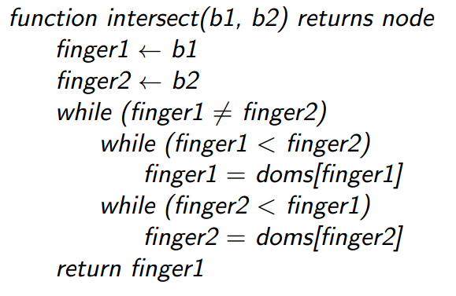
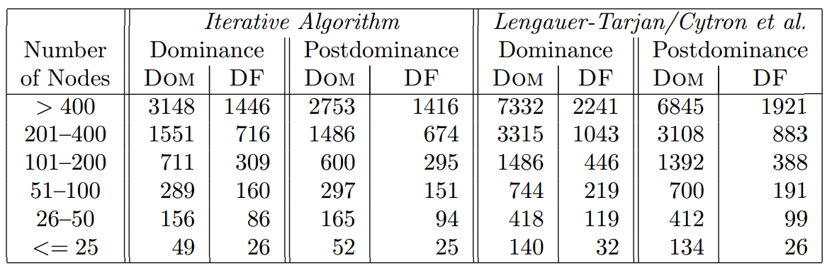
Calculating Dominator Frontier
Performed well in practice
http://www.cs.rice.edu/~keith/EMBED/dom.pdf

Slide 18
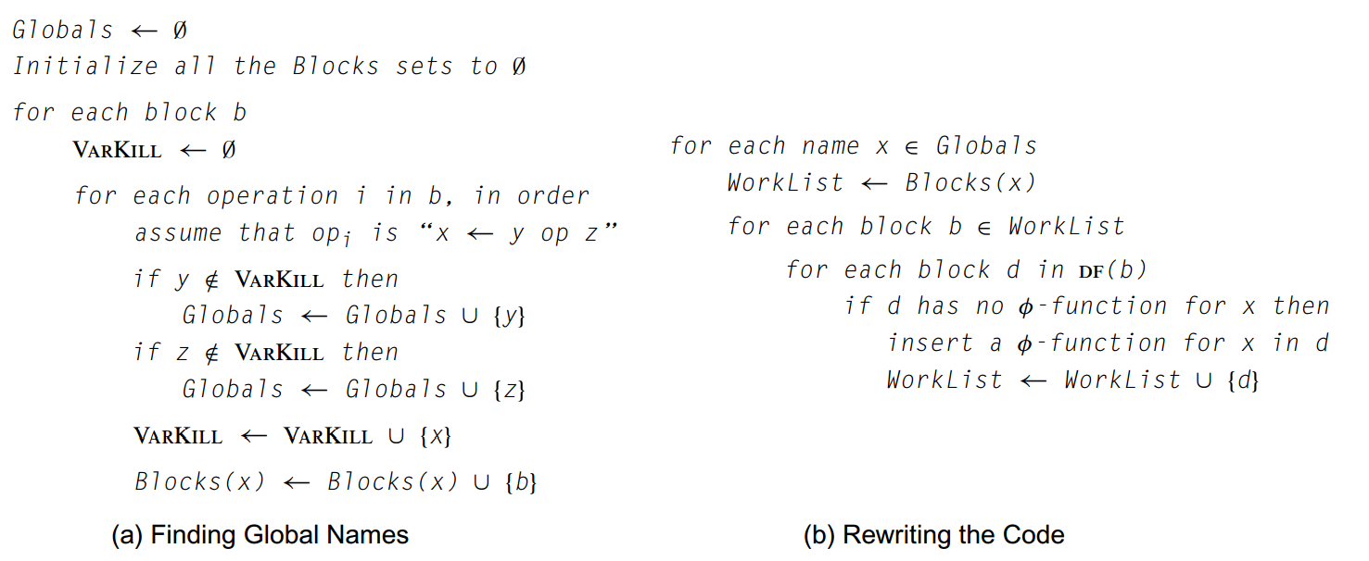
Constructing SSA Form
http://bank.engzenon.com/download/560e72f1-0a74-4507-8385-12aec0feb99b/Engineering_a_Compiler_2nd_edition_by_Cooper_and_Torczon.pdf

Slide 19
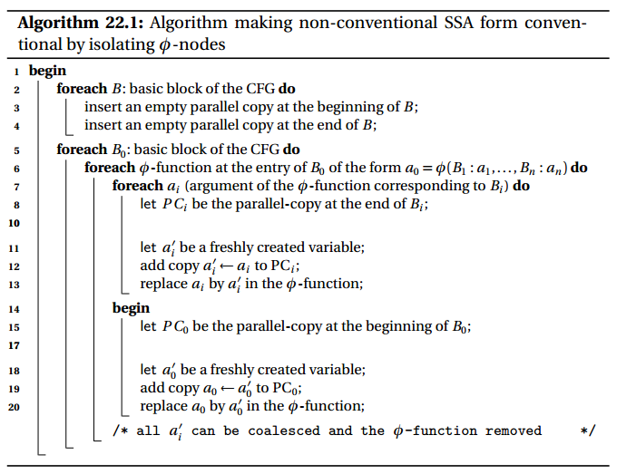
Destructing SSA Form
http://ssabook.gforge.inria.fr/latest/book.pdf

Slide 20
Registers in IR
Virtual register is a ideal conception that registers are infinite
Offset-registers is another conception used to represent subscription and member accessing operations
A naivё approach translating IR into assembly is to map every virtual register to memory
https://www.zhihu.com/question/29355187

Slide 21
Troubles
I feel tremendously difficult to translating IR into assembly considering the following case:
I raise a question on StackExchange and finally I surrender to selecting some special registers for compromise
index_a = 3
index_b = 4
a[index_a] = a[index_b]
mov dword [$rbp - 4], 3
mov dword [$rbp - 8], 4
mov dword [$rax + dword [$rbp - 4]],
dword [$rax + dword [$rbp - 8]]

Slide 22
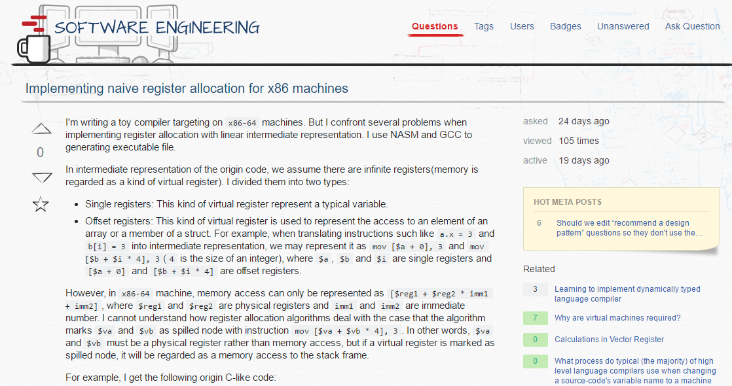
https://softwareengineering.stackexchange.com/questions/349684/implementing-naive-register-allocation-for-x86-machines

Slide 23
GCC’s Solution
GCC uses several passes to deal with this case
In the first pass, GCC use Graph Coloring to color each virtual register
If a node is marked spilled and this node cannot be in memory, then make a copy and re-allocate all virtual registers
The new copied virtual registers have few degrees, hence few passes can solve this problem
ftp://gcc.gnu.org/pub/gcc/summit/2003/Graph%20Coloring%20Register%20Allocation.pdf

Slide 24
Optimization & Code Generation
That what you say is false is true, which is false actually
What you say is true
mov $[what your say], true

Slide 25
Register Allocation
Delayed by the troubles above, I desperately implemented register allocation in a really short time with overdue penalty finally
I use 9 registers for allocation, and RAX, R14, R15, RBP, RSP, RCX are reserved
Code really become faster after register allocation
Allocator is naivё, but the performance is very well
Debugging and handling tricks are tremendously troublesome

Slide 26
Optimization in Code Generation
Usually we uses push and pop to pass spilled calling parameters, which needs a subtraction of RSP register
I calculate the size of all the spilled parameters first and then directly use sub $RSP, SIZE and then use mov instruction to pass the calling parameters
And the bool type is only one bit which make calculation related with bool faster.

Slide 27
What I Have Learned in This Project
I have learned how to extract useful information from a technical manual and from a paper
I have learned how to implement a tremendously complicated project in practice
I have learned how to struggle with my classmates who helped me a lot when I face some difficulties
I have learned how to keep calm under the overwhelming pressure

Slide 28
References
Engineering a Compiler
Tiger Books
ふつうのコンパイラをつくろう
NASM Tutorial
Lequn Chen’s Project
Zhijian Liu’s Project
……

Slide 29
Thanks for Listening

