Slide 1


QUERY-CONDITIONED DEEP LEARNING FOR ADAPTIVE MULTI-SOURCE MUSIC SEPARATION
Course Title:Deep Learning
Course Code: 22AIE302
Department :AIE
Achintya TR-CH.SC.U4AIE24003
BJ Kiranesh - CH.SC.U4AIE24006
Hithesh R - CH.SC.U4AIE24027
Parinitha K - CH.SC.U4AIE24052

Slide 2
Introduction
THE MIX
THE CATCH
Songs blend vocals, drums, bass, guitar, piano & percussion into one mixed recording.
Music Source Separation (MSS) recovers those individual sources from the mixture.
Deep learning has pushed MSS quality further than ever — but most systems still produce only a fixed set of output stems.
Most systems only output a fixed set of stems:
Mixed Audio → Vocals + Drums + Bass + Other
Ask for a source outside that set — a second guitar, a synth — and it simply can’t deliver.
OUR APPROACH
Let the user specify the desired source with a query — and separate exactly that.

Slide 3
Problem Statement
Design a query-conditioned deep learning model that adaptively separates a desired musical source from a multi-source mixed recording based on a given query — overcoming the limitations of conventional fixed-output music source separation.

Slide 4
Existing Problem
CONVENTIONAL APPROACH
Mixed Audio
→
Fixed Separation Model
→
Fixed Stems
Example: Song → Vocals + Drums + Bass + Other
1
Rigid categories
2
No arbitrary targets
3
Retraining needed
Output categories are fixed once training ends.
The model can’t respond to a source it hasn’t seen.
A new source category means retraining the model.
4
Countless combinations
5
Hard to distinguish
6
All-or-nothing output
Real-world songs mix instruments in endless variations.
Similar sources, like two singers or guitars, confuse it.
Users often want just one stem, not the full set.

Slide 5
Project Objectives
1
2
3
4
Query-conditioned framework
Learn strong representations
Explore conditioning mechanisms
Evaluate across sources
Develop a deep learning framework for adaptive music source separation.
Encode the mixed audio and target query into useful features.
Compare ways of fusing mixture and query information.
Measure separation performance for different target instruments.
5
6
7
Test variable combinations
Disambiguate similar sources
Compare conditioning strategies
Study separation under different source combinations.
Check whether query info helps separate similar sources, like two singers.
Benchmark strategies using objective and qualitative evaluation.

Slide 6
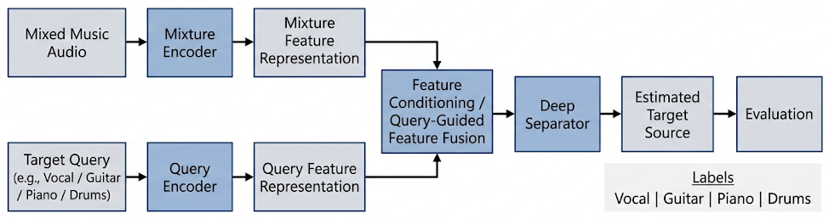
METHODOLOGY
Two encoders feed a shared feature space; the mixture and query representations are fused before the deep separator produces the target stem.

Slide 7
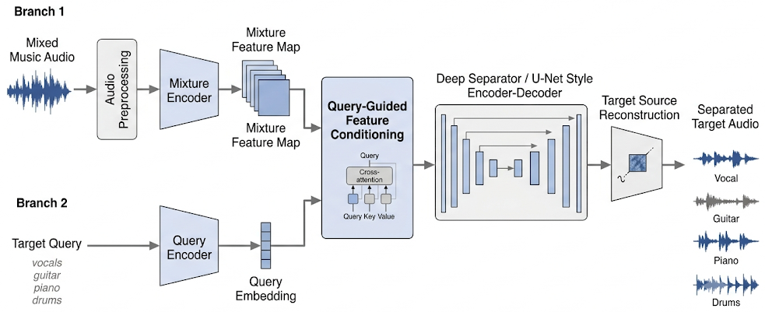
ARCHITECTURE
A U-Net style encoder–decoder reconstructs the target source, guided by cross-attention conditioning from the query encoder.

Slide 8
DATASET & EVALUATION
EVALUATION METRICS
MUSDB18 DATASET
150
SDR
Signal-to-Distortion Ratio
Measures overall separation quality.
full-length tracks
SIR
Signal-to-Interference Ratio
Mixtures
Vocals
Drums
Measures suppression of interference from other sources.
Bass
Other
SAR
Signal-to-Artifacts Ratio
Measures artifacts introduced during separation.

Slide 9
Literature Survey
S.No | Paper Name |  | Brief Description |  | Research Gap
Category A: Query-Conditioned & Conditioned Source Separation
1 | Separate This, and All of these Things Around It: Music Source Separation via Hyperellipsoidal Queries | Proposes query-by-region music source separation using hyperellipsoidal regions in an embedding space, enabling extraction of arbitrary musical sounds beyond fixed stem vocabularies. Evaluated on MoisesDB with state-of-the-art SNR and retrieval metrics. | Proposes query-by-region music source separation using hyperellipsoidal regions in an embedding space, enabling extraction of arbitrary musical sounds beyond fixed stem vocabularies. Evaluated on MoisesDB with state-of-the-art SNR and retrieval metrics. | The hyperellipsoidal query representation requires careful tuning of region parameters; scalability to highly polyphonic mixtures with many overlapping similar sources remains unexplored. | The hyperellipsoidal query representation requires careful tuning of region parameters; scalability to highly polyphonic mixtures with many overlapping similar sources remains unexplored.
2 | QSCNet: A Conditioned UNet for Music Source Separation | Introduces a conditioned U-Net (QSCNet) integrating conditioning into Sparse Compressed Network architecture for query-based MSS. Outperforms Banquet by over 1 dB SNR using less than half the parameters. | Introduces a conditioned U-Net (QSCNet) integrating conditioning into Sparse Compressed Network architecture for query-based MSS. Outperforms Banquet by over 1 dB SNR using less than half the parameters. | Relies on audio-only queries; does not explore text or multimodal conditioning. Performance on out-of-distribution instruments or unseen timbres is not evaluated. | Relies on audio-only queries; does not explore text or multimodal conditioning. Performance on out-of-distribution instruments or unseen timbres is not evaluated.
3 | PromptSep: Generative Audio Separation via Multimodal Prompting | Extends language-queried separation to support both sound extraction and removal, incorporating vocal imitation as a conditioning modality alongside text via a conditional diffusion model with data augmentation strategies. | Extends language-queried separation to support both sound extraction and removal, incorporating vocal imitation as a conditioning modality alongside text via a conditional diffusion model with data augmentation strategies. | Vocal imitation conditioning is limited to sound effects; applicability to fine-grained musical instrument separation is not demonstrated. Inference speed is constrained by iterative diffusion sampling. | Vocal imitation conditioning is limited to sound effects; applicability to fine-grained musical instrument separation is not demonstrated. Inference speed is constrained by iterative diffusion sampling.
4 | CLAPSep: Leveraging Contrastive Pre-trained Models for Multi-Modal Query-Conditioned Target Sound Extraction | Integrates the CLAP pre-trained model into target sound extraction, supporting positive/negative prompts in multiple modalities (text and audio). Achieves superior zero-shot and few-shot generalization across 5 diverse datasets. | Integrates the CLAP pre-trained model into target sound extraction, supporting positive/negative prompts in multiple modalities (text and audio). Achieves superior zero-shot and few-shot generalization across 5 diverse datasets. | Dependent on CLAP embedding quality; struggles when query descriptions are ambiguous or when multiple semantically similar sources are present in the mixture. | Dependent on CLAP embedding quality; struggles when query descriptions are ambiguous or when multiple semantically similar sources are present in the mixture.
5 | Hybrid-Sep: Language-Queried Audio Source Separation via Pre-trained Model Fusion and Adversarial Diffusion Training | A two-stage LASS framework fusing SSL acoustic representations with CLAP semantic embeddings. Introduces Adversarial Consistent Training (ACT) using diffusion as auxiliary regularization, surpassing AudioSep and FlowSep baselines. | A two-stage LASS framework fusing SSL acoustic representations with CLAP semantic embeddings. Introduces Adversarial Consistent Training (ACT) using diffusion as auxiliary regularization, surpassing AudioSep and FlowSep baselines. | The two-stage pipeline adds complexity; joint end-to-end optimization is not explored. Generalization to music-specific separation tasks (beyond general audio) is not validated. | The two-stage pipeline adds complexity; joint end-to-end optimization is not explored. Generalization to music-specific separation tasks (beyond general audio) is not validated.

Slide 10
S.No | Paper Name | Brief Description | Research Gap
Category B: Architectures for Music Source Separation
6 | Moises-Light: Resource-Efficient Band-Split U-Net for Music Source Separation | A lightweight band-split U-Net with RoPE Transformer blocks achieving SDRs competitive with models 13x larger. Demonstrates scalability using MoisesDB as additional training data on the MUSDB-HQ benchmark. | Focused on fixed four-stem separation (VDBO); does not support conditioned or query-based separation. Limited evaluation on diverse music genres and production styles.
7 | Band-SCNet: A Causal, Lightweight Model for High-Performance Real-Time Music Source Separation | Proposes a causal, real-time MSS model using sparse compression, cross-band/narrow-band blocks, and compressed self-attention. Achieves 7.79 dB SDR with only 2.59M parameters at 92 ms latency. | Causal design introduces slight quality degradation vs. non-causal models. Does not support query-based or user-specified target separation.
8 | Efficient Vocal Source Separation Through Windowed Sink Attention | Discovers that temporal attention in vocal separation models is highly localized. Replaces full attention with Windowed Sink Attention (WSA), recovering 92% SDR while reducing FLOPs by 44.5x. | Specific to vocal separation only; not validated on multi-instrument or conditioned separation. Requires fine-tuning from a pre-trained checkpoint â€” not a standalone training approach.

Slide 11

S.No | Paper Name | Brief Description | Research Gap
Category C: Surveys, Frameworks & Evaluation
9 | 30+ Years of Source Separation Research: Achievements and Future Challenges | A landmark ICASSP 2025 survey reviewing three decades of source separation, covering single/multi-channel methods, deep learning paradigms, evaluation culture (SDR/SIR/SAR), datasets, and future research directions. | Survey breadth limits depth on any single topic. Does not provide detailed analysis of query-conditioned or adaptive separation approaches, which are emerging trends.
10 | MSST: A Unified Framework for Training and Evaluating Music Demixing Models | An open-source framework unifying training, validation, and inference for MSS models via YAML configuration. Supports LoRA fine-tuning, test-time augmentation, model ensembling, and sliding-window inference with cross-fading. | Framework-level contribution without novel architectures. Does not natively support conditioned or query-based separation workflows. Limited to existing model families.
11 | SLAP: Scalable Language-Audio Pretraining with Variable- Duration Audio and Multi-Objective Training | Scales language-audio pretraining to 109M audio-text pairs. Redesigned Transformer audio encoder supports variable durations up to 30s. Multi-objective training (contrastive + SSL + captioning) yields richer representations. ICASSP 2026. | Pre-training focuses on retrieval/classification; direct application to source separation conditioning requires downstream adaptation. Music-specific evaluation is limited.
12 | LEAF-X: Listening with Attention â€” Entropy-Guided Explainability for Transformer-Based Audio Models | Proposes LEAF-X, a model-intrinsic XAI framework for Transformer-based audio models. Uses entropy-guided atte- -ntion weighting and multi-layer rollout for faithful, sparse token-to-frame attributions with 32% improved faithfulness. | Focused on ASR models; adaptation to source separation Transformers is not explored. Explainability insights have not been leveraged to improve separation quality.

Slide 12
S.No | Paper Name | Brief Description | Research Gap
Category D: Universal Sound Separation & Target Sound Extraction
13 | SAM Audio: Segment Anything in Audio | A foundation model for general audio separation using flow-matching transformers. Supports text, visual masks, and temporal span prompts in a unified framework, separating speech, music, and environmental sounds. | Extremely large model requiring significant compute resources; not practical for edge or real-time deployment. Music-specific fine-grained separation (e.g., individual instruments) is not deeply evaluated.
14 | USE: A Unified Model for Universal Sound Separation and Extraction | Unifies sound separation (SS) and target sound extraction (TSE) using an Encoder-Decoder Attractor network for source count inference and a multi-modal fusion network for clue-driven extraction. AAAI 2026 oral paper. | Joint training introduces balancing challenges between SS and TSE objectives. Performance on music-specific sources with complex harmonic overlap is not evaluated.
15 | UniSep: Universal Target Audio Separation with Language Models at Scale | Formulates audio separation as a sequence-to-sequence problem using LLMs in discrete latent space. Trained on 36.5k hours across speech, music, and sound with a novel pre-training strategy. | Discrete tokenization may lose fine-grained spectral details critical for music. Computational cost of LLM-based inference is high, limiting real-time applicability.
16 | ZeroSep: Separate Anything in Audio with Zero Training | Achieves zero-shot source separation by inverting mixed audio into a pre-trained text-guided diffusion model's latent space, using text conditioning to guide denoising. No task-specific training required. | Separation quality depends heavily on the backbone diffusion model's capabilities. Struggles with closely overlapping musical sources that share similar textual descriptions.
17 | CodecSep: Prompt-Driven Universal Sound Separation on Neural Audio Codec Latents | Performs text-prompted separation directly in neural audio codec latent space using a FiLM-conditioned Transformer masker with CLAP embeddings. Achieves 54x less compute than AudioSep in codec pipelines. | Operating in codec latent space introduces quantization artifacts. Separation quality on music with complex polyphony has not been benchmarked against dedicated MSS models.
18 | A Semantically Consistent Dataset for Data-Efficient Query-Based Universal Sound Separation (Hive) | Proposes an automated pipeline to create co-occurrence-free training data from in-the-wild datasets. The Hive dataset (2.4k hours) enables competitive separation with 500x less data than SAM Audio. | Dataset focuses on general sound events; music-specific stems and instrument combinations are underrepresented. Pipeline effectiveness on complex multi-track music recordings is unvalidated.

Slide 13
S.No | Paper Name | Brief Description | Research Gap
Category E: Diffusion & Generative Models for Source Separation
19 | Improving Music Source Separation with Diffusion and Consiste ncy Refinement (DiCoSe) | Uses a diffusion model as a refinement stage on top of deterministic separators. Applies consistency distillation for sin gle step inference. Architecture-agnostic â€” demonstrated on both U-Net and BS-RoFormer backbones. | Refinement adds an additional model on top of existing separators, increasing total model size. The approach has not been combined with query-conditioned architectures.
20 | Diff-VS: Efficient Audio-Aware Diffusion U-Net for Vocals Separation | A generative vocal separation model based on the Elucidated Diffusion Model (EDM) framework, processing complex STFT spectrograms via a music-informed U-Net. Matches discrimina tive baselines on objective metrics at ICASSP 2026. | Limited to vocal separation only; multi-instrument or arbitrary source separation is not addressed. Generative sampling adds latency compared to single-pass discriminative models.
21 | Training-Free Multi-Step Audio Source Separation | Reveals that pre-trained one-step separators can be iteratively applied via optimal blending for improved results without retraining. Theoretically linked to denoising diffusion bridge models. Works for speech and music tasks. | Multi-step inference increases latency linearly with steps. Optimal blending ratio search adds computational overhead. Not validated with query-conditioned separation frameworks.
22 | DAVIS / DAVIS-Flow: High-Quality Sound Separation via Visually-Guided Generative Modeling | Proposes DAVIS, a diffusion and flow-matching framework for audio-visual source separation. Synthesizes separated spectrograms from noise conditioned on mixed audio and visual input. Outperforms existing methods on AVE and MUSIC datasets. | Requires paired audio-visual data, limiting applicability to audio-only scenarios. Flow matching variant improves speed but still slower than regression-based methods. Not designed for music-only separation.

Slide 14
THANK YOU

