Slide 1

Ping-List-Bot
Kira Greifeneder

Slide 2
Specification
Provide IP addresses in a text file
Ping addresses and see ping outputs while other pings are still in progress
Ability to get a final summary

Slide 3
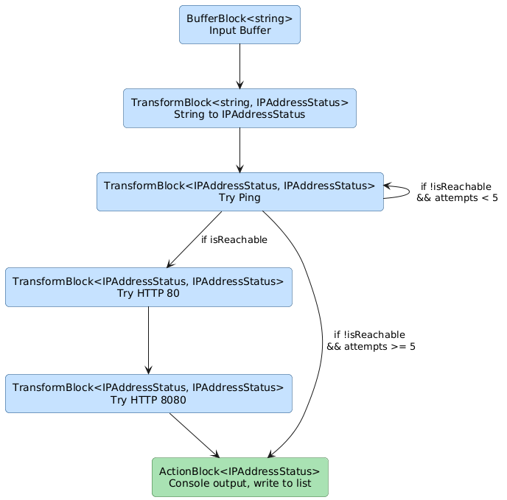
TDF Pipeline with unbounded parallelism in all blue blocks
IPAddressProvider that lets you get an IEnumerable of IP addresses
IPAddressStatus class used to pass availability info along

