Slide 1
课程介绍、算法和计算模型
赵建华
南京大学计算机系

Slide 2
什么是算法？
由一组基本操作按照特定结构构成的、用于在有穷的时间内解决特定类型目标问题的方法描述。
算法的描述可以是自然语言、流程图、图表、程序设计语言、某种抽象的语言。
算法的性质
精确描述
可行性
终止性
正确性
效率（时间/空间）

Slide 3
其它形式的算法描述：图灵机
状态集合{s1,s2,s3,s4,HALT}，初始状态A，结束状态{HALT}
符号集合{0,1}，其中空白符号0，输入符号1
动作表
 | s1 |  |  | s2 |  |  | s3 |  |  | s4 |  |  | s5
符号 | 写 | 纸带 | 状态 | 写 | 纸带 | 状态 | 写 | 纸带 | 状态 | 写 | 纸带 | 状态 | 写 | 纸带 | 状态
0 | N | N | H | E | R | s3 | P1 | L | S4 | E | L | s5 | P1 | R | s1
1 | E | R | S2 | P1 | R | S2 | P1 | R | s3 | P1 | L | s4 | P1 | L | s5
功能：复制1组成的串，如：…01110… -> …011101110…
原理：
1、从s₁开始，将第一个1转换为0, 并进入状态s₂，
2、向右移动纸带，跳过所有的1，到输入的左边, 碰到第一个0之后进入状态s₃，
3、继续右移纸带，跳过所有的1，并将第一个0替换为1、进入s₄；
4、然后往回移动，跳过所有的1，碰到0后进入状态s₅；
5、继续往回移动，跳过所有的1，碰到第一个0（即一开始写下的0），将0改回1
6、右移进入下一个1，进行下一次循环。

Slide 4
动作表
 | s1 |  |  | s2 |  |  | s3 |  |  | s4 |  |  | s5
符号 | 写 | 纸带 | 状态 | 写 | 纸带 | 状态 | 写 | 纸带 | 状态 | 写 | 纸带 | 状态 | 写 | 纸带 | 状态
0 | N | N | H | E | R | s3 | P1 | L | S4 | E | L | s5 | P1 | R | s1
1 | E | R | S2 | P1 | R | S2 | P1 | R | s3 | P1 | L | s4 | P1 | L | s5
步骤 | 状态 | 纸带
 |  |  | H
1 | s₁ | 0 0 0 0 1 | 1 | 0 0 0 0 0
2 | s₂ | 0 0 0 0 0 | 1 | 0 0 0 0 0
3 | s₂ | 0 0 0 0 0 | 0 | 1 0 0 0 0
4 | s₃ | 0 0 0 0 0 | 0 | 0 1 0 0 0
5 | s₄ | 0 0 0 0 1 | 0 | 1 0 0 0 0
6 | s₅ | 0 0 0 1 0 | 1 | 0 0 0 0 0
7 | s₅ | 0 0 1 0 1 | 0 | 0 0 0 0 0
8 | s₁ | 0 0 0 1 0 | 1 | 1 0 0 0 0
步骤 | 状态 | 纸带
 |  |  | H
9 | s₂ | 0 0 0 0 1 | 0 | 0 1 0 0 0
10 | s₃ | 0 0 0 0 0 | 1 | 0 0 1 0 0
11 | s₃ | 0 0 0 0 0 | 0 | 1 0 0 1 0
12 | s₄ | 0 0 0 0 1 | 1 | 0 0 1 0 0
13 | s₄ | 0 0 0 1 1 | 0 | 0 1 0 0 0
14 | s₅ | 0 0 1 1 0 | 0 | 1 0 0 0 0
15 | s₁ | 0 0 0 1 1 | 0 | 1 1 0 0 0
16 | H | 0 0 0 1 1 | 0 | 1 1 0 0 0

Slide 5
本课程中算法的描述方法（1）
使用类似于程序设计语言的写法
基本运算：赋值、加减乘除、…
结构：顺序、选择、循环
对于循环结构，必须保证循环的应用一定能够结束
一些语法上的简写，比如
for(i = 0,1,2,…,n)
A[i] = 0;
x, y = a+b, x+y;
//首先求出a+b和x+y的值，然后分别赋值给x和y
对子算法的调用

Slide 6
本课程中算法的描述方法（2）
可增加抽象运算，以便先忽略不必要的细节
抽象数据结构（有穷集合、List、Map）的运算
这些抽象运算在算法描述的上下文中必须是可以实现的。例如
x = 有穷整数集合S中的最大值
dom = {x | M(x) = c}，其中M是一个有穷的映射
反例1：令x=整数集合中满足条件P(x)的最小值
反例2：令s=图G中满足条件P的路径序列的集合
可增加特定的抽象控制结构，如以特定的顺序遍历某个数据结构中的结点
如：以后根序遍历树中的每个结点n:
n.height = MAX{sub.height | sub是n的子结点}+1
考虑算法效率时，必须将这些抽象运算具体化

Slide 7
子算法调用
算法可以调用其它已经明确定义的子算法（类似于过程调用）
调用过程可以嵌套，即A调用B、B调用C的情况
递归调用：算法可以直接/间接地调用自身。
必须保证递归调用能够结束
通常来说，一个算法A可以使用“较小”的参数递归调用自身，并且当参数“足够小”的时候不需要递归调用自身就可以完成计算
包含递归调用的算法称为递归算法
（无副作用的）递归算法通常比较简洁，容易设计
很多递归算法可以转换为迭代算法

Slide 8
Model of Computation
Problems
Why the algorithms we learn can run almost in all modern computer?
Why the algorithms we learn can be implemented in almost any modern programming language?
Machine- and language- independent algorithms, running on an abstract machine
Most of modern computers are based on Von. Noumann Architecture

Slide 9
RAM Model
x₁
x₂
…
x_{n}
Read-only input tape
Program
r₀
Accumulator
Location counter
r₁
r₂
r₃
…
Memory
y₁
y₂
…
Write-only output tape

Slide 10
The RAM Model of Computation
Each simple operation takes one time step
E.g., key comparison, +/-, memory access, …
Non-simple operations should be decomposed
Loop, Sequential, Conditional
Subroutine
Memory
Memory access is a simple operation
Unlimited memory
Tradeoff:
accuracy
vs.
ease of use

Slide 11
To Create an Algorithm
Algorithm design
Composition of simple operations, to solve an algorithmic problem
Decompose an algorithmic problem into smaller ones, till all these sub-problems can be solved by known sub-algorithms.
Algorithm analysis
Amount of work done / memory used
In the worst/average case
Advanced issues
Optimality, approximation ratio, …

Slide 12
算法设计所需要的知识
和算法/计算模型相关的知识
数值存放方法
计算顺序、代价
提高效率的方法：
避免重复/无效的计算
通过空间换取时间
…
和问题相关的知识
问题的解空间
在何种情况下可以分解为较小的子问题，以及如何根据子问题的解来合成问题的解
…
通过灵活应用上述知识，可以得到更加高效的程序

Slide 13
Algorithm by Example
Algorithmic Problem 1
Find the greatest common divisor of two non-negative integers m and n
Algorithmic Problem 2
Is a specific key K stored in array E[1..n]?
Notes:
讨论：不同的课程，讲授同样的内容

Slide 14
求最大公约数的算法设计
直接按照最大公约数的定义来设计？
给定m和n，有没有最大公约数相关的性质来把问题分解/归约成为“更小的”问题和基本问题？
如果m=0, gcd(m,n) = n；
如果n = 0, gcd(m,n) = m;
归约的性质：
gcd(m%n, n) = gcd(m,n)；
gcd(m, n%m) = gcd(m,n)；
什么叫做“更小的”问题？

Slide 15
Euclid Algorithm
Probably the Oldest Algorithm
Specification
Input: non-negative integer m, n
Output: gcd(m, n)
Problem
Find the greatest common divisor of two non-negative integers m and n
Euclid algorithm （迭代）
[E1] n divides m, the remainder -> r
[E2] if r = 0 then return n
[E3] n -> m; r-> n; goto E1
Euclid algorithm – recursive version
Euclid(m,n)
[E1] if n=0 then return m
[E2] else return Euclid(n, m mod n)

Slide 16
Problem 2：Is K in array E[1..n]?
K == E[1] or K isIn E[2..n] ?
显然K == E[1]是基本问题
但是K isIn E[2..n]怎么处理？
更加普遍的问题：K isIn E[i..n]？
i > n : FALSE；
i <= n : (K == E[i]) or (K isIn E[i+1..n])
IsIn(K, i, n)
{
if(i > n) return false;
if(K == E[i])
return true;
return IsIn(K, i+1, n);
}

Slide 17
Sequential Search
Specification
Input: K, E[1..n]
Output: Location of K (1,2,…,n; -1: K is not in E[])
Problem
Search an array for a specific key
Sequential search algorithm
int seqSearch(int[] E, int n, int K)
{ int ans, index;
ans=-1;
for (index=1; index<=n; index++)
if (K==E[index])
{
ans=index;
break;
}
Return ans;
}

Slide 18
Correctness of Algorithm
Criteria
Defining correctness
Precondition/前置条件/前件：What kind of input can be treated?
Postcondition/后置条件/后件：What is the relation between the input and the output?
Main challenge
For proving correctness of loops
Our strategy
Mathematical induction
循环不变式：Loop Invariants …
Specification
Input: non-negative integer m, n
Output: gcd(m, n)
Main challenge
The output is always correct, for any legal input.
Infinite possible inputs
Mathematical induction
Weak principle
Strong principle

Slide 19
Mathematical induction
For Your Reference
The Weak Principle of Mathematical Induction
If the statement p(b) is true and the statement p(n-1) => p(n) is true for all n>b, then p(n) is true for all integers n>=b.
The Strong Principle of Mathematical Induction
If the statement p(b) is true, and the statement {p(b) and p(b+1) and … and p(n-1) => p(n)} is true, for all n>b, then p(n) is true for all integers n>=b.

Slide 20
Correctness of the Recursive Euclid Algorithm（1）
Euclid algorithm – recursive version
Euclid(m,n)
[E1] if n=0 then return m
[E2] else return Euclid(n, m mod n)
Base case (n = 0)
Euclid(m, 0) returns m //if n = 0 then return m
gcd(m,0) = m //Math fact.
So Euclid(m,0) returns gcd(m,0)

Slide 21
Correctness of the Recursive Euclid Algorithm（1）
Euclid algorithm – recursive version
Euclid(m,n)
[E1] if n=0 then return m
[E2] else return Euclid(n, m mod n)
Assumption
For any non-negative integer n <= N₀, Euclid(m, n) returns gcd(m,n);
Induction
Euclid(m, N₀+1) returns the same as Euclid(N₀+1, m mod (N₀+1)) does;
//else-branch, and N₀>0
Euclid(N₀+1, m mod (N₀+1) ) returns gcd(N₀+1, m mod (N₀+1))
//By assumption, and m mod (N₀+1) <= N₀
gcd(N₀+1, m mod (N₀+1)) = gcd(N₀+1, m) = gcd(m, (N₀+1))
//Math fact about gcd
Thus, Euclid(m, N₀+1) returns gcd(m, N₀+1)
这个递归调用一定结束吗？
为什么？

Slide 22
Correctness of the Euclid Algorithm (Iterative)
r = m % n
while (r != 0)
{
m = n;
n = r;
r = m % n;
}
return n
迭代形式的算法通常无法按照参数使用数学归纳法进行处理;
通常可以对迭代次数使用数学归纳法，实际上就是找到循环不变式。

Slide 23
Correctness of the Euclid Algorithm (Iterative)
Proved the following assertion by induction on the iterations
循环的入口处下列性质总是成立
gcd(m,n) == gcd(m₀,n₀)，r == m%n
Base case (第一次到达入口点)
因为m,n没有被修改过，且r == m%n，因此结论显然成立
Induction
假设当循环地第N次迭代开始的时候，性质成立
分析循环体可知，在循环体之后
m == n’ ，n == m’ % n’，r == m%n
gcd(n’, m’%n’) == g(m’,n’) == gcd(m₀,n₀)
而循环体运行结束之后会回到循环头，因此第N+1次循环开始的时候性质仍然成立
结论：
不论循环执行多少次，在循环体开始处性质成立
当循环退出时，该性质仍然成立，并且循环条件不成立

Slide 24
Correctness of the Euclid Algorithm (Iterative)
性质gcd(m,n) == gcd(m₀,n₀)，r == m%n 称为这个循环的不变式
1、进入循环的时候成立
2、如果迭代开始时该性质成立，且循环条件满足，
那么该次迭代结束后，性质依然成立
因此当最后一次迭代结束时，
1、循环不变式依然成立
2、循环条件不满足
r = m % n
while (r != 0)
{
m = n;
n = r;
r = m % n;
}
return n
对于GCD的迭代算法，当循环退出时
1、 gcd(m,n) == gcd(m₀,n₀)，r == m%n
2、r==0成立（循环条件取反）
即：gcd(m,n) == gcd(m₀,n₀)且m%n==0，因此：
n == gcd(m,n) == gcd(m₀,n₀)
这个循环一定结束吗？
为什么？

Slide 25
Notes on Mathematical Induction
“Notes on Structured Programming”, E.W. Dijkstra
I have mentioned mathematical induction explicitly, because it is the only pattern of reasoning that I am aware of, that eventually enables us to cope with loops and recursive procedures

Slide 26
Algorithm Analysis
Criteria
Performance metrics
Worst case
Best case?
Average case
Average cost?
Advanced topics
Lower bound, optimality, …

Slide 27
Algorithm Analysis
How to measure
Not too general
Giving essential indication in comparison of algorithms
Should not be too precise
Machine independent
Language independent
Programming paradigm independent
Implementation independent

Slide 28
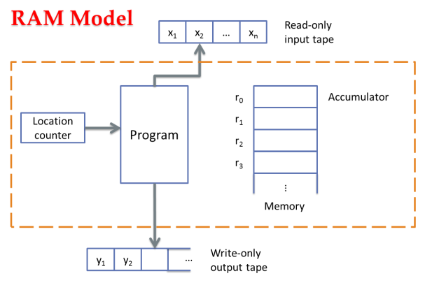
Algorithm Analysis
Criteria
Critical operation
How many critical operation are conducted
For example
Algorithmic problem | Critical operation
Sorting, selection, searching String matching | Comparison (of keys)
Graph traversal | Processing a node/edge
Matrix multiplication | Multiplication

Slide 29
Algorithm Analysis
Amount of work done
usually depends on size of the input
usually does not depend on size of the input only
n
Size of input
f(n)
Amount of work done
Algorithm
Analysis

Slide 30

Worst-case Complexity
W(n)
Upper bound of cost
For any possible input
$W(n)=\max_{I∈D_{n}}{f(I)}$

Slide 31
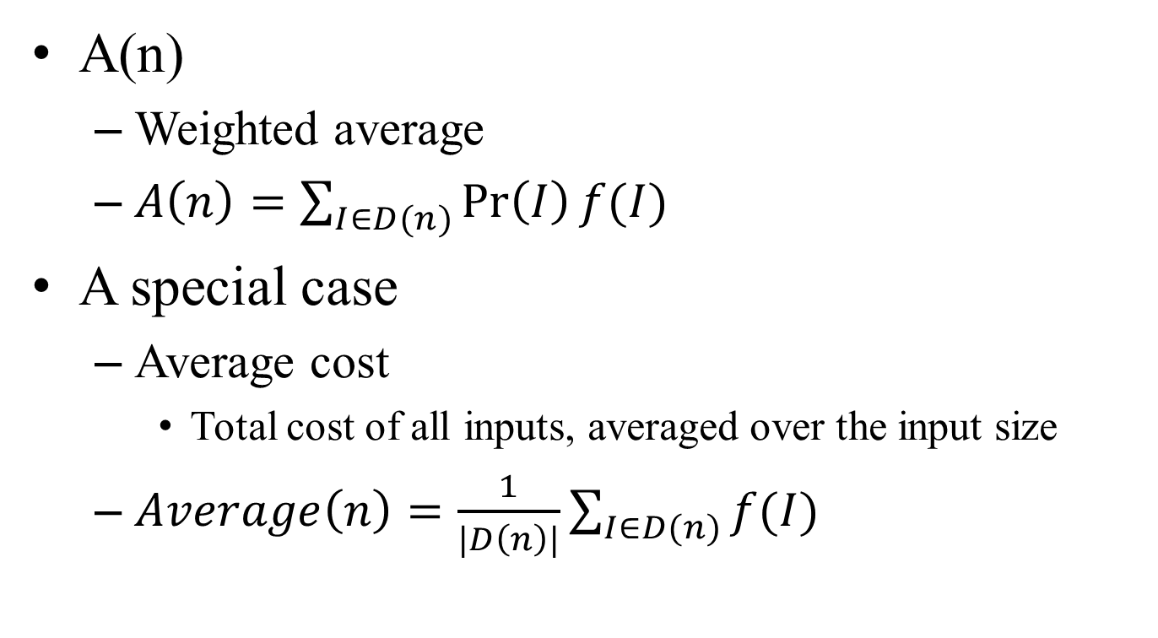
Average-case Complexity
A(n)
Weighted average
$A\left(n\right)=\sum_{I∈D(n)}{\operatorname{Pr}\left(I\right)f(I)}$
A special case
Average cost
Total cost of all inputs, averaged over the input size
$Average\left(n\right)=\frac{1}{|D\left(n\right)|}\sum_{I∈D(n)}{f(I)}$

Slide 32
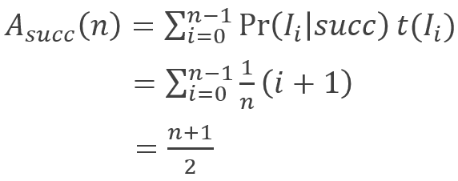
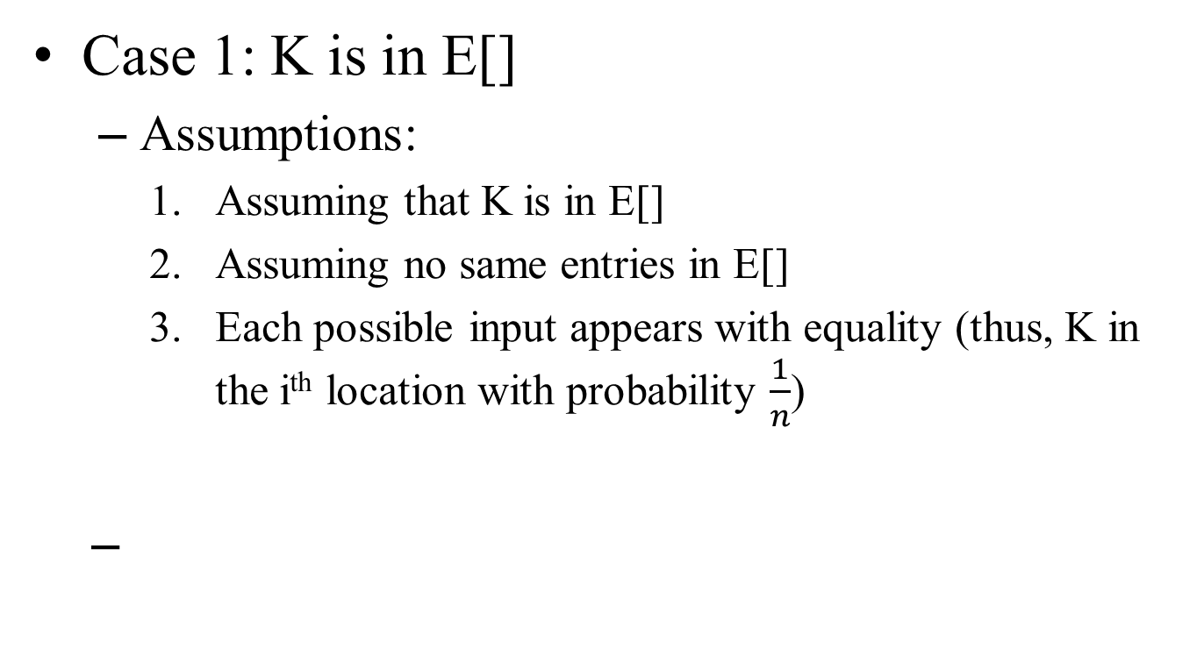
Average-case Cost of SeqSearch
Case 1: K is in E[]
Assumptions:
Assuming that K is in E[]
Assuming no same entries in E[]
Each possible input appears with equality (thus, K in the i^{th} location with probability $\frac{1}{n}$)

Slide 33
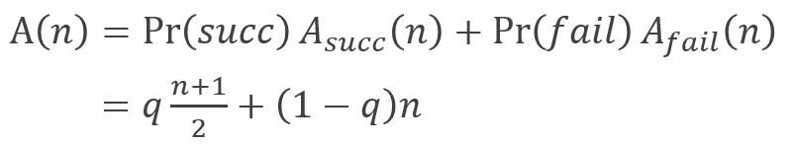
Average-case Cost of SeqSearch
Case 2: K may (or may not) be in E[]
Assume that K is in E[] with probability q
How to make reasonable assumptions?

