Slide 1
Email Promotion for
Wine Consumers
MSMA TEAM 8
Hector Abreu | Ying Wang | Geng Luo | Yunjiao Liu | Hairong Wang

Slide 2
Executive Summary
Opportunity: Increase purchase amount for customer through the use of targeted email promotion.
Recommendation: Use predictive model to score new customers on targeted email promotions . Tailor email content to match individuals preference: Sauvignon Blanc offers vs Cabernet offers.
Key Insights:
Average Causal Effect is $1.34 increase in purchase amount.
All baseline variables, except for Syrah wine, are significant in regression analysis.
Recent buyers, Sauvignon Blanc buyers, and Cabernet buyers will have a greater response to email promotion that lead to increase in purchase amount.

Slide 3
Our process is easy
Methodology
Decision Oriented Project: Which customers to target with email given different attribute levels.
Measurement Goals:
Average causal effect of email promotion on purchase amount.
Treatment effect given different baseline scenarios that may influence purchase amount.
Predict lift per individual observation given their baseline values.
Identify individuals with meaningful lift in purchase amount for targeted email.
Data Design: Well designed experiment for causal inference, testing the effect of email promotion on purchase amount given other variables that describe purchase behavior.
Analytics Task: Understand the causal effect that email promotion has on wine consumers. Investigate interactions between email treatment and other attributes to determine baseline variables of the “best” customers. Use models to decide whether or not and and how to target new customers that have similar baseline variables.
Analytics Tools: Slice and Dice Analysis, Predictive Uplift Model, Causal Forest.
Visualizations: Average Causal Effect(4) , Baseline Variables: Sauvignon Blanc and Syrah(5), Possible segmentation variables given both predicted target and not target(6).

Slide 4
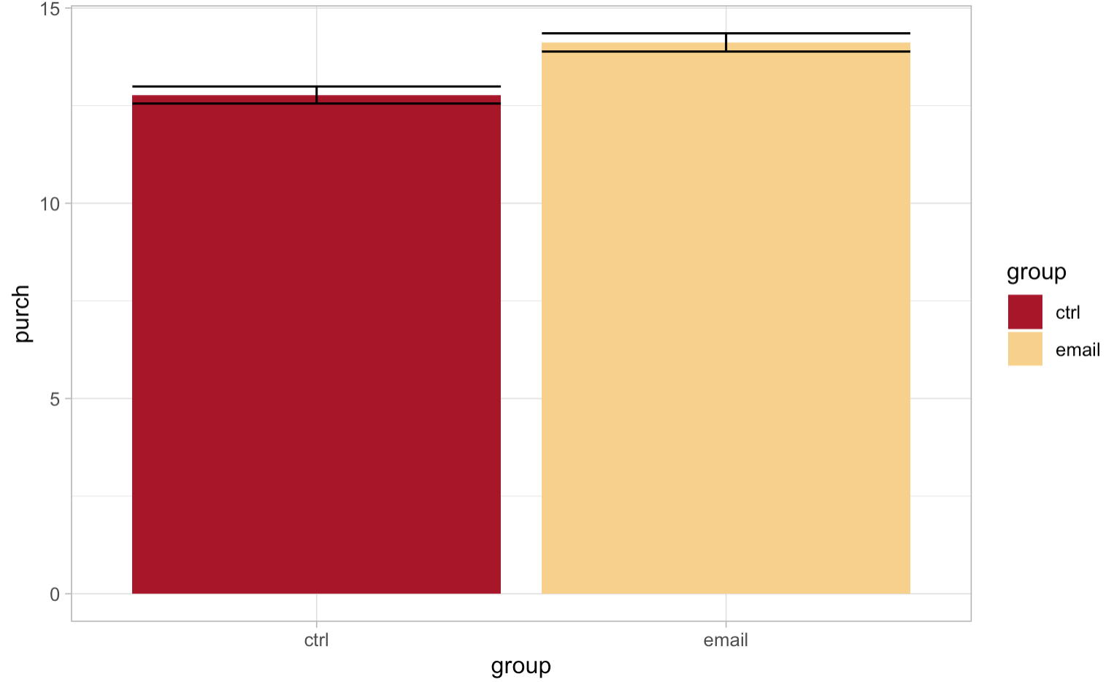
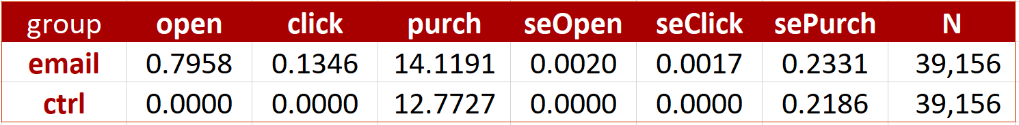
Average Causal Effect
14.11
12.77
Evaluation:
Regression on variable ‘group’ to observe the statistical significance of the treatment effect
The effect is highly significant and the effect size is $1.34 for e-mail
Precision of estimates is sufficient enough to establish the average effect

Slide 5
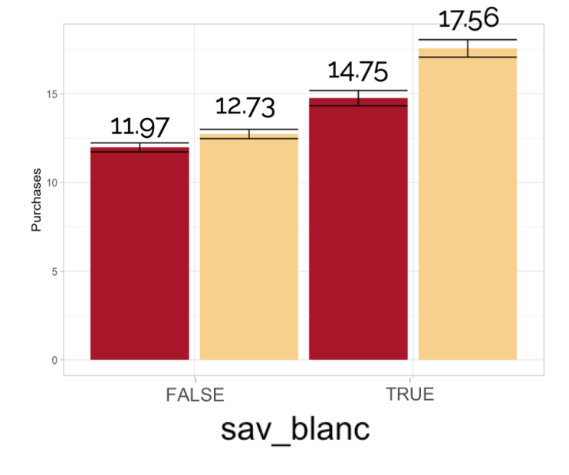
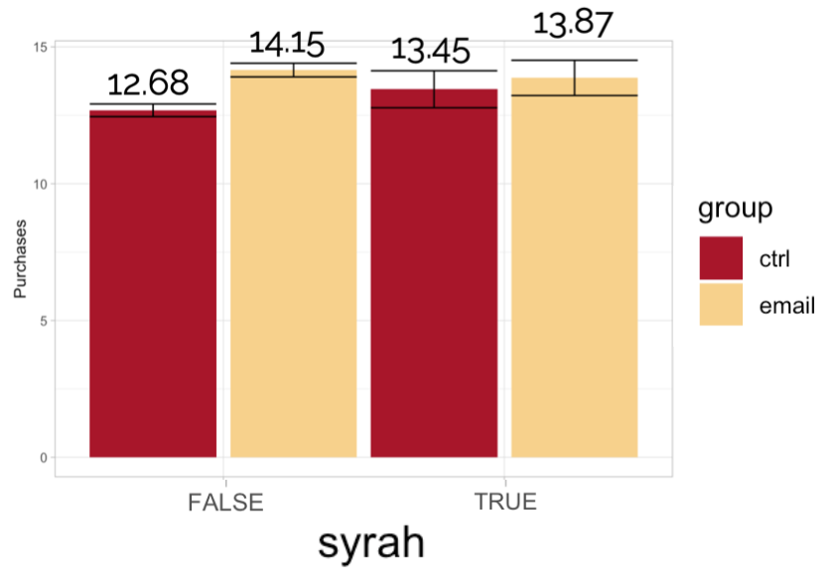
Slice and Dice
Baseline Variables
Last Purchase < 60 days
Past Purchase > $60
Visits > 5
Chardonnay > $0
Sauvignon Blanc > $0
Cabernet > $0
Sav Blanch
Syrah
Treatment effect of email
No Sauvignon Blanc : $.75
Buys Sauvignon Blanc: $2.80
Email is only effective for those that did not buy syrah
Does not buy syrah : $1.47

Slide 6
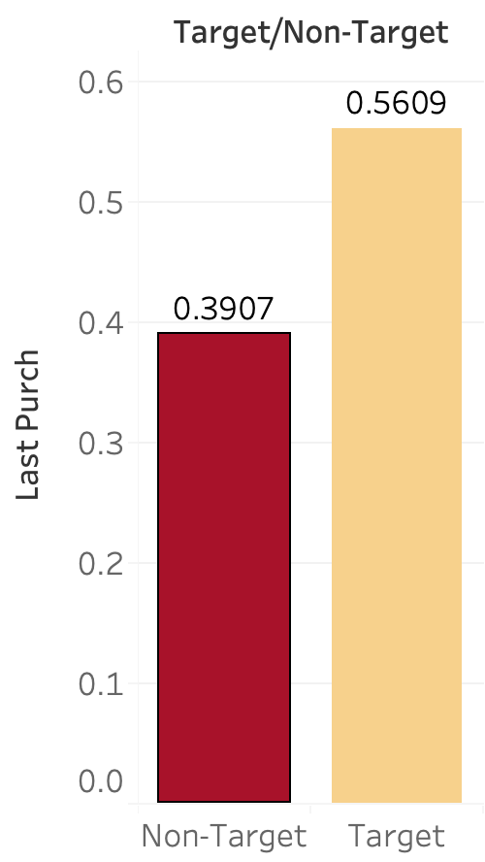
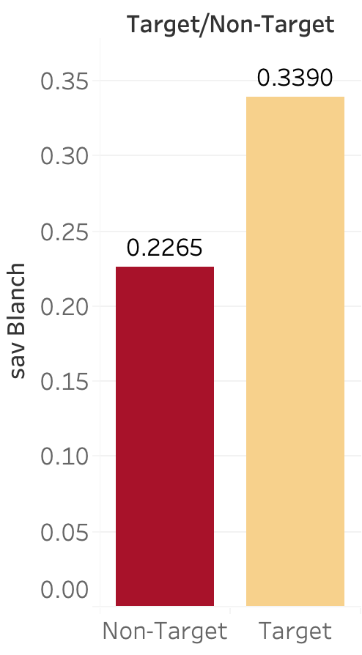
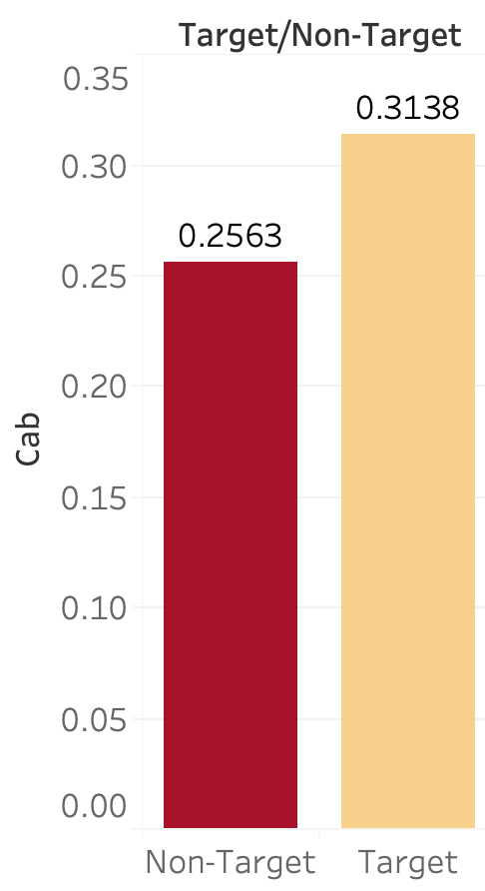
Predictive Model Insights:
Recent Buyers, Sauvignon Blanc, and Cabernet Buyers
Training Data : 60,000 observations
Percent of target customers : 53.9%
Post Prediction Assessment of Predicted Target :
16% increase in individuals that satisfy Last Purchase < 60 Days
11 % increase in individuals that satisfy Sauvignon Blanc > $0
6% increase in individuals that satisfy Cabernet > $0
Target:
Recent purchasers
Sauvignon Blanc buyers
Cabernet buyers

Slide 7
ANY QUESTIONS?
Hector.Abreu@simon.rochester.edu
Ying.Wang@simon.rochester.edu
Geng.Luo@simon.rochester.edu
Yunjiao.Liu@simon.rochester.edu
Hairong.Wang@simon.rochester.edu

