Slide 1
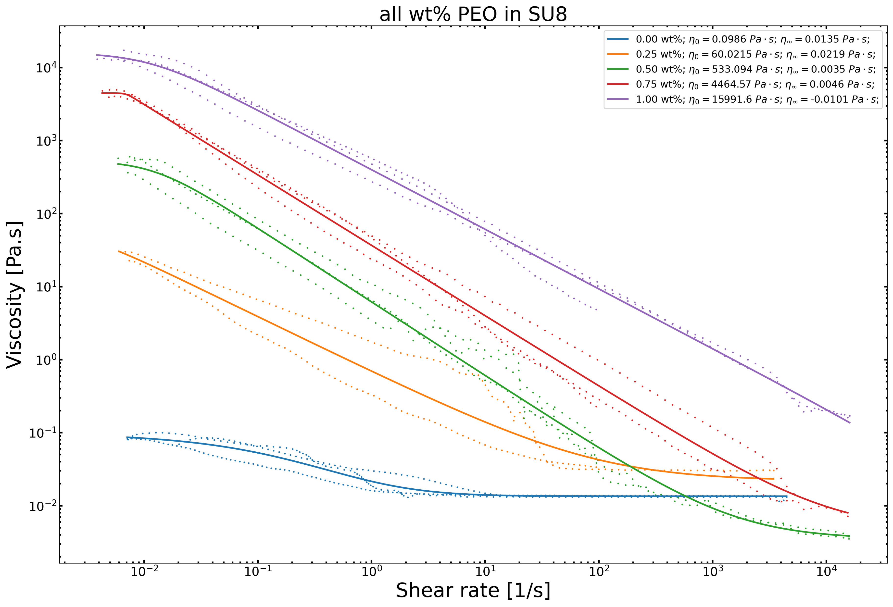
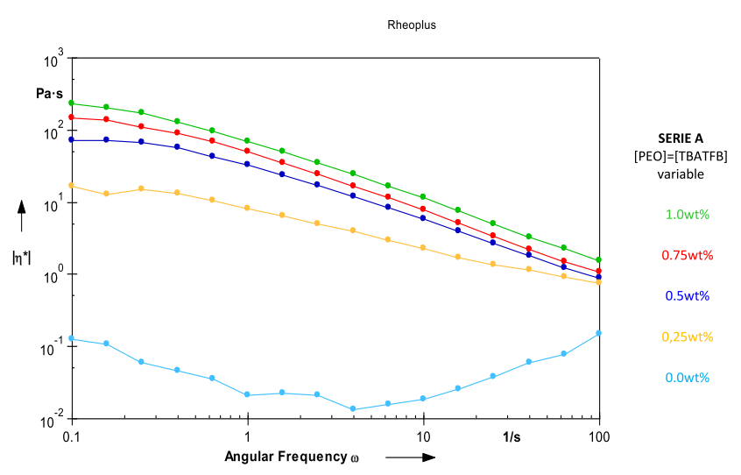
Notes:
D.R. Flores, Role of rheological properties in near field electrospun fibers morphology, (2017) 130.

Slide 2
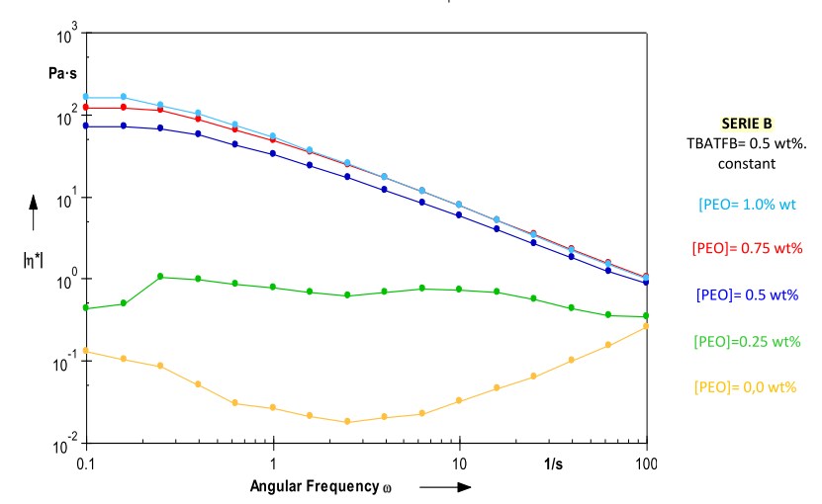
Notes:
D.R. Flores, Role of rheological properties in near field electrospun fibers morphology, (2017) 130.

Slide 3
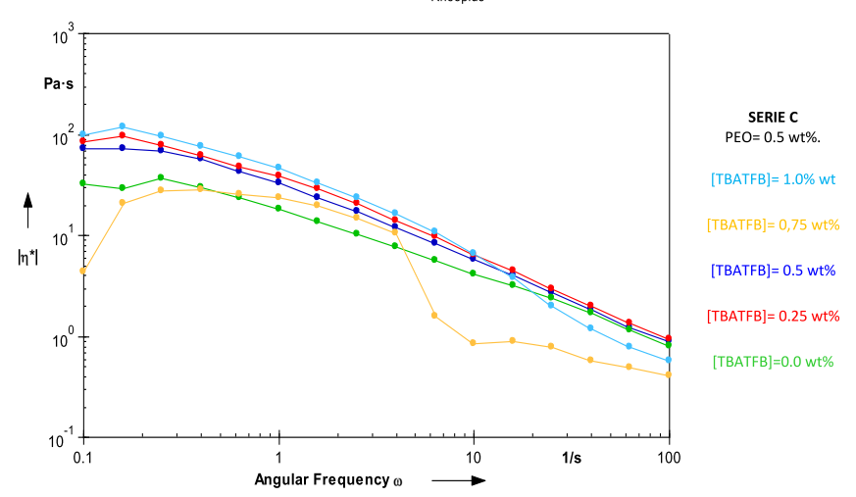
Notes:
D.R. Flores, Role of rheological properties in near field electrospun fibers morphology, (2017) 130.

Slide 4
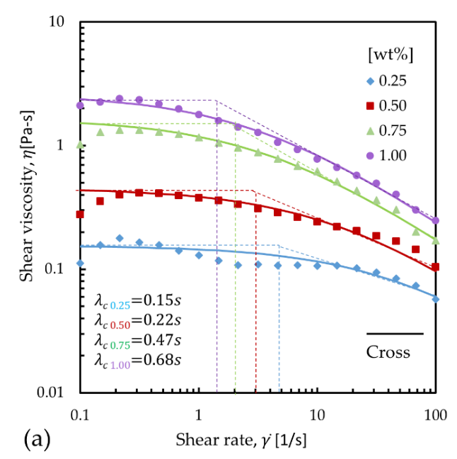
Flow curves
Notes:
D.R. Flores-hernandez, B. Cardenas-benitez, S.O. Martinez-chapa, J. Bonilla-rios, Tailoring the Diameters of Electro-Mechanically Spun Fibers by Controlling Their Deborah Numbers, (2020). https://doi.org/10.3390/polym12061358.

Slide 5
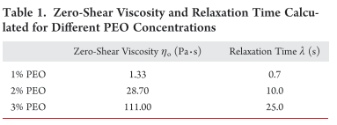
Zero-shear viscosity at 1wt% PEO
Around 10^2 Pa.s
D.R. Flores
(in SU8 and 0.5 wt% TBT)
(in SU8 and 0.5 wt% TBT)
G.S. Bisht
(in water)
Notes:
G.S. Bisht, G. Canton, A. Mirsepassi, L. Kulinsky, S. Oh, D. Dunn-Rankin, M.J. Madou, Controlled Continuous Patterning of Polymeric Nanofibers on Three-Dimensional Substrates Using Low-Voltage Near-Field Electrospinning, Nano Lett. 11 (2011) 1831–1837. https://doi.org/10.1021/nl2006164.

