Slide 1
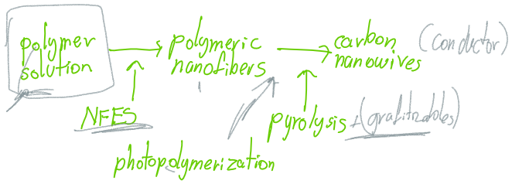
Polymer
Solution
Near Field Electrospinning
Polymeric
Nano-fibers
Pyrolysis and Carbonization
Carbon
Nano-wires
Photopolymerization

