Slide 1

Literature Review
Osamu Katagiri A01212611@itesm.mx
09 Oct 2019

Slide 2

Problem statement
Cárdenas-Benitez et al. studied the pyrolysis-induced shrinkage
of structures consisting of suspended microwires of photocured resin (SU-8 2050).
No studies (until now) have experimentally and theoretically assessed how nano-rods or micro/nano-wires transform upon carbonization.
Notes:
Despite the importance in analyzing the inherent volumetric shrinkage experienced during pyrolysis of TPP structures, no studies to date have experimentally and theoretically assessed how the different geometrical building blocks, such as nanorods or micro/nanowires30, and bars4,24, transform upon carbonization.
Thus, estimation of the voxel line- width percent reduction would enable the rational design of the carbonized version of photoresist templates, with- out necessarily undergoing extensive optimization
In this work, it’s studied the pyrolysis-induced shrinkage
of structures consisting of suspended microwires of photocured resin (SU-8 2050).
Although TPP allowed us to create suspended 3D carbon nanowires, the objective of this study was not to exploit the versatility of the technique to create a complex geometry. Rather, the main objective was to systematically analyze how the suspended structures written by TPP transform upon carbonization.

Slide 3
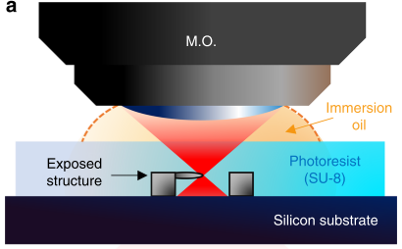
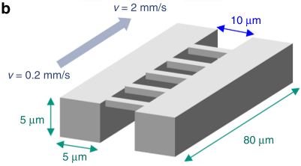
Experiment - step1 (SU-8 structures)
The TPP threshold for polymerization and successful patterning of the wires was 1.13 ± 0.12 mW laser average power, at a scanning velocity of 0.2 mm/s.
15 pairs of walls were produced, varying the laser average power from 0.2 to 3mW in steps of 0.2 mW
19 wires were produces for each pair off walls, varying the scanning velocity from 0.2 to 2 mm/s in steps of 0.2 mm/s
femtosecond pulsed laser (Coherent Mira 900D titanium:saphire laser)
Notes:
By varying the TPP exposure dose on the photoresist, the linewidth of the photoresist microwires was controlled in the range of 1250–1800 nm and subsequently reduced to 300–550 nm carbon structures through pyrolysis.
This variation was achieved by tuning the scanning velocity and power of the laser, to produce a change in the exposure dose.
We first undertook the fabrication of SU-8 microwires
by varying scanning velocity (v) and laser average power (Pt) to study the effect of dosage on voxel linewidth.
Following the fabrication of the suspended SU-8 microstructures, the samples were pyrolyzed in a fur- nace at 900 °C to obtain the carbon nanowire structures.
threshold for polymerization and successful patterning of the wires was 1.13 ± 0.12 mW, at a scanning velocity of 0.2 mm/s

Slide 4
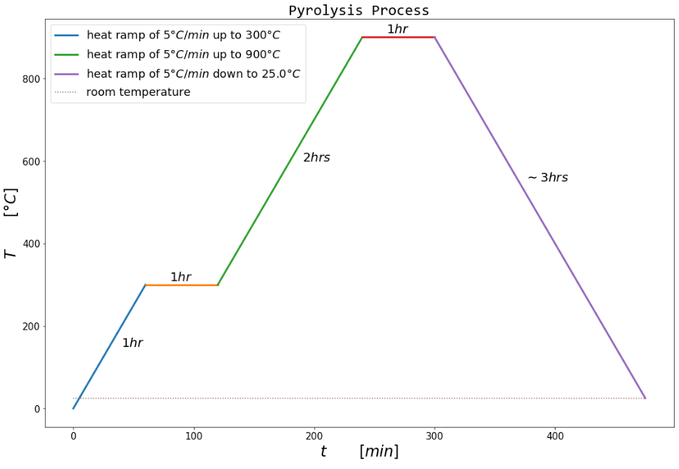
Experiment - step2 (carbon structures)
The pyrolysis conditions remained fixed
Focus the efforts on the effect of the pre-pyrolysis geometry effect
Chosen temperatures and ramp rates were as depicted by Microchem in the SU-8 2050 datasheet
Notes:
In these perspective applications, the multiple pyrolysis parameters (i.e., flow rate, heating/cooling ramp rate, intermediate/final tem- peratures, and dwell times) are expected to play a decisive role over the electrical, physical, and electrochemical properties of the derived glassy carbon57.
However, in this introductory study, we decided to maintain the pyrolysis conditions fixed in order to focus on the impact of the prepyrolysis geometry on feature shrinkage.

Slide 5
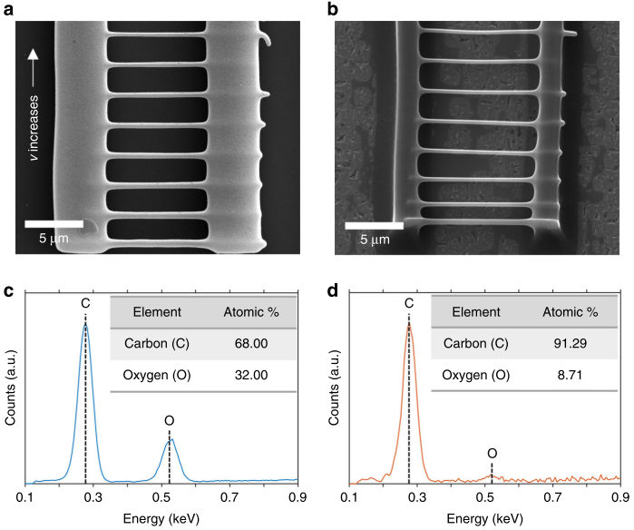
Characterization - before & after pyrolysis
High degree of heteroatom volatilization in the samples.
scanning electron microscopy (SEM)
Pyrolysis
energy dispersive X-ray spectroscopy (EDS)
Notes:
We examined the degree of shrinkage through direct mea- surement using scanning electron microscopy (SEM), and studied the quality of the obtained carbon material through energy dispersive X-ray spectroscopy (EDS) and Raman spectroscopy.
To confirm the degree of carbonization of the samples,
we analyzed their carbon-to-oxygen (C/O) weight per- centage, before and after pyrolysis using EDS.

Slide 6
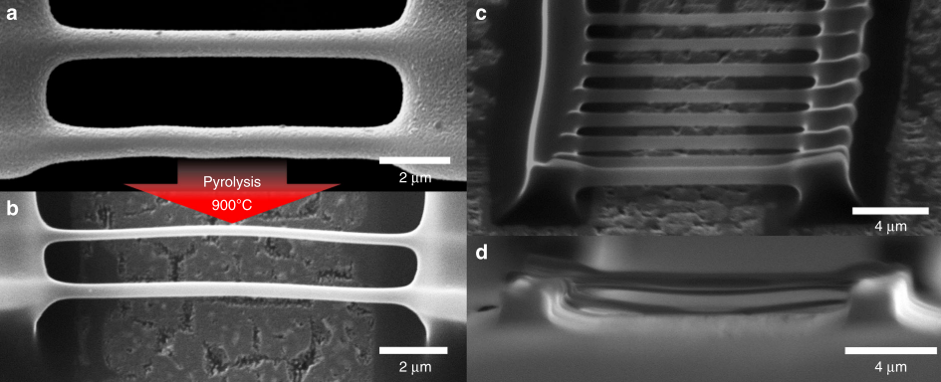

Modelling
The TPP linewidth (aka. voxel diameter) before pyrolysis can be described different parameters involved in the fabrication process, such as scanning velocity, average laser power, repetition rate, and pulse duration.
Notes:
In addition, we developed a semi- empirical model that estimates the near-isometrical transformation experienced by TPP structures after pyr- olysis.
Using this empirical model, we estimate the residual mass of the TPP structures, assuming that the volatilized material: (1) is solely lost to degassing; and (2) is dependent on the initially available surface area of the microstructures.
An expression for the resolution of the TPP linewidth
before pyrolysis can be obtained by taking into account the different parameters involved in the fabrication process, such as scanning velocity, average laser power, repetition rate, and pulse duration
\alpha : reflection characteristics
\w0 : lateral resolution of the focal point
\sigma : two-photon cross section
N0 : two-photon characteristics (pulse duration, repetition rate of the laser)
D : TPP exposure dose
C : relates the initial concentration of photoinitiator molecules and the minimum concentration of radicals needed to polymerize the resin

Slide 7

Modelling
The linewidth reduction after pyrolysis due to the stretching and degassing process can be described in terms of the residual carbon weight fraction, the initial dimensions/geometry, and the initial polymer density
Notes:
di : initial diameter
\theta : rate of initial polymer density and the resulting carbon density
\delta : axial strain
\nu : assumtion that an axial deformation on a wire with Poisson’s ratio induces a diameter reduction

Slide 8
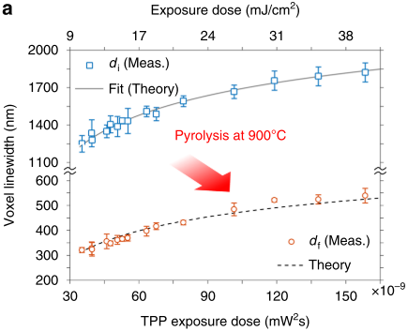
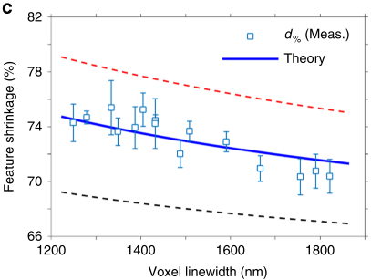
Modelling and Experimental Agreement
Voxel linewidth variation with TPP exposure dose in the scanning line configuration
Feature linewidth shrinkage as a function of the initial voxel linewidth
Notes:
The thicker samples (1400–1800 nm) have been fabricated using a higher energy density dose, and thus are likely to present higher voxel asymmetry (the maximum voxel asymmetry of ~1.9 for di = 1821 nm). Hence, we hypothesize that longer voxel structures could result in more lateral area available for degassing, meaning more reduction, which

Slide 9
Conclusions:
Shrinking values herein reported range between 70 and 75%
The reduction is likely caused by volatilization losses, rather than strain induced effects.
Volumetric shrinkage depends on the initial linewidth of the suspended microwires. (thinner samples leading to greater shrinking values)
A good agreement was obtained between our model and the experimental linewidth measurements of the fabricated structures.
TPP comes with added fabrication complexity (i.e., a stable femtosecond pulsed laser)
The TPP voxel asymmetry, can result in carbon nanowires with noncircular cross sections.
Notes:
A good agreement was obtained between our model and the experimental line- width measurements of the fabricated structures.
Shrinking values herein reported range between 70 and
75%, in agreement with previous reports on the pyrolysis of suspended SU-8 structures
This reduction is likely caused predominantly by volatilization losses, rather than strain induced effects.
pyrolysis of the samples resulted in a volumetric shrinkage dependent on the initial linewidth of the suspended microwires, with thinner samples leading to the greatest shrinking values.

Slide 10

Q&A

Slide 11
References
Cardenas-Benitez, B., Eschenbaum, C., Mager, D., Korvink, J. G., Madou, M. J., Lemmer, U., … Martinez-Chapa, S. O. (2019). Pyrolysis-induced shrinking of three-dimensional structures fabricated by two-photon polymerization: experiment and theoretical model. Microsystems & Nanoengineering, 5(1). https://doi.org/10.1038/s41378-019-0079-9

Slide 12


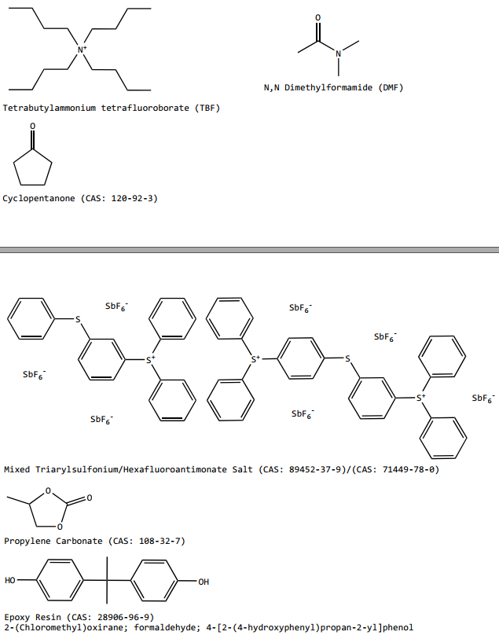

https://www.fishersci.com/shop/products/NC0702370/nc0702370#?keyword=MICROCHEM+CORP+PHOTORESIST+SU-8
https://www.fishersci.com/shop/products/NC9901158/nc9901158#?keyword=SU-8++developer
Notes:
https://rsc.aux.eng.ufl.edu/_files/msds/309.pdf

