Slide 1

Rheology [experiment]
A. Osamu Katagiri Tanaka A01212611itesm.mx
April 25, 2019

Slide 2
Agenda
My Thesis Overview : <3min
Experiment : ~10min
Q&A : ~10min

Slide 3
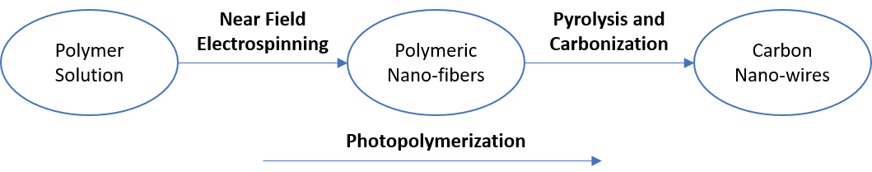
Thesis Overview
Design polymer solutions that can be electrospun by NFES, photopolymerized, and then pyrolyzed into carbon nano-wires.

Slide 4
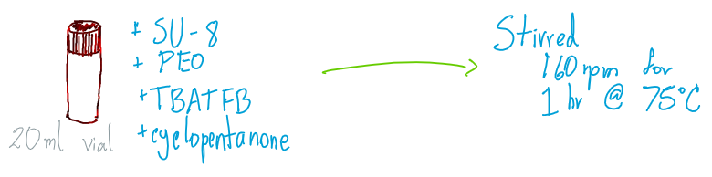
Materials & Sample Preparation
The polymer system studied is SU-8 2002 (SU-8) dissolved in cyclopentanone with poly(ethylene) oxide (PEO) and tetrabutylammonium tetrafluoroborate (TBATFB) as additives.
@campus-MTY
Notes:
tetrafluoroborato de tetrabutilamonio

Slide 5
Sample Preparation @campus-MTY
Sample | PEO concentration | TBATFB concentration
1 | 0.00 wt% | 0.50 wt%
2 | 0.25 wt%
3 | 0.50 wt%
4 | 0.75 wt%
5 | 1.00 wt%
During the stirring step, all the samples were isolated from light to avoid any chance of cross-linking of SU-8

Slide 6
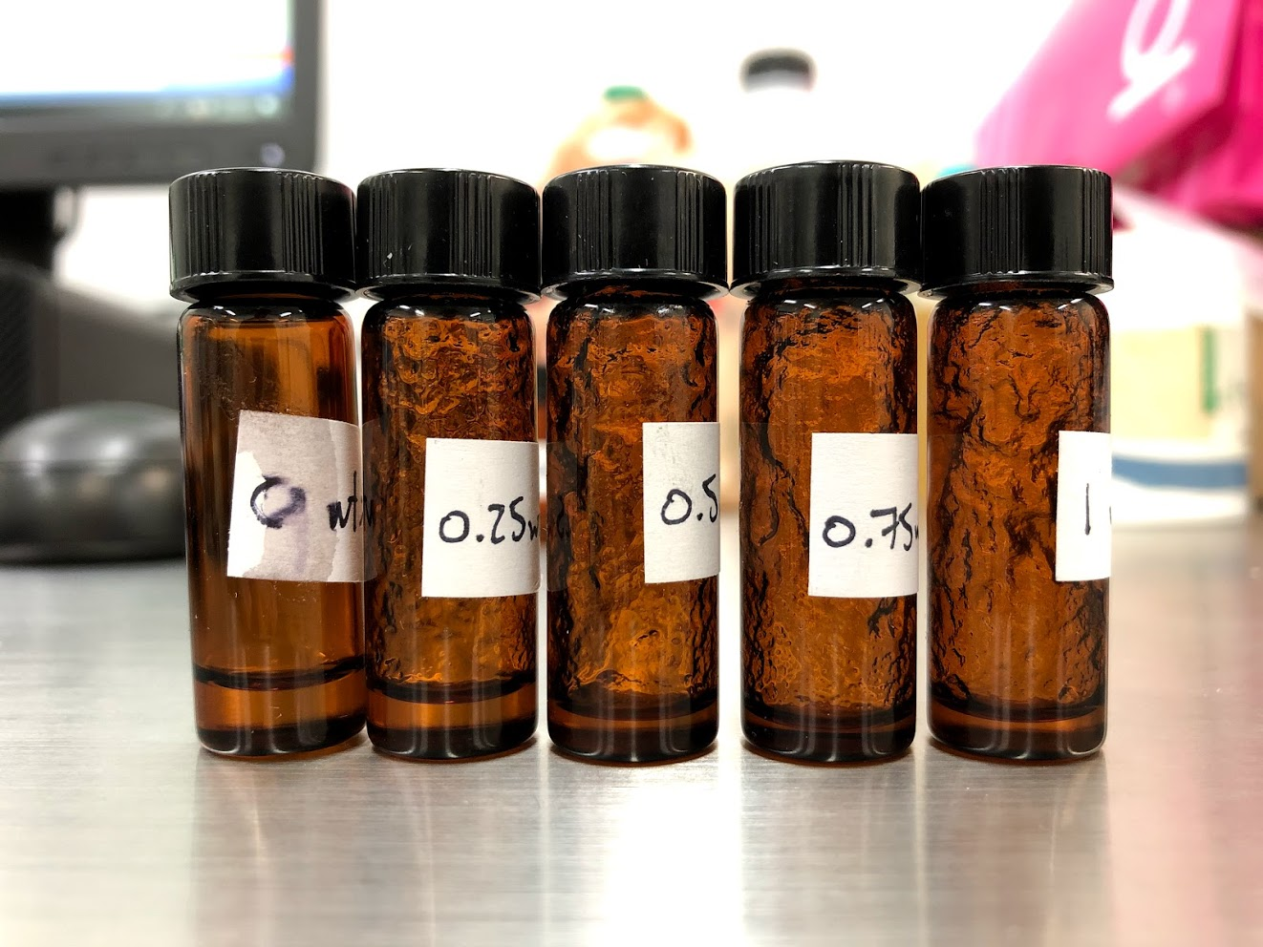
Characterization

Slide 7
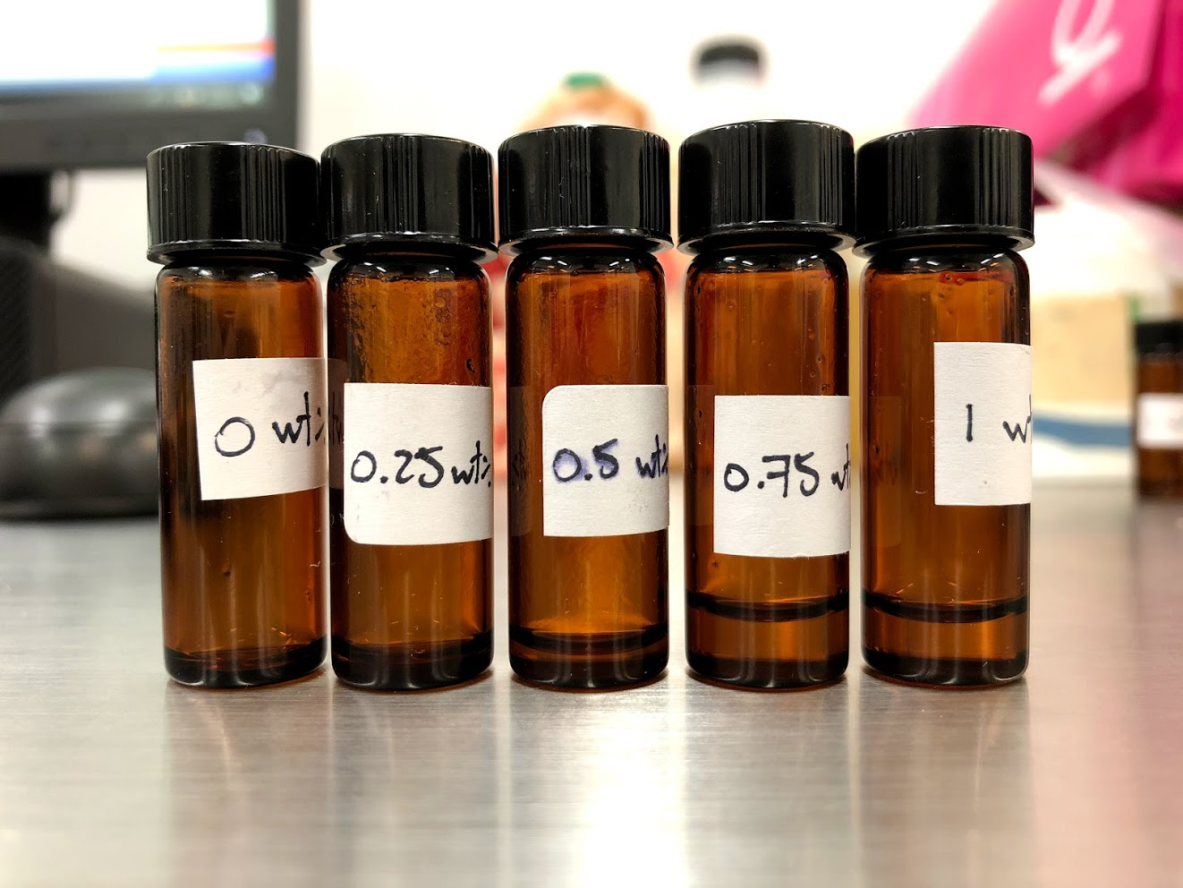
Characterization

Slide 8
Conclusions:
Ensure the samples are properly stirred
Measurements shall not last too long - as the solvent (cyclopentanone) evaporates

Slide 9

Q&A

